Slide 1
Black Flies Worldwide: River Blindness to Nuisance Control Using Targeted Bti Applications
Elmer W. Gray
University of Georgia
Department of Entomology

Slide 2
Black Flies (Diptera: Simuliidae)
Aquatic and terrestrial life histories – larval stage of their life cycle completed in flowing water, adults emerge from pupal stage and become aerial
Considered the third most important pest to humans after mosquitoes and ticks
Vectors of Onchocerciasis – River Blindness - filarial nematode, 25 million people infected, mostly in Sub-Saharan Africa and small area of Central and South America
Significant pests of livestock and wildlife
Significant biting and nuisance pests
Suppression programs operated around the world

Slide 3
Black Flies cont.
Problem populations often associated with larger rivers – sheer volume of habitat
Adults are notoriously strong fliers, day active
Larviciding of rivers and streams the only effective and approved technique for control
Larval stage described as passive filter feeders – indiscriminant filter feeders
Treating rivers and streams is a controversial activity – often a source of drinking water
Non-target concerns always present

Slide 4
Adult Black Flies

Slide 5
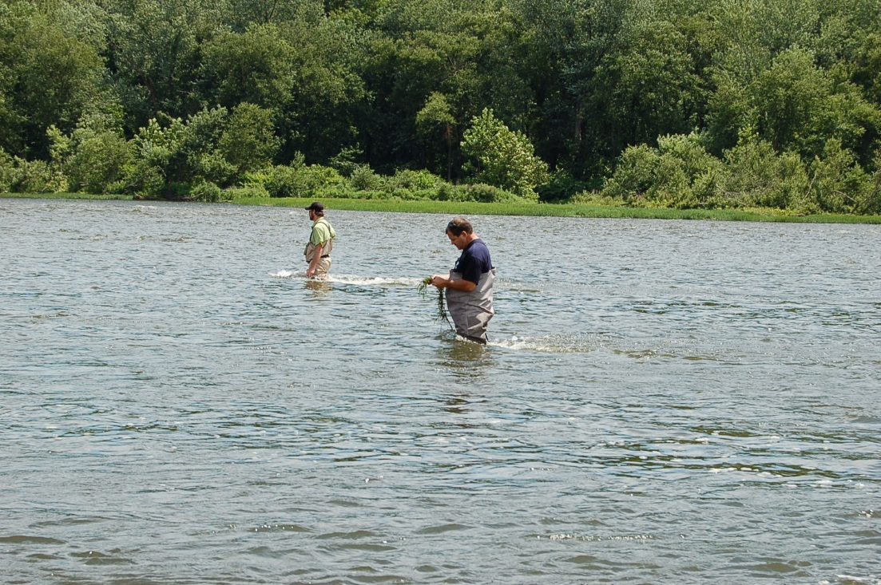
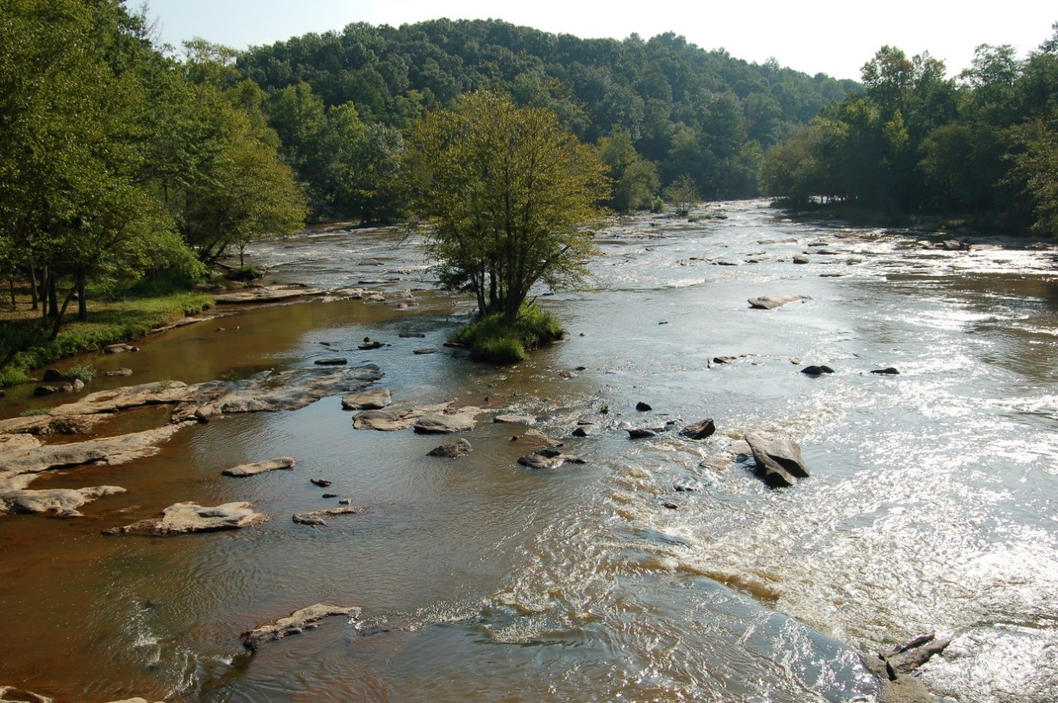
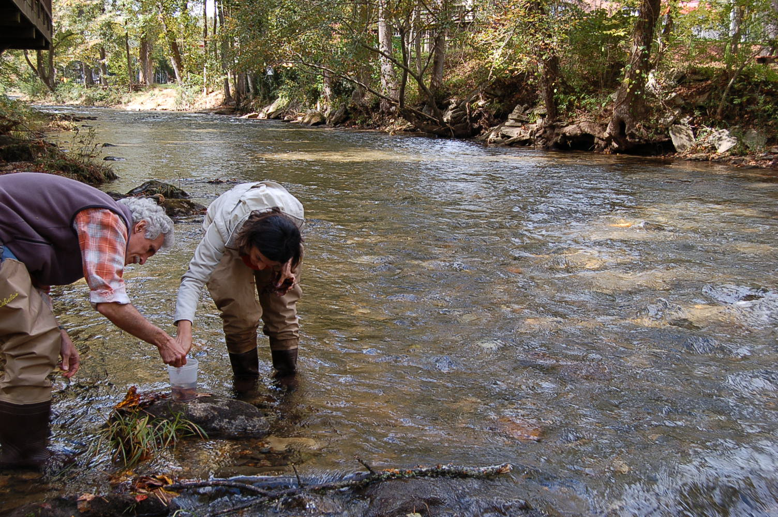
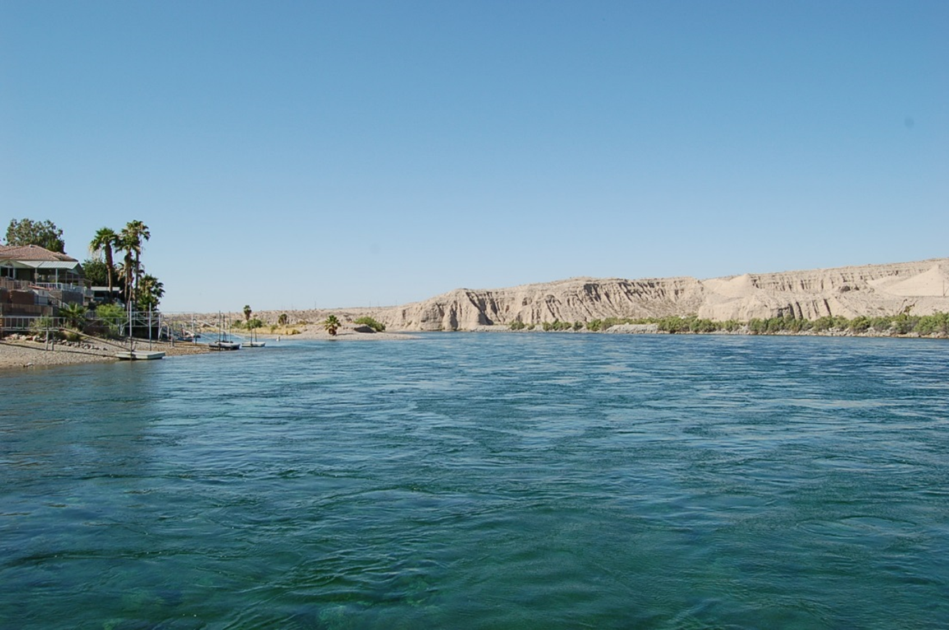

Slide 6
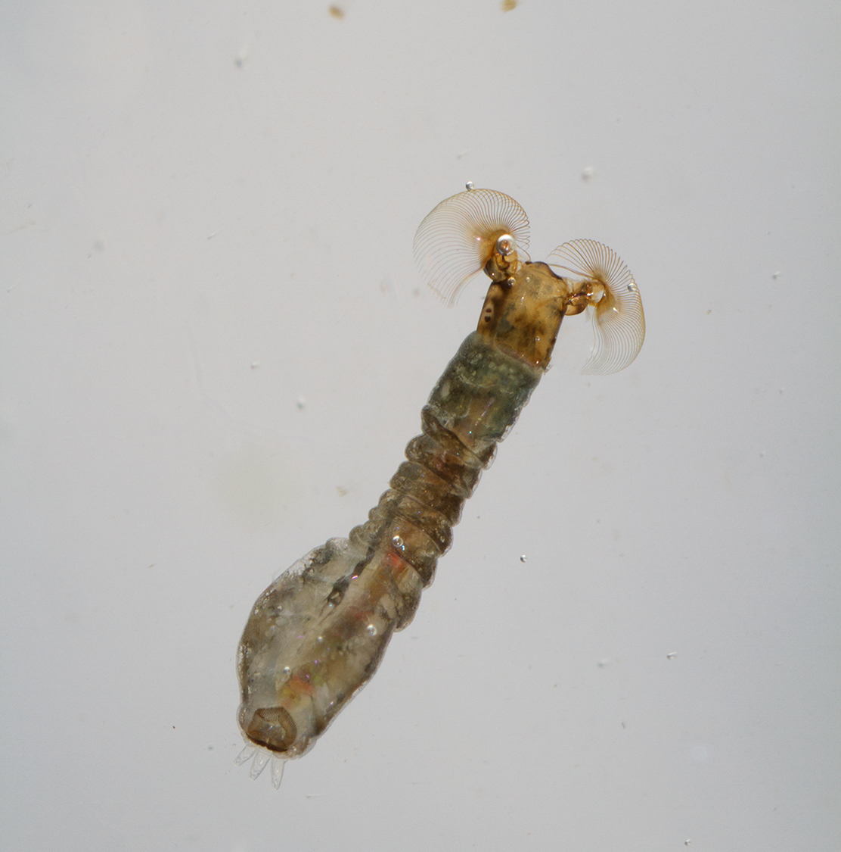

Slide 7
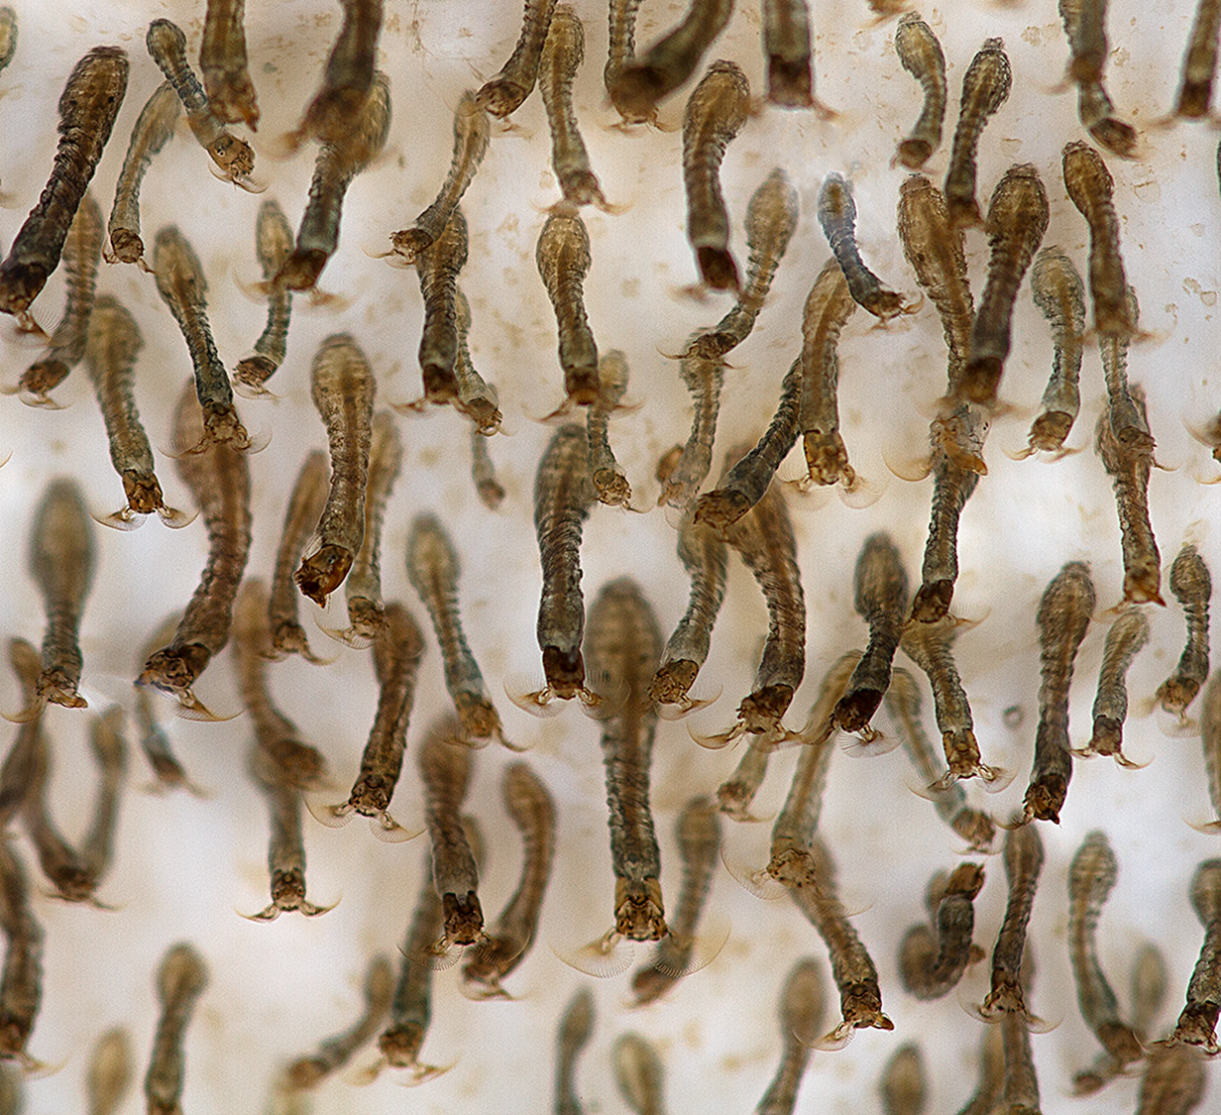

Slide 8
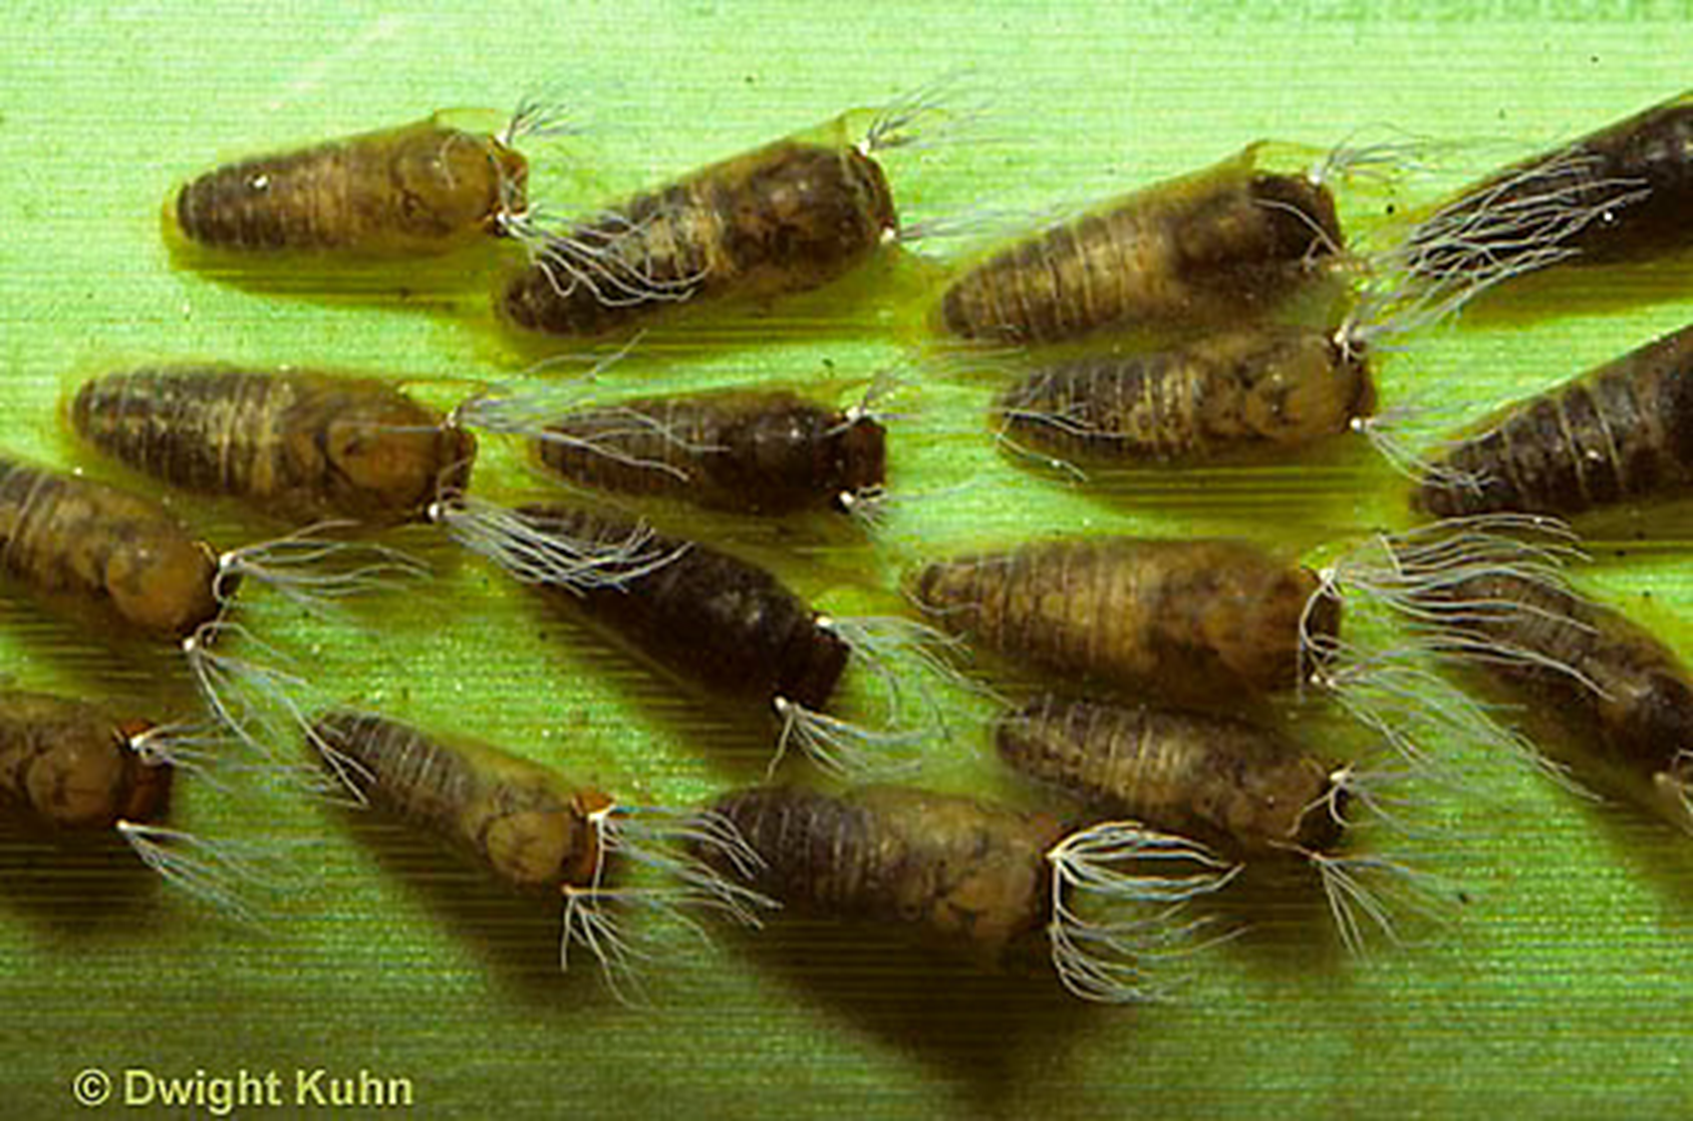

Slide 9
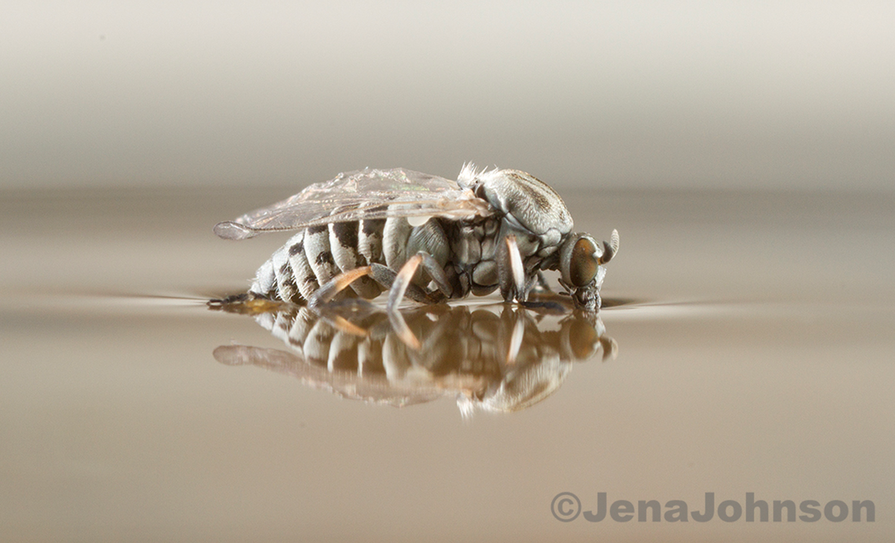

Slide 10
Onchocerciasis Control
1926 black flies identified as vector of Onchcerca volvulus, the causative agent of human onchocerciasis
1945 – demonstrated that DDT when applied to waterways was effective in larval black fly control
1973 - an operational plan and budget was approved through the WHO using the organophosphate Temephos – resistance soon followed
1976 - Bacillus thuringiensis subsp. israelensis discovered
Treatments shifted to Bti through the 1980’s
Peaked at 1.2 million km² and 40 million people protected, prevented blindness in 600,000, and 18 million children were born free from the threat of river-blindness

Slide 12
The Role of Biopesticides
Resistance and environmental degradation required change
Bti discovered and rapidly developed
Significant effort to produce products that were highly effective with the optimum physical properties
Dispersion & Carry
Stability
Viscosity
Cost effectiveness…..

Slide 13
The University of Georgia Black Fly Rearing and Bioassay Laboratory
Initiated in 1985 at Clemson University
Dr. Ray Noblet had been involved in black fly research since the early 70’s involving Leucocytozoon infections as part of his insect physiologist role
Began evaluating the earliest Bti based formulations in streams north of Clemson for Abbott Laboratories
By 1989 we conducted ~ 200 field evaluations/yr.
Measure stream flow
Treat at low concentration
Evaluate downstream mortality
Move upstream and replicate

Slide 14
Laboratory History cont.
Developed the Orbital Shaker Bioassay in 1990 - modified to the Controlled Current Toxicity Test in recent years
Today we operate the only black fly colony in the world (Simulium vittatum cytospecies IS-7) as part of our laboratory’s primary responsibility of evaluating the biopesticide used for black fly suppression
Classic example of industry and academia partnering…..for over 37 years!
Colony based around aquatic rearing units, ~600 liter reservoir, pump and compressor, 122 x 40 cm runway, water recirculated for ~60 days

Slide 15
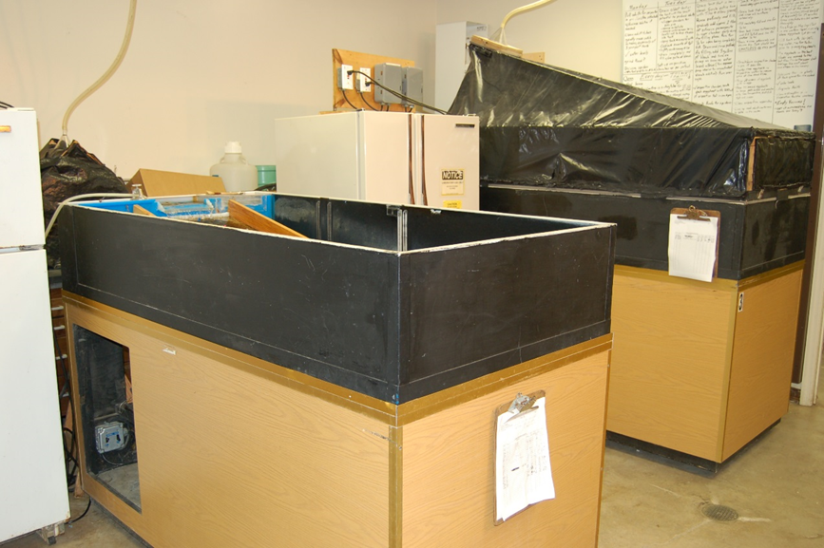

Slide 16
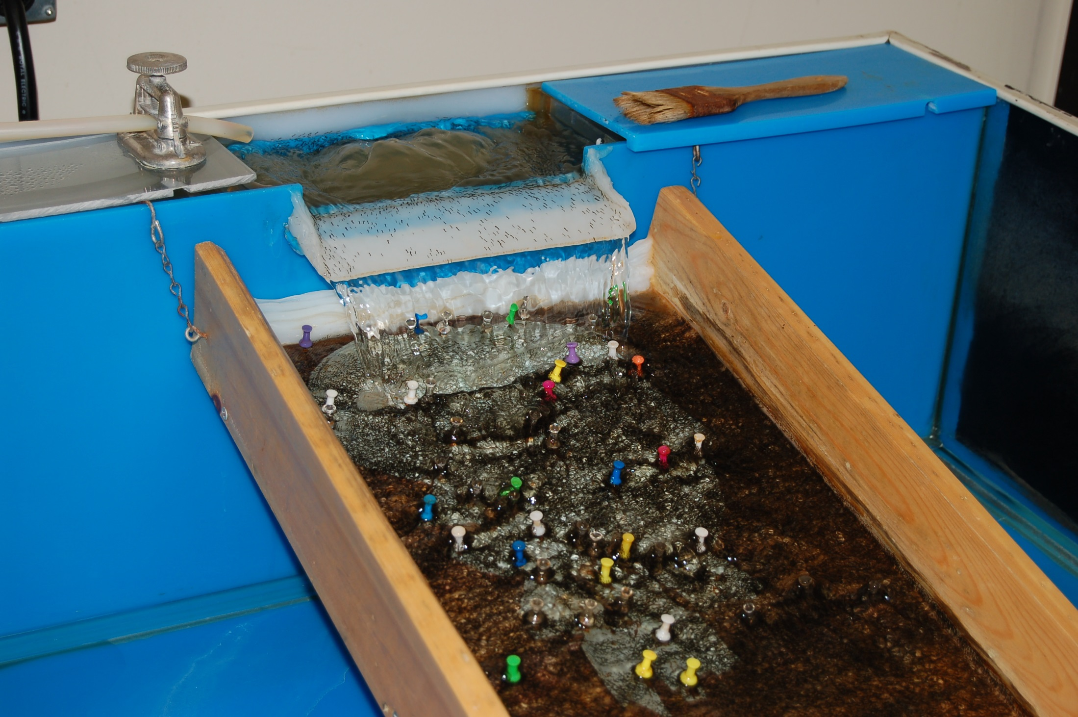

Slide 17
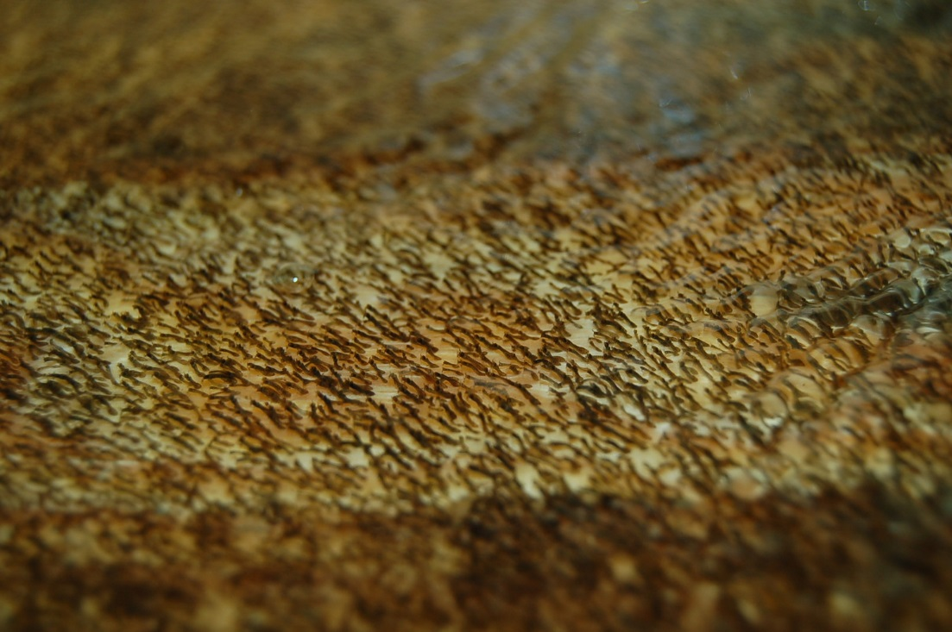

Slide 18
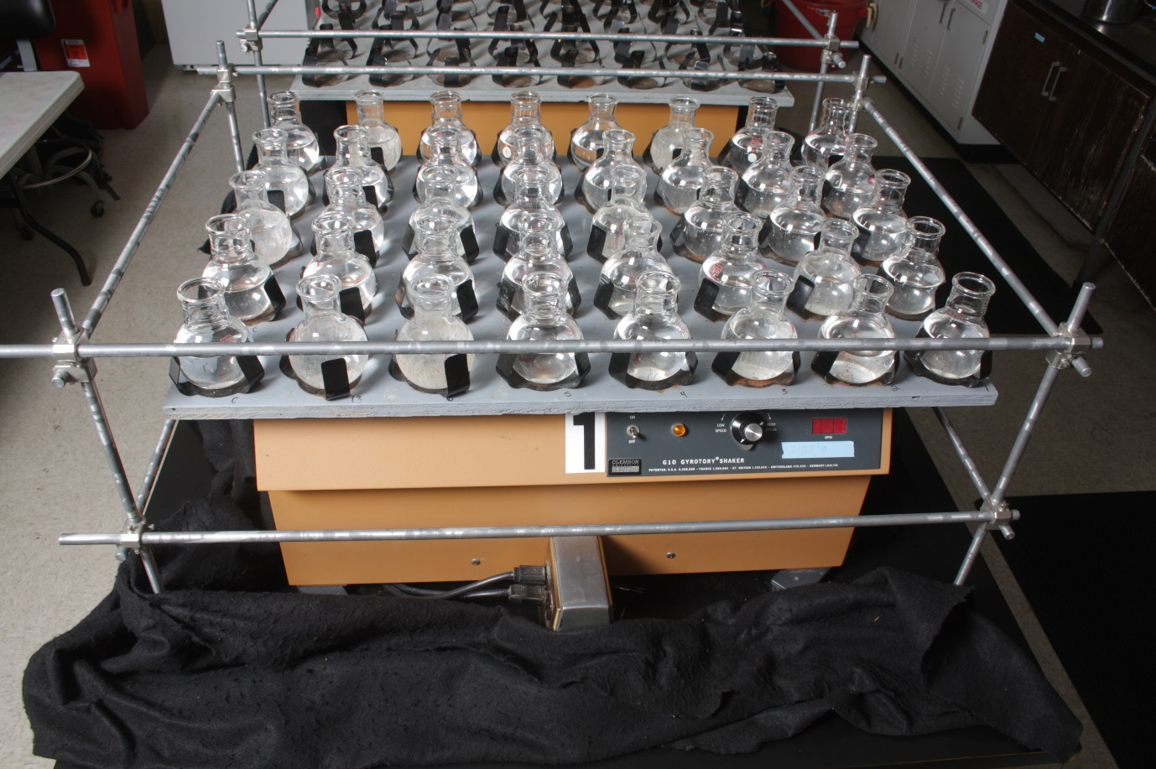
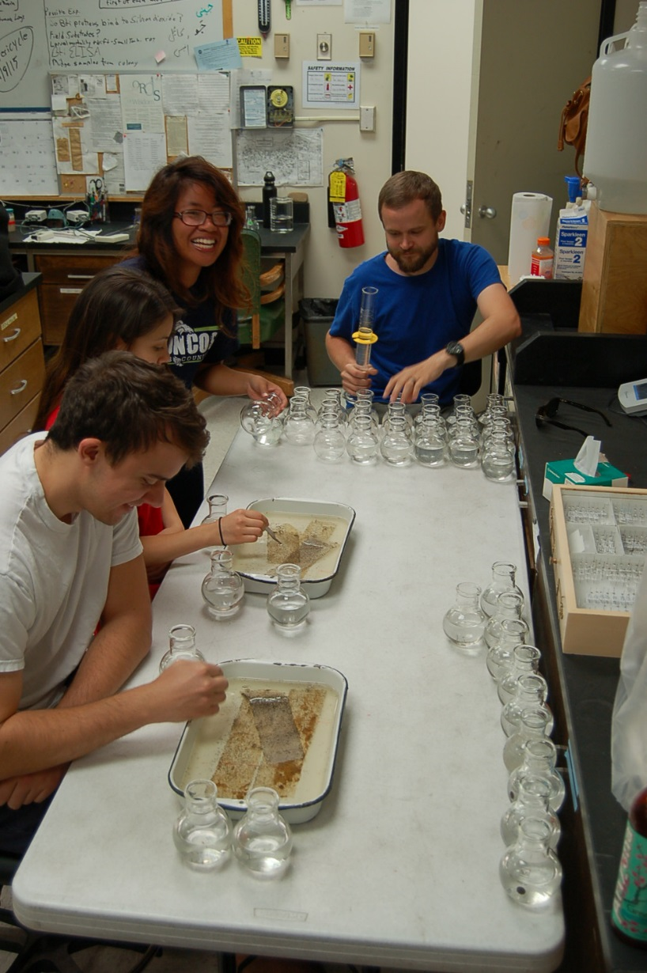
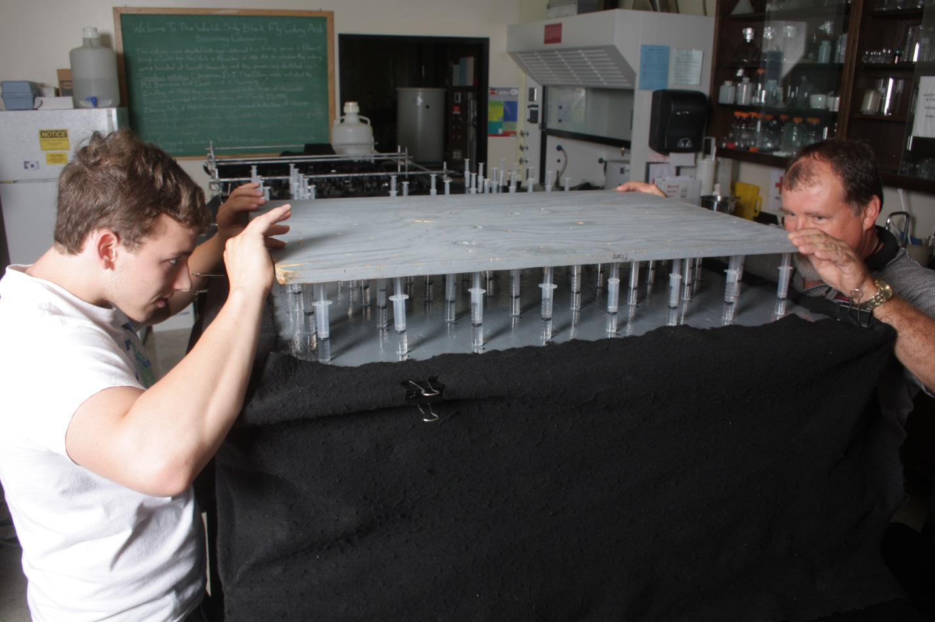

Slide 19
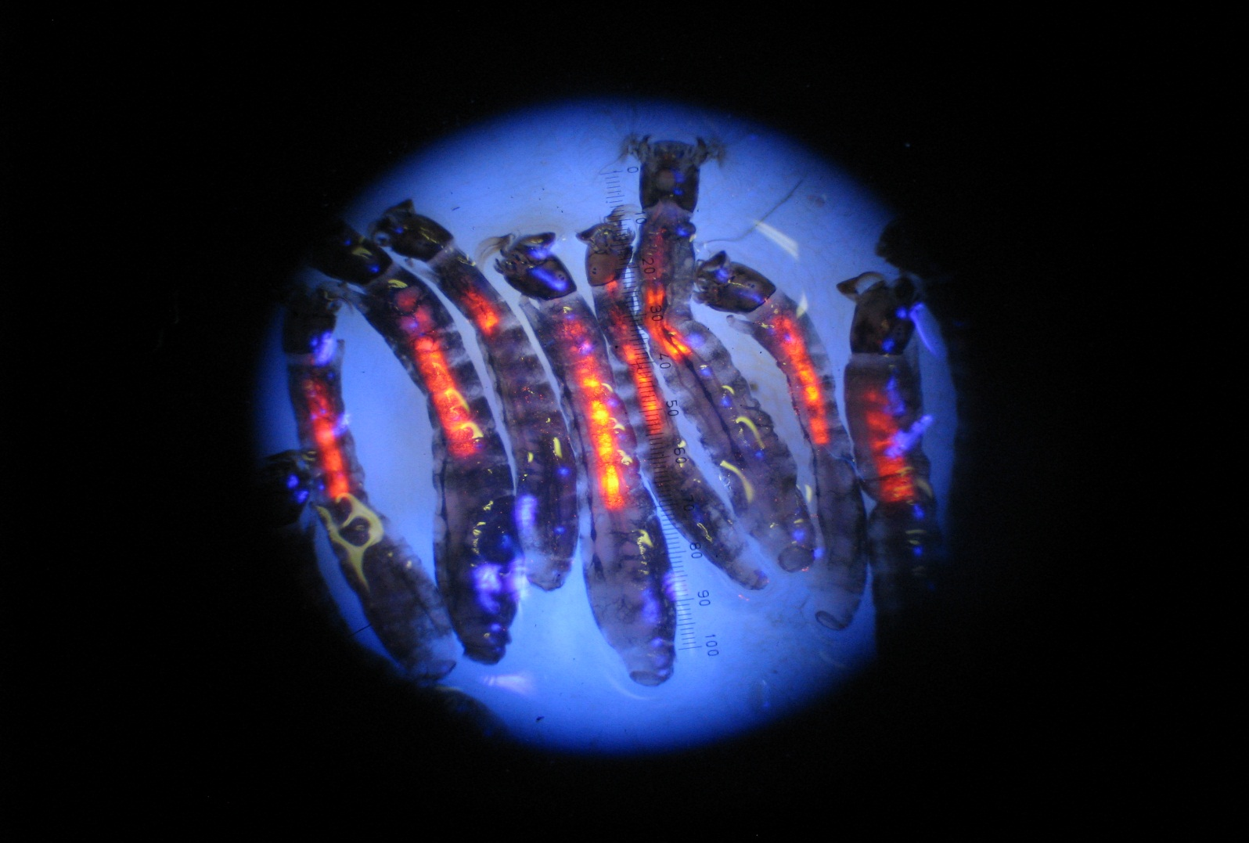

Slide 20
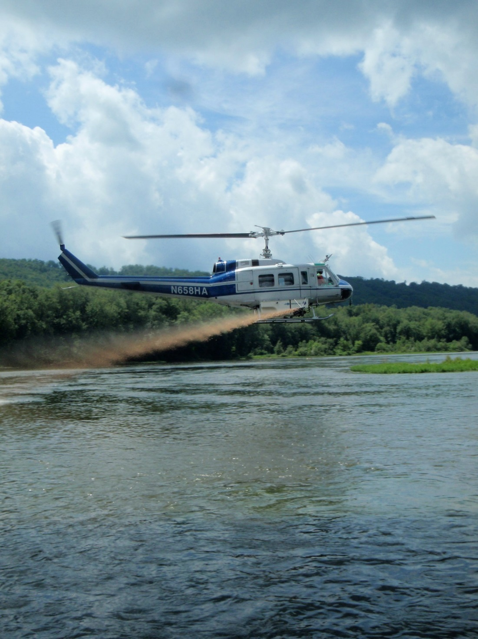
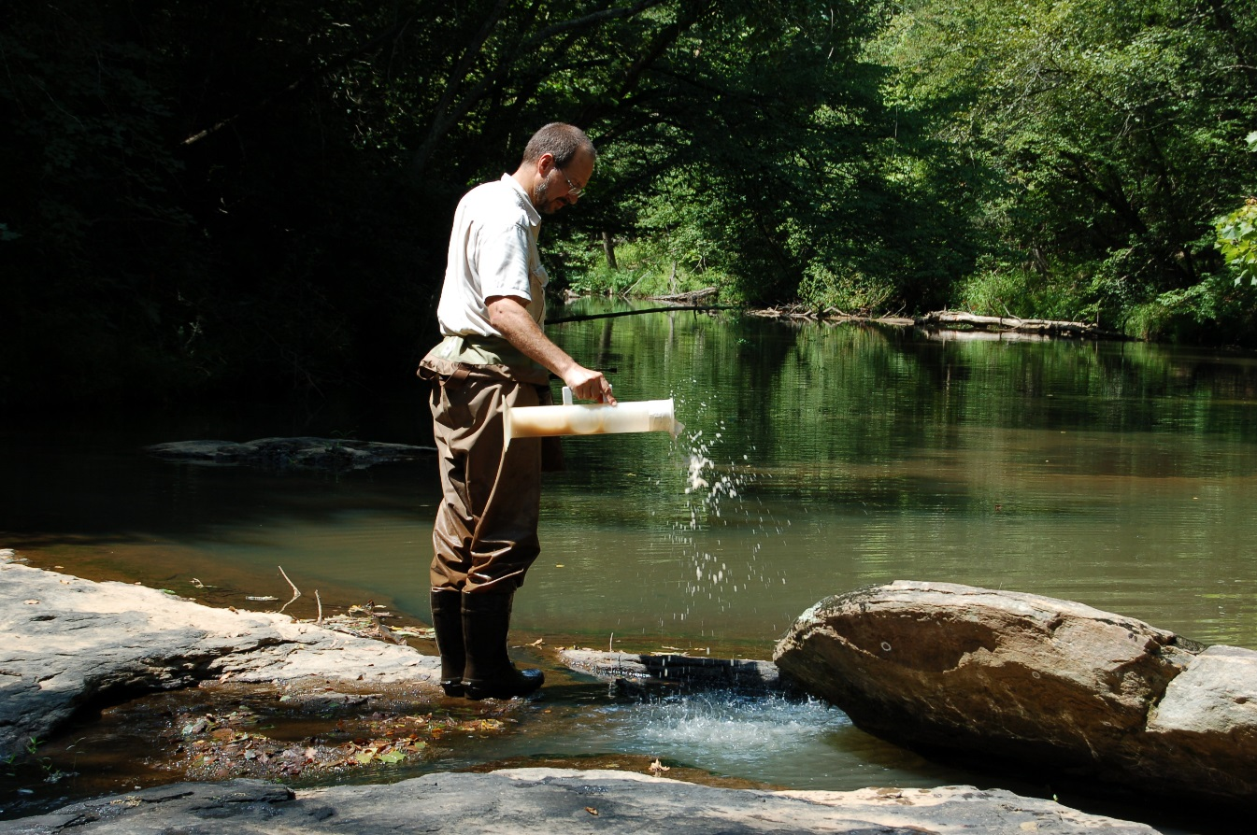
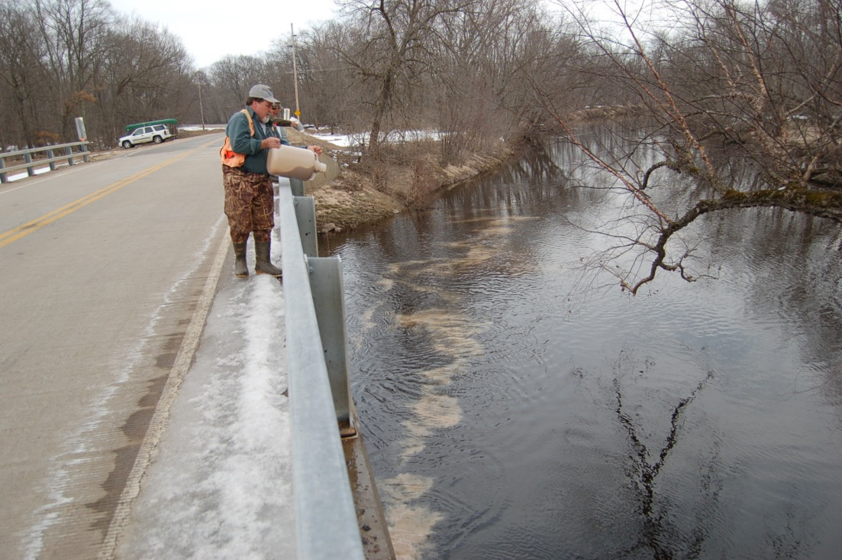
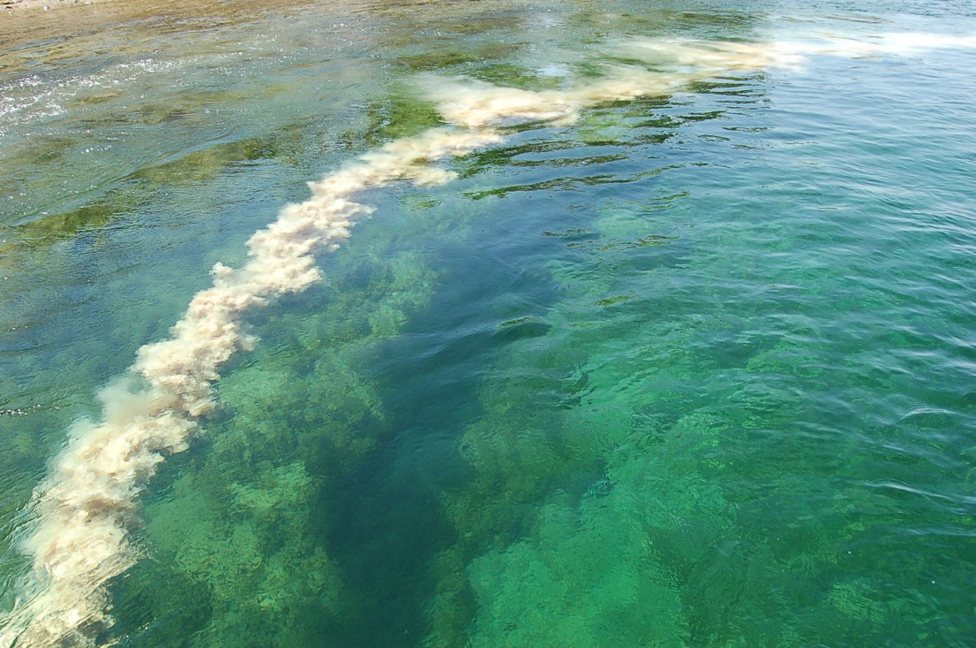

Slide 21
Related References
Gray, E. W. and R. Fusco, 2016. Microbial Control of Black Flies (Diptera:Simuliidae) with Bacillus thuringiensis subsp. israelensis. In Lacey L.A. ed. Microbial Control of Insect and Mite Pests. Academic Press, London, UK.
Gray, E. W. and R. Noblet. 2014. Black Fly Rearing and Use in Laboratory Bioassays. In Maramorosch K. and Mahmood F. eds. Rearing Animal and Plant Pathogen Vectors. CRC Press, Boca Raton, FL.

