Slide 1


The Sustainability Consortium
Christy Melhart Slay, Ph.D., Director of Research
Sustainable Products for a Sustainable Planet
WWW.SUSTAINABILITYCONSORTIUM.ORG

Slide 2
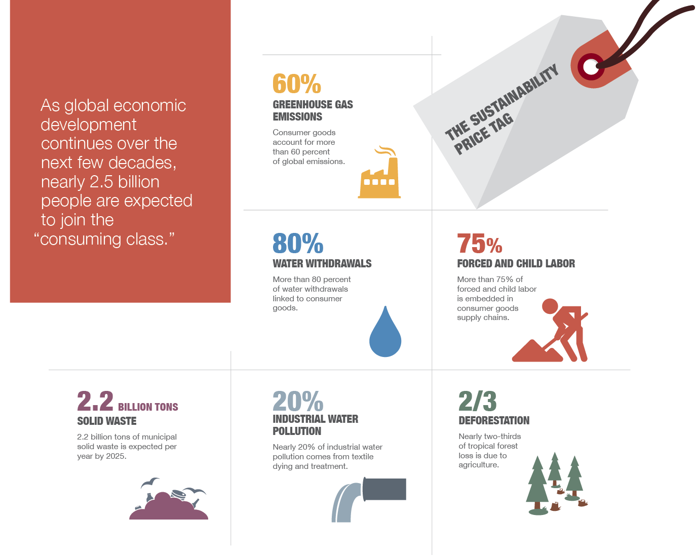
The sustainability impact–the price tag–of consumer goods is enormous and largely sits in supply chains
As global economic
development
continues over the
next few decades,
nearly 2.5 billion
people are expected
to join the
“consumer class.”
To capture the growth opportunity the consumer goods industry has to decrease the sustainability impact of consumer goods - which requires addressing supply chains

Slide 3



The Sustainability Consortium (TSC)
The mission of TSC
is to transform the consumer goods industry, and make the mainstream consumer goods we
buy every day better,
more sustainable
A multi-stakeholder
non-profit organization, translating the best sustainability science
into business tools to drive change in supply chains
A global organization, with offices in the United States, Europe and China
Over $130Bn
in consumer products sold using TSC Tools;
>100 Members
and 1,000s of users
TSC office locations
WAGENINGEN, NETHERLANDS
WAGENINGEN UNIVERSITY
TIANJIN, CHINA
TEMPE, ARIZONA
ARIZONA STATE UNIVERSITY
FAYETTEVILLE, ARKANSAS
UNIVERSITY OF ARKANSAS

Slide 4
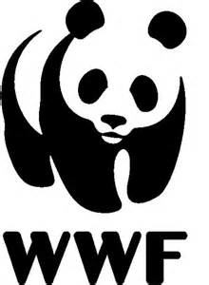










TSC has a multi-stakeholder approach that allows for pre-competitive collaboration
Board of Directors
Academic Advisory Council
Administering
Universities
Governance
Academic
Partners
Civil
Society
Organizations
Corporations
Corporate
Advisory Council
Civil Society Advisory Council
TSC Board of Directors
represent all stakeholder
groups across several industries…

Slide 5
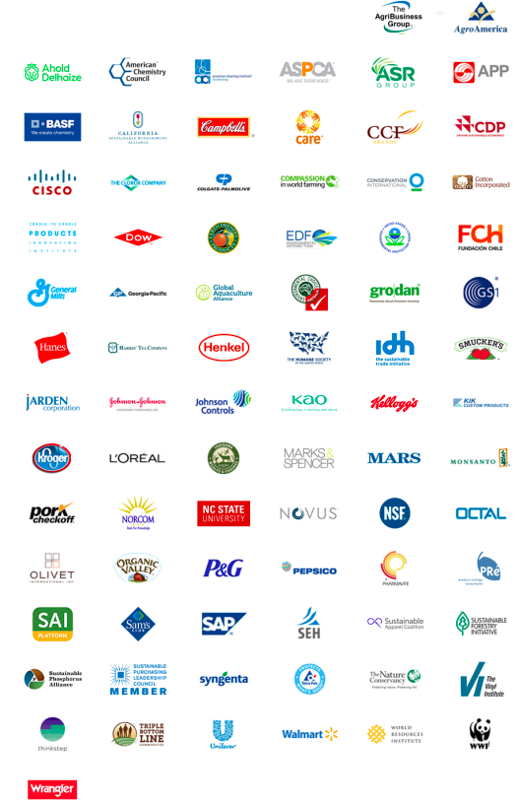
TSC Members Represent Industry Landscape

Slide 6
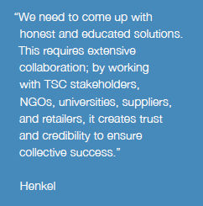
The TSC Vision
TSC: a catalyst for positive change
Retailers Commit
TSC’s platform enables retailers to measure and track supplier sustainability, making the ‘market signal’ clearer than ever before.
Manufacturers Drive Visibility
TSC tools allow a manufacturer to drive continual improvement and performance across the life cycle of their products.
Stakeholder Partner Alignment
Companies, NGOs, and other organizations work collectively to
create scale through harmonization of existing metrics and tools.

Slide 7
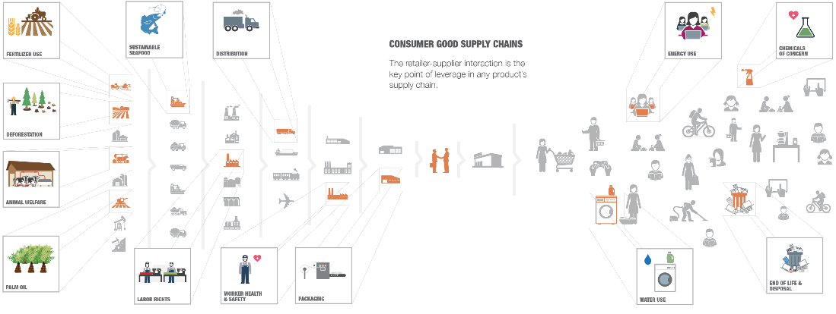
Mitigate Risks. Cost Savings. Drive Sales.
Transparency in Supply Chains

Slide 8







TSC tools enable cost efficiency and better communication in product sustainability
FROM:
Inefficient, unclear communication
TO:
Cost efficient and better communication
Suppliers
Conversations
Buyers
Suppliers
Conversations
Buyers
TSC Product
Sustainability Toolkits
Supply Chain Hotspots
Key Performance Indicators
Improvement Opportunities
TSC Toolkits help facilitate decision-making by buyers and suppliers along the value chain, with an emphasis on impact and improving product sustainability.

Slide 9









What does TSC do?
TSC translates complex sustainability tools into simple tools to allow buyers and other business users to embed sustainability in everyday business
Category Sustainability Profile
Social & Environmental Hotspots
Improvement Opportunities
Life Cycle Perspective
Key Performance Indicators
Up to 15 KPIs for retailer buyers to manage their suppliers
Multi-Stakeholder Process
Snapshots & Visuals
Simplified, visual training documents showing lifecycle stages, hotspots, KPIs etc.
THE SUSTAINABILITY CONSORTIUM © 2016 ARIZONA STATE UNIVERSITY AND UNIVERSITY OF ARKANSAS
9

Slide 10
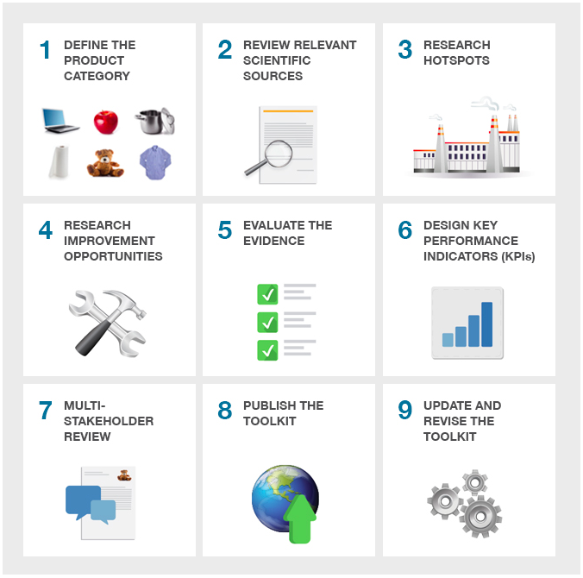
TSC Toolkit Creation Process

Slide 11
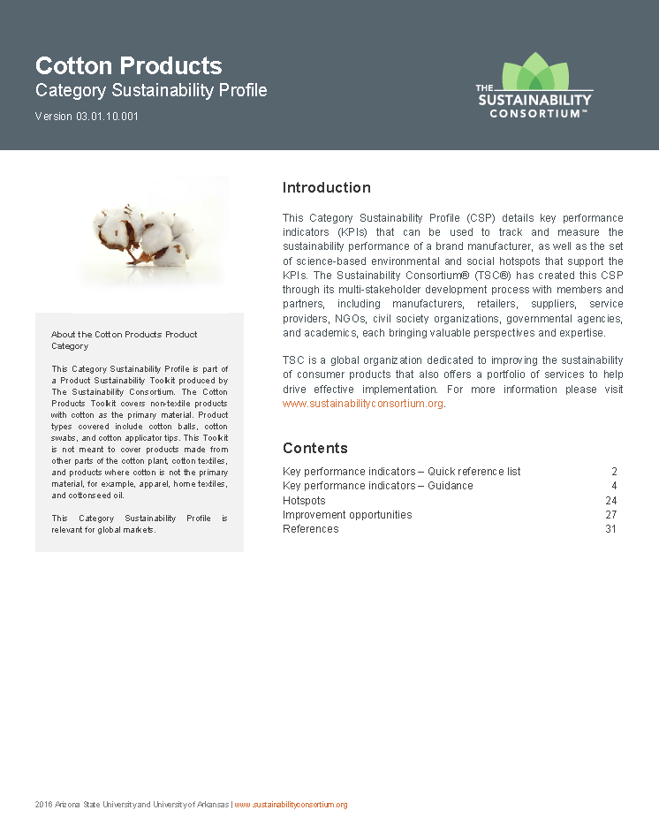
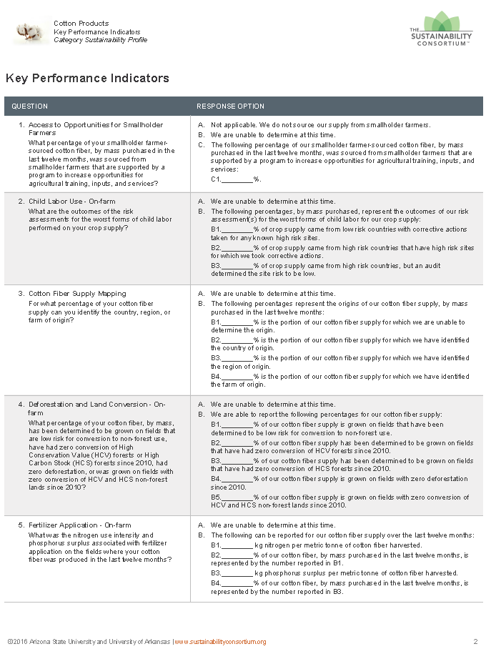
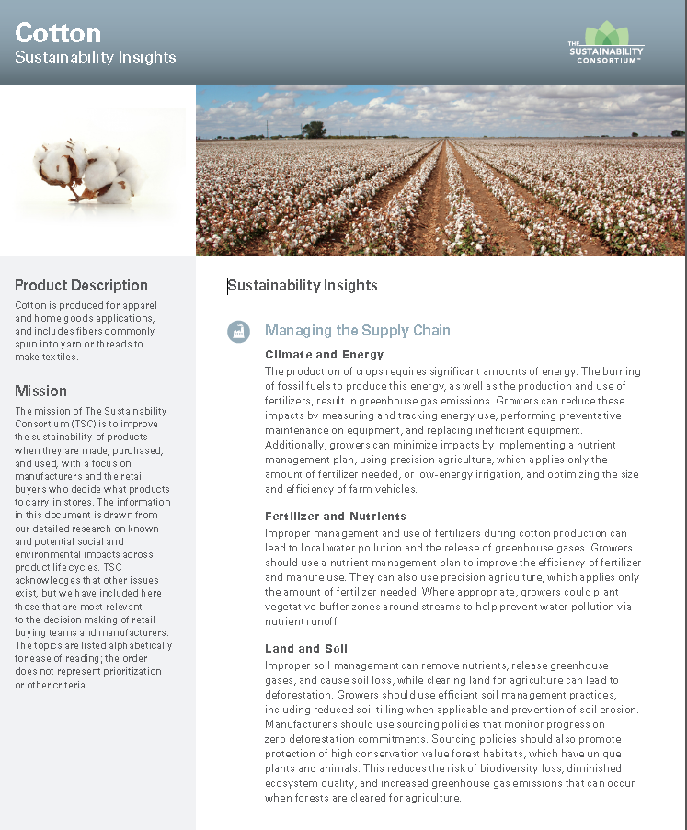
We create product category-level toolkits for action
Category Sustainability Profile (CSP)
Scope of coverage
Key Performance Indicators (KPIs)
Details of KPIs
  Hotspots
  Improvement Opportunities
Summary of the research used to identify the relevant issues
Key Performance Indicators
Questions (15 max) with numeric calculation-based response options or qualitative text choices
Calculation and scope guidance
Standards and tools references
Background information
Definitions of technical terms used in questions
Sustainability Insight
A short summary of relevant issues, hotspots and improvement opportunities for a product category in an accessible overview.

Slide 12

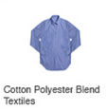

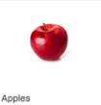
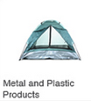
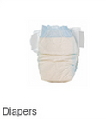



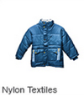



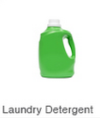



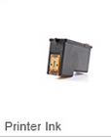
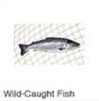
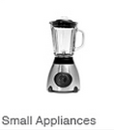



TSC has tools in 129 product categories, covering 80-90% of sustainability impacts in all of consumer goods
Cross Sector
Electronics
General Merchandise
Home & Personal Care
Paper, Pulp & Forestry
Toys
Clothing, Footwear & Textiles
Food, Beverage & Agriculture
8 categories, including:
10 categories, including:
48 categories, including:
21 categories, including:
13 categories, including:
10 categories, including:
5 categories, including:
Beef
THE SUSTAINABILITY CONSORTIUM © 2016 ARIZONA STATE UNIVERSITY AND UNIVERSITY OF ARKANSAS
12

Slide 13
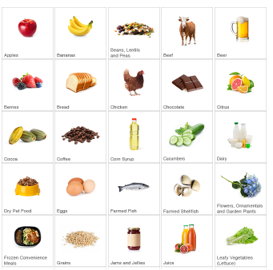
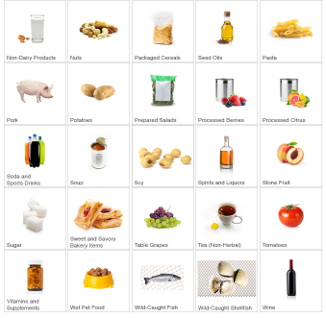
TSC Food, Beverage, and Agriculture Categories

Slide 14




















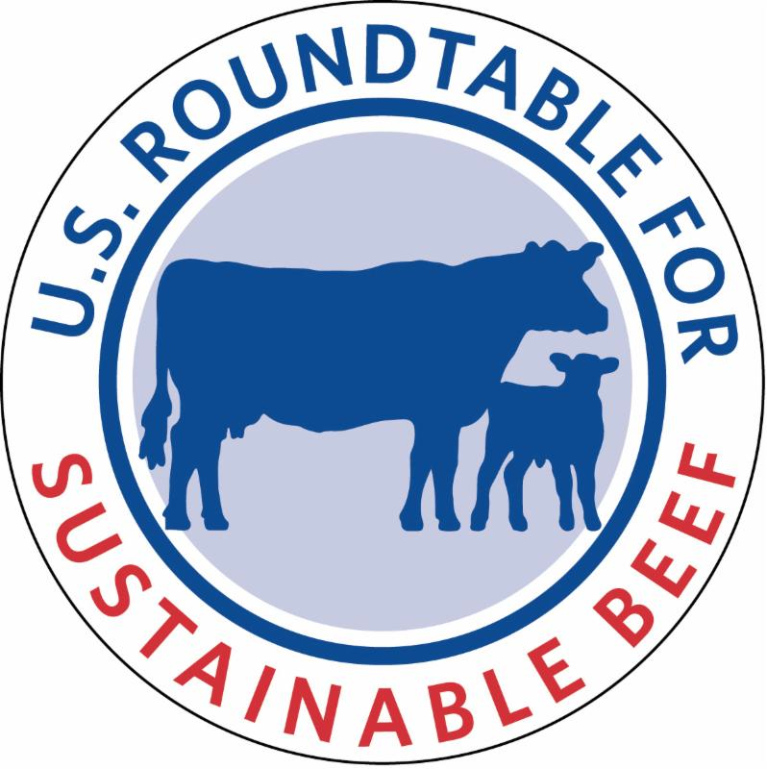
TSC Links to Key Sustainability Initiatives
TSC is active in the EU Product Environmental Footprint initiative, and also many sector-based programs
Cross Sector
Food, Beverage, and Agriculture
Electronics
Home and Personal Care
Textiles
Toys
Packaging
General Merchandise
Paper, Pulp, and Forestry

Slide 15
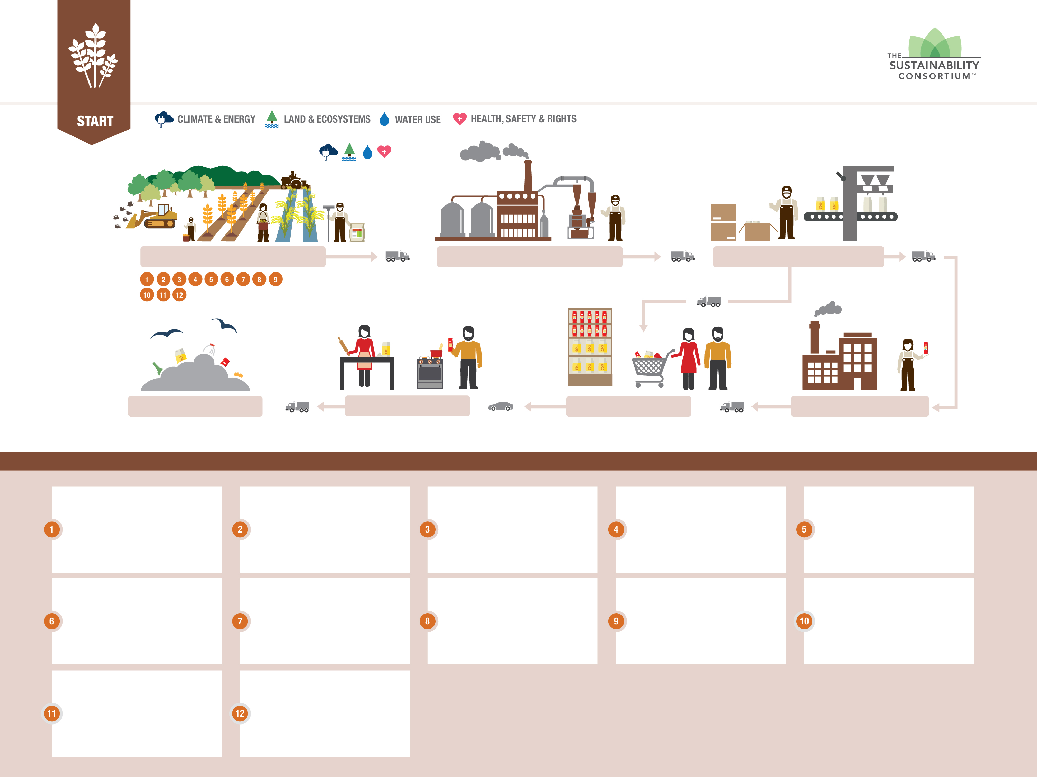
GRAINS
SUPPLY CHAIN HOTSPOTS
START
GRAIN PRODUCTION
PROCESSING
PACKAGING
END-OF-LIFE & DISPOSAL
CONSUMER USE
RETAIL
MANUFACTURING USE
HOTSPOTS
VERSION 1.0 | THE SUSTAINABILITY CONSORTIUM® | ©2016 ARIZONA STATE UNIVERSITY AND UNIVERSITY OF ARKANSAS
Access to opportunities for smallholder farmers: Operators of small-sized farms, especially women, face a number of challenges including access to agricultural inputs, services, and markets.
Energy consumption - On-farm: Fuel combustion and energy generated to power farm operations can cause climate change, deplete resources, and impact human health.
Fertilizer application - On-farm: Fertilizer use can cause soil and water quality impacts and can contribute to climate change.
Field flooding - On-farm, rice cultivation: Flooding of rice fields can cause methane emissions, contributing to climate change.
Forced labor and child labor use - On-farm: Issues in forced and child labor use in grain farming include no pay, long working hours, dangerous working conditions, and limited access to education.
Labor rights - On-farm
Workers are at risk of several labor rights issues including unfair pay, long hours, sexual harassment, discrimination, and challenges to self organization.
Land transformation - On-farm
Clearing and burning land for grain farming can cause air quality issues, climate change, deforestation, and biodiversity loss.
Pesticide application - On-farm: Pesticide use can impact biodiversity, soil and water quality, and human health.
Soil management - On-farm:
Tilling the soil can lead to erosion, which can impact soil and water quality.
Supply chain traceability:
Due to the complexity of grain supply chains, information about where the supply chain originates is limited, which is a challenge to improving issues.
Water use - On-farm:
Over-irrigation and excessive water use during dry seasons leads to freshwater depletion and biodiversity loss.
Worker health and safety –
On-farm: Farm workers can develop serious health problems from exposure to chemicals and dust and physical injury from other occupational hazards.

Slide 16
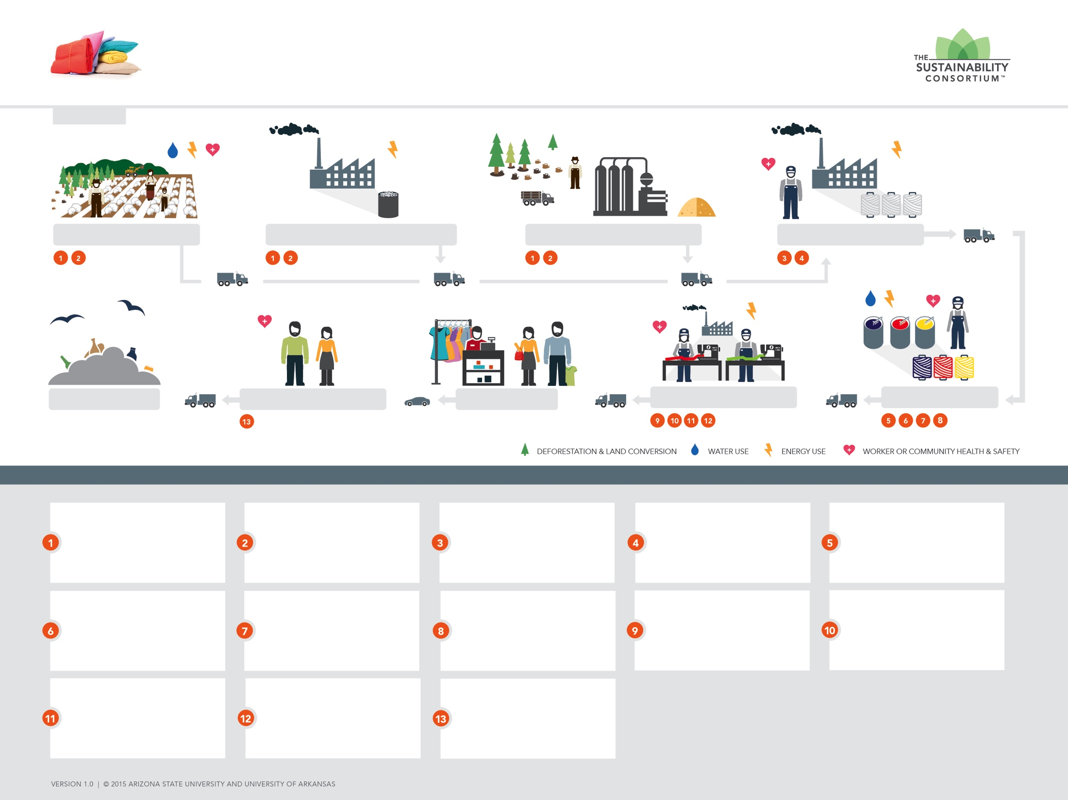

MIXED MATERIALS TEXTILES
SUPPLY CHAIN HOTSPOTS
START
RAW MATERIALS FOR YARN
& FABRIC PRODUCTION
POLYESTER & NYLON RESIN PRODUCTION
WOOD PULP PRODUCTION FOR RAYON
YARN PRODUCTION
PRODUCT DISPOSAL
WEARING & USING TEXTILES
RETAIL
TEXTILE PRODUCTION
DYEING FABRIC
1
2
THE HIGG INDEX
Environmental impacts – Material production: Cotton cultivation, resin conversion for polyester and nylon, and wood sourcing for rayon can cause can cause climate change, deplete resources, and cause environmental and human health impacts.
Social impacts – Material production: Cotton cultivation, resin conversion for polyester and nylon, and wood sourcing for rayon have labor and worker rights issues.
Energy consumption – Fiber production, nylon and polyester: Energy generated to power resin conversion can cause climate
change, deplete resources, and
impact human health.
Energy consumption –
Yarn spinning: Energy generated
to spin yarn can cause climate change, deplete resources, and impact human health.
Chemical use – Wet processing: Dyes and other chemicals used in textile production can lead to worker, human health, and environmental impacts.
Energy consumption – Wet processing: Energy generated to
heat water during dying can cause climate change, deplete resources,
and impact human health.
Wastewater generation – Wet processing: Wastewater from dyeing produces a significant volume of contaminated or untreated effluent that can pollute the environment.
Water use – Wet processing:
Large amounts of water are used
to pretreat, dye, print, and finish
textile materials, which depletes freshwater resources.
Energy consumption – Finished goods production: Energy generated to manufacture textiles can cause climate change, deplete resources,
and impact human health.
Labor rights - Textile production: Textile production may use child labor and forced labor, as well as violate other labor rights.
Homeworking – Textile manufacturing: Workers who work
in their homes may face labor rights issues that leaves them vulnerable
to exploitation.
Worker health and safety –
Finished goods production:
Workers can develop respiratory difficulties from exposure to fibers,
and physical injury from
occupational hazards.
Additive exposure – Product use: Consumers may experience health issues from exposure to chemicals added to textiles.

Slide 17







TSC members engage with several of the world’s leading retailers currently leveraging TSC metrics
Retailers currently leveraging TSC
In 2015 > $130 billion evaluated using TSC’s metrics

Slide 18


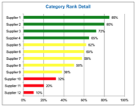


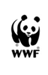






CASE STUDIES
TSC Powers Walmart’s Sustainability Index
Research Issues & Engage Stakeholders
Develop Metrics to Quantify Sustainability
Survey Suppliers & Collect Data
Drive Improvement and Reward Progress
  Who:
  100+ members; including leading retailers, manufacturers, NGOs, universities & experts
  Who:
  Buyers, Category Directors, Sourcing Directors, Product Development & Quality Teams
  Key Deliverable:
  Key Performance Indicators (KPIs) that are used to survey suppliers & measure their sustainability performance
  Key Deliverable:
  Category Scorecards that are used to set baselines, benchmark suppliers, track progress, & identify leaders and laggards

Slide 19
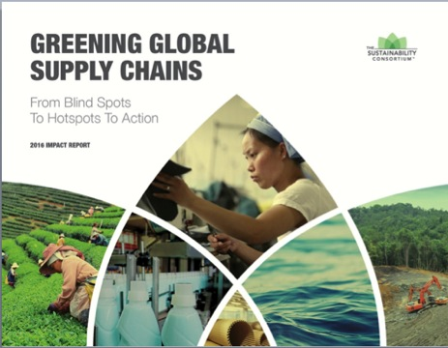
Our Impact Report
Results from Retailer Use of TSC KPIs
Data show that across sectors, most respondents do not have visibility
into the supply chains of the products
they make and sell.

Slide 20
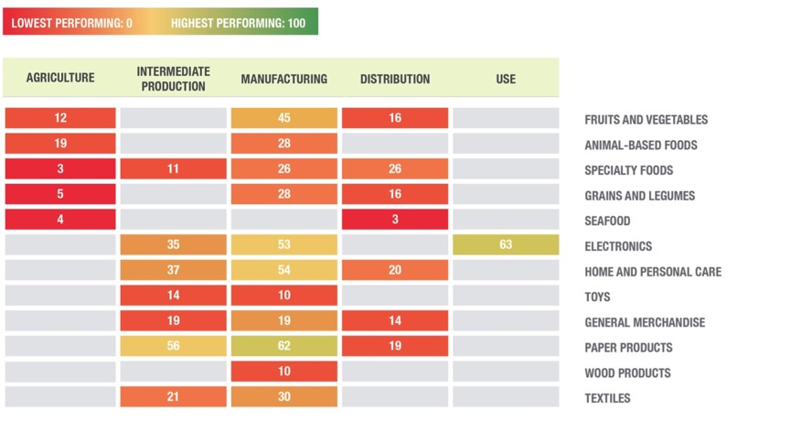
Managing Resources: climate, materials, water, energy

Slide 21
Mean Scores of Food, Beverage, and Ag
All KPIs in FBA Toolkits
 | 2016 Respondents | 2015 Respondents
Total | 1847 (+62%) | 1137
Average score | 34.1 | 30.5
Score range

Slide 22
2015 Benchmark Data for Cotton

Slide 23
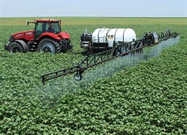
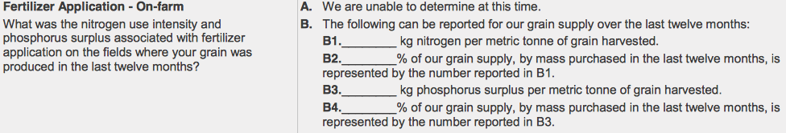
TSC On-farm Key Performance Indicator, Hotspot, and Improvement Opportunities
Hotspot- Fertilizer Application
Improvement Opportunities
Apply Nitrification Inhibitors on-farm
Implement Intercropping
Implement nutrient management programs on-farm
Key Performance Indicator

Slide 24

Role of Biostimulants in TSC Tools
Biostimulants can be used as Improvement Opportunities to address relevant TSC Hotspots
Fertilizer Application
Pesticide Application
Soil Erosion (health)
Water use efficiency
Yield
Energy use (indirectly)

