Slide 1

Trump In the Econosphere: Pollution or Fertilizer?

Slide 2
Our economy is our social environment, analogous in every way to our physical environment. It is a self-sustaining system that if left reasonably unfettered provides us with the signals and incentives that allow this planet to support its billions of inhabitants

Slide 3
Four Laws of the Econosphere
Law of Growth - Each new person brings additional new wealth to the world.
Law of Information – No matter the problem, better information is always part of the solution.
Law of Sustainability – Bounty comes from people and nothing else. The animating force of the Econosphere is humanity.
Law of Plenty – The Econosphere never takes from one to give to another.

Slide 4
How Do We Evaluate New Public Policy?
Does it improve information? Hopefully it doesn’t make it worse!
Does it help our chief raw material, the human lifespan, to be as efficient and productive as possible?
Does it preserve and sustain our social environment? It should not diminish the Econosphere’s ability to oversee the allocation of scarce resources.

Slide 5
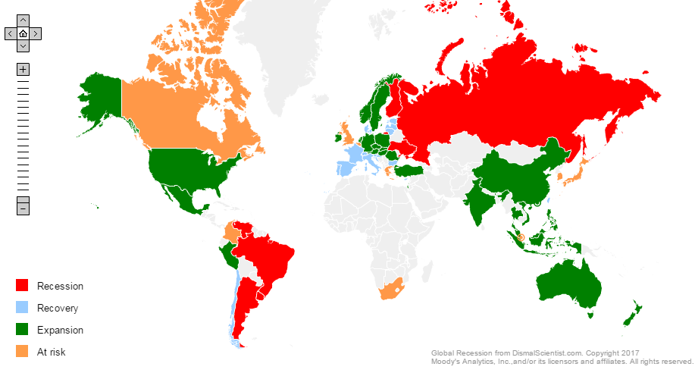
The Good and the Bad of the Global Economy

Slide 6
This Expansion is Increasingly Prolific

Slide 7
Year Ahead Key Indicators
Inflation: Going Up
Personal Income: Up, As Well
Business Conditions: Reasons to Be Hopeful
Demographics/For Sale Housing: Less Helpful

Slide 8
Income = ƒ(Jobs, Productivity, Inflation)

Slide 9
Lack of Productivity & Inflation Held Income Down In the Aggregate

Slide 10
Higher Inflation Is Already Baked In

Slide 11
Has the Labor Market Ever Been Tighter?

Slide 12
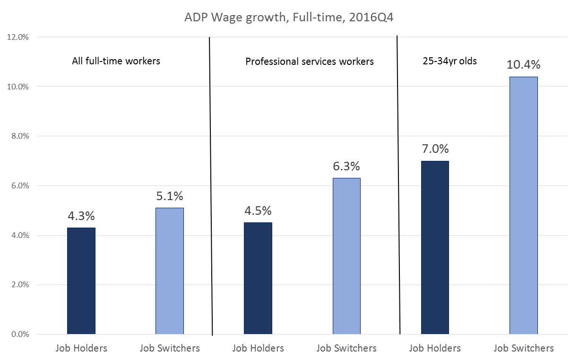
Wage Situation Is More Upbeat than the Aggregate Estimates Suggest

Slide 13
Business Conditions Suggest Continued Expansion

Slide 14
Political Risk? Administration Priorities Appear Aligned With Business Concerns

Slide 15
The Average Millennial Is over 30 years old; Boomers Are Heading Into Retirement

Slide 16
New Homes Lag, But the Existing Home Market Is In Good Shape

Slide 17
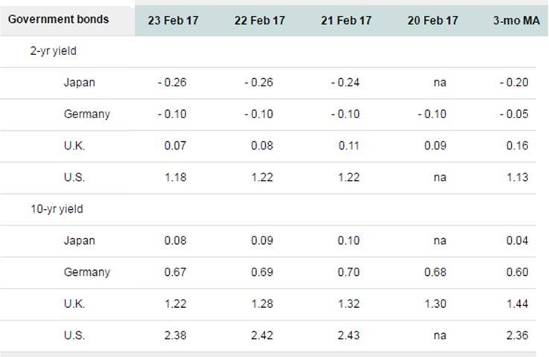
Does the UK Need the EU, or Does the EU Need the UK?

Slide 18
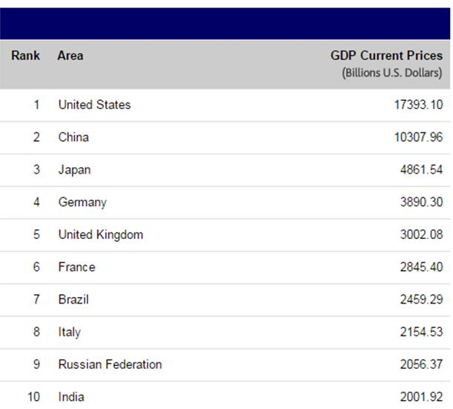
Does the UK Need the EU, or Does the EU Need the UK?

