Slide 1

A “GREEN” SUBSAHARAN-AFRICA – STRATEGIES FOR SAFER, FRESHER, AND SUSTAINABLE FOOD SUPPLY
Evans Baiya PhD
March-01, 2017
KEYNOTE -
2017 Spring Meeting & International Symposium, Reno NV USA

Slide 2
1982
Notes:
DDT (dichlorodiphenyltrichloroethane) Ban:
DDT is an organochlorine insecticide that was first synthesized in 1874
DDT was a commonly-used pesticide for insect control in the United States until it was canceled in 1972 by the United States Environmental Protection Agency (EPA).
DDT was canceled because it persists in the environment, accumulates in fatty tissues, and can cause adverse health effects on wildlife
DDT affects the nervous system by interfering with normal nerve impulses
People exposed to DDT while working with the chemical or by accidental exposure report a prickling sensation of the mouth, nausea, dizziness, confusion, headache, lethargy, incoordination, vomiting, fatigue, and tremors
One of the breakdown products of DDT, DDE3 , causes thinning of eggshells in birds and embryo deaths

Slide 3
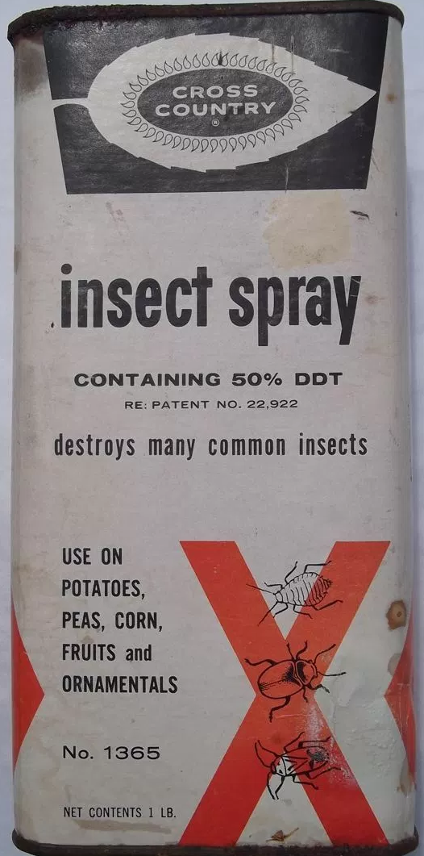
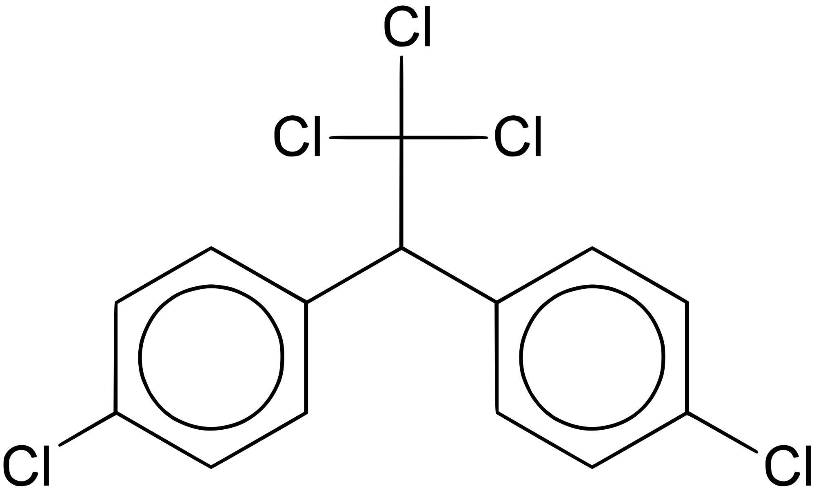

Slide 4
2015
Potato industry in Kenya

Slide 5
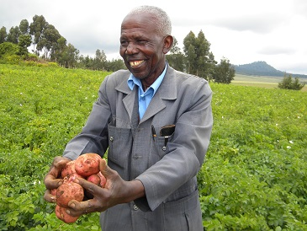
Potato Industry
GROWING CONSUMPTION
NOT ENOUGH SUPPLY
Food Services
Processors
Exporters
Institutions

Slide 6
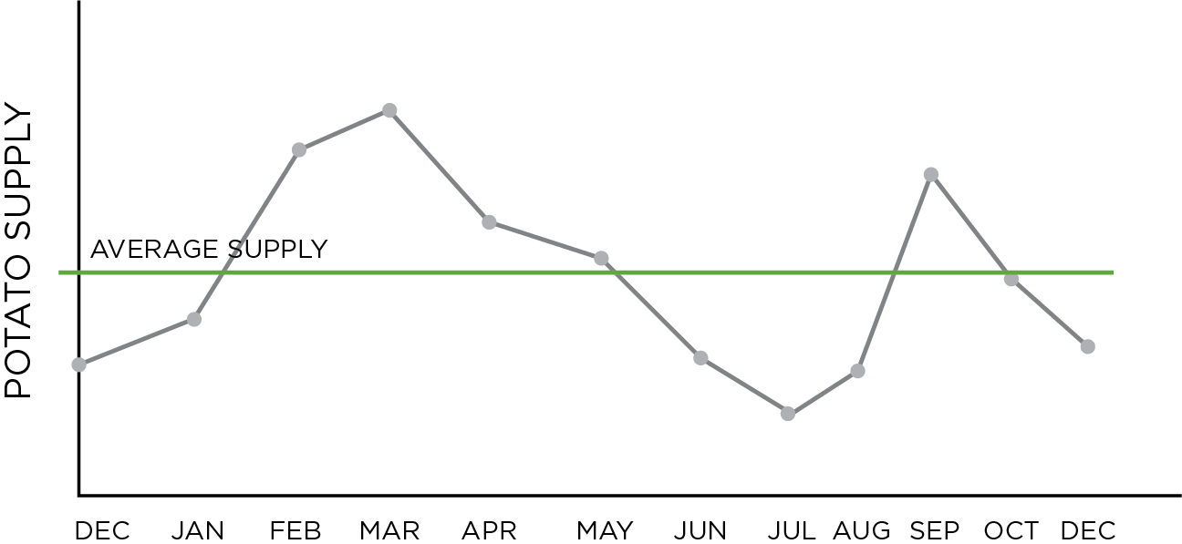
Supply Chain
Notes:
Unstable supply
Unsustainable supply chain

Slide 7
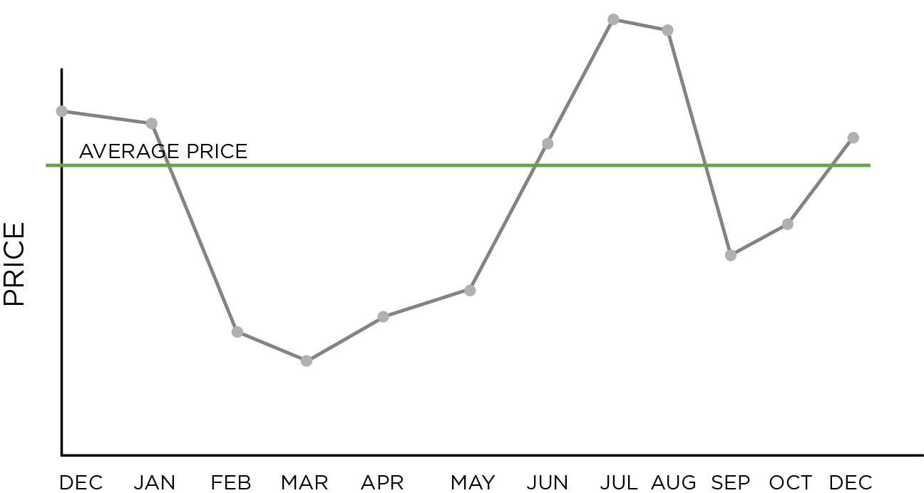
Pricing

Slide 8
PROBLEM
Lack of good storage of freshly-harvested produce

Slide 9
Develop holistic storage solutions for potatoes
For subsistence farming communities and must control
Sprout
Disease

Slide 10
Chemical Considerations
Safe
Affordable
Sustainable
Retains freshness of potatoes (wt)
No known environmental impact
MUST BE
Consumer ready produce
Seed
Sustained dormancy (pre/post sprout)
Sprouting can be controlled
APPLICABLE
ON
Notes:
Chlorpropham
–US MRL (maximum residue level) 30 ppm
–2009 USDA Pesticide Data Annual Summary: CIPC found in 80% (596/744) of samples and residue levels of 0.01 to 23 ppm. Mean detection 2.5 ppm. All below 30 ppm.
–Industry commissions sampling for residues.
–Industry looking for means to reduce rates and residues, utilize alternative chemistries.
–Applaud
•Potato Industry CIPC Stewardship Group – “Be CIPC Compliant”
----------------------
Dimethylnaphthalene (DMN)
–No residue issue; exempt from tolerance
–Thermally applied alone or with CIPC program
–Aerosol canisters for shipping containers
–Thermal application to seed (30 days before planting)

Slide 11
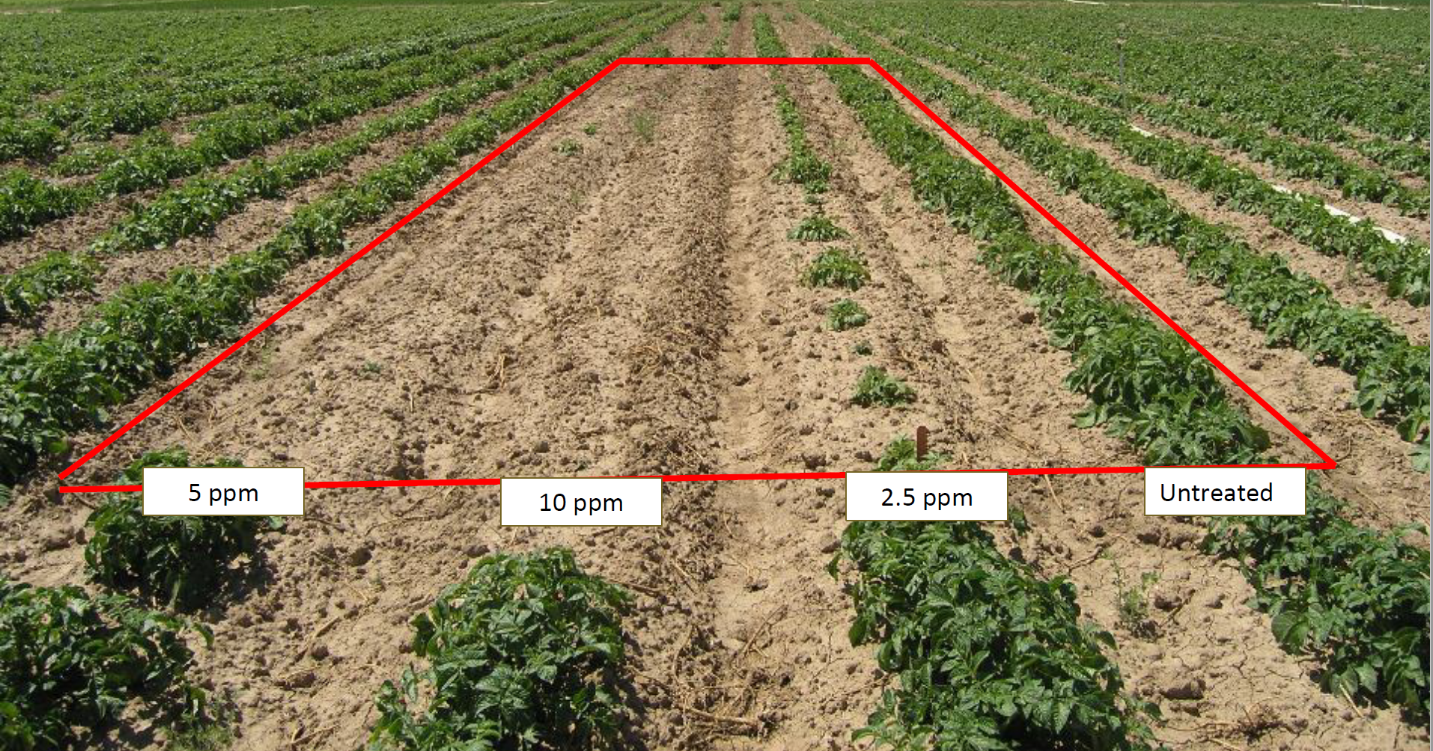
Impact of CIPC
Nora Olsen, Sprout Suppression – A Technical Viewpoint, University of Idaho - Sprout Suppression 2020

Slide 12
CIPC
Chlorpropham
Bio-Pesticides

Slide 13
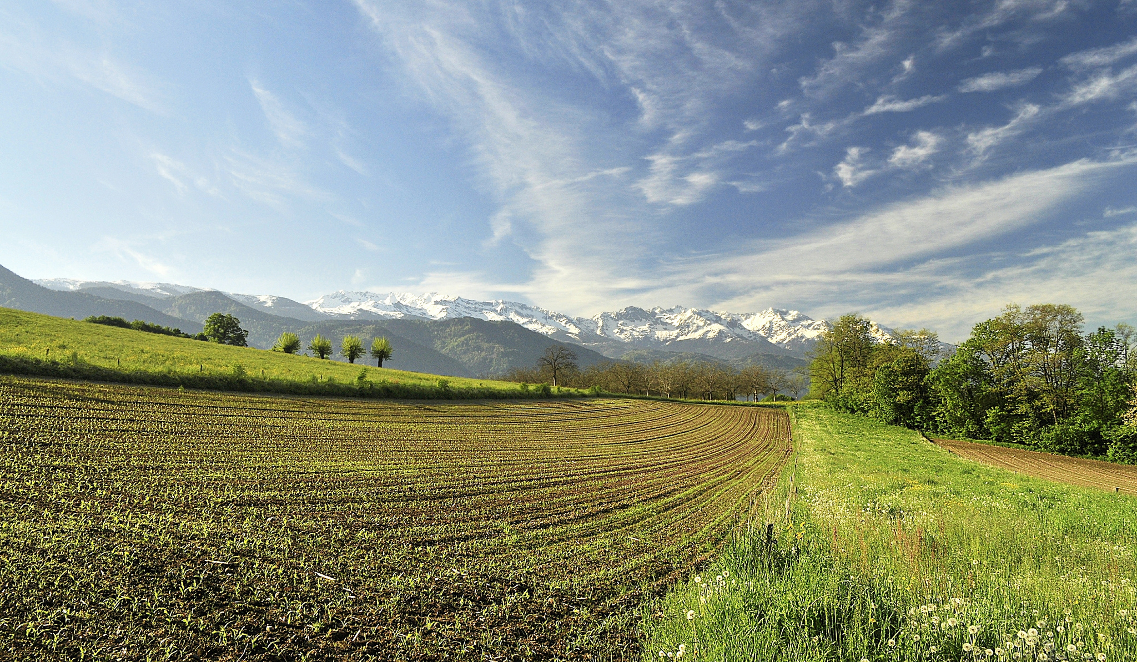
Bio-pesticides will enable the growth of safe and sustainable agriculture

Slide 14
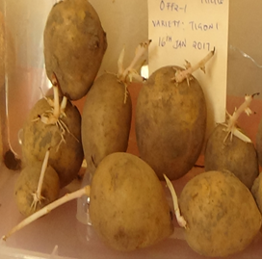
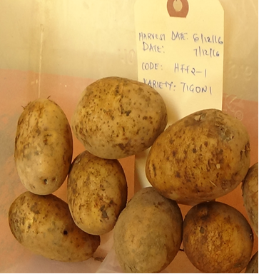
Results of BP on Local Potatoes
Variety
1
UNTREATED
TREATED

Slide 15
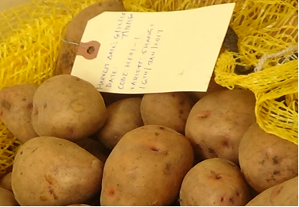
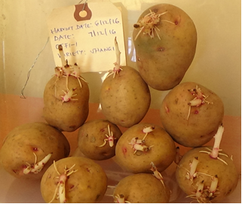
Results of BP on Local Potatoes
Variety
2
UNTREATED
TREATED
Notes:
Under local conditions

Slide 16
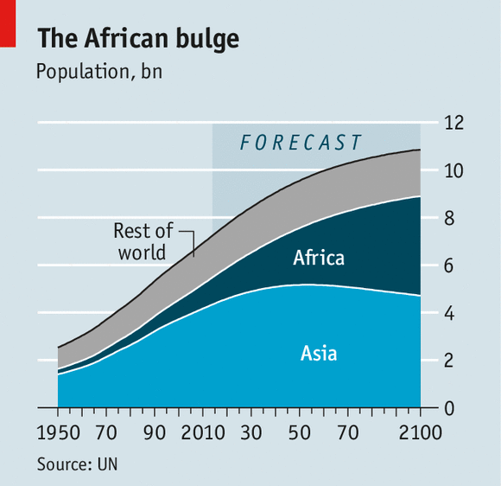
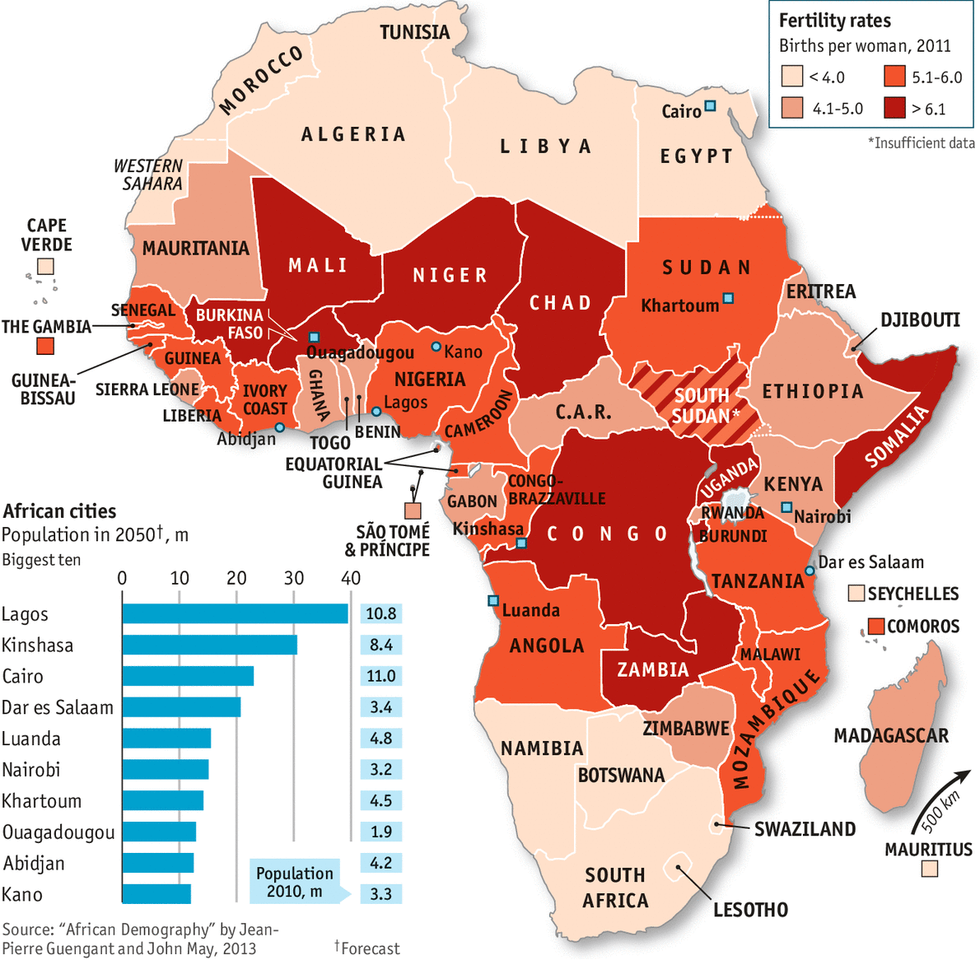
Future of Africa Requires Food Independence and Sustainable Agriculture
1.216 Billion in 2016

Slide 17
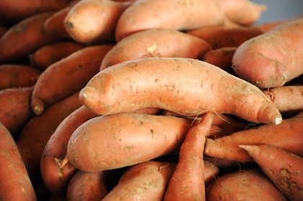
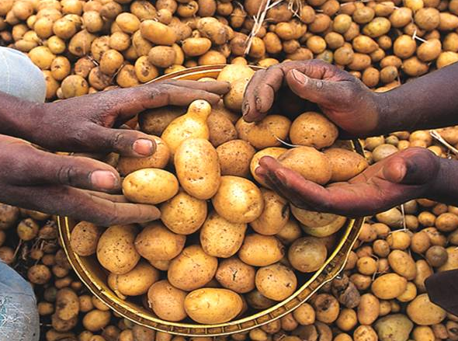
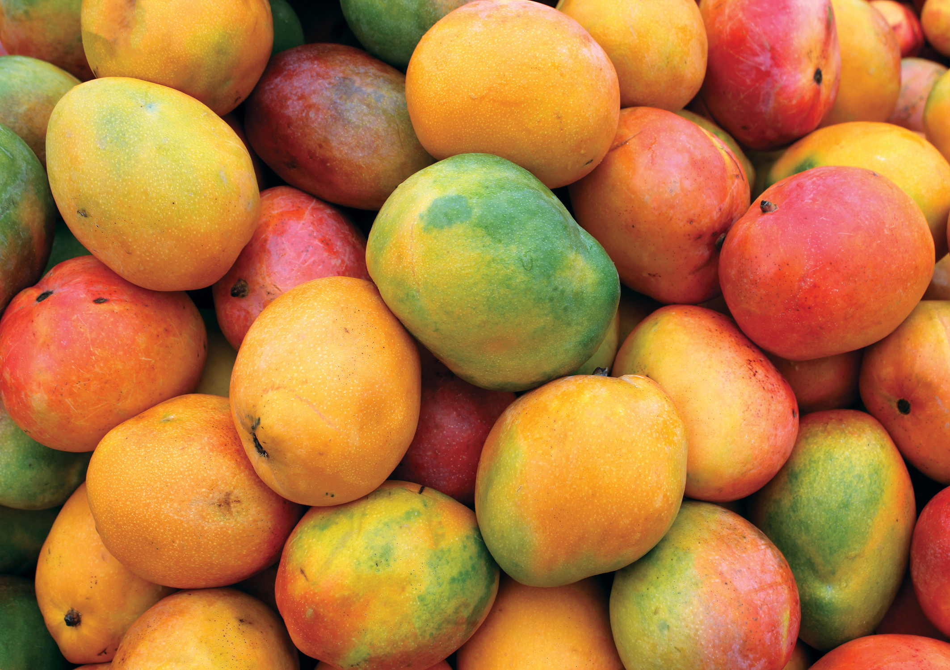
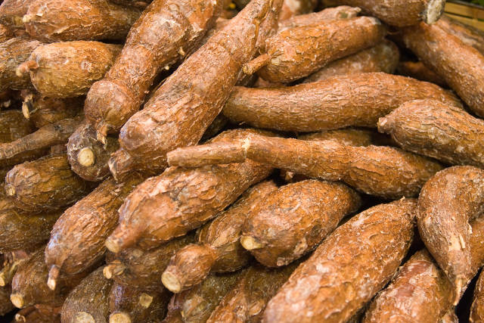
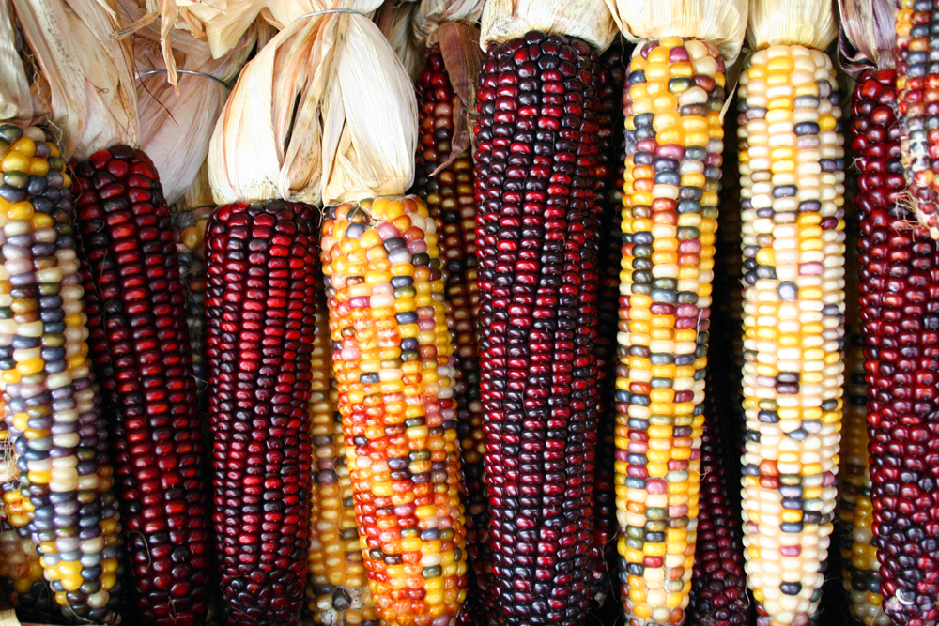
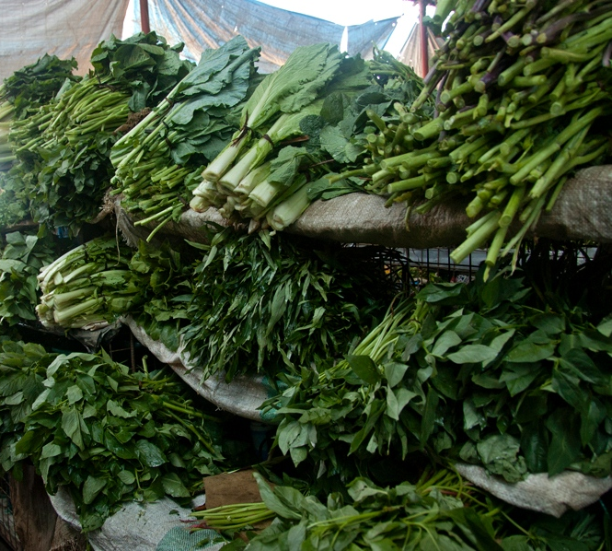
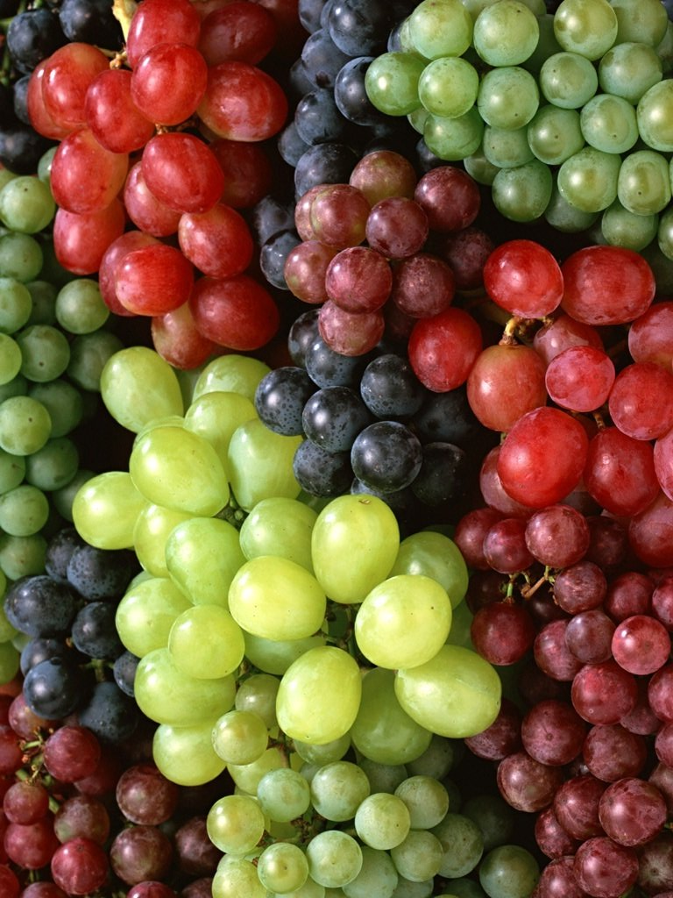
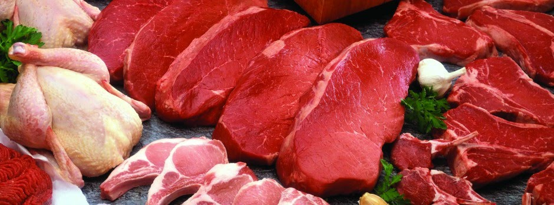
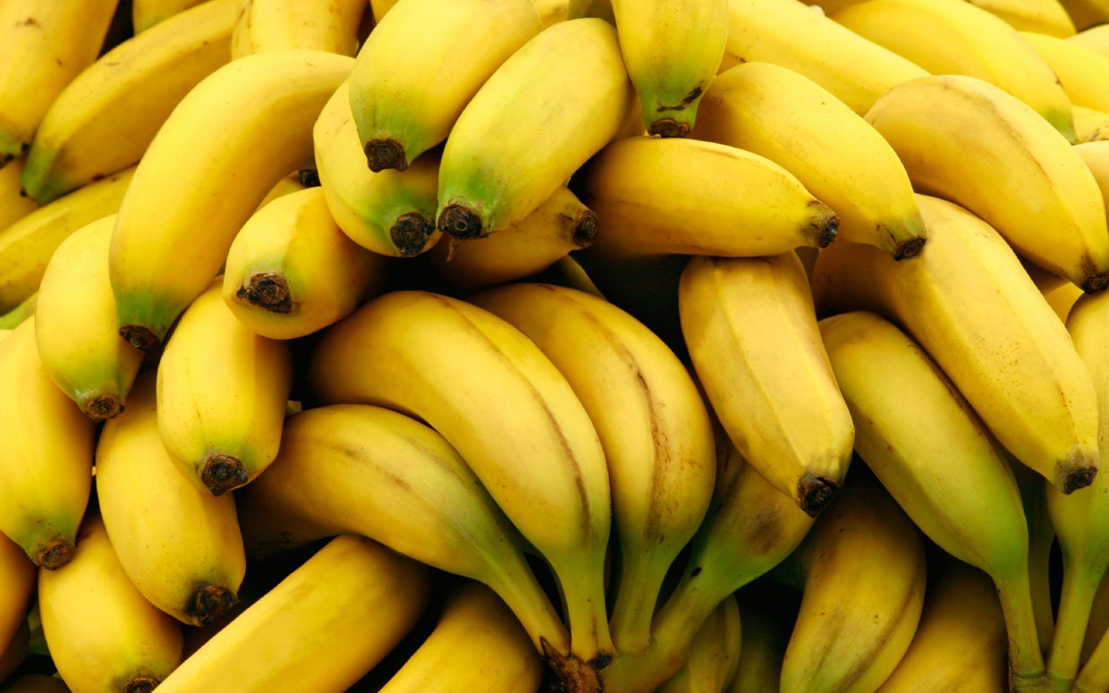

Slide 18
Biopesticides is what Africa needs as it develops its agriculture!
Bio pesticides for
Pre-planting
In the field
Post harvest
Enable safe and sustainable food supply!!

Slide 19


