Slide 1
International Markets:
Challenges of Globalization
Sarah Reiter
Stockton USA, Inc

Slide 2
International Markets: Challenges of Globalization
Item | Topic
1 | The challenges of selecting and managing a partnership
2 | The challenges of managing a technology for a partner

Slide 3
Challenges of Globalization: Selecting a Partner
Regulatory Schema
Communication and Culture
Grower needs
Competitor Set
Agronomic practice
Market insight
Food chain
No market intelligence resource exists that addresses all these factors sufficiently to give you 100% confidence in your partner selection. In the end, it = TRUST

Slide 4
Challenges of Globalization: Managing a Partnership
Tech Provider:
Maximize global sales
Service all my partners
Meet my business targets
TRUST
Partner:
Run my business
Grow my portfolio
Please my customers
Grow this product together
ALIGNMENT

Slide 5
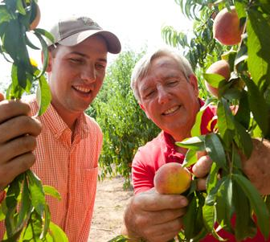
Challenges of Globalization: Managing a Partnership
People:
Communicate
Build trust
Share successes
Commiserate over failures
But, some cautions
People within organizations change over time
A word about global multinationals
Be sure your technology is not reliant on a single champion

Slide 6
International Markets: Challenges of Globalization
Item | Topic
1 | The challenges of selecting and managing a partnership
2 | The challenges of managing a technology for a partner

Slide 7
Challenges of Globalization: Managing Technology for a Partner
Every partner believes in the superiority of their technology
Keep their expectations grounded in local market reality

Slide 8
Challenges of Globalization: Managing Technology for a Partner
Take time to listen
Partners have deep understanding about the product and a view to its successes and failures outside your region
Actively learn
Reach out

Slide 9
Challenges of Globalization: Managing Technology for a Partner
Partners have expectations influenced by the promise of your market
Clearly communicate potential, but also downsides

