Slide 1
Biopesticides: Global health issues
Steve Krause, PhD
Director, Global Public Health
Valent BioSciences Corporation

Slide 2
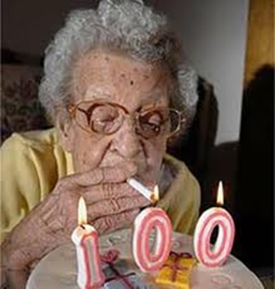
What is public health?
An organized program for population benefit
  “Art and Science of preventing disease and prolonging life” (1923)
  Improve life expectancy and quality
  PH is a B2G market; procurement processes
  vary widely among governments/donors
Key PH programs
  Vaccination
  Tobacco effects and awareness
  Food, water, motor vehicle safety
  Infectious disease management (biopesticides)
Public Health is the “Baseline to prosperity”
  Public Health Education Economic Growth
Notes:
Public Health may mean different things to different people, but essentially
Public Health programs designed to protect and improve the health of a community or population
Clinical Medicine focuses on interventions that improve the health of individuals
Public Health initiatives account for an estimated 85% of the increase in life expectancy experienced in the 20th Century
Key PH programs credited with improving human the quality and length of life….

Slide 3
What is a vector of infectious disease?
Arthropods, primarily mosquitoes (Culicidae) and black flies (Simuliidae)
  Adult female transmits/vectors pathogen to humans while blood feeding = illness, disease
  Immature feeding stage (larval) is aquatic
  Adapted to human culture and habitats (global)
  Evolved resistance to multiple classes of insecticides
Biopesticide Bacillus thuringiensis var israelensis (BTI) has proven success in reducing infectious disease, and no evidence of resistance after 30+ years of use

Slide 4
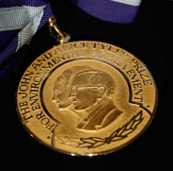
Tyler Prize for
Environmental Achievement
The premier award for environmental science, environmental health and energy conferring great benefit upon humanity.
  Tyler Laureates receive a $200,000 annual prize and are presented a commemorative medallion at ceremonies in Los Angeles.
2003 Laureate: Dr Yoel Margalith
  His discovery in 1976 of the new microbial subspecies known as Bacillus thuringiensis israelensis(Bti), which is lethal to most species of mosquito and black fly larvae, has had an enormous effect on human health and on environmental quality

Slide 5
Bti: from discovery in 1976, to worldwide registrations, , to proven control of Zika/Dengue vectors
Bti has had an enormous effect on human health and on environmental quality.
  Naturally occurring microbial agent
  Specific lethality to the larvae of most species of mosquitoes and black flies
  This natural enemy to the mosquito and black fly is often comparable in cost to chemical alternatives
  No insecticide resistance after 32 years of use
  Bti now used in over 40 countries worldwide against all mosquito vector species.
Bti strain AM65-52 completed the WHO Pesticide Evaluation Scheme in 2007
Improved formulations and delivery systems by ground and air provide for effective and economical control of container breeding mosquitoes to supplement integrated public health efforts.

Slide 6
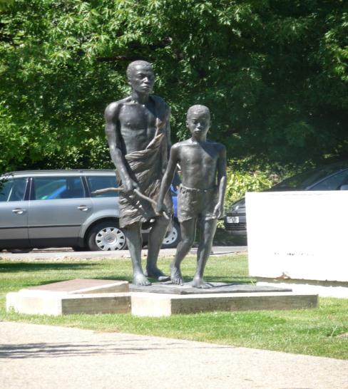

Black fly transmission of River blindness disease world health organization headquarters, Geneva
Notes:
1984…the registration of VectoBac in the US. Little did we know that this product would become the cornerstone of one of the most successful public health programs in the world. This statue plaque says:
This distressing scene of a child leading an adult blinded by river blindness – a curse on poor communities “at the end of the road” – was common in large areas especially in Africa.
The Onchocerciasis Control Programme in West Africa, the African Programme for Onchocerciasis Control and the Onchocerciasis Elimination Program for the Americas have through an outstanding partnership, rid humanity of this debilitating disease there by alleviating poverty.
This statue stands as a testimony to the accomplishment of a unique public health endeavour promoting at the same time socioeconomic development.
The statue was unveiled by Dr. Gro Harlem Brundiland, Director General of the World Health Organization, on 6 October 1999 on the occasion of the 25th anniversary of the Onchocerciasis Control Programme in West Africa.
This statue was given to WHO and erected on the premises of its headquarters by the generous contributions of the Carter Center, Interchurch Medical Assistance Inc., Interconex Inc. (International Moving and Shipping), the International Eye Foundation, the Organisation pour la Prevention de la Cecile, Merck & Co. Inc., the Mectizan Donation Program, Rebecca & John Moores, Sight Savers International and the World Bank.
The only Bti product reviewed, with safety & toxicity evaluated by WHO
The impelementation of VectoBac into this WHO program spearheaded by the then unknown Abbott finnacial analyst, outgoing, brash young gentlemen from West Africa to secure a 3 year contract…the largest of its kind in the 1980s. The implementation of VectoBac marked the beginning of a long road to create a larvicidng market for biorationals for public health pest control.

Slide 7
Evidence that Bti AM65-52 (VectoBac) biorational larvicides reduce the risk of human dengue disease
 | Primary Habitat | Application Method | Result
Malaysia¹ | Urban, natural/man-made containers | Ground, backpack spray | Dengue cases reduced 93%
Cambodia² | Villages with in-use water jars (500 villages, 1.5 M water jars treated) | Ground, direct | Dengue cases reduced 43%
Florida Keys³ | Urban, all containers, landscape coverage | Aerial helicopter | No local transmission since 2010
¹ Tan AWA, Loke SR, Benjamin S, Lee HL, Chooi KH, Sofian-Azirun M. (2012) Spray application of Bacillus thuringiensis israelensis (Bti strain AM65-52) against Aedes aegypti (L.) and Ae albopictus Skuse populations and impact on dengue transmission in a dengue endemic residential site in Malaysia. SE Asian Journal of Trop Med and Public Health 43: 296-310
² To Setha, Chantha N, Benjamin S, Socheat D. Bacterial Larvicide, Bacillus thuringiensis israelensis strain AM 65-52 Water Dispersible Granule Formulation Impacts Both Dengue Vector, Aedes aegypti (L.) Population Density and Disease Transmission in Cambodia. (in press)
³ Pruszynski CA, Leal AL, Hribar LJ, Mickle R, Doyle M. (submitted) A novel large scale biorational approach for managing Aedes aegypti populations to prevent Dengue, Chikungunya and Zika transmissions

Slide 8
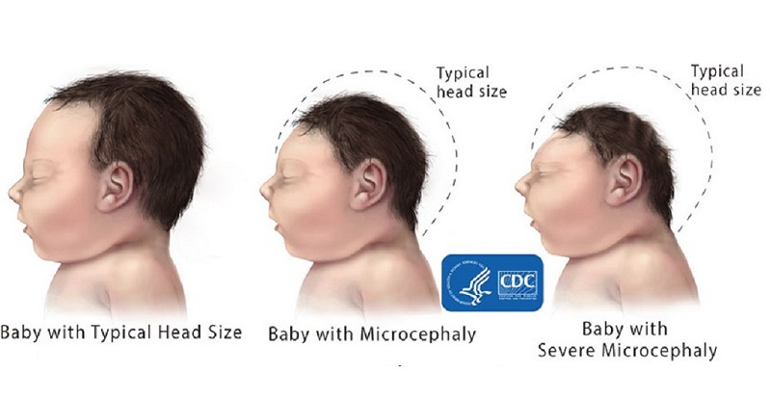
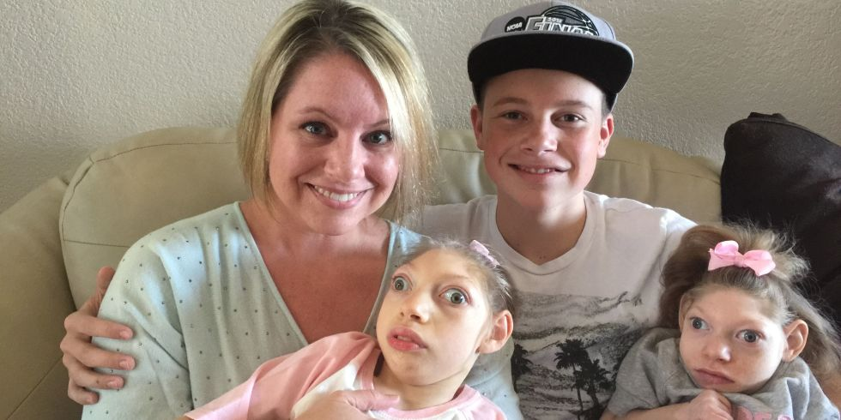
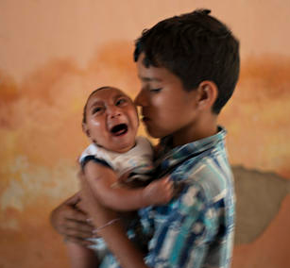
New Challenge: Zika virus and microcephaly
Elielson, 10, holds his 2-month-old brother Jose Wesley, who was born with microcephaly, at their house in Poco Fundo, Pernambuco state, Brazil, Dec. 23, 2015 (CBSNews.com)

Slide 9
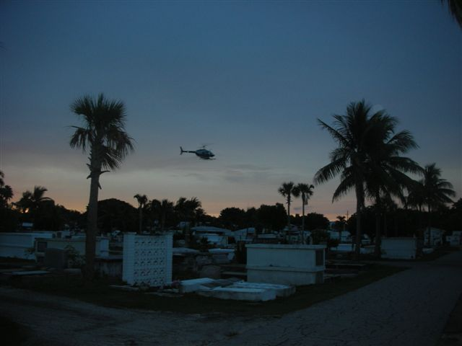
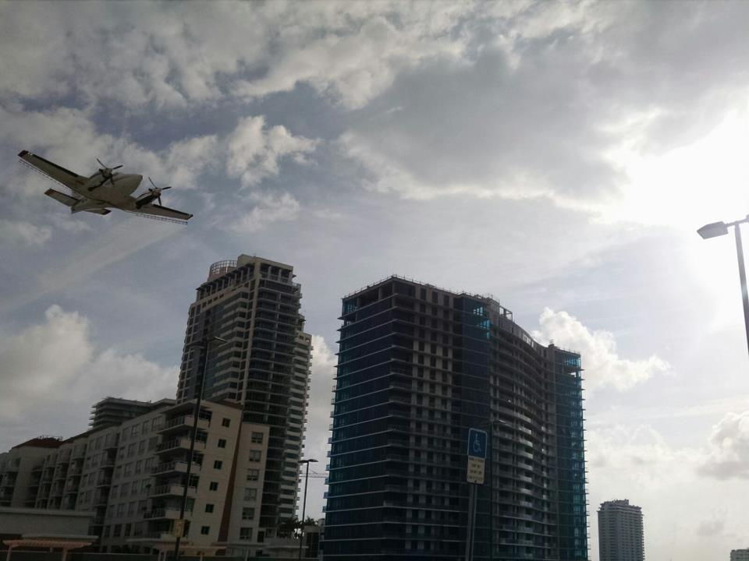
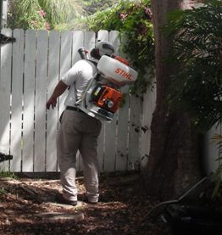
BTI is applied using 4 application platforms to
control ZIKA/DENGUE vectors in Florida

Slide 10
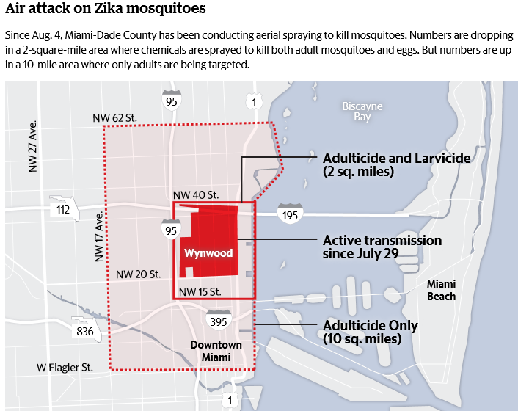
PPP and Zika control today
(Miami-Herald newspaper, 15Aug2016)
FL Governor declares Wynwood “zika-free zone”
Miami-Herald newspaper, 19 Sept 2016

Slide 11
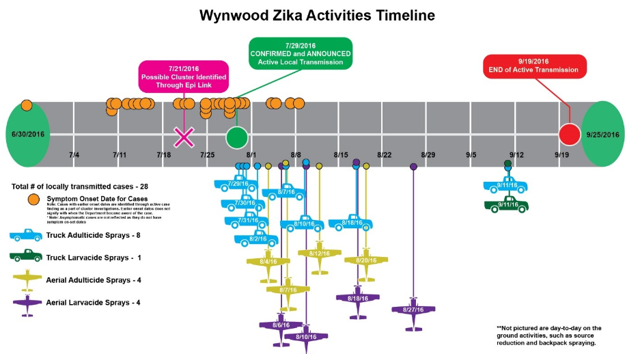
How BTI (VectoBac) helped stop Zika transmission
in Florida 2016

Slide 12
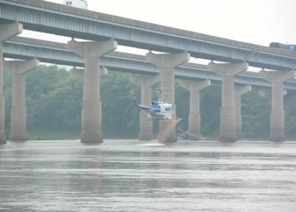
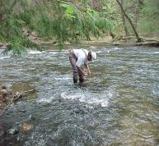
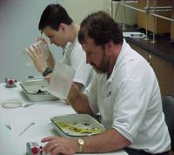
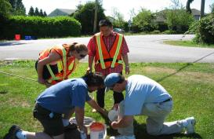
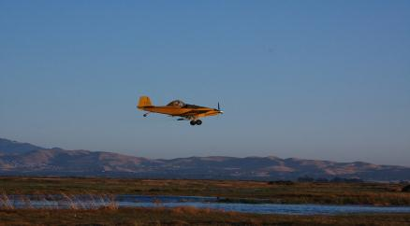
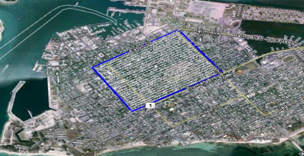
operational use of bti
Black fly river treatments
Wildlife refuge
Aerial Spray Block – Key West

