Slide 1
How to Build Credibility for the Biostimulants Industry
Sustainability Symposium
Wednesday, October 11th, 2017
1:30 to 2:30 PM

Slide 2

The Emerging Landscape of Products
– Broad and (Potentially) Confusing
Acids
Extracts
Other
Microbials
Humic substances
Humins
B Vitamins
Inorganic salts
Fulvic acids
Other organic acids
Mycorrhizae, Trichoderma, other beneficial fungi
Proteins
Amino acids Fatty acids / lipids
Protein hydrolysates
PGPR’s
Beneficial elements (Si, Na, Co, etc.)
Phosphites
Peptides
Cytokinins
Polyamines
Seaweed / Kelp
Carboxyls
Rhizobium
Nitrogenous compounds
Complex communities / consortia
Betaines
Phytohormones
Enzymatic extracts
Chitin / chitosan
Laminarin, alginates, other polysaccharides
Polyphenols
Other organic matter extracts
Allelochemicals
Botanicals
Source: Agricen Sciences’ analysis of
market analysts, survey papers on Biostimulants

Slide 3
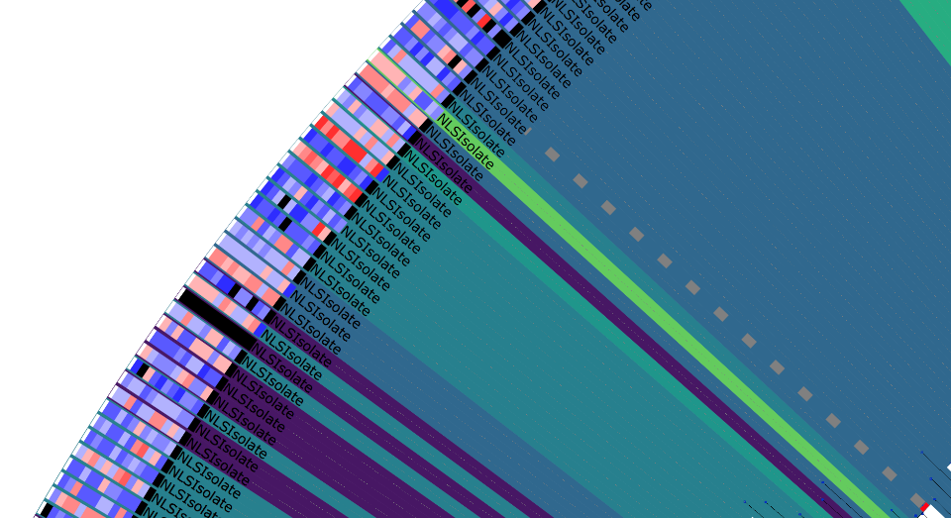
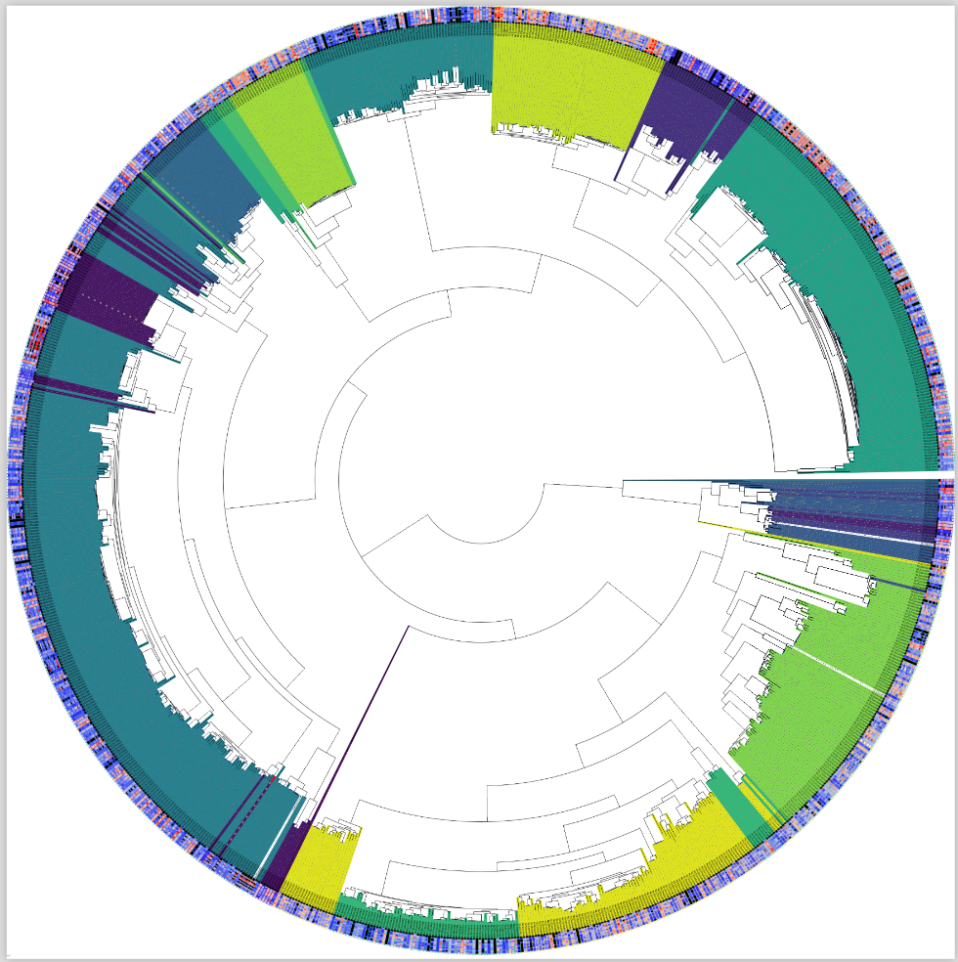
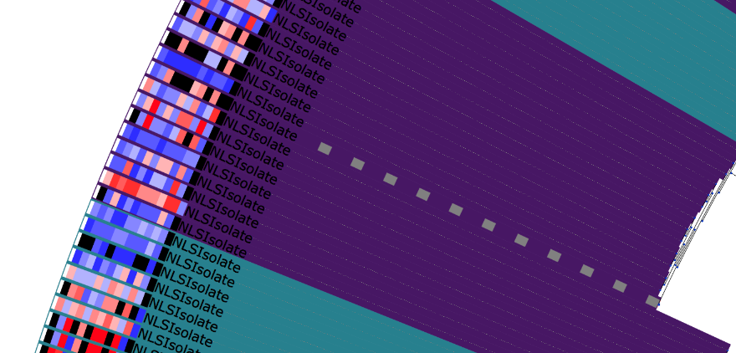
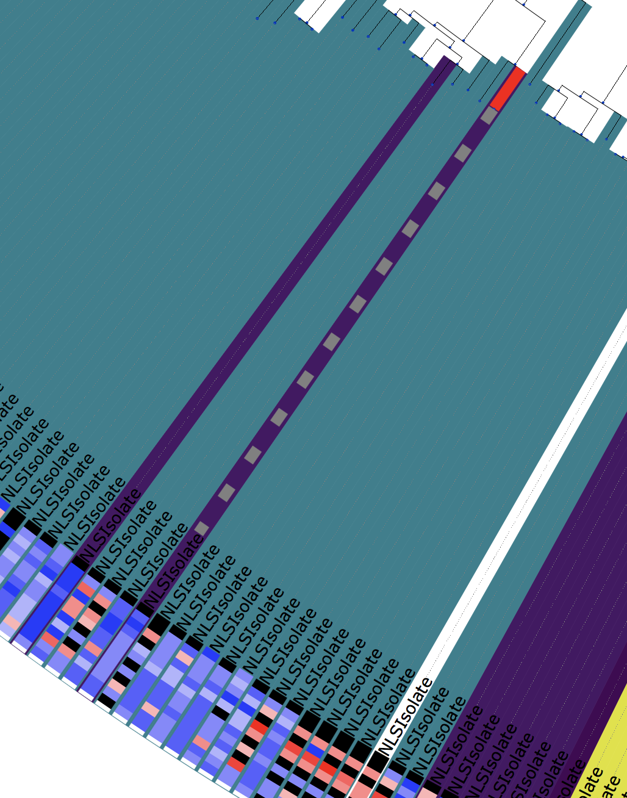
NewLeaf Strain Collection
Soy Lead;
across three year yield advantage
Methylotrophic strains from leaves and roots of wild crops
All genomes sequenced, assembled, annotated and visualized in PBKTM
Phylogeny based on 37 conserved singly copy genes shown
Lead strains demonstrate x year efficacy on yield enhancement, insect and disease control
Pest Lead;
across three year insect control
Disease Lead;
across three year disease control
Notes:
Phylogeny:
Genomic regions homologous to 37 conserved single copy genes’ amino acid sequences were identified by six-frame translation alignment in whole genome sequences. Genomic regions identified were extracted and candidate sequences were added to a multiple sequence alignment of the reference gene family. For each genome, alignments were then concatenated and used to build a phylogenetic tree using maximum likelihood analysis.
Clustering:
Genomes were clustered based on a depth first search of their phylogeny according to the median pairwise patristic distance (MPPD). A node is classified as a cluster if the MPPD between nodes of its subtree is below a threshold, where the threshold is chosen to partition the tree into the desired number of clusters.

Slide 4



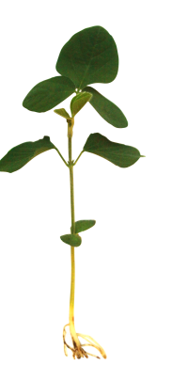
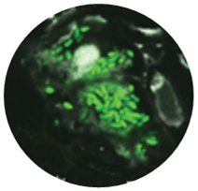


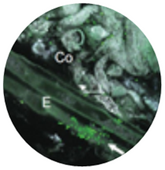

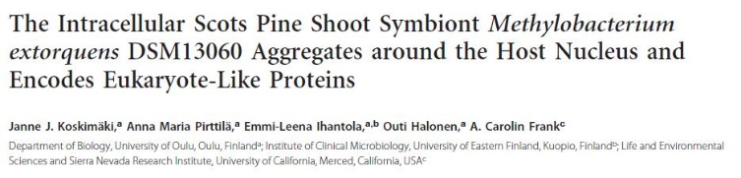
2016 Grey Leaf Spot Control in Corn
Why M-trophs?
220
215
210
205
200
195
190
25
20
15
10
5
0
Bushels/acre
GLS Severity
UTC
M-trophs
B/T
M-trophs
D/R
Preventative seed treatment mitigates late-season GLS infection in corn: +15 bu/acre
Putative MOA: plant vigor, priming, adaptive immunity, anti-fungal
Reduction in grower scouting and need for curative fungicide spray

Slide 5
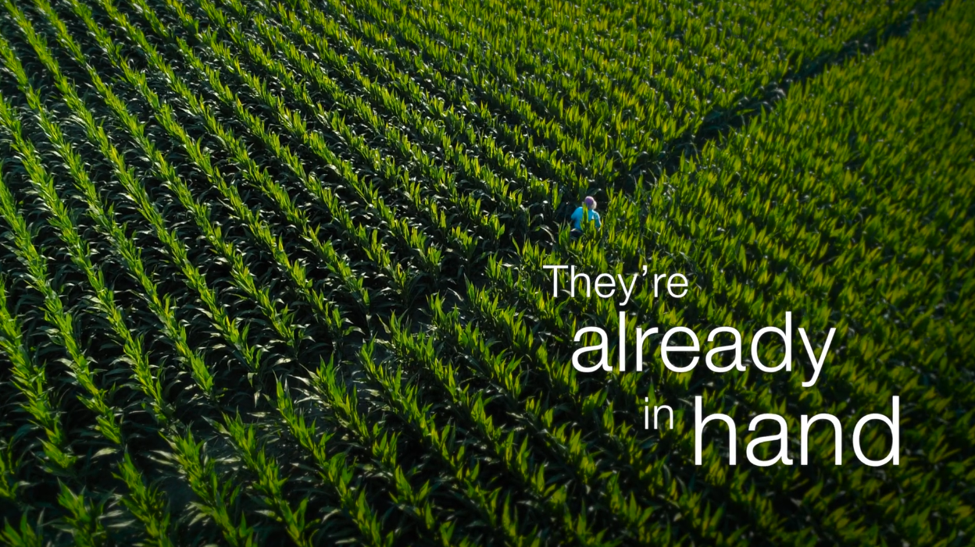
Biologicals in the Future of Agriculture
New traits and crop protection chemistries take $150 - 250 M and 10 - 12 years to the market
Biologicals have accelerated path-to-market
Mainstream agriculture recognize Biologicals (biopesticides and biostimulants) as major innovative technology

Slide 6

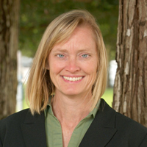
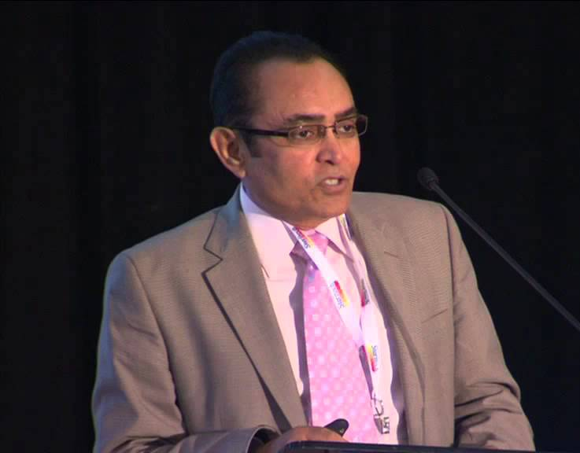
Panel Agenda
Kristen Sukalac is Senior Consultant to the European Biostimulant Industry Council (EBIC). She will lead with an overview of the work EBIC is doing to build credibility for biostimulant products and the sector through good practices, guidelines, standards, and an appropriate regulatory framework
Jennifer Greminger is the Global Regulatory Seed Applied Solutions Lead, at Monsanto company. Jennifer is representing the American Seed Trade Association and is the current Chair on ASTA’s Seed Treatment and Environment Committee. STEC recently established working groups focused on the emerging field of biological seed applied products and is building partnership with BPIA, industry and regulatory agencies within this space
Denise Manker PhD manages Technical Product Support for Bayer Crop Sciences, in Biologicals R&D. Denise will cover the way Bayer is approaching biostimulants and the scientific rigor necessary to develop efficacious products
Dr. Roger Tripathi of Global BioAg Linkages will wrap up with the important ways BPIA, EBIC, and other global agencies are promoting science-based initiatives to insure that biostimulants deliver efficacy, consistency and safety in the production of food, fibre, fuel and other products
Panel Round Table and Audience Questions

Slide 7

European Biostimulants Industry Council (EBIC)
Working towards clarity, transparency and predictability
Kristen Sukalac
Senior Consultant to EBIC
11 October 2017
BPIA 2017 Fall Meeting & Sustainability Symposium

Slide 8
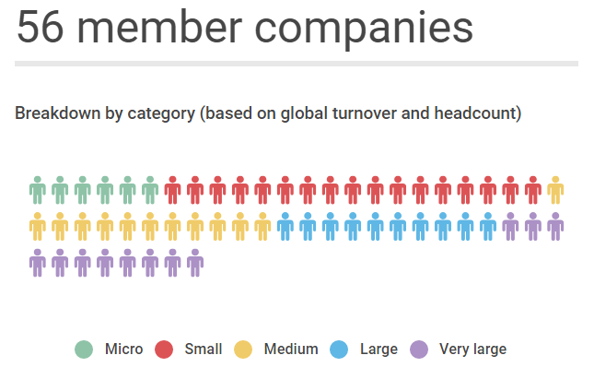

Slide 9
3 areas of activity
Promoting biostimulants within holistic crop production
Structuring the market
Securing proportionate regulation
An additional tool to grow more with less
Bringing order through self-regulation and best practices
Improving predictability through a fit-for-purpose policy

Slide 10
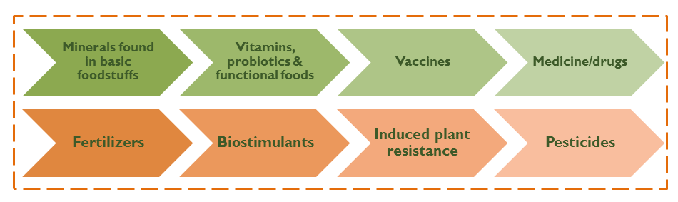
Rethinking the relationship between plant health and nutrition

Slide 11
Promoting a functional use definition…
Plant biostimulants contain substance(s) and/or micro-organisms whose function when applied to plants or the rhizosphere is to stimulate natural processes to enhance/benefit nutrient uptake, nutrient efficiency, tolerance to abiotic stress, and crop quality.
…based on the effect

Slide 12
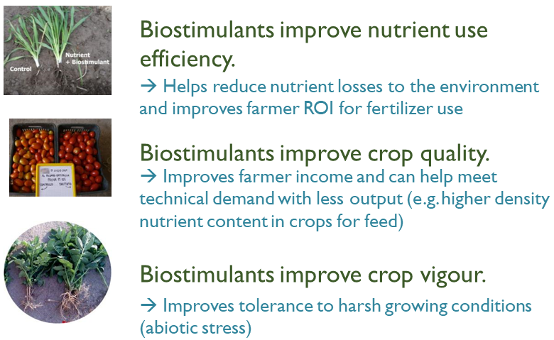

Slide 13
Structuring the market
  Defining and clarifying market terminology
  EBIC Code of Conduct:
    All claims must be support by robust science
    Strict boundary with plant protection
    Commitment to continuous improvement through implementation plans
    Emphasis on member education
    Enforcement process
  Coordination with the national trade associations
  Promoting best practices for making and justifying claims
  Supporting the underpinning science through congress sponsorship, etc.
  Exchange of experiences, member education, guidelines, etc.

Slide 14
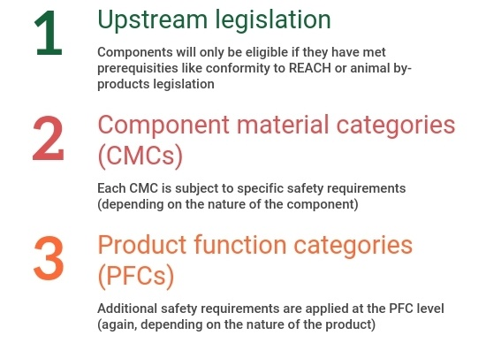
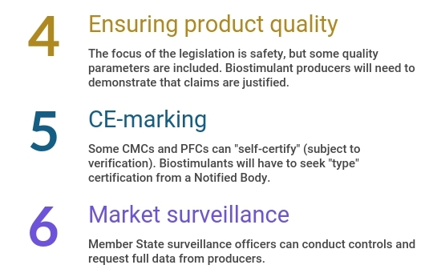
Securing proportionate regulation

Slide 15

Information & education
Rules of the game
Leading by example

Slide 16

For more information
kristen@prospero.ag
www.biostimulants.eu
Kristen Sukalac
Senior Consultant to EBIC
11 October 2017
BPIA 2017 Fall Meeting & Sustainability Symposium

Slide 17
One Question ?

Slide 18
Panel Agenda
Kristen Sukalac is Senior Consultant to the European Biostimulant Industry Council (EBIC). She will lead with an overview of the work EBIC is doing to build credibility for biostimulant products and the sector through good practices, guidelines, standards, and an appropriate regulatory framework
Jennifer Greminger is the Global Regulatory Seed Applied Solutions Lead, at Monsanto company. Jennifer is representing the American Seed Trade Association and is the current Chair on ASTA’s Seed Treatment and Environment Committee. STEC recently established working groups focused on the emerging field of biological seed applied products and is building partnership with BPIA, industry and regulatory agencies within this space
Denise Manker PhD manages Technical Product Support for Bayer Crop Sciences, in Biologicals R&D. Denise will cover the way Bayer is approaching biostimulants and the scientific rigor necessary to develop efficacious products
Dr. Roger Tripathi of Global BioAg Linkages will wrap up with the important ways BPIA, EBIC, and other global agencies are promoting science-based initiatives to insure that biostimulants deliver efficacy, consistency and safety in the production of food, fibre, fuel and other products
Panel Round Table and Audience Questions

Slide 19
Asta efforts to address complexities of BIOSTIMULANTS delivered ON SEED
Jennifer Greminger
Chair, Seed Treatment and Environmental Committee
October 11, 2017

Slide 20

Our History
The American Seed Trade Association (ASTA) is one of the oldest trade organizations in the United States
Over 700 members involved in seed production and distribution, plant breeding, and related industries worldwide
ASTA is a plant germplasm authority and advocates for science-based policy
Members drive the agenda and identify issues relevant to the seed industry

Slide 21
ASTA Seed Treatment and Environmental Committee
Addresses issues relating to the regulation and labeling of seed treated with pesticides, as well as how treatments relate to the environment, health, safety, and well-being of employees and consumers.

Slide 22
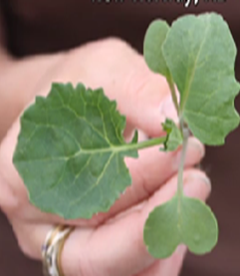

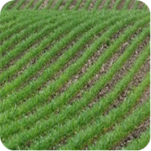
Product and Regulatory Landscape
BioPesticides
BioStimulants
BioFertilizers
Pesticides and Plant Growth Regulators (PGRs)
Materials that improve vigor, yield, stress tolerance, etc.
Living microorganisms that increase nutrient availability
FIFRA
EPA
State Fertilizer Laws
American Association of Plant Food Control Officials (AAPFCO)
Product claims and marketing intent are critical
Notes:
Biostimulants are a diverse group of materials that are used to improve crop vigor, quality, and yield, as well as tolerance to abiotic stresses (drought, salinity, heat, etc.). Biostimulants can work in many different ways, including: 1) facilitating nutrient uptake, 2) enhancing the development of soil microorganisms, and 3) stimulating root growth to increase water use efficiency.
Biofertilizers contain living microorganisms that, when applied to the seed, plant or soil, and inhabit the area around the roots or live in the roots. These microorganisms promote plant growth by increasing the supply or availability of nutrients, by stimulating root growth or by aiding other beneficial symbiotic relationships.
Plant Growth Promoting Rhizobacteria (PGPRs) are bacteria that colonize plant roots and form a symbiotic relationship with the plant. PGPRs can enhance plant growth by direct and indirect ways. Direct plant growth promotion can be by a variety of means, including: 1) fixation of atmospheric nitrogen so it can be used by the plant, 2) solubilization of minerals, and 3) the synthesis of phytohormones. Indirect plant enhancement is characterized by the ability of the PGPR to minimize the damaging effects of plant pathogens on plant growth. As new types of products become more widely used, growers should educate themselves and be aware of their advantages and challenges, and how they can be used effectively in various crop production systems

Slide 23
Seed Industry Challenges with Seed Applied Biologicals
Operational Challenges
  Application techniques
  Compatibility with seed treatments
  Seed storage conditions (seed companies, dealers/retailers, growers)
  Duration of on-seed viability
Regulatory Freedom to Operate for non-FIFRA Products
  State by state registration can be unclear and unpredictable
  Unclear/inconsistent seed labeling requirements
  Lack of clarity around state testing goals/capabilities

Slide 24
ASTA Priorities
Support
Partnership
Endorsement of BPIA efforts
Better engagement between the two organizations

Slide 25
ASTA Priorities – Working Group 1
  Education and Outreach
    Align on terminology and definitions and educate on those throughout the industry and regulatory community.
    Provide educational information on types of biologicals, applications, the role of treated seed and where biologicals fit within potential regulatory frameworks.

Slide 26
ASTA Priorities – Working Group 2
  Seed Labeling
    Facilitate inter-state movement of coated seed
    Consistent and predictable regulation of requirements
    Engagement with registrants to update product labels, if needed

Slide 27
ASTA Priorities – Working Group 3
  Approaches for Consumer Assurance
    Ensure truth in labeling
    Determine testing standards, both internal to seed companies and for oversight purposes
  Import/Export of Coated Seed
    Second Tier – will address once the items above are more mature

Slide 28
One Question

Slide 29
Panel Agenda
Kristen Sukalac is Senior Consultant to the European Biostimulant Industry Council (EBIC). She will lead with an overview of the work EBIC is doing to build credibility for biostimulant products and the sector through good practices, guidelines, standards, and an appropriate regulatory framework
Jennifer Greminger is the Global Regulatory Seed Applied Solutions Lead, at Monsanto company. Jennifer is representing the American Seed Trade Association and is the current Chair on ASTA’s Seed Treatment and Environment Committee. STEC recently established working groups focused on the emerging field of biological seed applied products and is building partnership with BPIA, industry and regulatory agencies within this space
Denise Manker PhD manages Technical Product Support for Bayer Crop Sciences, in Biologicals R&D. Denise will cover the way Bayer is approaching biostimulants and the scientific rigor necessary to develop efficacious products
Dr. Roger Tripathi of Global BioAg Linkages will wrap up with the important ways BPIA, EBIC, and other global agencies are promoting science-based initiatives to insure that biostimulants deliver efficacy, consistency and safety in the production of food, fibre, fuel and other products
Panel Round Table and Audience Questions

Slide 30

BPIA Sustainability Symposium
Bayer‘s Approach to Biostimulant Development
October 10, 2017 / Denise Manker

Slide 31





Innovation in Crop Protection is vital to safeguard harvests and secure food supply
Major crops analyzed:
rice, wheat, barley, corn,
potatoes, soybeans,
cotton and coffee
Actual
losses
100%
Due to
pests,
weeds, diseases and abiotic stresses
Today
58%
42%
Prevented
losses
By pests, weeds and diseases
30%
28%
Yield without
crop protection
Actual yield with
crop protection
Theoretically
attainable yield
Without crop protection, nearly half of the current harvest would be lost
Through innovations and adequate use of crop protection solutions,
total yield could be almost doubled
Source: Oerke et al., Crop Production and Crop Protection, Elsevier, Amsterdam, 1994

Slide 32


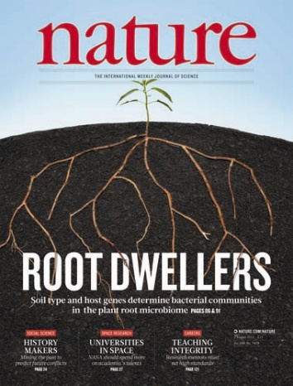
Bayer sees Biological Inputs as an Important
Contributor for Crop Production
  “Third leg” of agricultural science
    Opportunity for a new wave of agricultural inputs that are also sustainable products
  Technology platform to rationally develop a consistent pipeline of biological products for defined product concepts working in concert with traditional approaches
Chemicalinputs
Agronomic conditions
Plant genetics
Microbial inputs

Slide 33
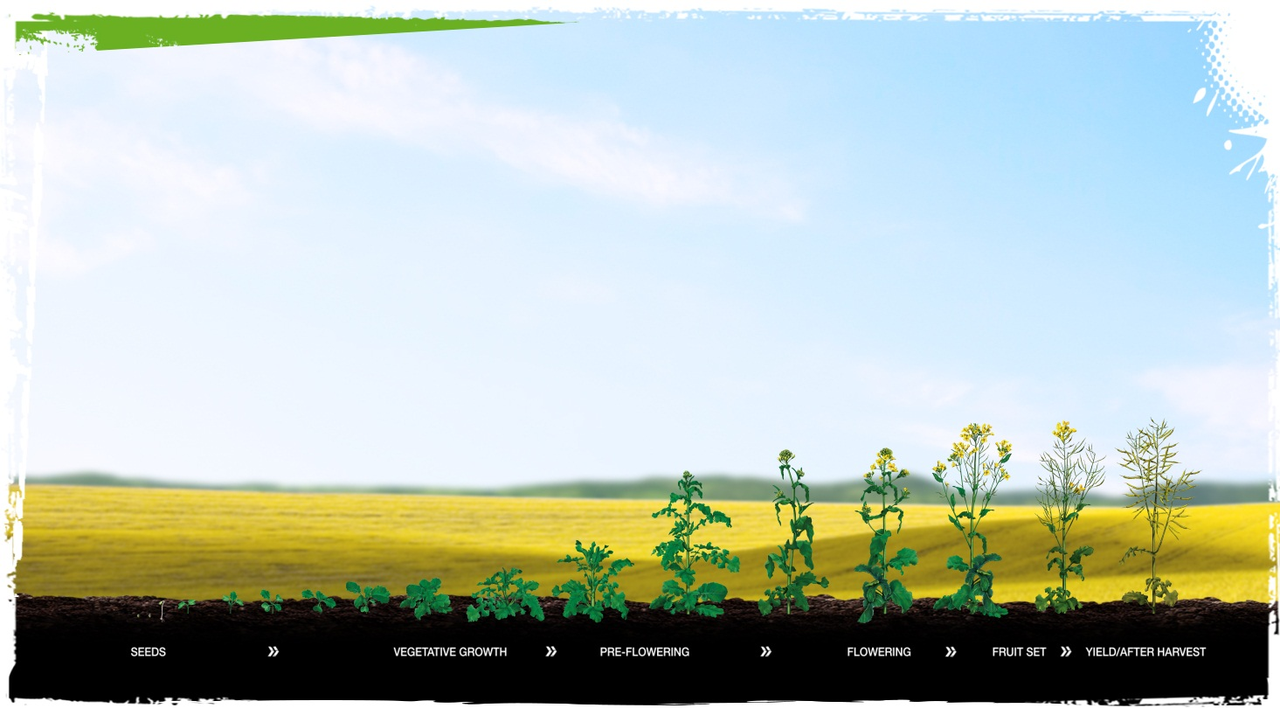



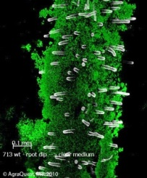
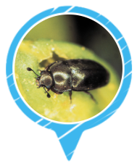
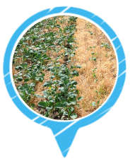
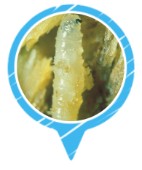
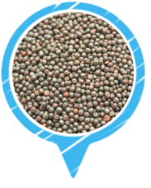
Bayer sees Biological Inputs as an Important
Contributor for Crop Production
Goal: Healthy, high yielding
and high-quality plants
Environment
Phytobiome effects
Services and consultancy
Disease Management
Pest Management
Weed Management
Seed Treatment
Seeds & Traits
Soil characteristics and microbial flora

Slide 34

BPIA, founded in 2000 as BioPesticide Industry Alliance
To build credibility of Biopesticides… did it work?

Slide 35
Mission and Purpose from 2015
The mission of the Association is to drive the acceptance and commercialization of biopesticides.
BPIA’s purpose is to
1. Promote industry standards for biopesticides among member companies,
2. Communicate the value of biopesticides in the markets we serve,
3. Collaborate with regulatory authorities to ensure timely, predictable, transparent, and appropriate registration and regulatory requirements, and
4. Be the leading source of information to key influencers who impact acceptance, commercialization, and adoption of biopesticides.

Slide 36
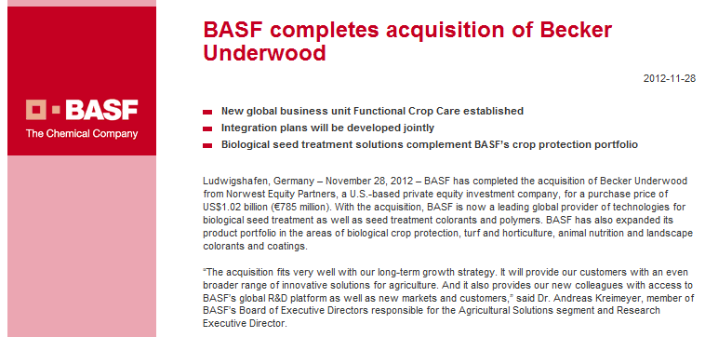
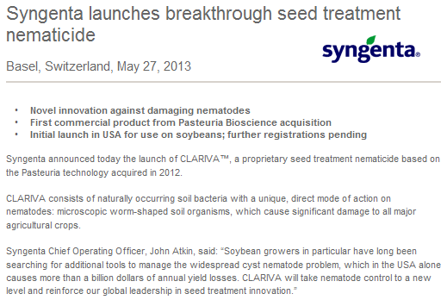
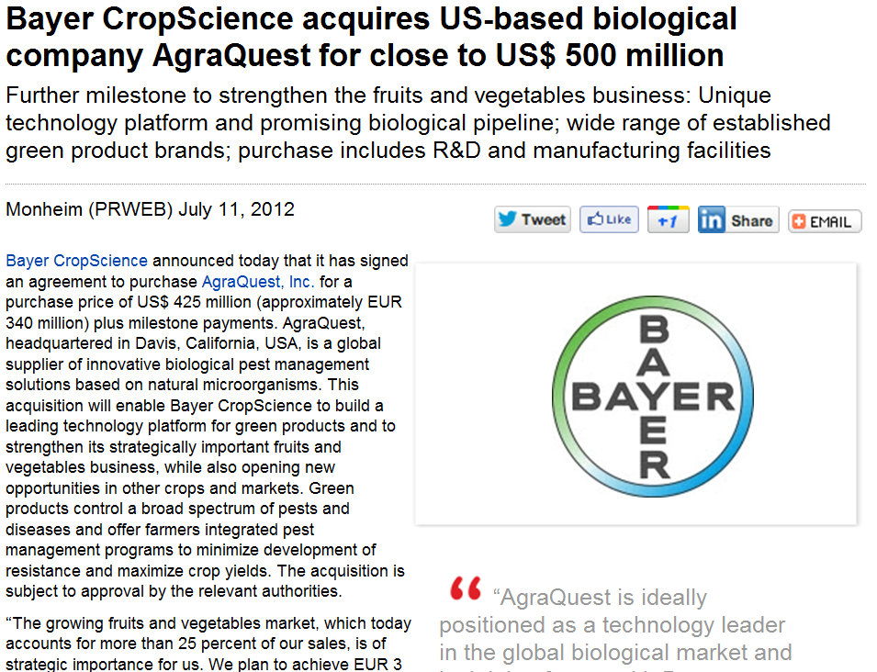


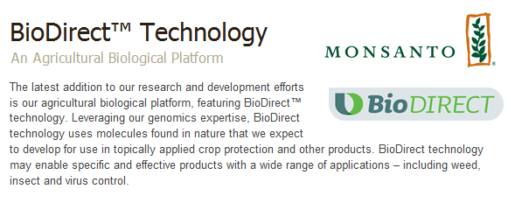
Investments made by every major AgChem company… validated product sector

Slide 37
Today, this could read…
The mission of the Association is to drive the acceptance and commercialization of biopesticides and biostimulants.
BPIA’s purpose is to
1. Promote industry standards for biopesticides and biostimulants among member companies
2. Communicate the value of biopesticides and biostimulants in the markets we serve
3. Collaborate with regulatory authorities to ensure timely, predictable, transparent, and appropriate registration and regulatory requirements, and
4. Be the leading source of information to key influencers who impact acceptance,
commercialization, and adoption of biopesticides and biostimulants.

Slide 38

Why is this important to Bayer?
We want to:
Be able to make credible claims and assure safety in a process that does not inhibit innovation
Improve crop production by having microbial biopesticides and microbial biostimulants as crucial components in conventional agricultural production practices

Slide 39
How does Bayer approach biostimulant development?
Extensive research to understand mode of action of crop response to microbial stimulant products to assure reproducible effect
Internal safety assessment for product stewardship

Slide 40
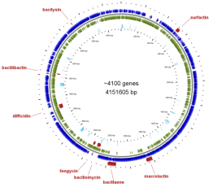
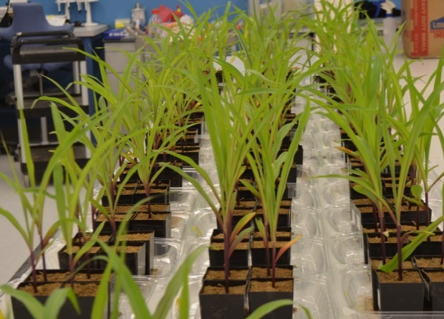
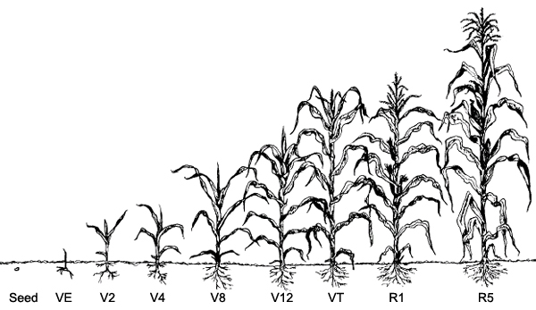
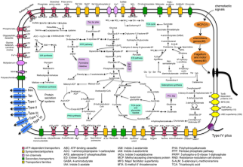
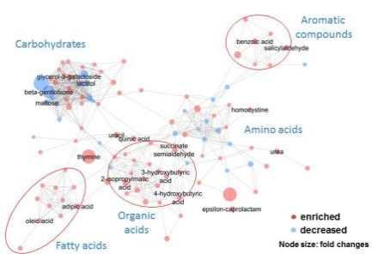
Field Testing to Prediction modeling:
Building a Robust Crop Efficiency Platform
Plant physiology
Plant microbe interactions
Microbial physiology
C₂H₂ +2H⁺ +2 e⁻
Nitrogenase
C₂H₄
Acetylene
Ethylene

Slide 41





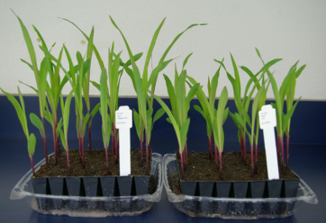


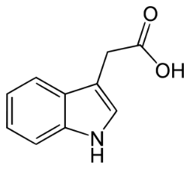


Plant Hormone/Signaling Molecules:
Loosens plant cell walls to facilitate increased root exudate providing additional nutrients in the soil
Affects plant cell division, extension, differentiation
Literature
In-house
Bernard Glick Plant Growth-Promoting Bacteria: Mechanisms and Applications, Scientifica Volume 2012, Article ID 963401
Spaepen, S., Vanderleyden, J. Auxin and Plant-Microbe Interactions. Cold Spring Harb. Perspect. Biol. 2011, 3:a001438.
Many more!
Exudate
Cells
A
B
PGP - Corn
A – Plant hormone seed treatment
B – Untreated control
Plant hormones
Initiates lateral and adventitious root formation. Increases root surface area and length
Stimulates seed and tuber germination.
Increases the rate of xylem and root genesis
Roots
Seeds
Extensive list of publications indicate hormones are a good target
Promising initial results for this target

Slide 42
Forward-Looking Statements
This website/release/presentation may contain forward-looking statements based on current assumptions and forecasts made by Bayer management.
Various known and unknown risks, uncertainties and other factors could lead to material differences between the actual future results, financial situation, development or performance of the company and the estimates given here. These factors include those discussed in Bayer’s public reports which are available on the Bayer website at http://www.bayer.com/.
The company assumes no liability whatsoever to update these forward-looking statements or to conform them to future events or developments.

Slide 43

Thank you!

Slide 44
One Question?

Slide 45
Panel Agenda
Kristen Sukalac is Senior Consultant to the European Biostimulant Industry Council (EBIC). She will lead with an overview of the work EBIC is doing to build credibility for biostimulant products and the sector through good practices, guidelines, standards, and an appropriate regulatory framework
Jennifer Greminger is the Global Regulatory Seed Applied Solutions Lead, at Monsanto company. Jennifer is representing the American Seed Trade Association and is the current Chair on ASTA’s Seed Treatment and Environment Committee. STEC recently established working groups focused on the emerging field of biological seed applied products and is building partnership with BPIA, industry and regulatory agencies within this space
Denise Manker PhD manages Technical Product Support for Bayer Crop Sciences, in Biologicals R&D. Denise will cover the way Bayer is approaching biostimulants and the scientific rigor necessary to develop efficacious products
Dr. Roger Tripathi of Global BioAg Linkages will wrap up with the important ways BPIA, EBIC, and other global agencies are promoting science-based initiatives to insure that biostimulants deliver efficacy, consistency and safety in the production of food, fibre, fuel and other products
Panel Round Table and Audience Questions

Slide 46
How Do We bring Credibility”?
ISSUE | SOLUTION
Exorbitant claims | Proven claims
Lack of scientific evidence | Comprehensive scientific program
Questionable quality | Robust quality assurance program
Unknown or undisclosed ingredients | Transparent documentation and labeling
Inconsistent field performance | Strong in-field program

Slide 47
Science Based Companies
Are Part of the Solution!
Notes:
Science based companies are a part of the solution for eradicating the “Snake Oil” stigma.
Throughout this presentation, I will be outlining the proactive steps should be taken in order to address each of these issues.

Slide 48
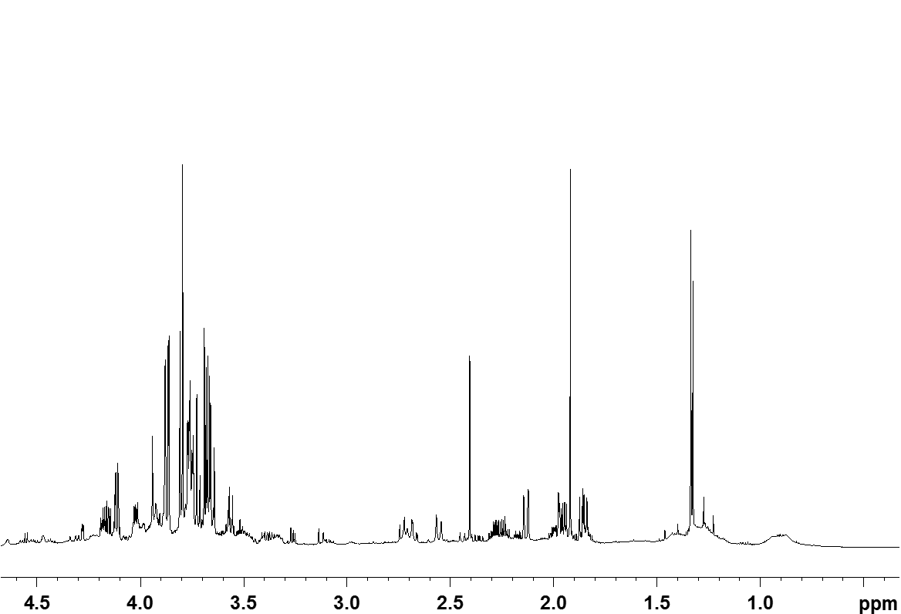
Complex Matrix of Components
Complex Matrix of Components
APH Products
For Example

Slide 49
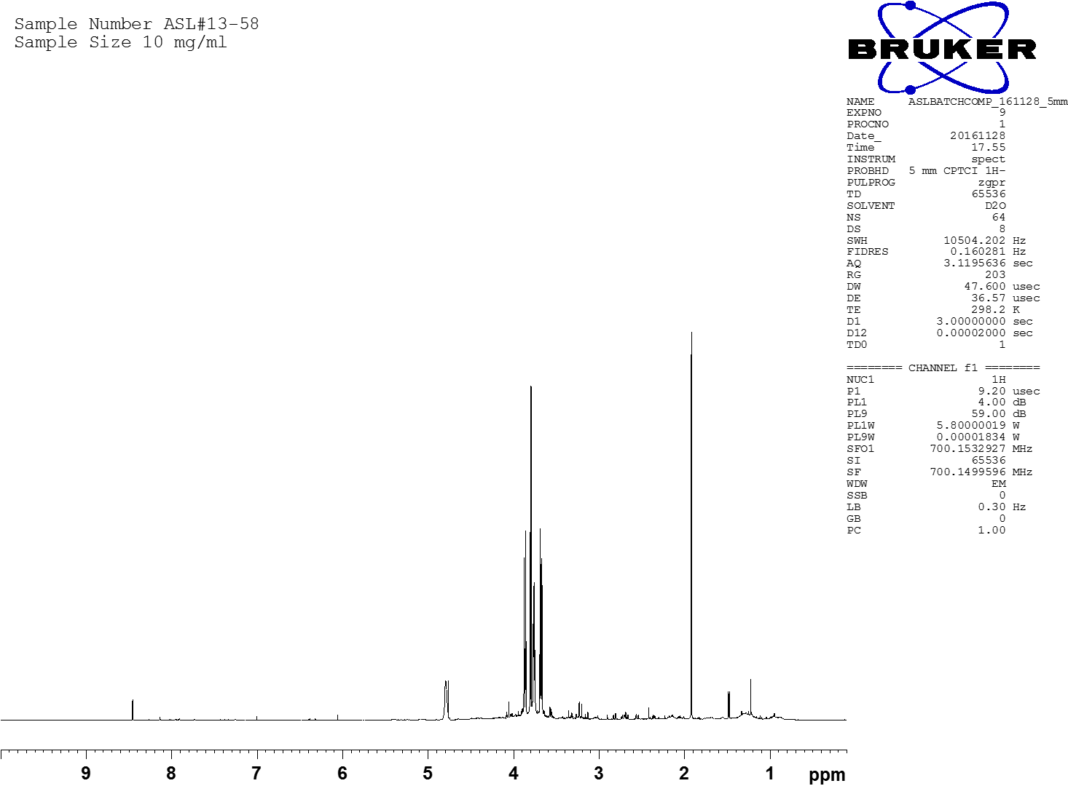
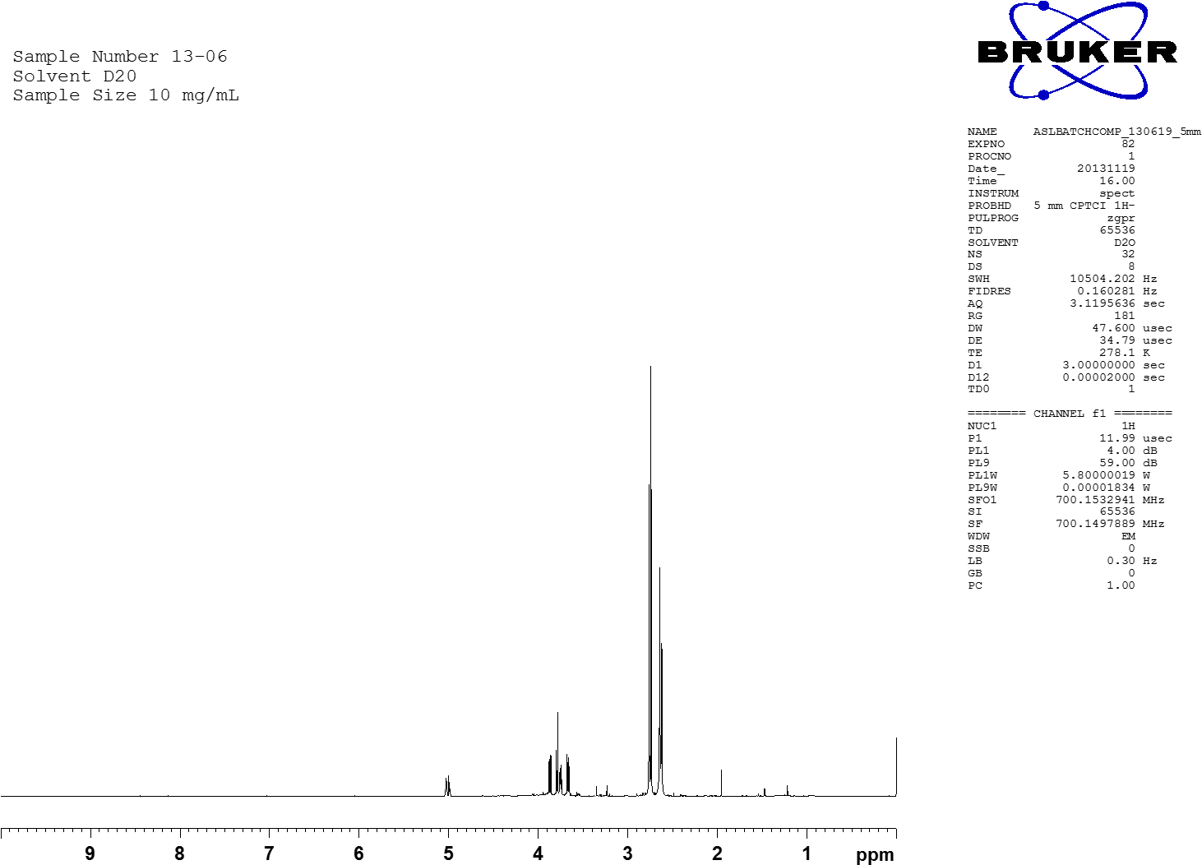

Comparisons make it Obvious!
Company A (South Africa)
Company B (California)
Company C (Italy)

Slide 50
Consistency is the Key!
Ingomar-Sept
Barrington-June
Bear Point-March
Glenwood NS-Jan

Slide 51
Consistency is the Key
NMR Project looked at 36 samples of a science based company and numerous competitor samples
While not perfectly identical, the reputable company samples are clustered in a tight pattern near the origin, showing the consistency
The competitor samples, shown in colors, have a different composition and thus produce different spectra
14
12
10
I_4
8
G_1
6
H_1
H_2
4
K_2
2
PC2
C_1
L_2
B_2
F_1
L_1
I_3
A_2
B_1
A_19
A_21
A_4
0
A_43
A_9
A_5
A_41
A_10
A_25
A_11
A_18
A_13
A_31
A_12
A_1
A_23
A_3
A_27
A_28
D_1
A_6
A_29
A_38
A_22
J_1
A_39
A_36
I_1
I_2
A_34
A_32
A_24
A_30
A_20
A_33
A_8
A_26
A_37
A_42
-2
A_40
A_35
-4
E_3
K_1
E_2
-6
-8
-10
-12
E_1
-10
0
10
20
PC1

Slide 52
New Regulatory Initiatives
Are Bringing Credibility to Biostimulants
The European Biostimulant Industry Council (EBIC) was founded in 2011 to promote plant biostimulants in Europe. EBIC is Currently working to modify the fertilizer legislation to create new harmonized standards for biostimulants under the modernized fertilizer regulations, that will differentiate them from snake oils.
The United States Biostimulant Coalition (USBC) and Biological Products Industry Alliance (BPIA) are working collectively to address regulatory issues surrounding biostimulants, that will differentiate us from snake oils. These two groups are currently working with the US EPA to find a solution for the proper regulation of these innovative products.
Notes:
To bring further credibility to our sector, companies are working with organizations to bring about new regulatory initiatives.
Read off slide

Slide 53
New Regulatory Initiatives
Are Bringing Credibility to Biostimulants
The CABIO (Camara Argentina de BioInsumos) is representing BioStimulants and BioControl products in Argentina.
ABC Bio and ABISOLO are two groups who are representing BioStimulants and Biocontrol products in Brazil but with lots of gray areas.
A new group is formed in India under ICFA, which will represent BioStimulant interest with Government of India.
Similar groups need to be formed in Africa (SABO should take lead) and China (new initiative required).
Global regulatory agencies recognize the need for allowing market access and differentiation to BioStimulants while imposing some level of control to prevent fraudulent and harmful or ineffective products, we need to coordinate with out wasting any time.
Notes:
To bring further credibility to our sector, companies are working with organizations to bring about new regulatory initiatives.
Read off slide

Slide 54
New Regulatory Initiatives
Are Bringing Credibility to Biostimulants
BioProtectionGlobal (BPG) is the new name that has been adopted by the Federation of the world’s leading Biocontrol and Biopesticide Associations, established in fall 2014.
The new name was approved and Board members were elected at the Annual Biocontrol Industry Meeting (ABIM) 2015 in Basel, Switzerland.
The objective of BPG is to achieve international harmonization for regulation of biological pest control solutions and to be the central contact for governmental and non-governmental stakeholders worldwide related to biocontrol and biopesticides.
Notes:
To bring further credibility to our sector, companies are working with organizations to bring about new regulatory initiatives.
Read off slide

Slide 55
New Regulatory Initiatives
Are Bringing Credibility to Biostimulants
BPG’s founding members are,
  the Associscao Brasileira das Empresas de Controle Biologica (ABCBio),
  the Association of Natural Biocontrol Producers (ANBP),
  the Bioproducts Industry Alliance (BPIA),
  the International Biocontrol Manufacturers (IBMA),
  and the South African Bioproducts Organisation (SABO),
Notes:
To bring further credibility to our sector, companies are working with organizations to bring about new regulatory initiatives.
Read off slide

Slide 56
New Regulatory Initiatives
Are Bringing Credibility to Biostimulants
“The key to achieving international harmonization is having a global body representing our industry and speaking with one voice to government policy makers and regulators all over the planet,” said Ravensberg.
“The biocontrol and biopesticides industries are rapidly growing because of demands from consumers everywhere, and there needs to be consistent regulation in all parts of the world to allow our member companies to satisfy these demands.”
“As BPIA has included BioStimulants as part of BioProducts, EBIC and IBMA have come closer, its important that BPG also include BioStimulant in their group.”
Notes:
To bring further credibility to our sector, companies are working with organizations to bring about new regulatory initiatives.
Read off slide

Slide 57
Trust Equation brings Credibility
Credibility
+
Reliability
+
R&D
Trust
=
Selfish Profiteering
Credibility - delivering on the promises
Reliability – consistent efficacy
R&D – investment in science and innovation
Selfish Profiteering – taking advantage of the customer
(Adapted from David H. Maister, Charles H. Green, Robert M. Galford, 2001, “The Trusted Advisor”)
Notes:
Ultimately the main way to ensure that our products are not perceived as "snake oil" products is to gain the trust of growers and the public eye.
To gain this trust, we employ the TRUST equation which is a combination of credibility + reliability + R&D over selfish profiteering.
It is the assurance of credibility through our messaging and delivering, reliability through scientifically-proven claims and efficacy, and the use of a dedicated R&D team to build a foundation of science and innovation. All of these components over selfish motivation is the primary means to gaining the trust of all consumers.

Slide 58
Conclusions
Use solid, credible science and work on trust equation
Relay that biostimulants are not promising miracles
Point out that they are most effective in integrated crop programs
Make a strong bridge between the laboratory and the field
Work closely with research community, universities, government researchers and respected technical partners
Focus on agronomic benefits
Deliver best-use application information to growers and end-users
to maximize their ROI

Slide 59
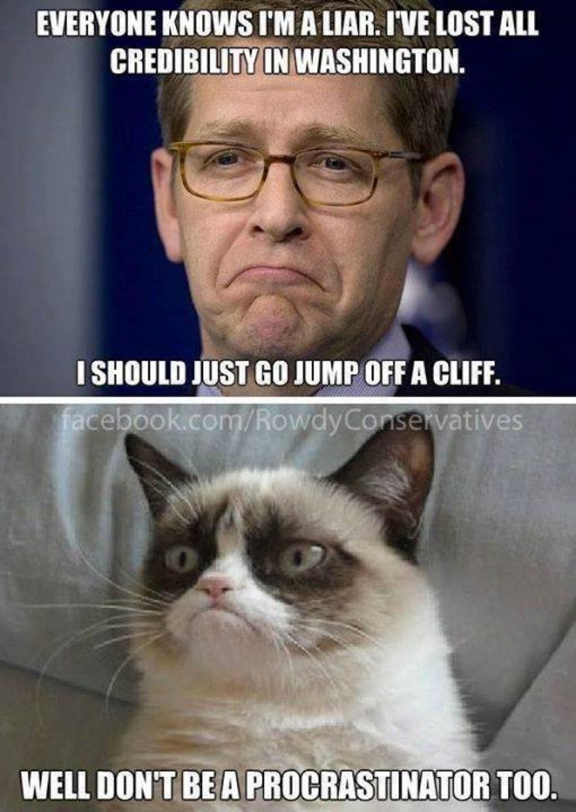
Just for Fun!

Slide 60
panel Round Tabel
Questions & Answers

