Slide 1
Biopesticides: A Look Forward
BPIA Fall Meeting
October 11, 2017

Slide 2
Office of Pesticide Program’s Mission
The Office of Pesticide Program’s mission is to protect public health and the environment from potential risks from pesticides and toxic chemicals.

Slide 3
Biopesticides and Pollution Prevention Division’s Mission
The Biopesticides and Pollution Prevention Division’s mission is to protect human health and the environment by ensuring the availability of properly regulated biopesticides, and encouraging sustainable pollution prevention practices.

Slide 4
BPPD Reorganization
Director
Environmental Stewardship
Biochemicals
Microbials
Director
Environmental Stewardship
Emerging Technologies
Risk Assessment
Biochemicals
Microbials

Slide 5
Workload Snapshot (FY17)
Registration
9 new active ingredients
8 new uses
13% renegotiation rate for 163 completed PRIA decisions
99% of 163 PRIA decisions completed on time
Registration Review
25 Preliminary Work Plans
11 Final Work Plans
3 Final Decisions/Case Closures
Electronic Label Submissions
524 biopesticide submissions

Slide 6
Renegotiation Rate

Slide 7
New Active Ingredient Registrations

Slide 8
Biopesticide Factoids
~410 registered biopesticide active ingredients
>75% of all US corn and cotton has at least one PIP trait
Use trending up significantly for several years (8 M lbs ai in 2015)
Bacillus thuringiensis (Bt)
Bacillus firmus
Gibberellic acid
Kaolin clay
Several crops have high % treated with biopesticides
80% of table grapes treated with gibberellic acid
45% of strawberries treated with Bt
55% of mosquito larvacide treatments are biopesticides (Bt israelensis and B. sphaericus)

Slide 9
Zika-Related Efforts
Zika response a top OPP priority
Expediting review of submissions of potential value in combating Zika
Registration of a new mosquito attractant
Experimental Use Permit for Wolbachia pipientis to test its effectiveness in suppressing Aedes aegypti mosquito populations
Leading OPP and ORD response on White House strategy for Zika on research and development

Slide 10
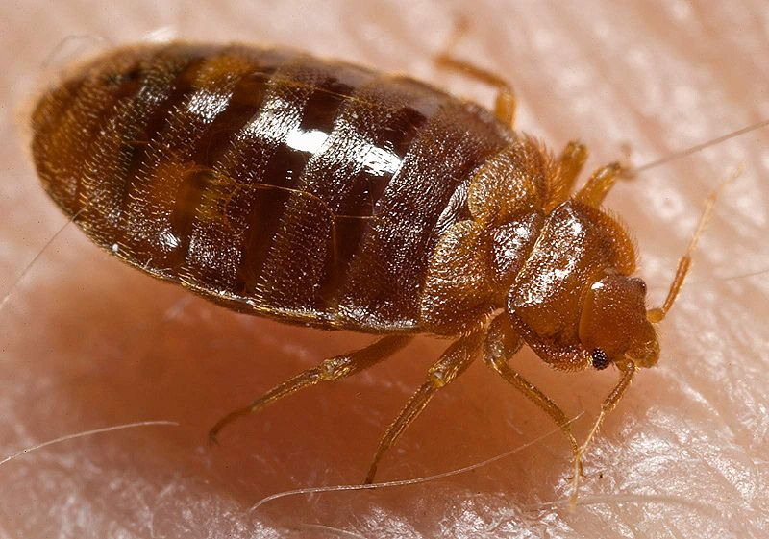
A Biopesticide Solution for Bed Bugs
BPPD registered a potentially ground-breaking new use of a biopesticide in April 2017
Beauveria bassiana strain GHA controls bed bugs and is effective against pyrethroid resistant bed bugs
Applied at very low volumes to cracks and crevices on bed frames and box springs, where direct human contact is unlikely

Slide 11
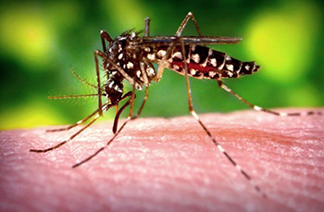
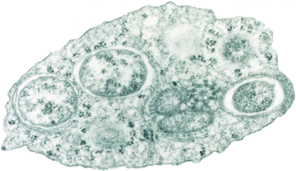
New Microbial Experimental Use Permit Targets Disease-Carrying Mosquitoes
Recent expansion of an EUP to field test Wolbachia pipientis, targeting population suppression of Aedes aegypti, the primary carrier of Zika virus
Wolbachia bacteria is carried within male mosquitoes released to the wild
Wolbachia-carrying males that successfully mate with wild females will result in non-viable offspring
Credit: Public Library of Science / Scott O'Neill

Slide 12
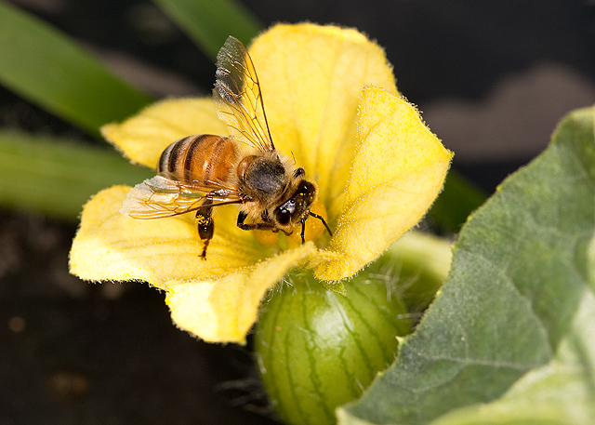
Improvements in Honey Bee Testing
EPA is striving to make improvements to honey bee testing for microbial pesticides
Options include:
Improving the current guideline by providing more information and better guidance
Adapting other guidelines, such as OECD guidelines, in development for testing chronic effects of conventional pesticides in honey bees

Slide 13
Waiving Acute Dermal Toxicity Tests
Analysis and Guidance for Waiving Acute Dermal Toxicity Tests for Pesticide Formulations
GOALS:
Minimize the number of animals used while expanding the amount of information obtained
Only require data that inform regulatory decision making and avoid unnecessary use of time and resources, data generation costs and animal testing
Focus on the information most relevant to a particular assessment and still ensure there is sufficient information for regulatory decisions that are protective of public health and the environment

Slide 14
Waiving Acute Dermal Toxicity Tests
Data related to dermal acute toxicity for conventional, antimicrobial, and biochemical pesticides may be waived if any of the following criteria are met:
Test material Toxicity Category I for primary dermal irritation
Placed in dermal Toxicity Category I due to potential dermal effects
Test material is corrosive to skin, or has pH <2 or >11.5
Placed in dermal Toxicity Category I due to potential dermal effects
Product design prevents dermal exposure
e.g., childproof insect baits and rodent bait boxes

Slide 15
Tolerances and Exemptions
Biopesticides typically are exempt from the requirement of a tolerance often with limitations
Consistency
Hazard-based vs. risk-based
Limitations
Implications in enforcement
Implications for expanding product labels/uses
Office is considering guidance to clarify

Slide 16
PRIA 4
PRIA 3 extended until December 8, 2017
New legislation being drafted by Congress
Maintenance fees increase from $27.8M to $31.0M/year
PRIA 4 timeframe being debated
Possible changes to biochemical and microbial timeframes and fees
BPPD categories subject to the 2-day label review:
Standardization across OPP
Clean labels for the States
Stakeholders will receive pre-decisional determinations 2 or 4 weeks in advance of PRIA due date

Slide 17
Plant Biostimulant Guidance
EPA recognizes the growing importance of plant biostimulants in environmentally sound agricultural practices
EPA developing guidance for plant biostimulant products and associated label claims that may be included in, or excluded from regulation under FIFRA
Provides clarity on label claims:
Plant growth regulator claims
Claims associated with current exemptions (soil amendment, plant inoculant, vitamin hormone and plant nutrient)
Other related claims that are not considered pesticidal
Definitional issues to be addressed in the future
Guidance will be available for public comment

Slide 18
Plant Regulator or Biostimulant?
FIFRA [Sec 2(v)] Plant Regulator Definition
Through physiological action, does the substance or mixture of substances:
Accelerate or retard the rate of growth?
Accelerate or retard the rate of maturation?
Alter the behavior of plants or the produce thereof
A plant biostimulant may be considered to be a plant regulator if known activity and/or product label claims fit within the FIFRA definition of plant regulator

Slide 19
Plant Biostimulant Guidance
Exclusions based on substances excluded from regulation by FIFRA*
Vitamin-hormone products
Plant macronutrient or micronutrient trace elements
Plant inoculants
Soil amendments
Includes guidance for products generic product label claims for products not covered by the exclusions from the FIFRA Section 2(u) definition of a plant regulator
*(40 CFR 152.6 (f)(1) & (2) and (g)(1), (2) & (3) and FIFRA Section 2(u))

Slide 20
Outlook for 2018
Expected surge in biopesticides is here
39 new active ingredient decisions due in FY2018/2019
Implement PRIA 4 (if enacted)
Emerging technologies and innovations in biotech are advancing in ways presenting policy and assessment challenges:
GE mosquitoes
Gene editing (e.g., CRISPR)
Non-PIP RNA interference technologies
Microbial bee guidelines
Biostimulant Guidance

Slide 21
Concluding Thoughts

