Slide 1
A Consumer Packaged Goods Perspective on agricultural sustainability
October 11, 2017
Ron Williams, Ph.D.
Director, Crop Protection Technology Safety
Global Scientific and Regulatory Affairs
The Coca-Cola Company
Atlanta, GA

Slide 2
Key Drivers for Consumer-Facing Food and Beverage Companies
Safety – all of our ingredients and finished products must meet strict safety requirements
Compliance – all of our ingredients and products must comply with local regulations
Brand Reputation – must be protected

Slide 3
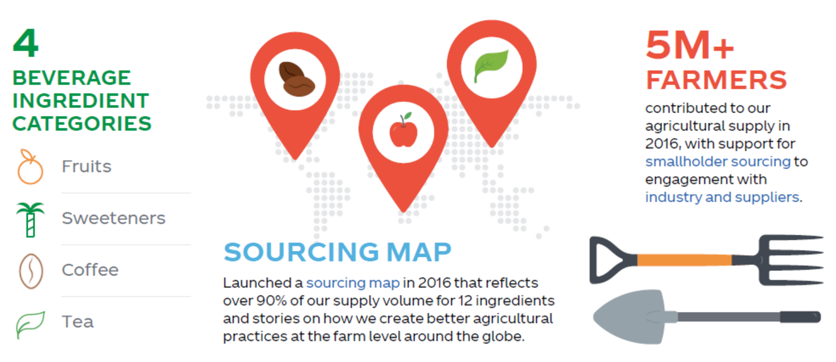
Agricultural sustainability: The Coca-Cola company
Agriculture accounts for about half of our spend on inputs to products and packaging.
A healthy agricultural supply chain is essential to the well-being of communities, economies and the environment.
Sustainable sourcing is when our farm suppliers meet certain standards relating to human and workplace rights, environmental protection and responsible farming management.

Slide 4
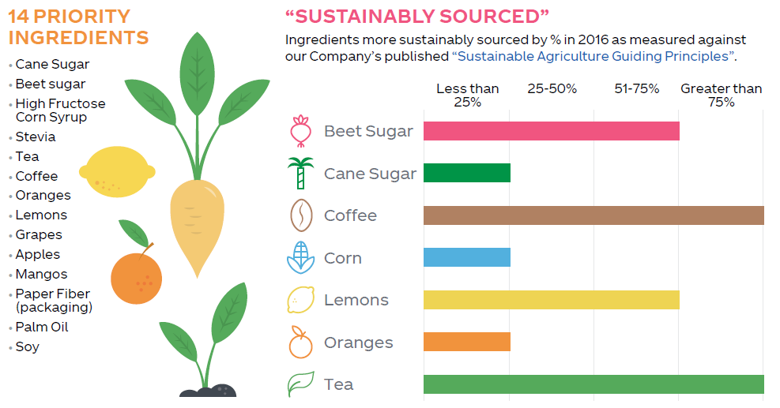
Learn more: http://www.coca-colacompany.com/sustainable-agriculture
Full update: http://www.coca-colacompany.com/stories/2016-agriculture
© 2017 The Coca-Cola Company All rights reserved.

Slide 5
Biopesticide and biostimulant discussion
Exemptions from tolerances and maximum residue limits (MRLs) can reduce trade barriers across market boundaries
Environmental footprint
Residues
Worker safety
Effectiveness
Solutions to address citrus greening are needed

