Slide 1
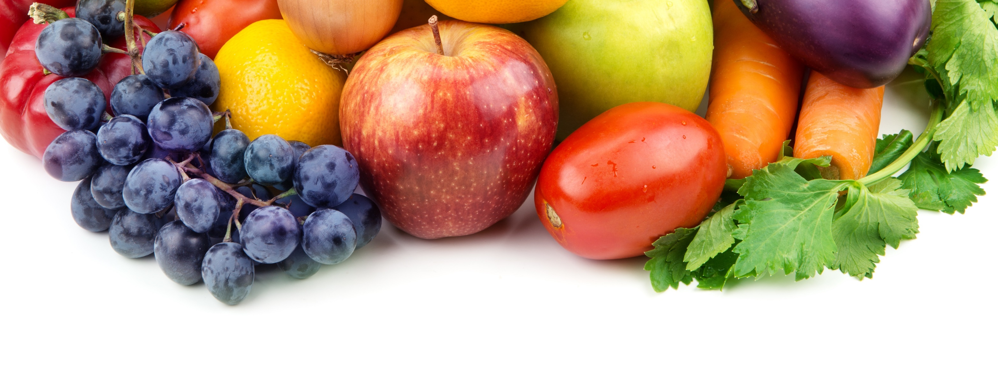

"Consumer Insights:
Food Production, Safety and Sustainability“
Tamika D. Sims, PhD
October 11, 2017

Slide 2
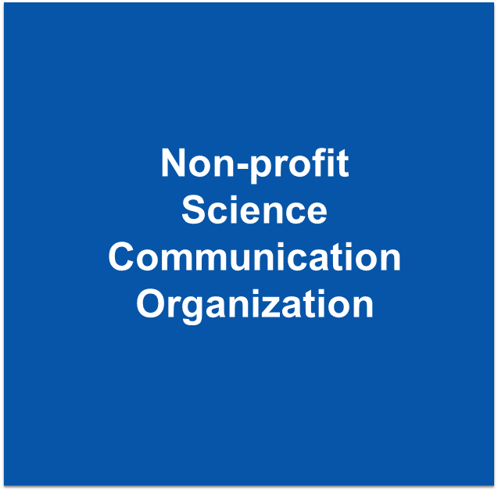

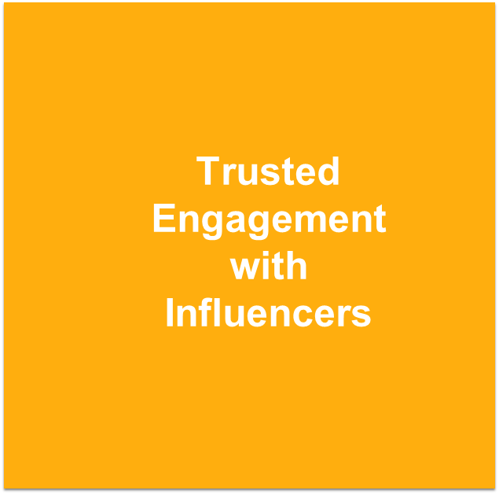

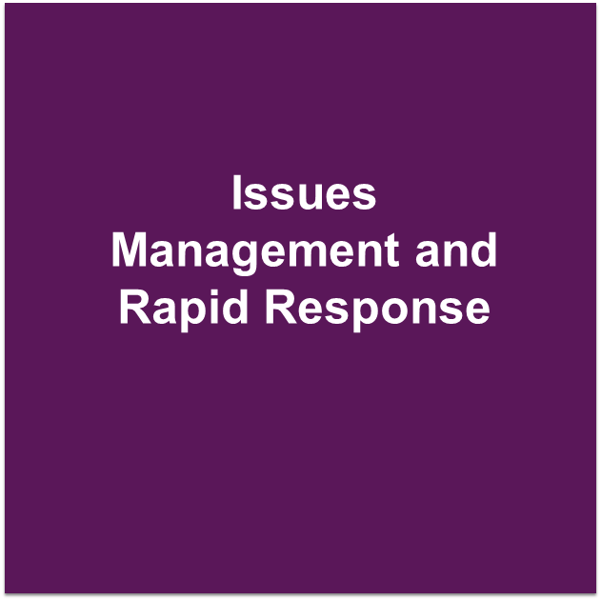
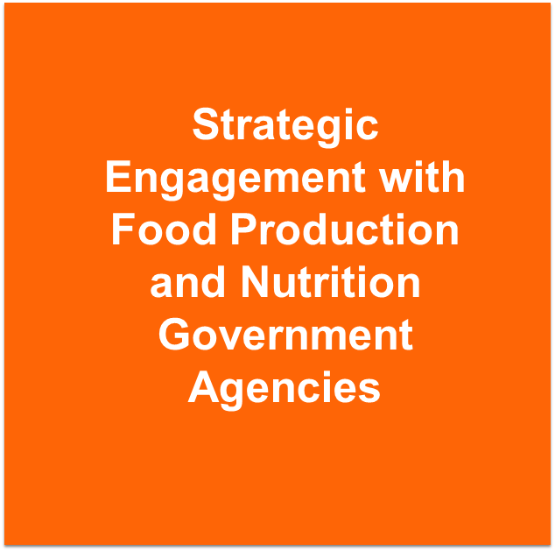
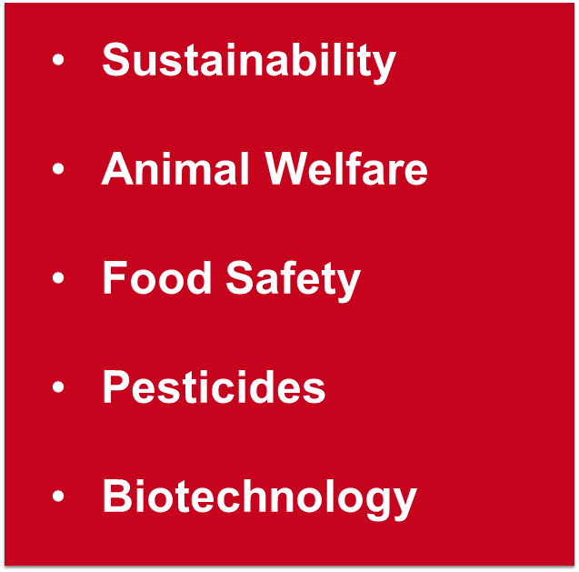

Slide 3
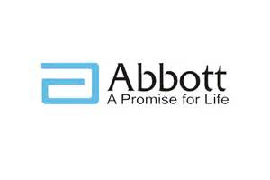




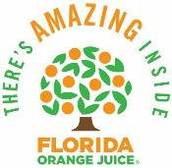






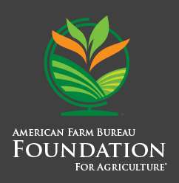
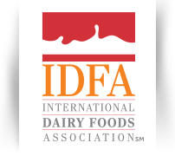

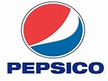


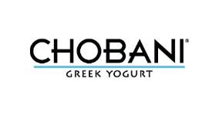









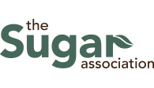

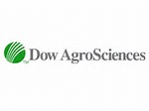





IFIC Members

Slide 4
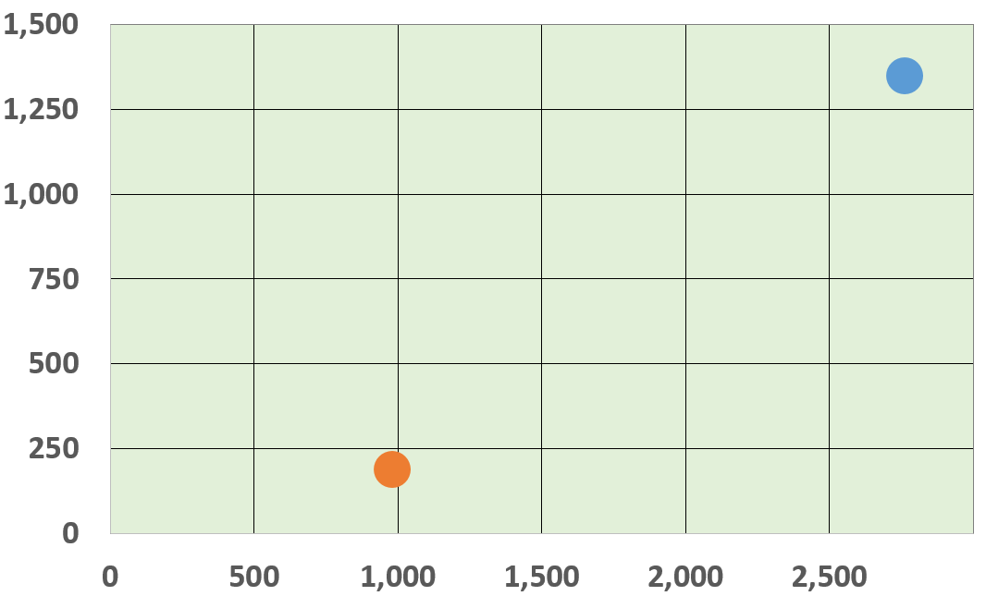
IFIC Digital Metrics
Food Babe
(in thousands)
IFIC Foundation
CSPI
Social Media
Followers*
3,000
Website Visits**
*Facebook + Twitter
**Source: SimilarWeb.com
(in thousands)

Slide 5

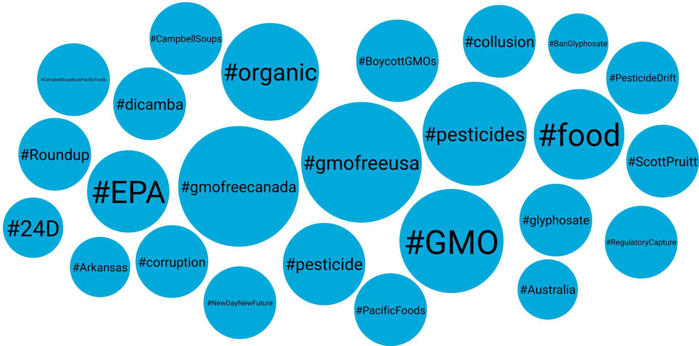

Getting Social With Pesticides

Slide 6
Getting Social With Pesticides
Positive sentiment -- ways to reduce pesticide use (or the use of organic pesticides with the misconception that they are safer)

Slide 7
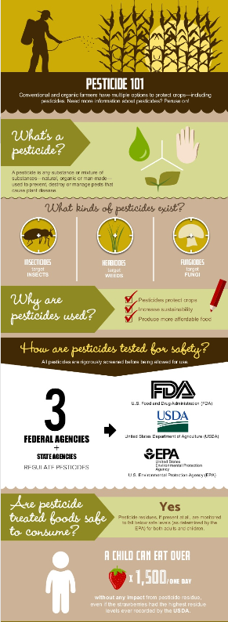
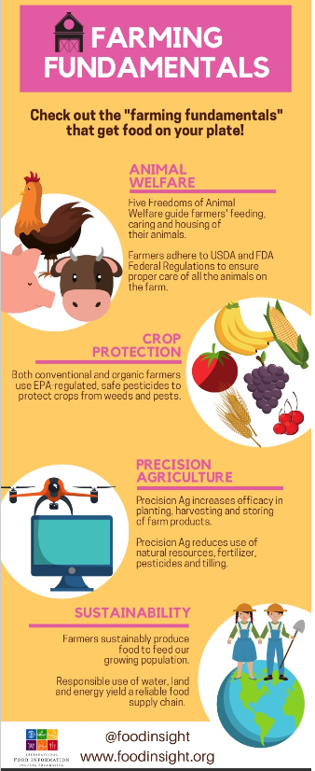
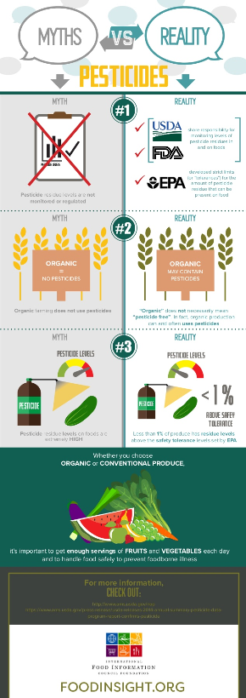
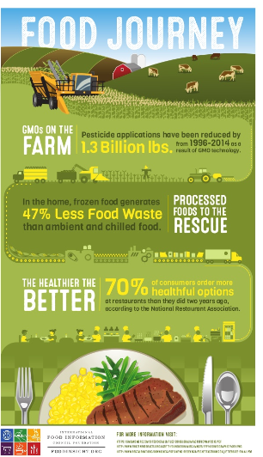
Communications
Resources

Slide 8

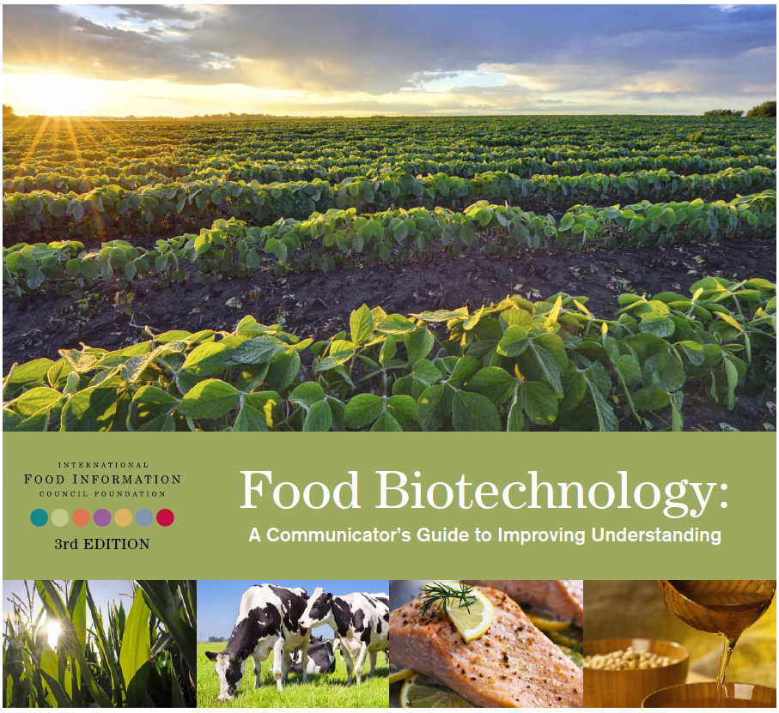


Communications
Resources

Slide 9













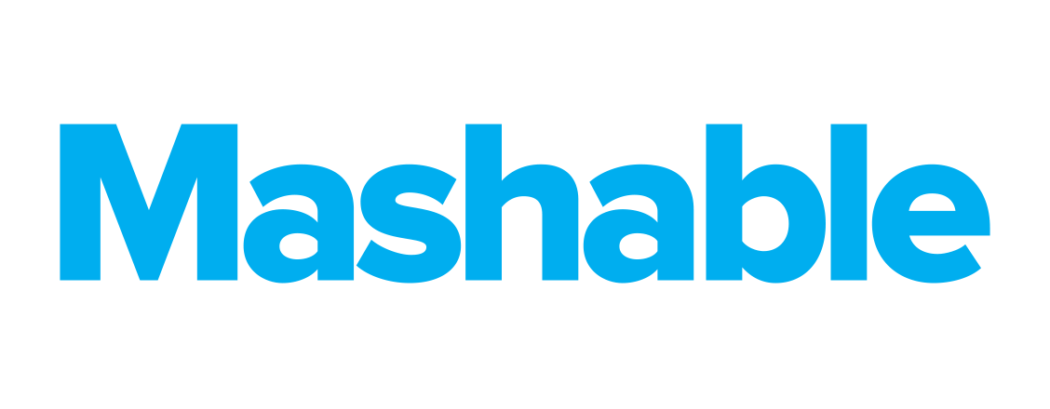




Recent and Secured Placements

Slide 10

Background
The International Food Information Council (IFIC) Foundation’s 2017 Food & Health Survey, “A Healthy Perspective: Understanding American Food Values,” marks the 12th edition of an ongoing investigation into the beliefs and behaviors of Americans.
This year, the survey investigates important issues regarding consumer confusion, the food information landscape, health and diet, food components, food production, sustainability, and food safety.
Methodology
Online survey of 1,002 Americans ages 18 to 80. March 10 to March 29, 2017. Approx 22 minutes to complete.
Significant trend changes from the 2016 results are noted with up and down arrows.
The results were weighted to ensure that they are reflective of the American population ages 18 to 80, as seen in the 2016 Current Population Survey. Specifically, they were weighted by age, education, gender, race/ethnicity, and region.
The survey was conducted by Greenwald & Associates, using ResearchNow’s consumer panel.

Slide 11
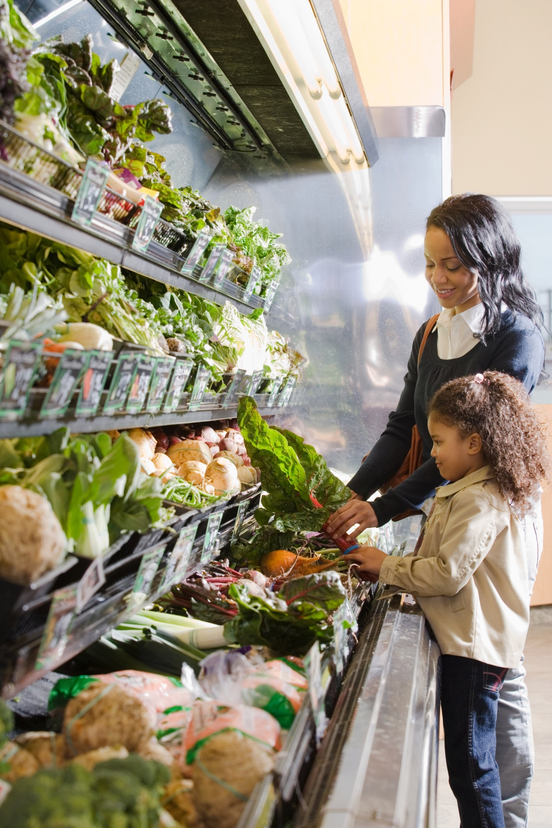
Food
Confusion
Americans turn to friends and family to help us guide our food choices but see others, like dietitians and healthcare professionals, as the most trusted sources. The disconnect between trust and reliance of sources may lead to the glut of conflicting nutrition information.

Slide 12


Trust in food companies ranked low
Two-thirds have high trust in advice from a conversation with a Registered Dietitian Nutritionist
Trusted Sources About Which Foods to Eat/Avoid
Women have greater trust in RDNs and in fitness professionals. Men have more trust in friends and family.
Q: How much would you trust information from the following on which foods to eat and avoid? (n=1,002)

Slide 13
Healthcare professionals and friends/family are top source
Sources for Information About Which Foods to Eat/Avoid
38%
Of Millennials say friends and family are a top source of information, vs. 21% of Boomers.
Millennials are also more likely to get info from many other sources.
Q: How often do you get information from the following on which foods to eat and avoid? (n=1,002)

Slide 14
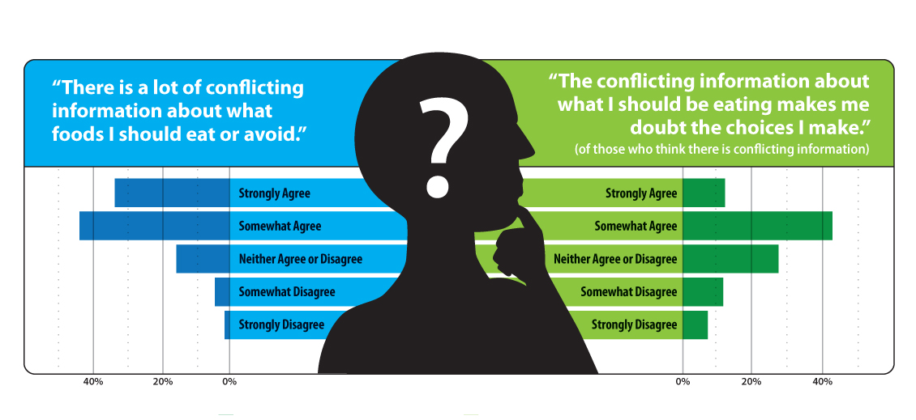
Conflicting advice abounds
8 in 10 find conflicting advice about what to eat or avoid, many doubt their food choices
Q: Do you agree or disagree with the following statements?
“There is a lot of conflicting information about what foods I should eat or avoid.” (n=1,002)
“The conflicting information about what I should be eating makes me doubt the choices I make.” (Of those who agree about conflicting information, n=775)

Slide 15
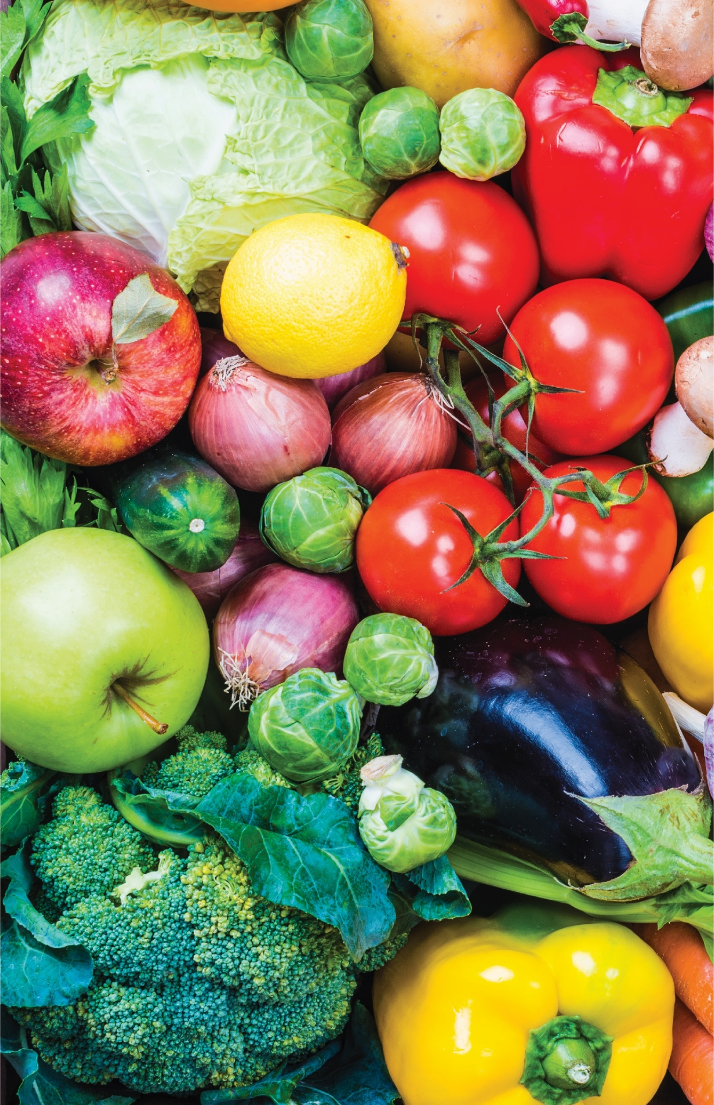
Thinking beyond
the box
When it comes to what Americans’ eat and why, considerations go far beyond the factors that traditionally drive purchases - taste, price and convenience. How food is produced, where it comes from, and perceived corporate values have a big impact on food decisions.

Slide 16
Sustainability important for half of consumers
Pesticide use and conserving natural habitat are top concerns related to sustainability
Importance of Food Being Produced
in a Sustainable Way
Most Important Aspects of Sustainability
(For Those Who See Sustainability as Important)
i
h
h
h
h
h
i
h
56% of women care about food being produced in a sustainable way, vs. 42% of men.
h
h
Q: How important is it to you that the food products you purchase or consume are produced in a sustainable way? (n=1,002)
Q: What 3 aspects of producing food in a sustainable way are most important to you? (Sustainability is important, n=527)

Slide 17
Labels impact product and restaurant choice
“No added hormones” most impactful for products; “natural” most impactful for restaurant choice
Labels Consumers Regularly Seek on Packages/at Restaurants
Q: Which of the following, if any, do you do on a regular basis? Select all that apply.
Buy foods and beverages because they are advertised on the label as… (Split sample, n=501); Eat at restaurants because they advertised their foods and beverages as… (Split sample, n=501)

Slide 18
Food production, values impact purchases
One third say it is highly important to know that a company shares their values
Production-Related Purchase Factors
Women are more likely to care about recognizing ingredients, knowing where food comes from, the number of ingredients, and how food is produced
68%
Of Boomers say that recognizing ingredients listed is important, vs. 54% of Millennials
Q: How important are the following factors in your decision to purchase a food or beverage? (n=1,002)

Slide 19

Food attributes top list of important values
Characteristics of food manufacturers also top list of important values
Important Values
(Of those who care at least somewhat about values)
Examples:
Healthy, natural, few additives, organic, safety, minimally processed, low sugar, non-GMO
Honesty/integrity, no animal cruelty, fair trade, community focus, local business, made in U.S.
Environmentally friendly/sustainable/responsible, less waste, less/recyclable packaging, company recycles
1 in 5
Do not cite any particular value(s)
Q: You mentioned that you prefer to buy foods and beverages that are produced by companies that share your values. What values are you thinking about specifically? (Cares about shared values, n=654)

Slide 20
Thinking beyond the box:
Food Confidence
& Concerns
Americans’ food values are also reflected in their perceptions of the food supply and their food safety concerns.

Slide 21
Confidence in food supply down slightly
Foodborne illness remains top safety concern, but concern about carcinogens on the rise
Confidence in Safety of
U.S. Food Supply
Most Important Food Safety Issues Today
i
h
h
i
i
i
35%
Of Millennials are not confident, vs. 24% of Boomers
Q: Overall, how confident are you in the safety of the U.S. food supply? (n=1,002)
Q: What in your opinion are the three most important food safety issues today? (n=1,002)

Slide 22
News, family and friends influence safety concerns
Top Concern | #1 Source | #2 Source | #3 Source
Foodborne illness | News article or headline 36% | Friend or family 17% | Government agency 8%
Carcinogens | News article or headline 31% | Reading a scientific study 17% | Friend or family 13%
Chemicals in food | News article or headline 24% | Friend or family 20% | Reading a scientific study 10%
Pesticides | News article or headline 22% | Friend or family 18% | Reading a scientific study 11%
Food additives/ ingredients | Friend or family 21% | News article or headline 17% | Reading a scientific study 15%
Animal antibiotics | News article or headline 18% | Friend or family 18% | Reading a scientific study 13%
Biotech/GMOs | Reading a scientific study 25% | News article or headline 21% | Wellness counselor 11%
Allergens | Friend or family 24% | Personal health prof. 14% | Government agency 9%
A news article or headline is the #1 source for getting information on food safety
Q: What one source of information most influenced your opinion on [your top safety concern]? (n=1,002)

Slide 23
Food safety concerns alter eating habits
Foodborne illness and carcinogens driving changed eating habits
Changed Eating Habits Due to
Concerns about Top Safety Issue
Changed Habits by the Concern Driving the Change
43%
Yes
Q: Have you changed your eating habits due to concerns about [your top safety concern]? (n=1,002)

Slide 24
For more information on the
2017 Food and Health Survey
visit foodinsight.org/FHS

Slide 25
www.foodinsight.org
@foodinsight

