Slide 1
Biopesticide: Tolerance Exemptions – Global Implications BPIA October 11, 2017 Orlando, FL
Nina Wilson

Slide 2
Why are we talking about tolerance/MRLs and Exemptions? …Not just a regulatory but also a commercial discussion
Initially, the focus was on clarifying the data requirements and risk assessment process for biopesticides with an exemption from tolerance (Maximum Residue Limits - MRL)
Feedback from EPA, some registrants and grower groups was that a numerical tolerance might be preferred

Slide 3
Tolerance Exemptions: Why the Different Perspectives?
Biopesticide Registrants – cost & time saving toward broadly labeled product
Other registrants – globally focused (import/export) strategy
Growers – tolerance/MRL are top of mind for their export market because of experience with “conventional” chemistry
Regulatory authorities – very high bar to prove certainty around safety
Tolerance Exemptions:
Not no residues but no residues of toxicological concern

Slide 4
Why now?
New and novel biopesticide technology
Biochemical or microbial (metabolites)
Advancements in analytical detection
Countries moving toward positive list system – global discussion on MRL harmonization
New regulations
Export crops take their history with them
Consumer’s changing view on food safety

Slide 5
Biopesticides can be a solution
Michael Braverman – IR4
Harmonization platforms – what can we learn from MRL harmonization
Cindy Smith – Gowan
Commercial development and planning for tolerance exemptions
Gabriele Ludwig – Almond Board
Unintentional consequences and issues

Slide 6
Tolerance Exemptions: Challenges and Potential pathways towards Globalization
Michael Braverman
IR-4 Project, Rutgers University

Slide 7
Reasoning for Tolerance Exemption?
No toxic endpoint- Based on toxicology studies or public literature of common substances
No anticipated exposure- Application of fruit crops in a vegetative phase. Application at planting. Physical separation - Product placement or in a retrievable dispenser.
Indistinguishable……

Slide 8
Type of AI?
Microbial- What is there to analyze for?
PIP- RNAi’s may not be in harvestable portion
Biochemical- Some challenges…

Slide 9
Domestic versus International
Conventional Chemicals | Biochemical Like –Reduced data set | Biopesticide | Biostimulants | 25b
Most data requirements | Somewhat more requirements than biopesticides | Standard but ever increasing bar | ??????? | Exempt- Thyme oil 25B
Thymol- US Varroa
Thymol- EU Veterinary Medicine

Slide 10
International Residues
Conventional Chemicals | Biochemical Like –Reduced data set | Biopesticide | Biostimulants | 25b
Most data requirements | Somewhat more requirements than biopesticides | Standard but ever increasing bar | ??????? | Exempt- Thyme oil
Phosphite- Tolerance needed
Phosphite-Exempt Tolerance US

Slide 11
EFSA- Residues
Phosphonates are not significantly oxidised in plants to phosphate, therefore do not act as a phosphorus source in plants. The meeting of experts also discussed the possibility of another route of exposure to phosphonic acid residues resulting from the use of soil fertilisers and of fosetyl and disodium phophonate.

Slide 12
International Residues
Conventional Chemicals | Biochemical Like –Reduced data set | Biopesticide | Biostimulants | 25b
Most data requirements | Somewhat more requirements than biopesticides | Standard but ever increasing bar | ??????? | Exempt- Thyme oil
Phosphite- Tolerance needed International
Fostyl-ethyl aluminum-Tolerance US and International

Slide 13
International Residues
Conventional Chemicals | Biochemical Like –Reduced data set | Biopesticide | Biostimulants | 25b
Most data requirements | Somewhat more requirements than biopesticides | Standard but ever increasing bar | ??????? | Exempt- Thyme oil
Phosphite- Residue studies Tolerance needed International
Thymol- Residues needed for US
IR-4 conducted residue studies

Slide 14
Potassium Phosphite
IR-4 conducted residue studies
Almond, Apple, Blueberry, Caneberry,
Citrus, Pecan, Pistachio, Walnut

Slide 15
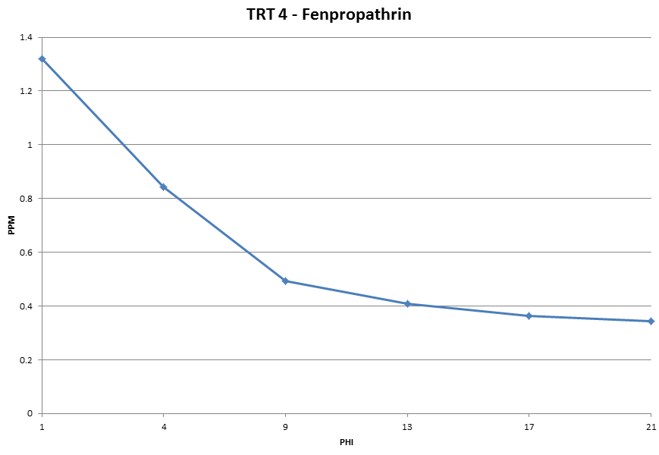
Pesticide Degradation – Decline curve
7 day PHI and 7 days effective control
7 days
effective
control
PERIOD OF NO PROTECTION –USE SHORT PHI BIOPESTICIDE
Korea = 0.5ppm
Japan 0.3 ppm
(Days)

Slide 16
MRL- Pesticide Residue Mitigation
Crop export concerns- What are the conventional products causing trade irritants?
Differences in MRLs between exporting and importing countries
Decline curves/persistence
PHI(Pre harvest interval), retreatment interval
Target pests in last application
Biopesticides available to impact late season pests
How important and how wide is the gap in MRLs/tolerances?

Slide 17
How Promote Harmonized Exemption from Tolerance
Focus areas? Follow the regulatory drivers
Replacements for Antibiotics
Replacements for copper replacements
Conventional residues

Slide 18
How Promote Harmonized Exemption from Tolerance
Global Joint Review?
EU- Coordination agreements with Regulation 1107/2009 introduced new categories of 'Low-risk' (Articles 22 and 47) and ''Basic substances' (Article 23)
Germany – Plant strengtheners
Veterinary Substances

Slide 19
How Promote Harmonized Exemption from Tolerance
CODEX
April 2016 INFORMATION PAPER ON EMERGING ISSUES: A PROPOSED RISK MANAGEMENT APPROACH TO ADDRESS DETECTION IN FOOD OF CHEMICALS OF VERY LOW PUBLIC HEALTH CONCERN Prepared by New Zealand
Inadvertent cleaning agents, Nitrification inhibitors, fertilizers
Threshold of Toxicological Concern (TTC).

Slide 20
PATH FORWARD?
Global Minor Use Summit 3 Montreal, Canada
Review and publish a list of substances exempt from MRLs (such as biopesticides and compounds of no toxicological concern)
Lead Organizer- IR-4
Volunteers- Nina Wilson, Leslie Farmer, Carrie Link David Cary, Jeroen Meeussen, Pranjib Chakrabaty
(Need help- LATAM)

Slide 21
PATH FORWARD?
Global Minor Use Summit 3 Montreal, Canada
Review and publish a list of substances exempt from MRLs (such as biopesticides and compounds of no toxicological concern).
List- Database Parameters and Scope
Timelines
Regulatory harmonization component
Meet discuss follow up.

Slide 22
Thank
You!
Michael Braverman
braverman@aesop.rutgers.edu

Slide 23
Exemption From Tolerance Panel BPIA – Commercial Considerations
Cindy Baker Smith
Gowan USA
October 11, 2017

Slide 24
Decision Process for Registrants
Market Analysis
R&D Companies
Discovery
Other Basics
Partnerships
Universities

Slide 25
Active Ingredient Screening
What does the product do?
What do we know preliminarily about cost?
What do we know preliminarily about regulatory profile?
Market Analysis

Slide 26
Market Analysis
Market Size
Conventional
Organic
Minor Crops vs. Major Crops
Market Need
Fit in IPM program
Competitive Markets
Regulatory and Development Cost
Human Tox and Exposure
Environmental Tox and Exposure
International Regulatory Cost –requirements vary by country
Efficacy Data
Time to Market
Potential Pricing
Culminating and a proposed business plan

Slide 29
Registrant Challenges with Product with Exemption from Tolerance
Inconsistent data requirements globally
Inconsistent risk assessment process globally
Regulatory authorities vary in if/how they register products with exemption from tolerance
Lack of understanding for some in food chain
Inconsistent enforcement and understanding globally
Registrations in countries to obtain MRLs

Slide 30
Two Examples
Post Harvest Biochemical
Approved by US EPA with an exemption from the requirement for a tolerance
Challenge in other countries and marketing in the US due to lack of MRLs
Elemental compound- insecticide
US EPA establishes tolerances the rest of the world does not
Challenges with countries that have positive lists

Slide 31
Thank You

Slide 32
Biocontrols East Conference 10/11/17 Gabriele Ludwig, Ph.D. Director, Sustainability & Env. Affairs Almond Board of California

Slide 33
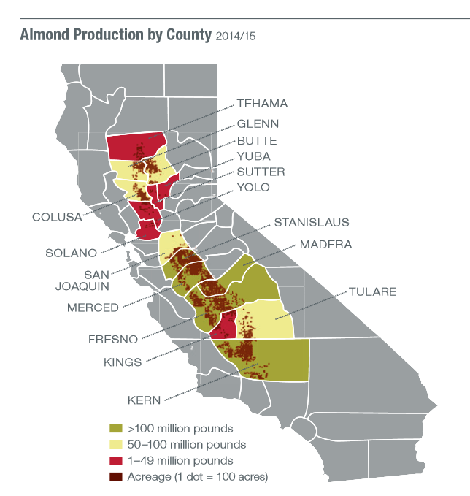
California Almonds: Basic Facts
2016: 940,000 bearing/ 1.24 mill total A
6,800 growers, 105 handlers
67% of operations are =/< 100 acres*
> 90% family-owned*
67% export, 33% domestic
Generates 104,000 industry-related jobs**
$11B to State GDP
Almond Board of California is Federal Marketing Order
Funded by grower assessment
Global generic marketing
Research
Grade and food safety standards
Sources:
*USDA Agricultural Statistics Service, Pacific Region (NASS/PR)
**Source: Economic Impacts of the California Almond Industry: UC Ag Issues Center

Slide 34
California Almond Shipment Overview 2016/2017
Almonds are top US specialty crop in export value
Almonds are top California crop in export value

Slide 35
Top Ten California Crops by Acreage and by Farmgate Value
Source: USDA, NASS. *Calendar year January through December 2015. Value based on farm-gate prices. †This is the corn and wheat values for 2014.
Notes:
Value vs. Acreage is increasing
This is why growers are moving towards permanent crops like almonds

Slide 36
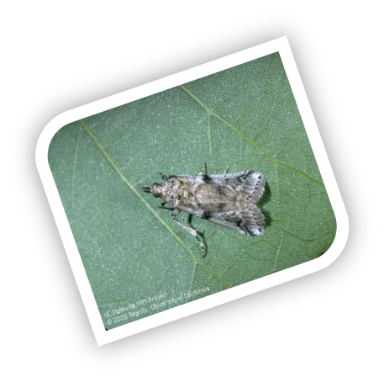
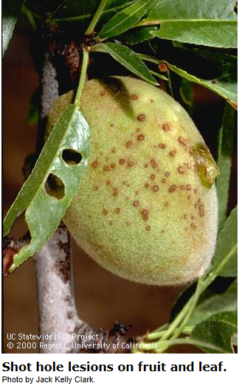
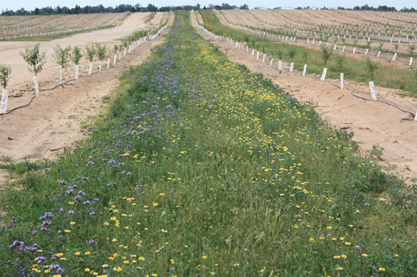
Pest Management Needs in Almonds
Insects
Navel Orangeworm, Peach Twig Borer, web-spinning mites, leaf-footed bugs, ants, etc
Diseases
Bloom diseases: brown rot, Anthracnose, shot hole
Summer: Alternaria, hull rot
Root pathogens and nematodes: replant disorder, Phytophthora, Verticillium, oak root fungus
Weeds
Keep irrigation system clear, frost protection, clean floor for harvest
Vertebrates
Ground squirrels, pocket gophers, coyotes, birds, ,
Post-harvest
Storage insects, human pathogens, phytosanitary requirements

Slide 37
What happens if exemptions are not exempt everywhere: Phosphite (phosphonate)
In US potassium phosphite is sold as both a fertilizer and as a pesticide. Also have calcium-, zinc-, etc. phosphites
Used in many crops for fertilizer/fungicidal/resistance stimulation reasons.
Exempt from a tolerance in the US
In late 2013, the EU changed the designation of phosphite from both a fertilizer and pesticide, to only a pesticide
Instead of establishing a separate Maximum Residue Limit (MRL) for phosphite-containing products, these residues were included under the MRLs for fosetyl-Al
fosetyl-Al is which is not approved for use in the U.S or EU. on bearing tree nuts
Default fosetyl-Al MRL for tree nuts is 2 ppm
German state government lab tested some walnuts from a major retailer
➔Voluntary recall of walnuts from large German retailer due to exceedance of fosetyl-Al MRL (Dec 2014)
EU buyers worried about supply.

Slide 38
Took a lot of team work for workable solution….
For 2015 growing season, notified growers not to use!
The California tree nut industries along with the EU trade and U.S. government raised these concerns with the EU, which led to the EU setting a temporary MRL of 75 ppm for tree nuts and several other crops in 2014
TASC grant from USDA-FAS for residue trials
IR-4 conducted the trials
Trade in EU lobbied for tree nut extension
USDA-ARS research on analytical methodology, etc.
Dossier with a proposed tree nut MRL has just been sent from rapporteur country to EFSA for review.
Cherries, cane berries, blue berries, etc.

Slide 39
European Union – Fosetyl-Al/Phosphite
November 9-10
Standing Committee adopted legislation to extend tMRL for tree nuts
Generate science-based information
Rational & purpose for use
true plant health effects
January 21-22
EU changes definition: phosphonate under Fosetyl regardless of source
Publication of Regulation extended tMRL to March 2019 and retroactive to 1 January 2016
Monitoring data
domestic/import data
2mg/kg
Summer 2016
Analytical Methods
multiplier in MRL definition?
Sept 2016 Dossier submitted by Tree Nuts proposing permanent MRL for tree nut group
75 mg/kg
Field trials
develop residue data for MRL setting with IR-4
Autumn 2017-February 2019
Effective until Dec 31,2015
Consideration by EU Commission, EFSA, Member States; adoption no later than March 2019
2014-2016
Notes:
Julie
ABC will work to submit the dossier for import tolerance in Summer 2016
The dossier will emphasize tree nut grouping (almonds, pistachios, walnuts, hazelnuts, cashew nuts and macadamia nuts)
The one tree nut that has not been involved in these conversations is pecans.
Julie is in Europe next week for meetings with ESA and FRUCOM. Together they will be putting together joint communication.
ABC is comfortable moving forward.
Uncertainty with growers to use the product. PCA’s and seller leery to sell or recommend the product due to uncertainty of residue limits below 75ppm

Slide 40
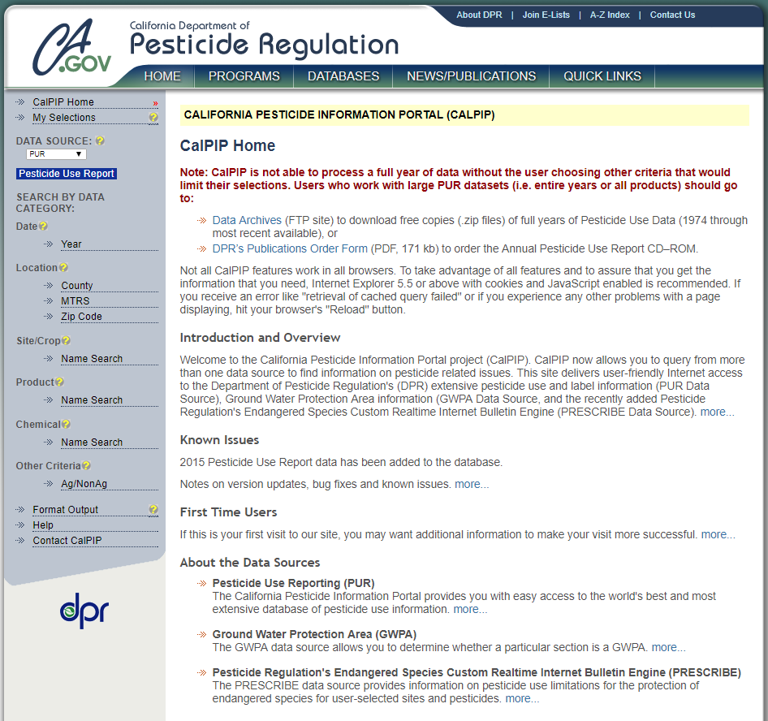
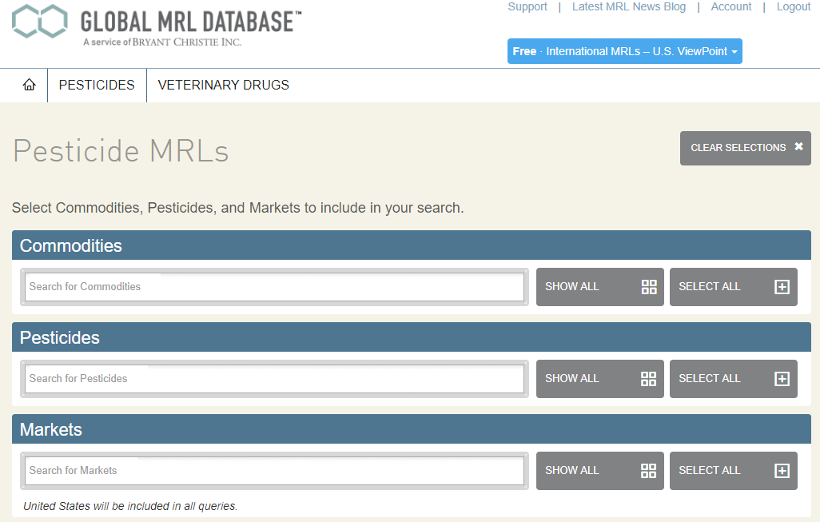
Anybody can see what pesticides are used on California crop: PUR
Pesticide use in California
Mandatory reporting
Data is open to the public via Pesticide Use Reporting (PUR) database:
www.cdpr.ca.gov/main.cfm
Pesticide Maximum Residue Levels
www.globalmrl.com
Free to users in the United States
Dozens of commodities paired with registered compounds and global markets

Slide 41
Examples of Biopesticides/ Exempt from Tolerances currently used in Almonds:
 | 2015 Acres treated | US Status | EU Status
Polyoxin D | 115,967 A | Exempt | Not approved, default MRL 0.01 ppm, but doesn’t show up in EU MLR list.
Copper, various | 280,000 A | Exempt | 30 ppm
Sulfur | 46,036 A | Exempt | Exempt
Phosphite |  | Exempt | Use fosetyl-Al MRLs
Methoprene | 100,407 A | Exempt | 0.05 ppm
Azadirachtin | 2,245 A | Exempt | 1 ppm
Limonene | 16,654 A | Exempt | Can’t find any record in EU
B. thuringiensis (various) | 20,600 A | Exempt | Exempt
Aspergillus flavus 36 | Just got CA reg. | Exempt | nothing
NOW pheromones |  | Exempt | Exempt
Indian Meal Moth pheromone |  | Exempt | Exempt

Slide 42
Next steps for consideration by the Biopesticide industry:
Understand the trade flows for your major food use markets
Don’t assume that if it is exempt from a tolerance in the United States, it will be exempt everywhere else in the world
For growers/processors better to have some evidence that it has been reviewed, than not.
➔ Disharmony can cause significant trade disruption!!!
Actions to consider:
Understand opportunities for international harmonization
Be engaged now before different definitions of biopesticides, exemption from tolerances, data requirements become entrenched.
Currently no place for something that doesn’t leave a residue within the Codex Process, no exemption from tolerance, or something similar (NZ paper)
If decide yes, then need to work with US EPA to be engaged in these areas.
- Global database of status of biopesticides – currently most don’t show up in the MRL databases because don’t’ have residues/don’t need MRL. No good way to show a buyer something is OK.

Slide 43
Thank you!
Gabriele Ludwig
gludwig@almondboard.com

