Slide 1
What Does IPM Have to do With Sustainability?
David Epstein
USDA Office of Pest Management Policy

Slide 2
IPM is a Decision-Making Framework
IPM
Orchard Pest Management, Beers et. al.
Autocidal
Biological
Cultural
Chemical
Predictive Models
Economic Injury Level
Other Farm Practices
ID & Monitoring
Biology & Ecology
Socioeconomic Factors
Applicable across ALL farming systems
A philosophy of pest control founded on the principles of ecology
Promotes use of varied tactics: knowledge of the crop, pests and associated natural enemies to avoid crop loss, minimize harmful effects on the environment
Takes into account financial, physical and human aspects of farm operations

Slide 3
Many IPM Success Stories in Achieving Sustainability
1950s – 1970s: Calendar spray programs – preventative, not informed
Post IPM introduction: monitoring, predictive models, thresholds inform need / timing of chemical controls
Promotion / Integration of chemical controls with biological and cultural controls – incorporation of biopesticides
  Broad adoption of MD
  Viruses
  No till
  Entomopathogens
  Cover crops
  Trap crops
  Areawide Management

Slide 4
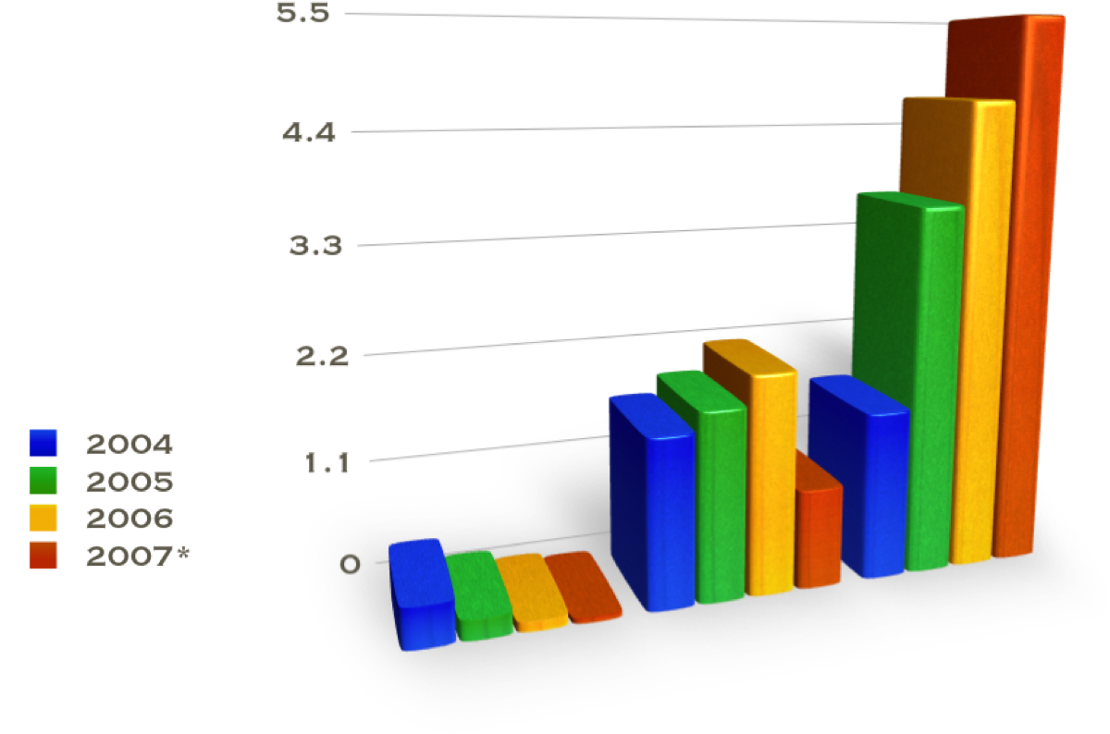
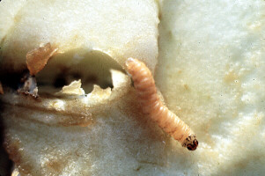
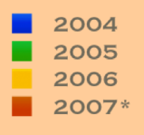
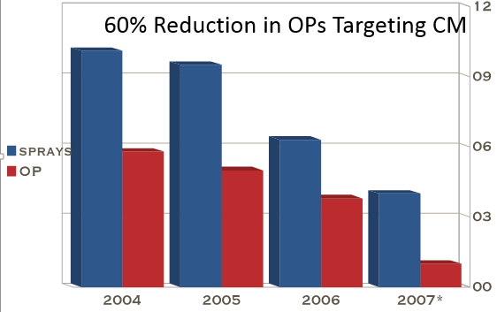
US EPA Pheromone Registrations
Reduction in fruit injury
IPM is an ecological approach to pest management that encourages farmers to utilize multiple tools to address pest management challenges while also addressing human and environmental health concerns

Slide 5
Why is IPM not lauded far and wide as Sustainable?
IPM Metrics – all success is measured in PESTICIDE REDUCTION – expectation that pesticide use will disappear or become “LAST RESORT”
  Acknowledges pesticide use – emphasis on informed, wise use
USDA PDP annual summaries/database for pesticides detected on food at market points of sale - 2016 >99% of samples tested had residues well below the tolerances established by the EPA -23% no detectable residue
Farms are not natural ecosystems – pests must be managed in a manner that is effective and economical
  Endemic key pests
  Invasive Pests
Pesticides, incl. biopesticides for marketable produce
Major consideration in sustainability is keeping farmer in business, providing safe and affordable supply of food

Slide 6
Biopesticides, IPM and Sustainability: Research Success and Needs
Michael Braverman
IR-4 Project, Rutgers University

Slide 7
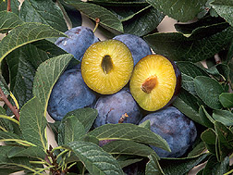
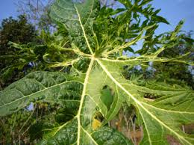
Biotechnology and Sustainability
Plum Pox Virus and HoneySweet Plum
Papaya Ringspot virus resistant Papaya- Viral Coat Protein

Slide 8
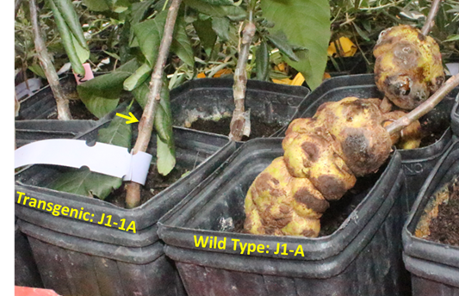
Biotechnology and Sustainability
Crown Gall Resistant Transgenic Walnut Rootstocks Line
RNAi mediated inhibition of IAA production
.
Transgenic Paradox
Wild Type Paradox
Daniel Kluepfel

Slide 9
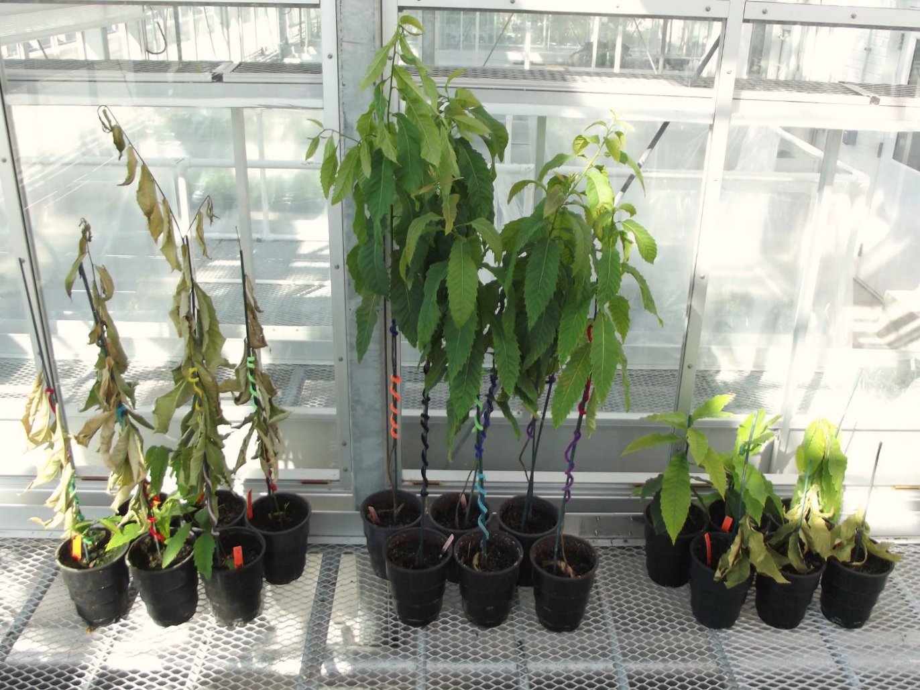
Biotechnology and Sustainability
Oxalate oxidase (OxO) gene from wheat
Wild type American chestnut
Darling 54 American chestnut
Qing Chinese chestnut

Slide 10
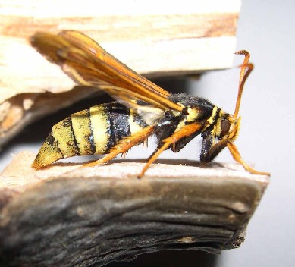
Poplar Clearwing Moth Pheromone
Use of pheromone in N.E. Oregon estimated to have decreased use of Chloropyrifos by 44,000 pounds

Slide 11
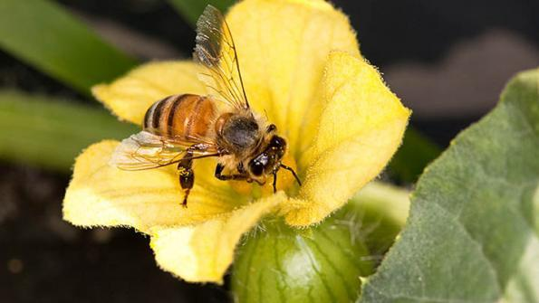
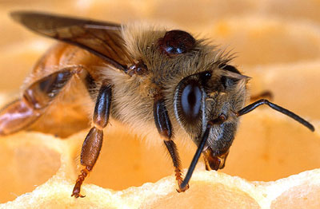
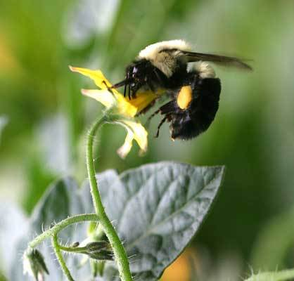
Pollinator Safety
In hive -Varroa mite-
Natural products like thymol,
hop extracts. Some
conventional products may
increase sensitivity to in-
crop pesticides. In field or greenhouse-
during
pollination

Slide 12
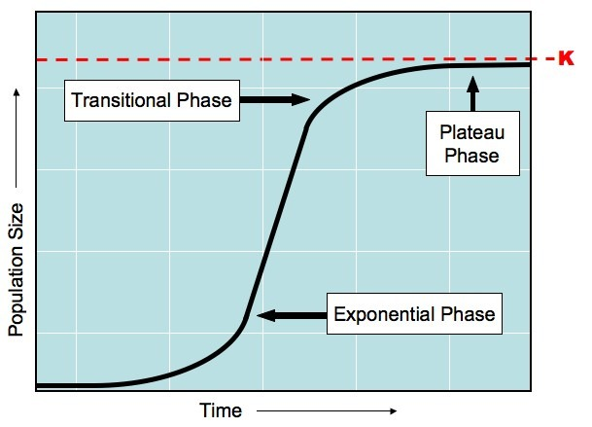
Std. Growth Curve
Cornerstones IPM- Scouting and Thresholds
Lag Phase

Slide 13
Std. Growth Curve
IPM+Biopesticides- Need better understanding pest population dynamics
Threshold Conventional
Lag Phase

Slide 14
Std. Growth Curve
IPM+Biopesticides- Need better understanding pest Population Dynamics
Threshold Conventional
Threshold Biopesticide
Lag Phase

Slide 15
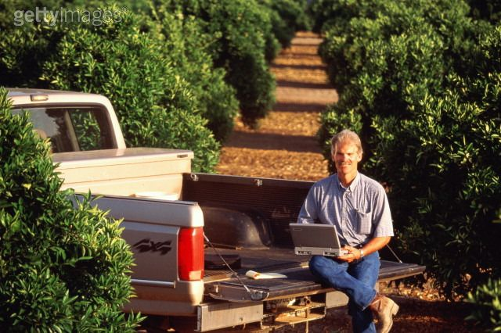
Biopesticide Label Database
Biopesticides and IPM - What are the tools?
Biopesticide Label Database
INPUT >
Crop
Pest
State
Option- Limit output to Organic products

Slide 16
Biopesticide Label Database
Biopesticides and IPM - What are the tools?
Biopesticide Label Database
INPUT >
Crop
Pest
State
Option- Limit output to Organic products

Slide 17
Thank
You!
Michael Braverman
braverman@aesop.rutgers.edu

Slide 18
Engaging IPM in Sustainability
Lori Berger
UC Statewide IPM Program
October 11, 2017
Orlando, Florida

Slide 19
IPM is stuck.

Slide 20
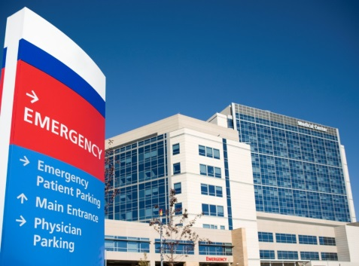
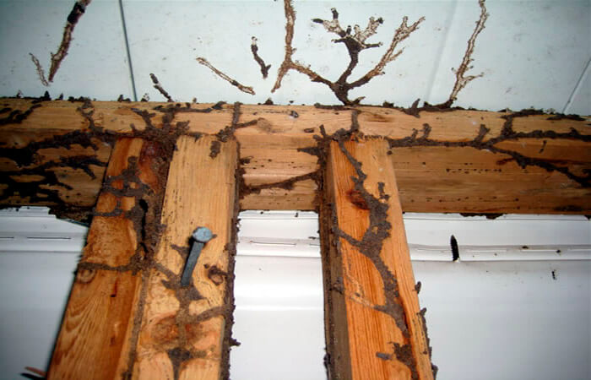
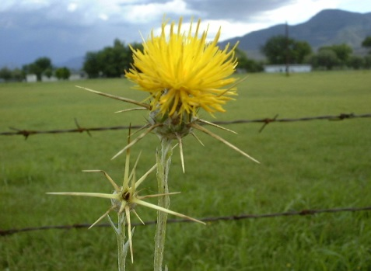
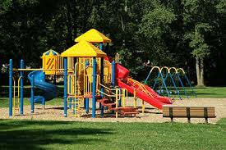
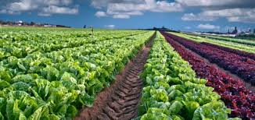
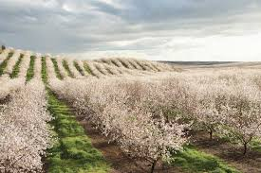
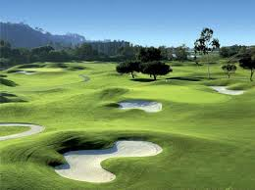
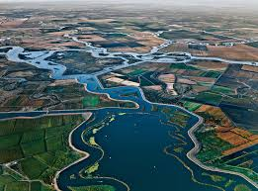
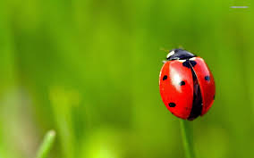

Slide 21
Policy,
Innovation, &
Communication
Structural
IPM
Agricultural
IPM
Landscape
IPM
Recommendations:
2018 White Paper
On-Going Dialogue:
IPM Summit April 2018

Slide 22
Conventional Thinking…
In order to optimize the whole,
we must understand the parts.
Systems Thinking…
In order to optimize the whole, we must
understand the relationship of the parts.

Slide 23
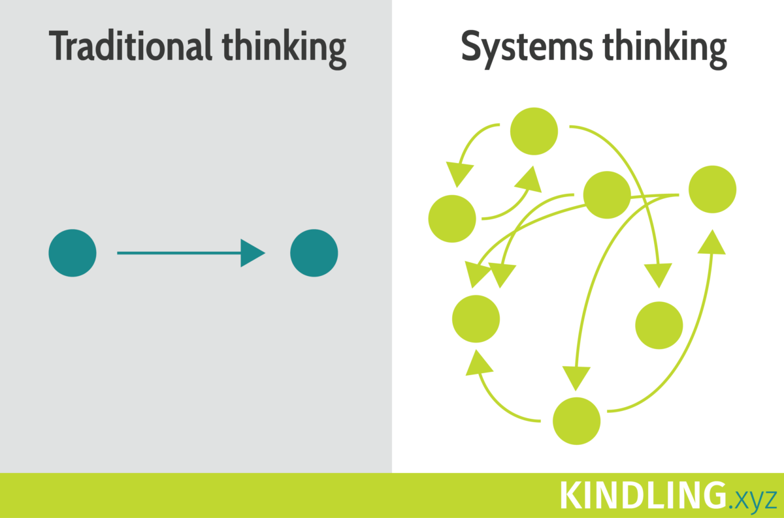

Slide 24
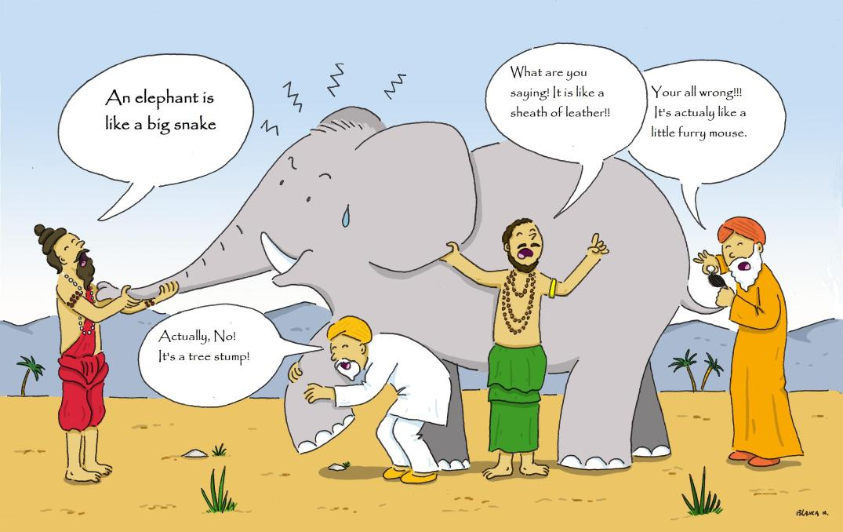

Slide 25
Lessons Learned
Reinvest in Collaborative, Relevant Research
Recognize Pest Management is Dynamic
Many Tools Are Needed
Biologicals Are Important

Slide 26
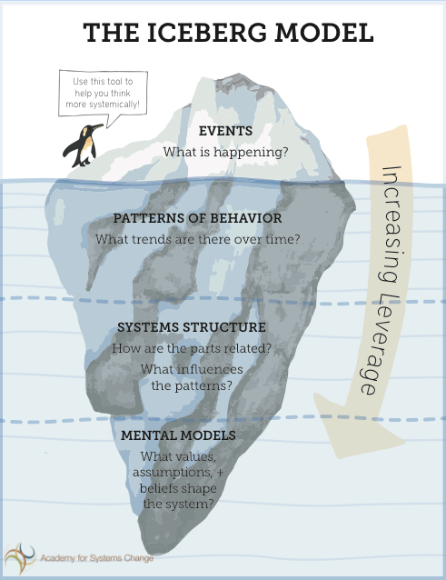

Slide 27
What Should Be Done Differently?
Understand the Systems and Mental Models
Trusted Messengers
Simple, Consistent Messages About Risk
Recognize Millennials are Driven By Values

Slide 28
Fully Engaging IPM in Sustainability
Drive Demand for IPM (IPM is a Part of Sustainability)
Holistic and Landscape Approaches to IPM
Innovation
Uncommon Collaborations
“We Are in This Together”

Slide 29
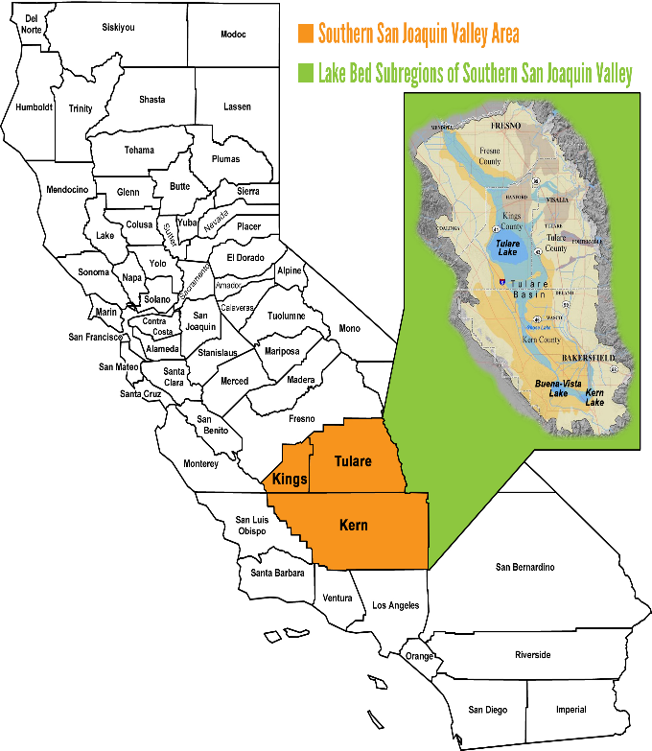
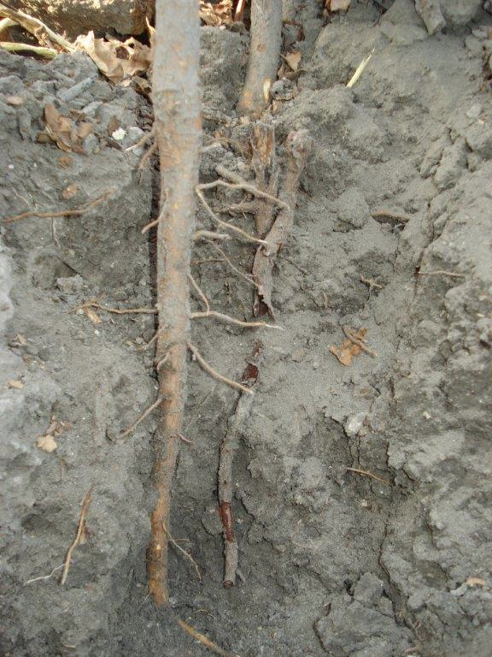

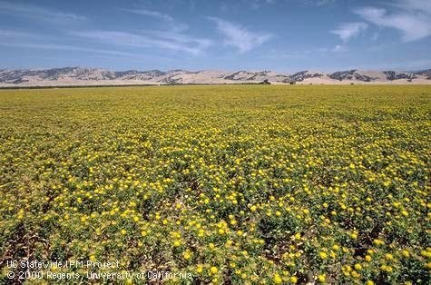

Slide 30
Michael Rozyne at BPIA 2017 Fall Meeting, Orlando, Florida
Where Is IPM?
In the Public Conversation on Sustainability

Slide 31



Slide 32

My objectives, in next 7 minutes:
1. Reframe the question from Where? to Why?
2. Introduce one answer to the question Why?
And then one example of How?
3. Modify your vacation reading list

Slide 33
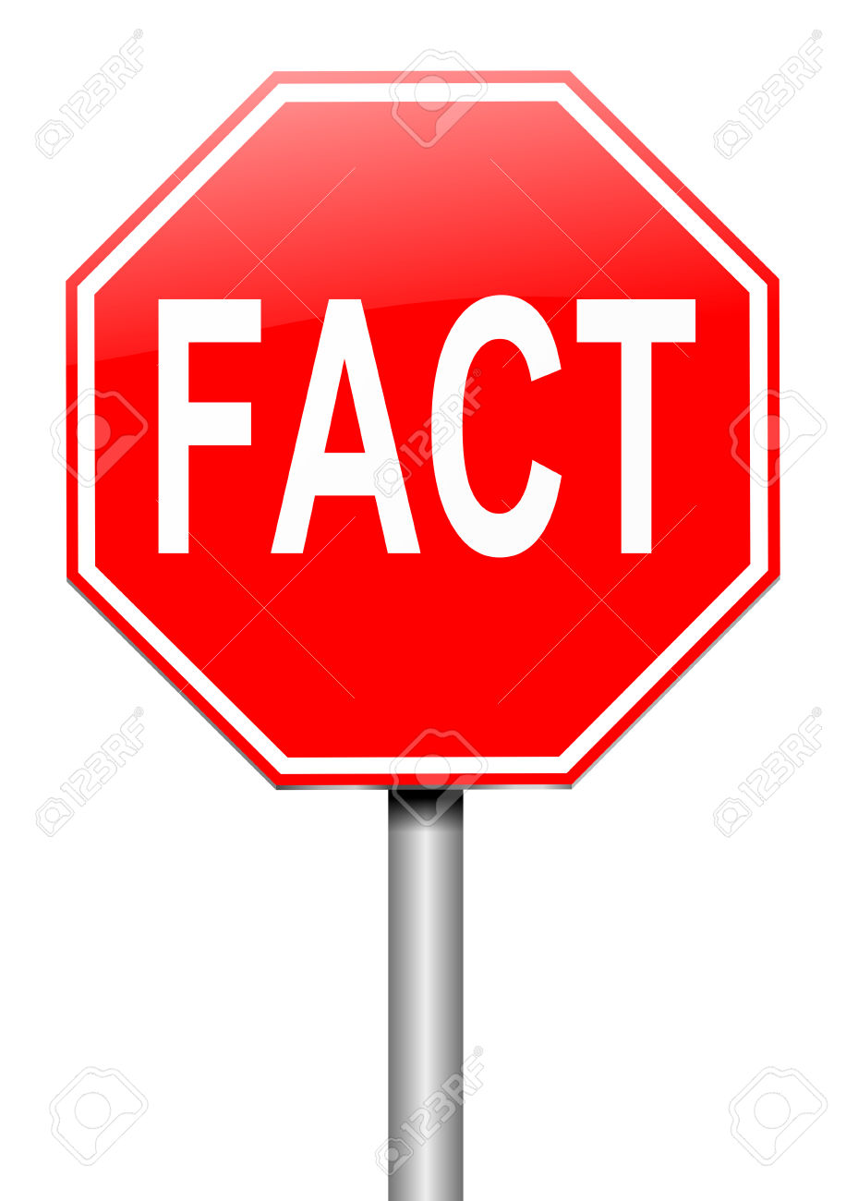
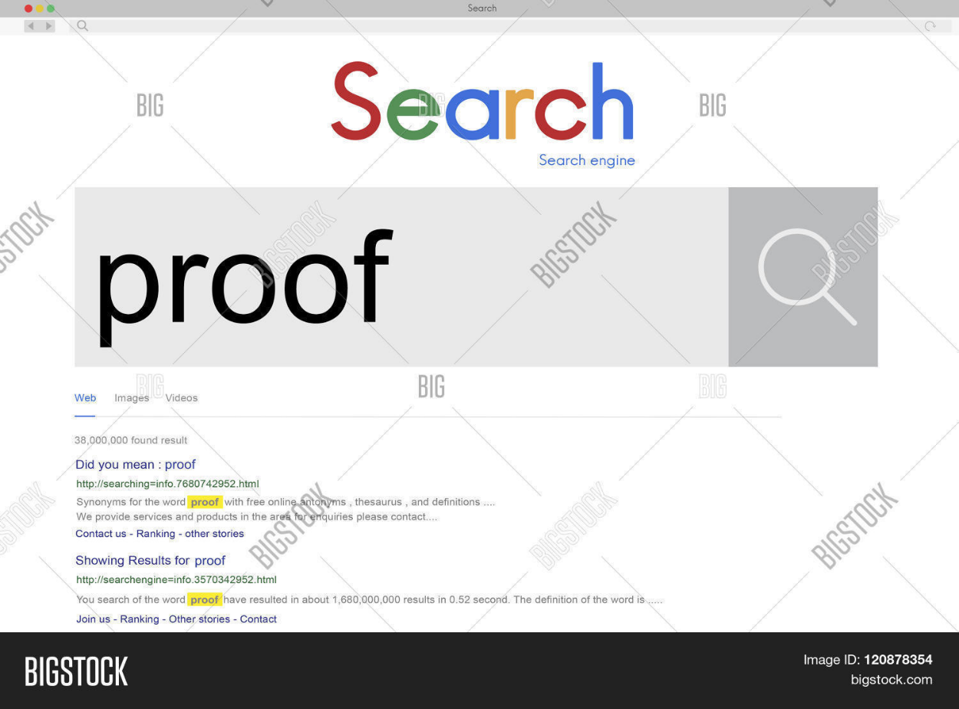

Slide 34
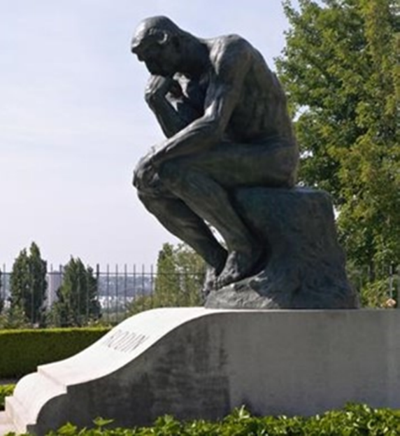
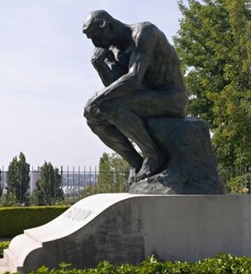
My Undoing!
Hmmmmmmm…

Slide 35

Emotion vs. reason: who decides?

Slide 36
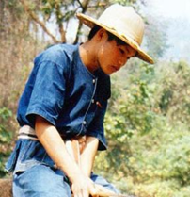
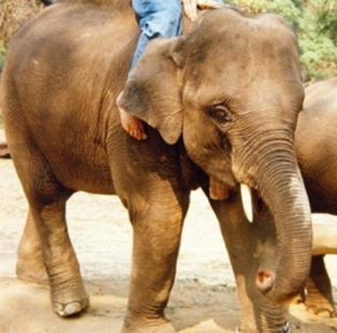

The elephant (emotion) is in charge.
The rider (reason) justifies and assists.
Thinking system #1:
fast and automatic—
intuition, feelings, emotion
Thinking system #2:
slow, analytical—
reasoning, rational

Slide 37

Framing is how human beings process information
Information
facts
The mental structures that shape how we see the world
The stories we tell ourselves about how the world works
Language, words, trigger the frames already in your mind

Slide 38



good farming practices
and the Food Narrative Project
People just don’t understand agriculture
And when there is talk about farming practices, it’s oversimplified!
It’s often soooo polarized!!
(is anyone really listening?)
And, where are the facts??? Where is the science????

Slide 39



First: Map the terrain
Use strategic frame analysis to develop better ways to communicate about farming
E
CM
Expert
Interviews
Cultural Models
Media Content & Field Frame Analysis
What needs to be communicated?
How does
the public think?
What frames
are in play already?
Courtesy of the FrameWorks Institute

Slide 40


Then: Reframe--develop and test a framing strategy that can navigate to new terrain
Candidate Metaphors or Reframes
OTS
On-the-Street
Interviews
Controlled
Experiments
Persistence
Trials
Which reframes seem to work?
Which reframe drives policy preferences?
How will this frame fare in the world?
Effective Metaphors
Courtesy of the FrameWorks Institute

Slide 41

Then: Make the new framing content useful to the field
Translate into formats that allow advocates to appreciate and adopt them
With these tools in hand, pursue outreach, organizing and training activities to equip and support the field
Courtesy of the FrameWorks Institute

Slide 42

Your vacation reading:
1. Thinking, Fast and Slow by Daniel Kahneman
2. The Righteous Mind by Jonathan Haidt
3. Whose Freedom? by George Lakoff
4. Don’t Think of an Elephant by George Lakoff
5. The Undoing Project by Michael Lewis

