Slide 1
BIOLOGICAL PRODUCTS INDUSTRY ALLIANCE
© 2018 BPIA ALL RIGHTS RESERVED

Slide 2
Biostimulants Resource Deck
© 2018 BPIA ALL RIGHTS RESERVED

Slide 3
Purpose: An education and communication tool for various audiences, including:
Internal BPIA – BOD, Committees, new members, etc.
External – Hill, other trades, regulators and other state & federal institutions, researchers, growers, specialty products market, consumers, distributors, shippers, exporters, grocers, home and garden retailers
Intended Users – any interested BPIA member
Flexible Format – Main deck = detailed version that may be used as is or shortened / lengthened / customized for specific audience
A Living Document – to be continuously updated; kept current to meet evolving needs

Slide 4
Use of this Presentation:
The information in this presentation was compiled from sources believed to be reliable for informational purposes only. All information herein should serve as background, which you can use to create your own presentation. Any and all information contained herein is not intended to constitute legal advice. You should not take, or refrain from taking action based on its content. We do not guarantee the accuracy of this information and further assume no liability. Reproduction and distribution of this presentation without written permission of the Biological Products Industry Alliance (BPIA) is prohibited.
© 2018 BPIA ALL RIGHTS RESERVED

Slide 5
What are biostimulants?
Acids
Extracts
Other
Microbials
© 2018 BPIA ALL RIGHTS RESERVED

Slide 6
Biostimulants
Biostimulants are a new class of products for which legal definitions do not exist and regulatory pathways are unclear
Fertilizers
Biostimulants
Pesticides
Provide macro and micro nutrients
Well known regulatory pathways
Low to medium level of requirements
Improve nutrient use efficiency
Abiotic stress
Crop quality / Vigor
Regulatory pathways are unclear / under construction
Legal definitions are not established
Preventative or curative effects
Specific targets
PGR
Well known regulatory pathways
High level of requirements
Description
Regulatory status
© 2018 BPIA ALL RIGHTS RESERVED

Slide 7
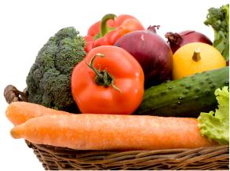
Plant Biostimulants are NOT Pesticides
Biostimulants…
Do not alter plant growth in a manner consistent with the original intent of the Federal Insecticide, Fungicide and Rodenticide Act (FIFRA), regarding “plant regulators”
Do positively affect the physiology of the plant
Do enable plants to achieve more of their natural growth potential
Do offer benefits consistent with products excluded from FIFRA, i.e.:
Plant nutrients and trace minerals
Soil amendments
Plant inoculants
ISSUE: No current State or Federal path to market allows use of the term “biostimulant” or covers the appropriate product claims
© 2018 BPIA ALL RIGHTS RESERVED
7

Slide 8
Biostimulant Definition?
No definition is currently recognized by U.S. State or Federal regulatory authorities;
Until a definition is adopted BPIA supports a working definition that emphasizes the following elements:
Substances and/or microorganisms that are -
Applied -
To Enhance/Benefit:
Nutrient uptake, Nutrient efficiency;
Abiotic Stress Tolerance;
Crop quality and/or yield
© 2018 BPIA ALL RIGHTS RESERVED

Slide 9
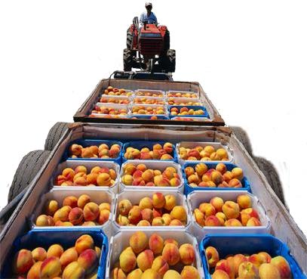
BPIA supports the following definition:
Plant biostimulants are substance(s) and/or micro-
organisms whose function when applied to seeds,
plants or the rhizosphere is to stimulate natural processes
to enhance/benefit nutrient uptake, nutrient efficiency,
tolerance to abiotic stress, crop quality and/or yield.
© 2018 BPIA ALL RIGHTS RESERVED

Slide 10
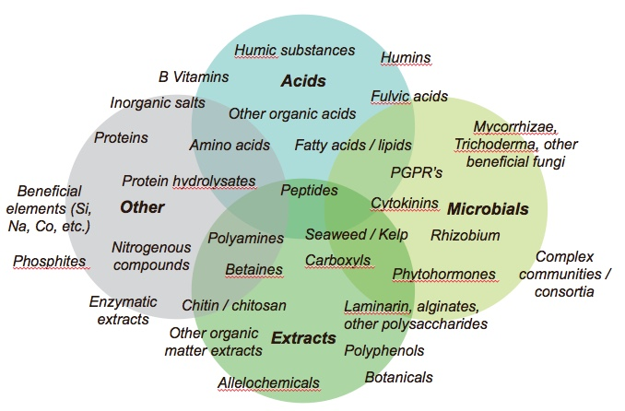
The Emerging Landscape of Products Broad and (Potentially) Confusing
Source: Agricen Sciences’ analysis of market analysts, survey papers on Biostimulants
© 2018 BPIA ALL RIGHTS RESERVED

Slide 11
BPIA’s Goal
Acids
Extracts
Other
Microbials
Work with industry and regulatory stakeholders towards:
Legally accepted definition for biostimulants
Clearly defined regulatory pathway
Outreach and Education
Promote Benefits of Biostimulants
© 2018 BPIA ALL RIGHTS RESERVED

Slide 12
Benefits of Biostimulants
Nutrient uptake,
Nutrient efficiency;
Abiotic Stress Tolerance;
Crop quality and/or yield
© 2018 BPIA ALL RIGHTS RESERVED

Slide 13
Benefits of Biostimulants
Biostimulants are compatible with the most advanced farming
Techniques used in Integrated Crop Management
Enhance uptake and efficient use of nutrients, both applied and existing
Improve soil health by enhancing beneficial soil microorganisms
Improve tolerance to abiotic stress: drought, extreme temperatures (cold, frost and heat) and salinity;
Enhance crop quality through plant health and vigor
Increase harvestable yields
© 2018 BPIA ALL RIGHTS RESERVED
13

Slide 14
Biostimulants Contribution to Agricultural Sustainability
Sustainability
Terry Stone,
Vice President, Regulatory Affairs & Sustainability Programs July 25, 2017
© 2018 BPIA ALL RIGHTS RESERVED

Slide 15
Sustainability & Biostimulants
Biostimulants are a vital and sustainable solution to address key agriculture challenges, including:
Increased agricultural demand necessitated by a growing population
Extreme weather and growing conditions related to climate change
Limited natural resources; water, soil, arable land
Industry focus is to develop and commercialize biostimulants that are compatible with advanced farming techniques used in Integrated Crop Management (ICM), the cornerstone of sustainable agriculture
© 2018 BPIA ALL RIGHTS RESERVED

Slide 16
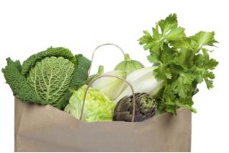
Biostimulant Benefits Provide Sustainable Outcomes
Biostimulant benefits:
Nutrient uptake
Nutrient efficiency
Abiotic Stress Tolerance
Crop quality and/or yield
Sustainable Ag Outcomes:
Water Quality: increased uptake of applied or existing nutrients reduces potential for runoff
Water Use: greater yield from same or less water applied extends available supply for all uses
Soil quality: enhanced microbiome improves composition, organic content, and carbon sequestration
Carbon Emissions: increased plant uptake of applied or existing nutrients reduces N₂O emissions
Food loss: improved quality increases harvest of marketable produce and grower profitability
Land Use: greater yield per acre reduces need to cultivate additional acres
© 2018 BPIA ALL RIGHTS RESERVED
16

Slide 17
The Sustainability Consortium (TSC)
“Research around the use of biostimulants points to clear opportunities for reducing key impacts
related to agricultural production.
Incorporating biostimulants into our improvement opportunities reflects TSC’s commitment to science as the foundation for our work. This effort ultimately strengthens the quality and impact of our toolkits by reflecting new scientific findings.”
The Sustainability Consortium (TSC)
© 2018 BPIA ALL RIGHTS RESERVED

Slide 18
Role of Biostimulants in Sustainable Agriculture
Biostimulants are integral to continual improvement needed to achieve a sustainable food, feed and fiber supply
Biostimulants are a valuable addition to existing tools that enhancing crop health, quality and grower profitability
TSC’s recognition of biostimulants as "improvement opportunities" further highlights biostimulants unique contribution to sustainable agriculture
To encourage adoption, biostimulant companies must educate stakeholders from “field to fork” of their benefits
© 2018 BPIA ALL RIGHTS RESERVED

Slide 19
Biostimulant market
© 2018 BPIA ALL RIGHTS RESERVED

Slide 20
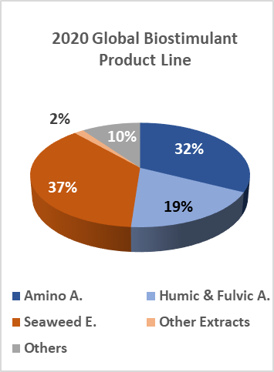
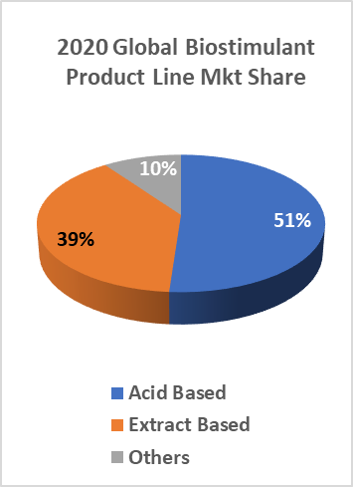
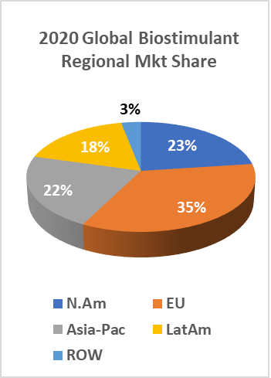
Global Market Performance—biostimulant
35%
~ 13%
Euro Share of Global Market slowest CAGR
Global CAGR in 2020
37%
~15%
Seaweed E. Largest Product Line
Microbials Product Line Fastest Growing
Biostimulants—Sustainable Growth—12 to 15%
Latin American market growing faster than any other region
Climate and crops grown in Latin America well adapted to use of biostimulants
Technology for Abiotic stress & management’s constraints
More efficient use of resources (fertilizer, water, other inputs)
Consumer willingness to pay for quality on fruits & vegs
Biostimulant market still dominated by rapidly growing entrepreneurial companies
Large companies focused on microbials but consolidation has started
Market consolidation underway
Market access as key success factor
Possible impact of increasingly strict regulatory requirements
R&D increase its importance as differentiation and future business sustainability issue
74%
>16%
Foliar Application Major Use
Seed Application Fastest Growing
© 2018 BPIA ALL RIGHTS RESERVED

Slide 21
MARKET SUMMARY
2016 Industry
2016 B$ - manufacturer level
Biocontrol Market includes Biopestcides
(biochemicals & microbials) and Macro-organisms
Biostimulants Market includes humic and fulvic acids, seaweed extracts, proteins, amino-acids and microbials.
Industry Outlook
Growth trend for biocontrol, biostimulants and specialty nutrient industry is extremely positive for the next years:
Biostimulants provide new solutions that increase yields while minimizing inputs and environmental impacts.
Biostimulant products feature operator safety and generally do not warrant the regulatory limitations of some traditional crop protection products.
Source: Valagro elaboration from different external and internal sources
© 2018 BPIA ALL RIGHTS RESERVED

Slide 22
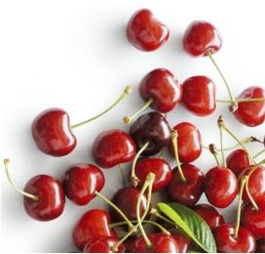
Market Overview
Drivers
Challenges
More product use to avoid soil degeneration
Expanded use beyond pioneer countries (new markets)
New products targeting specific agronomic needs
Focus on conventional crop (with more acres)
Growers lack knowledge & understanding of biostimulants
Lack of a widely accepted definition and uniform labelling
Lack of consistent risk -based regulation
Slow rate of acceptance in the market place
Source: Valagro elaboration from different external and internal sources
© 2018 BPIA ALL RIGHTS RESERVED

Slide 23
Regulatory environment
© 2018 BPIA ALL RIGHTS RESERVED

Slide 24
Biostimulants
Biostimulants are a new class of products for which Legal definitions do not exist and regulatory pathways are unclear
Fertilizers
Biostimulants
Pesticides
Provide macro and micro nutrients
Well known regulatory pathways
Low to medium level of requirements
Improve nutrient use efficiency
Abiotic stress
Crop quality / Vigor
Regulatory pathways are unclear / under construction
Legal definitions are not established
Preventative or curative effects
Specific targets
PGR
Well known regulatory pathways
High level of requirements
Description
Regulatory status
© 2018 BPIA ALL RIGHTS RESERVED

Slide 25
Plant Biostimulants are NOT Pesticides
Biostimulants…
Do not alter plant growth in a manner consistent with the original intent of the Federal Insecticide, Fungicide and Rodenticide Act (FIFRA), regarding “plant regulators”
Do positively affect the physiology of the plant
Do enable plants to achieve more of their natural growth potential
Do offer benefits consistent with products excluded from FIFRA, i.e.:
Plant nutrients and trace minerals
Soil amendments
Plant inoculants
ISSUE: No current State or Federal path to market allows use of the term “biostimulant” or covers the appropriate product claims
25
© 2018 BPIA ALL RIGHTS RESERVED

Slide 26
BPIA supports the following definition:
Plant biostimulants are substance(s) and/or micro-
organisms whose function when applied to seeds,
plants or the rhizosphere is to stimulate natural processes
to enhance/benefit nutrient uptake, nutrient efficiency,
tolerance to abiotic stress, crop quality and/or yield.*
© 2018 BPIA ALL RIGHTS RESERVED

Slide 27
Elements of an Effective US Regulatory Environment
Distinct Biostimulant Category – recognized by State & Federal Authorities
Consistent & Appropriate Biostimulant label claims
Labeling Standards - e.g., single label for all states
Science-based Risk Assessment
Market Protection - level “playing field”
Data Protection
Predictable path to market (time and cost)
Adaptable to innovation and future technologies
© 2018 BPIA ALL RIGHTS RESERVED
27
An Effective Regulatory Framework Would Include… | AAPFCO | EPA
Biostimulant Category – distinctive, recognized by all states | X | X
Biostimulant Labeling (appropriate claims) | X | X
Risk Assessment (scientifically reasonable) | None | Unnecessarily complex
Labeling Standards | Multiple, often contradictory, state standards Masked as fertilizer | Unnecessarily complex for biostimulants Masked as PGR
Market Protection (uniformly fair) | X | X
Data Protection | X | X
Consistent Regulatory Requirements (e.g., single label for all states; specific biostimulant criteria) | X | X
Predictable path to market (time and money) | Can take many months to nail down approved label version(s) | Inherently long and expensive process.
Adaptable to innovation and future technologies | X | X

Slide 28
What Would an “Ideal” Regulatory Environment Entail?
Definition for biostimulants recognized by regulatory agencies
Clear, consistent and predictable process for market entry
Clarity on acceptable claims for biostimulants
Single label for all US states
Clear approach for registration of products that may have dual use
Global harmonization of standards and practices (to the extent possible)
Supports industry practices that enhance market credibility
© 2018 BPIA ALL RIGHTS RESERVED

Slide 29
Multiple Stakeholders involved, each with a role
EPA | USDA | States
Regulate pesticides through FIFRA Determines required safety data and reviews before “approving” Identified product categories excluded from FIFRA and not considered pesticides Plant nutrients, trace elements soil amendments, plant inoculants, vitamin hormones and nutritional chemicals Addresses questions from state regulators on pesticidal status of biostimulants (BS) Clarifies claims for excluded categories including nutritional chemicals | No current regulatory oversight of BS Benefits of BS are consistent with USDA sustainability goals Nutrient management Resource use efficiency Adoption of sustainable ag practices Interested in coordinating cross-stakeholder workgroup to help industry achieve goals USDA, EPA, NASDA, AAPFCO Industry Development of federal regulatory framework Accept potential oversight of BS | Fertilizer officials reside in State Department of Agriculture Report to the State Secretary of Agriculture Implement fertilizer/ biostimulant regulations States have own legislation for regulating fertilizers/ BS products States are members of AAPFCO AAPFCO establishes guidelines for state fertilizer regulation Potential to establish uniform regulations States may or may not follow recommended guidelines National Association of State Departments of Agriculture May have influence over state fertilizer officials
© 2018 BPIA ALL RIGHTS RESERVED

Slide 30
Multiple Stakeholders involved, each with a role
EPA | USDA
To achieve industry goals, EPA: Defines biostimulants (BS) Clarifies BS are not pesticides Develops non-pest. risk assessment Approves/ registers BS Outcomes: BS definition, single label and regulatory assessment Or Amends FIFRA to clarify BS are not pesticides and under their authority Outcomes: Enables another Agency to define, regulate, establish single label and perform risk assessment Or Signs MOU with Agency having BS oversight to perform risk assessment Outcomes: risk assessment or data reviewed by Federal Agency | To achieve industry goals, 2018 Farm Bill Formal BS definition established USDA assumes oversight of BS Workgroup initiated to establish regulatory framework Outcomes: BS defined, USDA oversight clarified, workgroup established USDA Led BS Workgroup Key stakeholders: USDA, EPA, NASDA, AAPFCO, Industry, etc. Agree on implementation of uniform state labels for BS with NASDA and AAPFCO Develop framework details, e.g. registry, certification, other, etc. Establish criteria to assess e.g. safety, quality, efficacy Outcomes: Single/ uniform label, criteria for regulatory assessment | Establish USDA/ EPA MOU for safety assessment EPA performs product safety assessment PRIA an example of user fee process Outcome: Federal safety review Or Establish credible third party certification administered by USDA Workgroup establishes criteria for safety, quality, efficacy, etc. Workgroup identifies credible 3rd party certifiers to review standard compliance USDA confirms/ affirms competency of certifiers Outcomes: Federal Agency supported safety, quality, efficacy, etc. review, potential harmonization with EU and other countries.
© 2018 BPIA ALL RIGHTS RESERVED

Slide 31
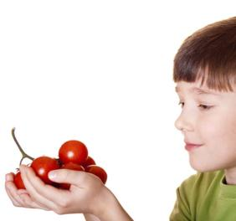
Where does BPIA go from here?
Influence
Advocate
Communicate
Educate
Collaborate
Implement
© 2018 BPIA ALL RIGHTS RESERVED
31

Slide 32
BPIA’s Influence and Advocacy
© 2018 BPIA ALL RIGHTS RESERVED

Slide 33
Success begins with a strong BPIA
Globally:
>400 Companies have a commercial interest in Biostimulants
~200 Companies have Biostimulant products in the market or in development
BPIA officially included Biostimulants in it’s scope, mission and priorities
125 Member companies and is still growing – from start ups to major global firms
Established a committee infrastructure to focus on biostimulant issues, give voice to the industry, and integrate biostimulants into existing BPIA initiatives & priorities
Dedicated member volunteers with expertise to drive key biostimulant initiatives in coordination with full time BPIA Executive Director and Staff
© 2018 BPIA ALL RIGHTS RESERVED
33

Slide 34
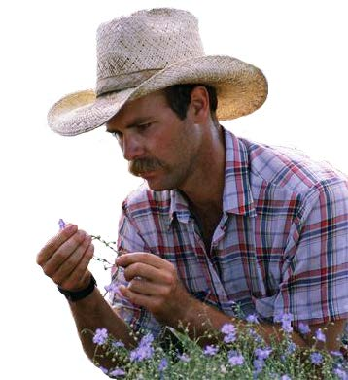
Member-Driven Committees & Meetings
Biostimulant Integration Committee:
Communications
Regulatory & Government Affairs
Biostimulant Industry Working Group
BPIA Meetings:
Two all-member meetings annually
Capital Hill “Fly-Ins”
BPIA Attends / Presents / Sponsors at various national and international meeting venues
© 2018 BPIA ALL RIGHTS RESERVED
34

Slide 35
Industry Collaboration
BPIA companies hold joint memberships and BPIA has joint initiatives with multiple industry associations:
USBC (US Biostimulant Coalition)
ASTA (American Seed Trade Association)
EBIC (European Biostimulant Industry Council)
IBMA (International Biocontrol Manufacturers Association)
AAPFCO (Association of American Plant Food Control Officials)
TFI (The Fertilizer Institute)
BIO (Biotechnology Innovation Organization)
© 2018 BPIA ALL RIGHTS RESERVED
35

Slide 36
BPIA Advocacy
Biostimulant Definition:
Adopted by EBIC, USBC and BPIA
Set forth in requested Farm Bill Legislation
EPA Label Claim Guidance:
Adoption and use pending final EPA approval and release (2018)
Continued discussions on developing definitions for nutritional chemical and biostimulants
© 2018 BPIA ALL RIGHTS RESERVED

Slide 37
BPIA Advocacy
Farm Bill Initiative:
Requested legislation to define Biostimulants
Establish USDA Stakeholder Workgroup to develop regulatory framework
Authorize USDA to conduct a multi-stakeholder study to identify potential regulatory framework
Requests the Secretary of Agriculture to conduct a study to assess types of, and which practices associated with the use of fertilizers, biostimulants and soil amendments best achieve the goals set forth in the NRCS Conservation Nutrient Management Practice 590
© 2018 BPIA ALL RIGHTS RESERVED

Slide 38
Want To Learn More?
Yakhin, O.I., Lubyanov, A.A., Yakhin, I.A., and Brown, P.H. (2017). Biostimulants in Plant Science: A Global Perspective. Frontiers in Plant Science 7:2049. doi: 10.3389/fpls.2016.02049
Du Jardin, P. (2015). Plant Biostimulants: Definition, Concept, Main Categories and Regulation. Sci. Hortic. 196, 3–14. doi: 10.1016/j.scienta.2015.09.021
Halpern, M., Bar-Tal, A., Ofek, M., Minz, D., Muller, T., and Yermiyahu, U. (2015).The Use of Biostimulants for Enhancing Nutrient Uptake. Adv. Agron. 130, 141–174. doi: 10.1016/bs.agron.2014.10.001
Calvo, P., Nelson, L., and Kloepper, J. W. (2014). Agricultural Uses of Plant Biostimulants. Plant Soil 383, 3–41. doi: 10.1007/s11104-014-2131-8
Du Jardin, P. (2012). The Science of Plant Biostimulants – A Bibliographic Analysis, Ad hoc Study Report. Brussels: European Commission.
© 2018 BPIA ALL RIGHTS RESERVED

Slide 39
THANK YOU
Keith Jones Your Name
Executive Director | BPIA Contact Info:
(202) 570-1411 (xxx) 123 - 4567
jones@bpia.org abcd@xyz.com
© 2018 BPIA ALL RIGHTS RESERVED

Slide 40
Additional slides – to supplement / make more in-depth slide deck

Slide 41
Biological Products
Source: DunhamTrimmer LLC
Biofertilizers
BioStimulants
Biological Control Products
BioPesticides
Biochemicals
Microbials
Macroorganisms
Insects
Mites
Semio-chem
Plant
Extracts
Bacteria
Fungi
Protozoa
Virus
Nema-todes
Yeasts
Others
Organic
Acids
Microbials
Abiotic Stress Mgmt
N Fixing
P2O5 Solubilizing
Amino Acids
Microbials
Plant
Extracts
K Mobilizers
Others
Organic Acids
Seaweed
Extracts
Biofertilizers
Microbials used to enhance plant nutrient uptake from soil
Nitrogen fixing bacteria make up largest group
Others include mobilizers of specific nutrients (zinc, sulfur) and mycorrhizal fungi
Biofertilizers regulated under country/state fertilizer regulations
Biostimulants
Seaweed Extracts make up the largest segment in this group
Microbials, primarily bacteria, often used as seed or soil treatment to aid in nutrient assimilation
Organic acids are humic and fulvic acids used as soil amendments, formed by the microbial degradation of plant matter.
Definition and regulation of biostimulants is still under development in most parts of the world
BioPesticides
Biopesticides are derived from natural materials, such as plants, bacteria and certain minerals. Biopesticides target specific pests and are inherently less toxic than synthetic pesticides.
Macroorganisms
Insects; Mites; Nematodes
Insects followed by mites makeup the largest groups
Unique in that the live organism in the form of eggs, larvae, pupae or adult is used.
Most important challenge for Macros is logistics—shipping live organisms that have to have special care to survive
Normally not classified as a Biopesticide—only as Biological Control Products
Biochemicals
Plant Extracts; Semiochemicals; Organic Acids
Plant Extracts make up the largest segment in this group
Semiochemicals (pheromones) has the largest actual number of products
Largest challenge for Plant Extracts is manufacturing and consistent quality in the active ingredient(s)
Microbials
Bacteria; Fungi; Virus; Protozoan; Yeasts
Bacteria, followed by Fungi make up the largest groups commercially (>90%)
Microbials are the largest market of biopesticides.
Biggest challenges for microbials are formulation related: 1) Shelf-life; 2) Stability; 3) Performance enhancement
© 2018 BPIA ALL RIGHTS RESERVED

Slide 42
Biostimulant Product categories
Microbial Biostimulants --- from bpia.org
Beneficial fungi and bacteria represent the core of the focus within the smaller but rapidly growing category of microbial biostimulants. A wide variety of microbial products are sold as biofertilizers, plant inoculants (to aid primarily in nutrient processing), soil amendments, and other beneficial additives. Microbial products can include “pure strain” fermentation solutions, based on individual isolates; consortia of admixed or co-fermented isolates; or much more complex “natural” communities derived from organic matter processing. Microbial products have been shown to enhance plant growth through various direct and indirect mechanisms; and to help with nutrient availability and uptake, improving soil condition, helping plants tolerate abiotic stress, and enhancing overall crop quality attributes.

Slide 43
Biostimulant Product categories
Acid-Based Biostimulants ---from bpia.org
Humic substances, which include humic and fulvic acids, are among the most common organic substances on earth, making up much of the organic matter in the world’s soils. Humic and fulvic acids are complex organic molecules of diverse structure and composition that form in the soil as byproducts of the decomposition and microbial metabolism of plant and animal residues. While the materials can vary quite dramatically in molecular structure and weight, humic substances have been recognized and used for decades to improve soil structure and function (e.g., chelate nutrients and improve cation exchange capacity, or CEC), enhance plant nutrition, and contribute to improved crop yield and quality. They can be applied in various ways, including direct application to the soil, foliar application, incorporation into fertilizer and other products, and through irrigation water.
Amino acid products (along with other protein-derived biostimulants, based on peptides or protein hydrolysates) can be derived from the chemical or enzymatic hydrolysis of animal, plant, or microbial protein. The protein sources are often recycled waste products of agricultural crop residues or animal processing such as collagen, epithelial tissue, crustacean shells and other materials. Recycling these otherwise waste substances into useful agricultural products is a unique environmental benefit of protein-derived biostimulants. There is strong evidence for a variety of benefits, including improved soil fertility, better plant health and vigor, enhanced crop yields and quality, and improved stress tolerance.

Slide 44
Biostimulant Product categories
Seaweed and Plant Extracts
The use of seaweed in agriculture dates to ancient times, when it was often used to improve fertility by augmenting soil organic content. Seaweed extracts, also referred to as kelp or sea kelp extracts, have been used in modern agriculture as more concentrated means to deliver benefits to soils and plants. They have been shown to improve soil properties (to improve soil structure, water retention, and aeration), as well as helping to fix or chelate nutrients and improve CEC. Seaweed extracts have also been shown to aid in the functioning of beneficial soil microorganisms, and to improve the provisioning, uptake, and utilization of plant nutrients. An impressive body of research is aimed at understanding how complex extracts and many of the constituent compounds derived from them can stimulate, elicit, or augment the healthy growth of beneficial plants. Improved stress tolerance effects have also been broadly reported.
Plant extracts (or “botanicals”) are perhaps less well studied, but represent a fast growing category of biostimulant materials. The use of allelochemicals — active plant compounds that can be extracted and concentrated — is an especially active area of both industry and academic investigation.

Slide 45
Diverse Groups are Working on How to Measure Agricultural Sustainability
Collaborative Sustainability Initiatives
The Sustainability Consortium
Cool Farm Alliance
Field to Market
Stewardship Index for Specialty Crops
Sustainable Agriculture Alliance Platform
Individual Company Programs
Heinz Global Agriculture Program
McDonalds Sustainable Beef Program
PepsiCo Sustainable Farm Initiative
Unilever Sustainable Living Plan
Walmart Fertilizer Optimization Initiative
Plus 100’s of certifications
Field to Market
© 2018 BPIA ALL RIGHTS RESERVED
45

Slide 46
The Sustainability Consortium
Food, Beverage & Ag Sector Members:
Global, non-profit collaboration of corporate, civil society, and government stakeholders
Transforming the consumer goods industry to make products more sustainable
Translating the best sustainability science into business tools to drive change in product supply chains
Identifying hotspots, improvement opportunities, and key performance indicators for different types of consumer products
Retail members represented ~
$470B of US grocery sales in 2016
© 2018 BPIA ALL RIGHTS RESERVED
46

Slide 47
Plant Biostimulants: What are the Claimed Benefits?
Improve nutrient use efficiency
Mobilization of nutrients (in soil)
Recruitment / acquisition of nutrients (e.g., stimulate root function, nutrient sensing, N-fixation)
Improved uptake
Transport, storage and assimilation
Improve abiotic stress tolerance
Performance under physical or chemical stresses
Common targets are heat, cold, water (flooding or drought), salinity
Improve crop quality traits
Nutritional / nutraceutical value, color / cosmetics, shelf life, sizing, grade, pounds solids, etc.
© 2018 BPIA ALL RIGHTS RESERVED

