Slide 1

National Association of State Departments of Agriculture: Partnerships Drive Ag Policy

Slide 2

Whitcomb
(Comm)
Jasper
(Comm)
Tebbetts
(Sec)
Sandison
(Dir)
Thomas
(Dir)
Goehring
(Comm)
Lebeaux
(Comm)
Frederickson
(Dir)
Ball
(Comm)
Taylor
(Dir)
Harsdorf
(Sec)
Wenk
(Dir)
Ayars (Chief)
Gould
(Dir)
Jaspers
(Sec)
Miyamoto
(Dir)
Redding
(Sec)
Reviczky
(Comm)
Wellman
(Dir)
Naig
(Sec)
Daniels
(Dir)
Vacant
(Dir)
Kettler
(Dir)
Leonhardt
(Comm)
Poe
(Dir)
Bronaugh
(Comm)
Fisher
(Sec)
Adams (Comm)
Ross
(Sec)
Brown
(Comm)
McClaskey
(Sec)
Chinn
(Dir)
Quarles
(Comm)
Scuse
(Sec)
Troxler
(Comm)
Templeton
(Comm)
Weathers
(Comm)
Bartenfelder
(Sec)
Killian
(Dir)
Reese
(Sec)
Ward
(Sec)
Witte
(Sec/Dir)
Gipson
(Comm)
Black
(Comm)
McMillan
(Comm)
Strain
(Comm)
Putnam
(Comm)
Miller
(Comm)
Keyes
(Dir)
NEASDA
Enright
(Chairperson)
SASDA
Alaska
Hawaii
NASDA Member & Regional Overview (as of March 2018)
MASDA
WASDA
Denotes Elected

Slide 3
About NASDA: Our Mission
To grow and enhance agriculture by forging partnerships
and creating consensus
to achieve sound policy outcomes
between state departments of agriculture, the federal government, and stakeholders.
Notes:
NASDA members serve as educators, regulators, ambassadors, and advocates.

Slide 4
About NASDA: Our Affiliates
23 Active Affiliate Organizations -
  Animal & plant health
  Seed, fertilizer & feed control
  Grain inspection
  Food safety
  Dairy, meat inspection
  Weights & measures
  Communications
  Pesticide regulation
  Technology
Notes:
NASDA enjoys a robust relationship with our 23 affiliates across a broad range of mission areas, including but not limited to: animal & plant health; seed & feed control; grain inspection; aquaculture; dairy; meat inspection; weights & measures; PIOs; and of course, FIFRA programs…just to name a few.

Slide 5
Our Policy Priorities
Enhancing State – Federal Partnerships
Growing International Trade
Implementation of the Food Safety Modernization Act (FSMA)
We Need A Farm Bill

Slide 6
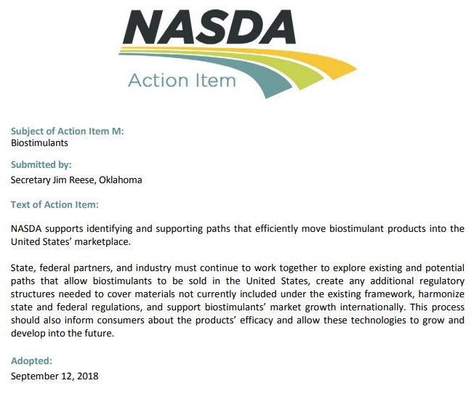

Slide 7
NASDA & Biostimulants
Work with AAPFCO and industry partners
State Departments of Ag:
  Promotion & Regulation
Water Quality Programs
  State
  Federal
Soil Health Programs
  Maryland
  California

Slide 8
Questions?
Britt Aasmundstad
Associate Director, Policy
(202) 296-9680
britt@nasda.org
Twitter: @NASDANews
Instagram: @NASDANews
www.nasda.org

