Slide 1
Biological Seed Treatments and sustainability
Jane DeMarchi
Vice President for Government and Regulatory Affairs

Slide 2
Our History
The American Seed Trade Association (ASTA) is one of the oldest trade organizations in the United States
Over 700 members involved in seed production and distribution, plant breeding, and related industries worldwide
Members produce seed for row crops, vegetables, grasses, and cover crops
Conventional, genetically engineered, and organic seed markets.

Slide 3
ASTA Mission
ASTA’s mission is to be an effective voice of action in all matters concerning the development, marketing and movement of seed, associated products and services throughout the world.
ASTA promotes the development of better seed to produce better crops for a better quality of life.

Slide 4
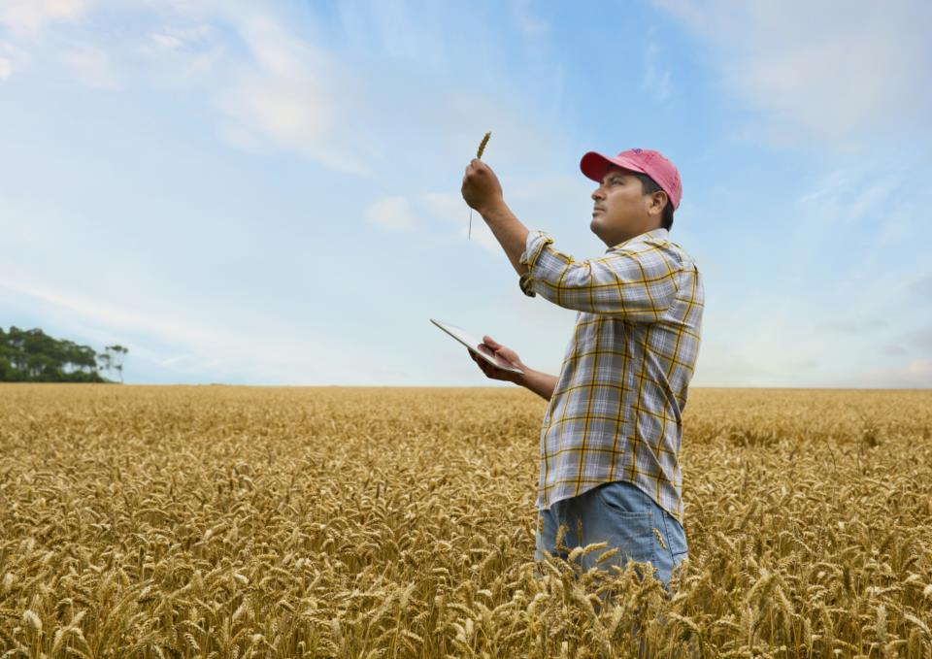
What Could the Future Hold for Farmers?
Help to
Use water and nutrients more efficiently
Manage changing weather
Use fewer inputs
Notes:
Discuss ASTA focus groups and how consumers view environmental benefits

Slide 5
Seed Treatment

Slide 6
Challenges for Traditional Tools
Lengthy EPA registration and re-registration review processes
Activist sponsored court challenges
State and local initiatives banning pesticides

Slide 7
Targets for Biological Seed Applied Technologies
Yield enhancement
Increased nutrient availability
Abiotic stress
Disease and pest control

Slide 8
Examples of Biological Seed Applied Technologies
Microbial seed applied product for soybean that maximizes the yield potential of soy by enhancing plant nutrition.
Microbial seed applied product for corn that enhances root and shoot growth and increases yield potential.
Microbial seed applied product for several crops that improves the availability of nitrogen, phosphorous and potassium resulting in improved yield potential.
Notes:
Mike McFatrich
A corn seed treatment, containing Penicillium bilaiae, that makes soil-bound phosphate more available to the plant, which can

Slide 9
Questions & Answers

