Slide 1
US Industry Efforts for Regulatory Sustainability of Biostimulants
John Breen, Actagro LLC
Biostimulant Coalition

Slide 2
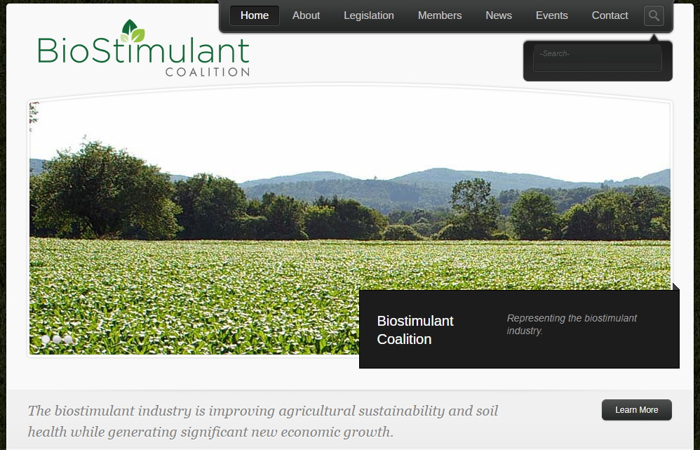
Membership of BSC
Acadian Seaplants
Actagro LLC
Agricen, a Loveland Products Company
Agrinos
Arysta LifeScience North America
CH Biotech
Cytozyme
DeltAg Formulations
Lebanon Seaboard Corporation
LignoTech
Loveland Products
Marrone Bio Innovations
NewLeaf Symbiotics
Ocean Organics
Scotts
Concentric
Growcentia
SBM Life Science Corp.
Indigo Agriculture
Plant Impact
http://www.biostimulantcoalition.org/

Slide 3
Biostimulant Industry Working Group (BIW)
BSC

Slide 4
Industry Collaboration – Working together to support biostimulants
BSC / BIW companies hold joint memberships and has joint initiatives with multiple industry associations:
AAPFCO (Association of American Plant Food Control Officials)
ASTA (American Seed Trade Association)
BIO (Biotechnology Innovation Organization)
EBIC (European Biostimulant Industry Council)
IBMA (International Biocontrol Manufacturers Association)
TFI (The Fertilizer Institute)
USBC (United States Biostimulant Coalition)

Slide 5
What Would an “Ideal” Regulatory Environment Entail?
Definition for biostimulants recognized by regulatory agencies
Clear, consistent and predictable process for market entry
Clarity on acceptable claims for biostimulants
Single label for all US states
Clear approach for registration of products that may have dual use
Global harmonization of standards and practices (to the extent possible)
Supports industry practices that enhance market credibility
© 2018 BPIA ALL RIGHTS RESERVED

Slide 6
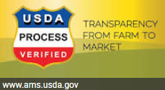
What is BIW working towards ?
Recognition of biostimulants in the US Farm Bill (definition, study report on legislative reforms)
Voluntary program
Administered by USDA-Agricultural Marketing Service
Reviews products according to an agreed set of criteria. Similar to Angus Beef and other self- promoted ag products.
NOT a substitute for existing state or federal regulations
However, by engaging all stakeholders, we hope to be in a position to influence regulatory changes when they come.

Slide 7
Supplemental Information

Slide 8
The Implied Landscape for Regulation (Draft)
State (AAPFCO) Oversight / Criteria
Federal Oversight / Criteria
R&D / Discovery
Soil Amendments
Plant nutrients
Biopesticides
”Biostimulants”
(PBS)
Plant inoculants
Trace elements
Plant Regulators
Plant nutrients
Nutritional Chemicals
Voluntary
“Biostimulatory” MOA and Related Claims
Certified to Defined Criteria
Regulatory Continuum
Fertilizers
FIFRA Exclusions
USDA AMS?
FIFRA

Slide 9
Potential USDA Oversight of Plant Biostimulants (PBS)
U.S. Plant Biostimulant Program (PBP)
PBP Administration
PBP Criteria
PBP Certification
PBP Products
On-going facilitation/ oversight by USDA AMS
Comprised of USDA, Industry, NASDA, AAPFCO & other stakeholders
Establishes program requirements/ guidelines
Oversees development/ adoption of criteria
Monitor and maintain registry of certified PBS products and 3rd party certifiers
Coordinated by PBPA
Criteria established to address: human and environmental safety, labeling, quality, efficacy claims, contaminants, etc.
Requirements established to qualify 3rd party certifiers
Criteria developed with ANSI/ ISO to encourage global harmonization
Voluntary program
Standard conformance assessment conducted by PBPA certified auditors
Certified conformance required to label and market product as “Plant Biostimulant”
PBS product registered with PBPA.
Label registered or acknowledged by States
Differentiates Plant Biostimulants (new category) from pesticides and fertilizers based on claims and intent
Assures validity of product claims, contents, safety, etc.
Recognizes higher level of product quality, consistency
AMS to manage Plant Biostimulant product and certifier registry (potential fee for service)
Increases industry credibility and assures federal oversight

