Slide 1
The Future of Biological Products in Sustainable Agriculture
Kate Shenk
Manager, Regulatory Affairs
Industrial and Environmental
October 10, 2018

Slide 2
What is BIO?
Biotechnology Innovation Organization (BIO)
World’s Largest Biotech Trade Association Based in Washington, D.C.
Over 900 Member Companies in the U.S. and 30+ Countries
Advocacy, Communications, Business Development
Emerging Companies
Food and Agriculture
Health Care
Industrial and Environmental

Slide 3
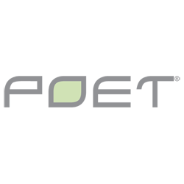
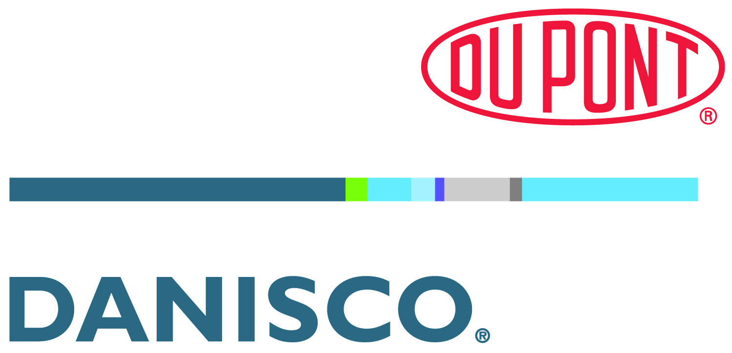
Industrial and Environmental Section Members

Slide 4
The Biobased Economy

Slide 5
Feedstocks for the Biobased Economy
Ag Crops
Grains, Camelina, Sorghum, etc.
Cellulosic Crop Residues
Corn Cobs and Stalks, Wheat Straw, Rice Hulls, etc.
Wood and Forest Waste
Municipal Solid Waste (MSW)
Waste Industrial Gases
Natural Gas
Dedicated Energy Crops
Sugars
CO2

Slide 6
Evolva: Vanillin
Complex blend of flavor and fragrance
Ingredients are found in the seed pods of the vanilla orchid
Uses yeast to convert biobased feedstocks in a fermentation process
Creates a more sustainable environment
Reduces cost and supply chain variability

Slide 7
Biotechnology & Ag Microbials
Biotechnology innovation has created products that enhance natural microbes.
Biotechnology allows researchers to identify microbes with particular attributes.
Biotechnology benefits the plant and the environment.
Biotechnology companies are investing in research and development.

Slide 8
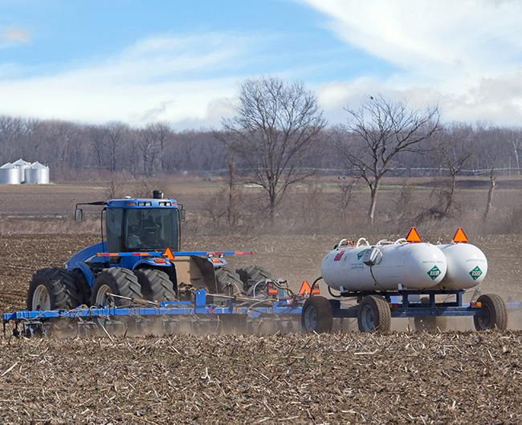
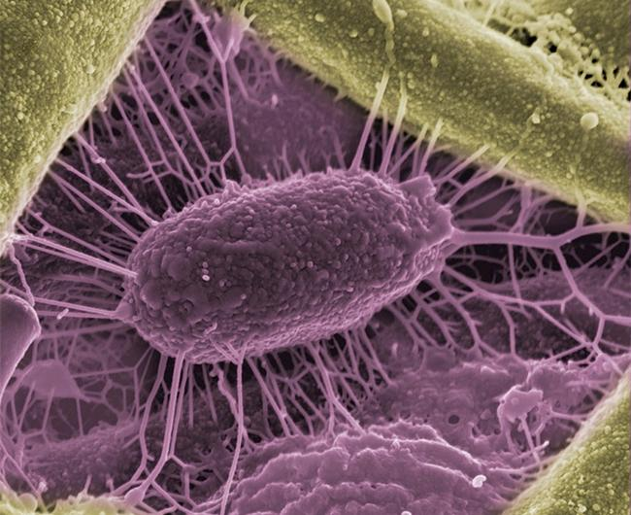
PIVOT BIO: From Chemistry to Biology
Highly accessible
Serves peak demand
Reduces infield variability
CHEMICALS ARE STATIC AND DEGRADE
MICROBES INTERACT AND GROW
Notes:
http://www.istockphoto.com/photo/sunset-over-wheat-gm183057394-14186942

Slide 9
What is BIO doing?
Promote the commitment and contributions to global sustainability.
Educate about the benefits of industrial biotechnology.
Create a favorable and supportive investment climate.
Support and enable companies that advance sustainability.
Coordinate efforts to leverage a common voice.

Slide 10
Thank You
Kate Shenk
Manager, Regulatory Affairs
Industrial and Environmental Section
Biotechnology Innovation Organization
kshenk@bio.org
202.280.1635

