Slide 1


Regulating biostimulants in Europe for greater agricultural sustainability
Kristen Sukalac
Senior Consultant
EBIC
The Status of Biostimulants in Sustainability BPIA 2018 Fall Meeting
10 October 2018 | Rochester

Slide 2
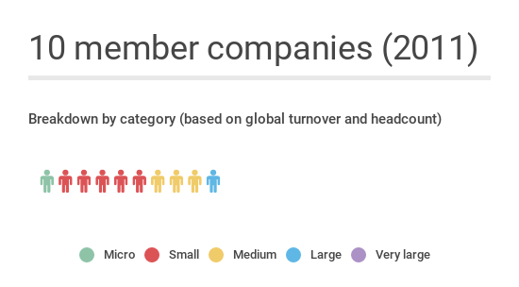
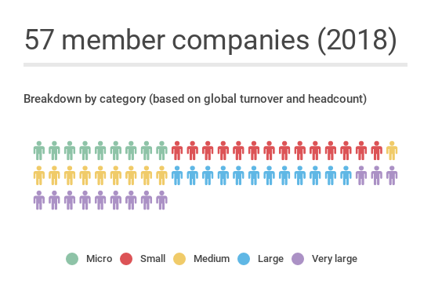

European Biostimulant Industry Council (EBIC)
Founded in 2011
…and still growing
Founded in June 2011
www.biostimulants.eu
@biostimulantsEU

Slide 3



What is EBIC’s mission?
To promote the contribution of plant biostimulants to make agriculture more sustainable and resilient
To foster the growth and development of the European biostimulants industry
To improve the regulatory framework for biostimulants, improving accessibility and transparency for the end-users: farmers

Slide 4
What are biostimulants?
Biostimulants stimulate natural processes to enhance:
nutrient uptake, nutrient efficiency
tolerance to abiotic stress
crop quality
With benefits for yield and vigor
Raw materials include seaweeds, plant extracts, humic and fulvic acids, hydrolysed proteins and micro-organisms, among others
Notes:
Biostimulants act on the processes in the plant and soil and do not act directly on the character of the fertilizer that the biostimulant may be coating.
Biostimulants effect the natural processes within plants and the soil, they do not effect the product itself.
Abiotic stress includes drought, extreme heat and cold, salt build-up, water excess (flodding conditions) etc….

Slide 5
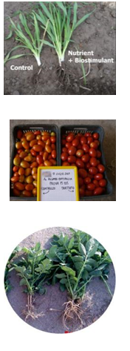
Biostimulants help nutrient use efficiency
→ Reduces nutrient losses to the environment and improves farmer ROI for fertilizer use
Biostimulants improve crop quality
→ Increases farmer’s income and helps meet technical demand with less output (e.g. a higher density of nutrient content crops for animal feed)
Biostimulants improve crop vigor
→ Improves tolerance to harsh growing conditions (abiotic stress)

Slide 6
Today, there are 28 different sets of requirements for marketing biostimulants in the EU
→ This raises the cost of bringing products to market and discourages companies from serving farmers in smaller markets

Slide 7
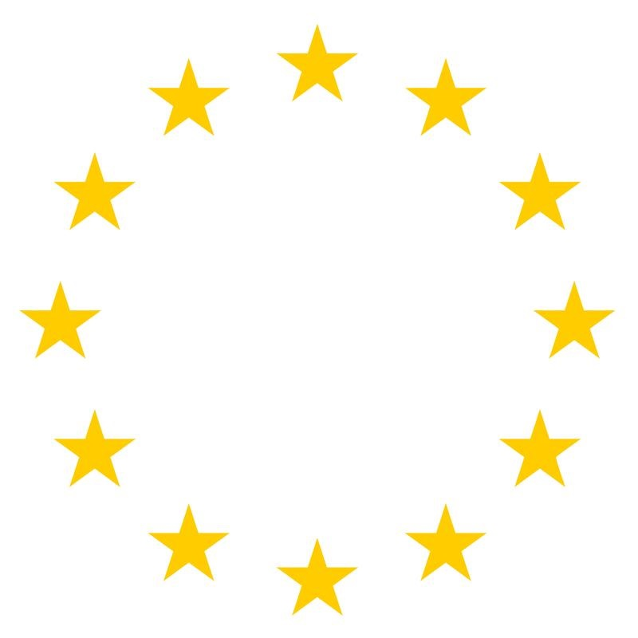
→ These will be replaced by one single harmonized set of rules and requirements for all EU countries

Slide 8
Harmonization is also an opportunity to updated an outdated regulatory framework
Minerals found in basic foodstuffs
Medicine/drugs
Vitamins, probiotics & functional foods
Vaccines
Fertilizers
Pesticides
Biostimulants
Induced plant resistance
→ Creating a unique and newly recognised place in the spectrum of crop inputs for biostimulants
Notes:
Biostimulants occupy a unique and newly recognised place in the spectrum of crop inputs

Slide 9
The policy ecosystem of the sustainability of biostimulants in Europe
Draft reg.
Plant health / invasive species
Animal
By-Products
REACH (chemicals)
& GHS/CLP
Circular Economy (recycling & industrial symbiosis)
Water Framework Directive (nutrient runoff)
Bioeconomy
Food industry quality control (for food industry byproducts)
Common ag policy
Upstream policy improving sustainability of biostimulants
Policies where biostimulants contribute to sustainability

Slide 10

Policy context for revised fertilizer regulation: Circular Economy
Recognizes need to improve resource efficiency (nutrients) and recycling
Recognizes role of Key Enabling Technologies like biostimulants
More integrated, cross-cutting approach to regulatory to achieved political objectives by connecting dots
Improving nutrient use efficiency is clearly in line with the objectives of the Circular Economy
Many ingredients come from secondary raw materials in other sectors (industrial symbiosis)
Notes:
The Circular Economy has been under discussion for several as a way of thinking about making the European economy more sustainable. In 2014, the new Commission withdrew a first proposal for making the Circular Economy a reality and has just proposed a new version, which is meant to be more ambitious. The proposal is subject to public consultation through August and then will be finalized in the 4th quarter.

Slide 11
Draft regulation on “Fertilising products” covers 7 Product Function Categories (PFCs)
PFC 3
Soil
improvers
PFC 4
Growing media
PFC 5
Agronomic additives / inhibitors
PFC 6
Bio-
stimulants
PFC 7
Combinations
PFC1
Fertilizers
PFC 2
Liming
materials
➔ The only 2 product categories covered by EU regulation 2003/2003.
11

Slide 12
The component material categories (CMCs)
(as listed in the March 2016 COM proposal)
Virgin substances and materials
Plant materials and extracts (including seaweeds)
Composts
Energy crop digestate
Other digestate
Food industry by-products
Microorganisms
Agronomic additives
Nutrient polymers
10. Other polymers
11. Materials derived from animal by-products
Additional CMCs expected:
Industrial by-products
Struvite
Biochar
Ashes
= most relevant CMCs for biostimulants

Slide 13
Nearing the end of negotiations on the draft regulation
Deadline: European elections in May 2019
There is a strong political will to have the file completed before elections next year, which means concluding talks by the end of 2018. This means that the text will be imperfect, and revisions will start immediately.
Some important hurdles remain
While some issues can be corrected/improved after the initial text is agreed, some could block agreement. Notably, there is currently a blockage on the issue of cadmium limits in mineral fertilizers; this could hold up the regulation for all product categories.

Slide 14

Biostimulants are an innovative tool that can bring value to farmers under the right conditions
What is required
Why it matters
More resilient crop production under volatile growing conditions
Better quality and yields for improve farmer incomes
Meeting societal demands for sustainable agriculture
Updating regulations for agricultural inputs
Fostering local industry development tied to local resources and knowledge
Strengthening farmer extension and training
Notes:
In conclusion

Slide 15
For more information
EBIC Secretariat
kristen@prospero.ag

