Slide 1
BioPesticide
Compliance to
Organic Regulations
Prepared for
Biological Products Industry Alliance Symposium
March 13, 2019
by Bill Wolf

Slide 2
Agenda
1. Introductions
Short History of Organic Regulations and the National Organic Program
Challenges of the Organic Regulatory Process
4. Opportunities and Suggestions

Slide 3
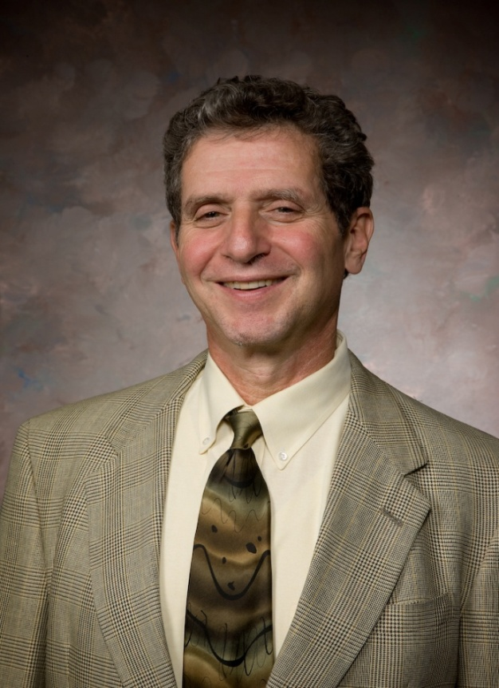
Bill Wolf
Four decades building organic sector including pest controls, fertilizers and foods
OMRI, Founding President
Organic Trade Association, Past Board President
Founder, Necessary Trading Company
1st national organic farm supply company
Founder, Concern ®
Organic gardening supplies to retail
New Resource Bank
1st commercial green bank in USA
President;
Strategic Planning Specialist

Slide 4
Service Areas
Strategic Planning
Organic Business Strategy
Sustainable Initiatives
Global Organic Compliance
Organic System Plans
Certification Audits
Informational
Webinars
Sustainable Agriculture
Soil & Pest Management
Standards Development
Policy & Standards
Organic Regulations
International Trade Policy
Our mission is to deliver the strategic expertise to help organic, socially and environmentally responsible products and projects reach their full potential — and flourish.

Slide 5
Thirty Years Refining USDA NOP
Regulating a Philosophy
1990 - OFPA Federal Law
1992 to date - NOSB Meetings and Two Public Drafts
Dec. 21, 2000 - Final Rule
Apr. 21, 2002 - 1st Accredited Certifier List
Oct. 21, 2002 - Full Enforcement
To Present - Many rule changes & Guidance Documents
All food product labeled “organic” in the U.S. must be certified
by USDA accredited Certifiers and comply with 7 CFR 205.

Slide 6
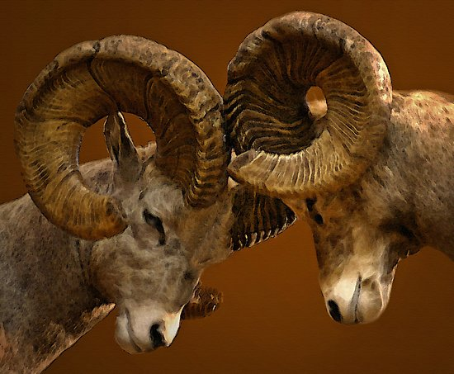
THE BIGGEST CHALLENGE:
Differing Beliefs and Interpretations About Organic Principles and Philosophy

Slide 7
The Meaning of Organic
Basic Organic Agricultural Principles
Emulate natural systems
Build soil fertility
Reduce agricultural pollution
Recycle with the system
Increase bio-diversity
Healthy plants from healthy soils

Slide 8
Unifying Principles of Organic
Integrated farming system that mimics nature
Robust system – covers all crops from seed to table
Embeds continuous improvement in the regulations
Organic value is created in the crop growing method
Organic value is maintained & protected in Chain of Custody and Handler Certification
Precautionary Principle guides evaluation of Inputs

Slide 9
Areas of Disparity
Allowing or Prohibiting all synthetics
Allowing any petroleum-derivatives at all
Balancing the Precautionary Principle against the needs of Farmers and Handlers

Slide 10
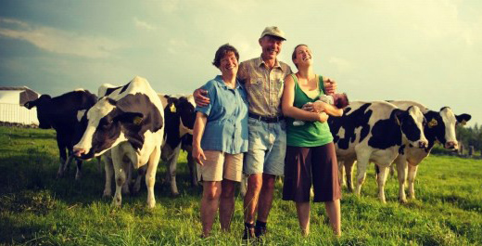
Areas of Disparity
Different Interpretations of the Organic Belief System and Philosophy
Keep organic limited to small farmers
Increase organic acreage
or

Slide 11
NOP National List of Materials
If NATURAL, then automatically allowed unless prohibited under 7 CFR 205.602
If SYNTHETIC, then prohibited unless listed under 7 CFR 205.601

Slide 12
The National List: Original Intention
A robust toolbox for producers and handlers
Approval required by NOSB before USDA can list

Slide 13
Areas of Disparity
Consumer groups re-define the objectives of the National List to make it as small as possible
“Conservatives” oppose additions and re-listings
Can we inform and find a balance & compromise?
The needs of farmers to increase acreage within core organic principles should be the judge

Slide 14
Issues That Need Work
Process for replacing List 4 is stalled
If a need is already met by a listed material, then no new addition to the list
Need for more NOP technical staff to support NOSB material reviews

Slide 15
Challenges of the Regulatory Process
The most transparent and public standard ever vetted in the U.S.
NOSB is open to all – platform for any opinion or advocacy – attracts & allows “non-organic” and marginal issues and advocacies to take center-stage
Lack of expertise on NOSB for review of TRs
NOP is structured as a public/private partnership

Slide 16
Suggestions for Manufacturers
Formulate carefully
Get help to understand the NOP Process
Pay attention to Sunset Process
Educate your distributors / customers
Encourage participation, especially via both written and oral comments

Slide 17
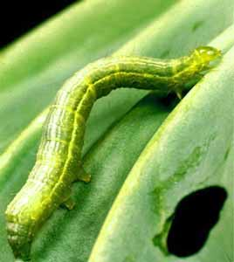
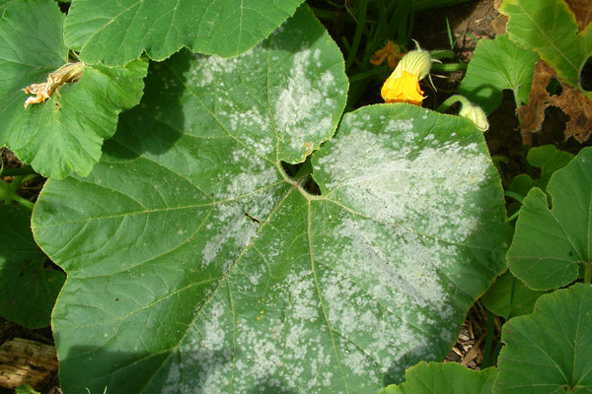
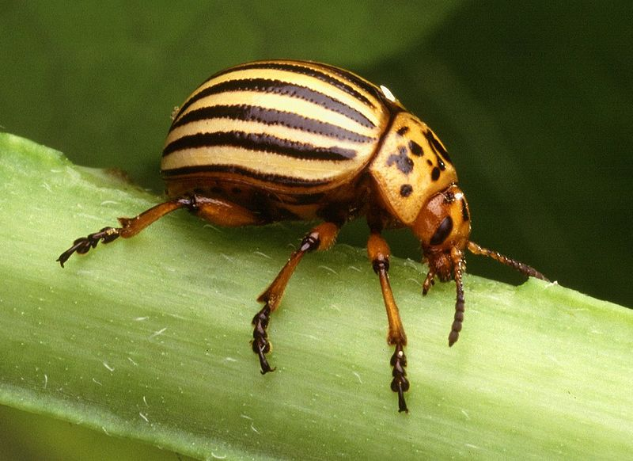
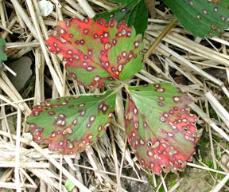
Opportunities

Slide 18
Thank you! www.organicspecialists.com 540.864.5107
Our mission is to deliver the strategic expertise to help organic, socially and environmentally responsible products and projects reach their full potential — and flourish.

