Slide 3
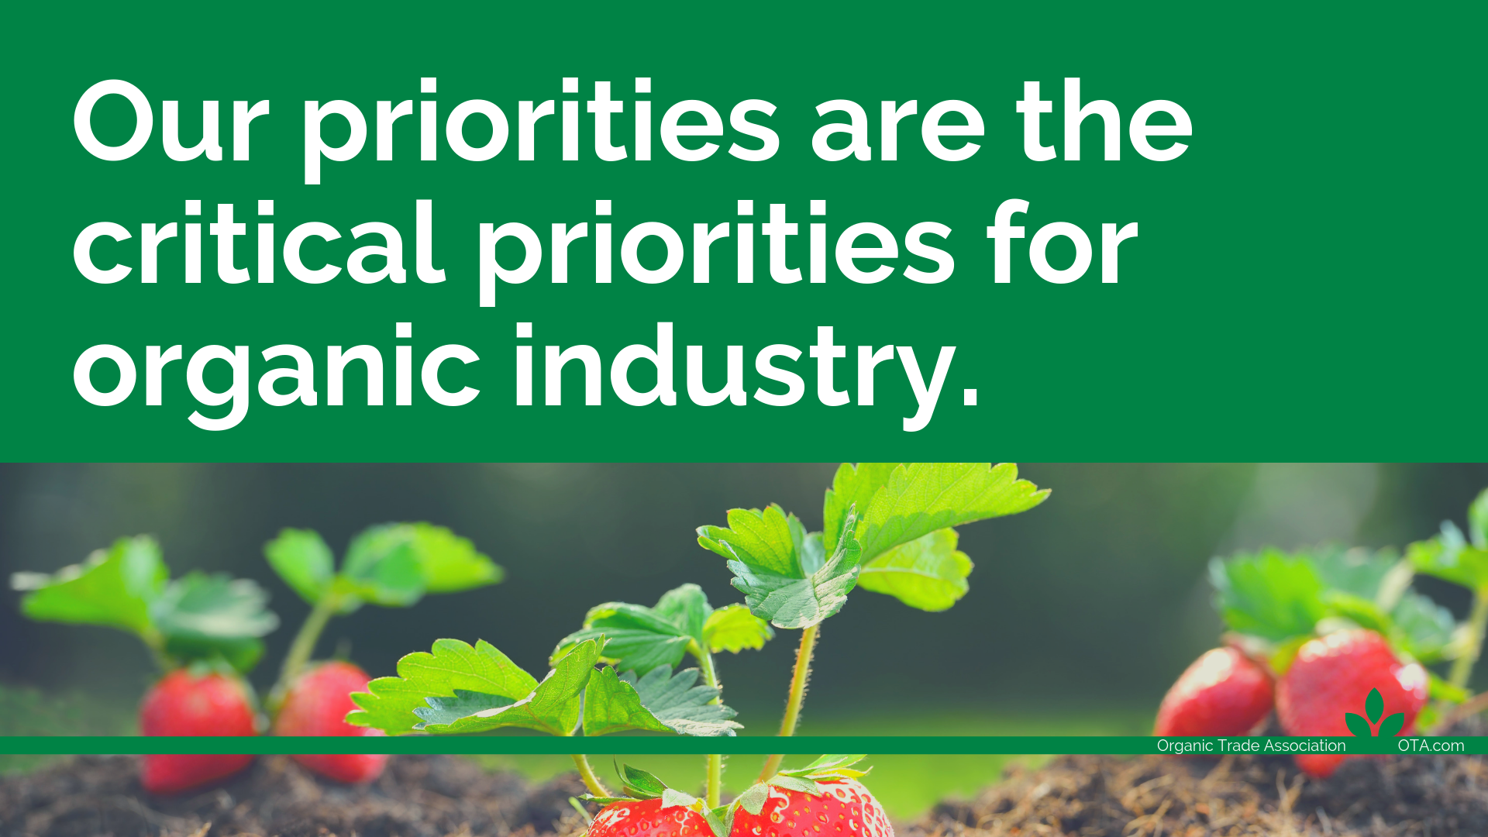
Notes:
Convene
Do we want to say organic produce or organic fresh fruit and veg?
We want to say “organic produce industry”.

Slide 6
Notes:
educate

Slide 9
Notes:
Organic Integrity and Imports (https://ota.com/news/issues/ota-takes-action-fraudulent-imports)
The Organic Trade Association believes fraud cannot be tolerated in the organic system, whether inside or outside of the United States, and is proactively working on several fronts to help prevent any future fraudulent imports. Members are working together under OTA’s task force system to develop a best practices guide to help brands and traders manage the risk of organic fraud. We are advocating for the 2018 Farm Bill to include support and adequate funding for the USDA National Organic Program (NOP) to keep pace with industry growth, set uniform standards, and carry out compliance and enforcement actions in the U.S. and abroad.

Slide 10
Notes:
The Organic Agronomy Training Series (OATS) is a collaboratively-managed, science-based train-the-trainer program for agricultural professionals working with organic or transitioning producers in the U.S.
OATS has been spearheaded by Pipeline Foods. The intention is to transfer management to a public or nonprofit organization. GRO funding would be directed to project management/host organization.
GRO will also explore opportunities with the Natural Resources Conservation Service (NRCS) to increase the number of organic education specialists. We envision that collaborations between OATS and NRCS could enhance the programming of each and create new pathways for technical assistance to reach farmers.

Slide 12
We need to stand together to advance organic priorities. As a leader in the industry, others follow in your footsteps. Please mark your calendar and register now at for Organic Week in D.C.
Coming along to cover “advocacy in action” for their massive consumer networks are the handpicked thought-leaders and brand ambassadors who make up our first-ever Influencer Program.
Organic Week Schedule:
Member Day – Monday, May 20
Advocacy Day – Tuesday, May 21
Conference Day – Wednesday, May 22
Board of Directors Meeting – Thursday, May 23

