Slide 1
Material Review and Organic Certification
Biological Products Industry Alliance (BPIA) March 13, 2019 Portland, Or
Presentation by
Doug Currier
Technical Director
Notes:
Title Page

Slide 2
Discussion Outline
OMRI Review Process
OMRI and NOP
About OMRI
Notes:
1. About OMRI
2. Overview of OMRI Canada Review Program
3. Update on OMRI Canada Products List
4. Update on OMRI’s Implementation of 2015 Revision of the Canadian Organic Standards
5. Roundtable / Q & A (CB acceptance of OMRI Listed Products)

Slide 3
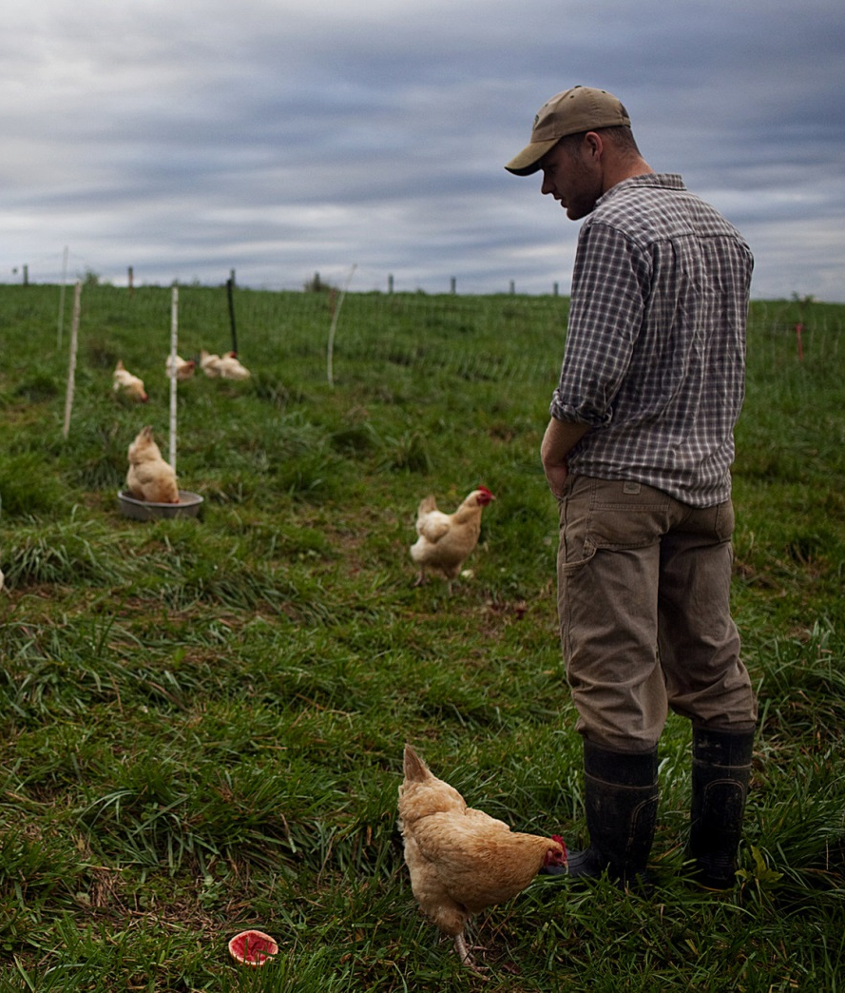
Who is OMRI and what do we do?
OMRI's mission is to support the growth and trust of the global organic community through expert, independent and transparent verification of input materials, and through education and technical assistance.
Nonprofit organization • Founded in 1997 • Based in Eugene OR
Notes:
1. Mission is to: “support the growth and trust of the global organic community through expert, independent and transparent verification of input materials, and through education and technical assistance.

Slide 4
OMRI is…
Nonprofit organization founded in 1997
Voluntary program
3rd party input evaluation program
US National Organic Program (NOP)
Canadian Organic Regime (COR)
Scope of review program: crops, livestock, handling
Based in Eugene, Oregon
Grown to 62 staff members
Unlike certification body (CB) review, OMRI is optional
Notes:
2. 501(c)(3) Nonprofit organization
3. Founded in 1997 by certifiers
4. Staff of 62 based in Eugene, OR
5. 3rd party input evaluation program
6. Program scope: NOP and COR in crops, livestock, handling

Slide 5
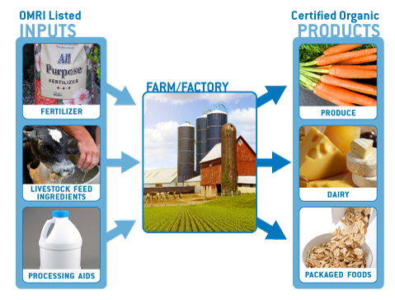
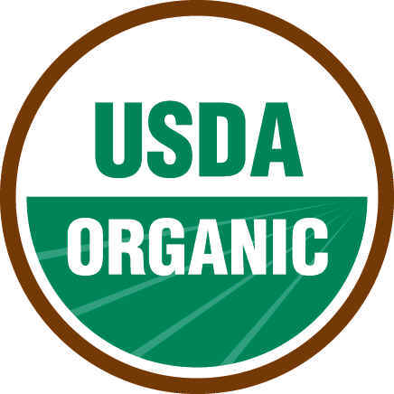
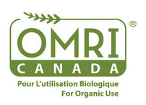
OMRI’s Role in Organic Certification
Notes:
1. Diagram illustrates how OMRI fits into the organic certification process
2. Left side: OMRI “expert, independent and transparent verification of input materials” that are used on organic farms and in organic processing facilities
3. Right side: Certification Bodies perform certification of the final certified organic product.
OMRI does not certify final organic products.
We are unique b/c we specialize only in the input materials

Slide 6
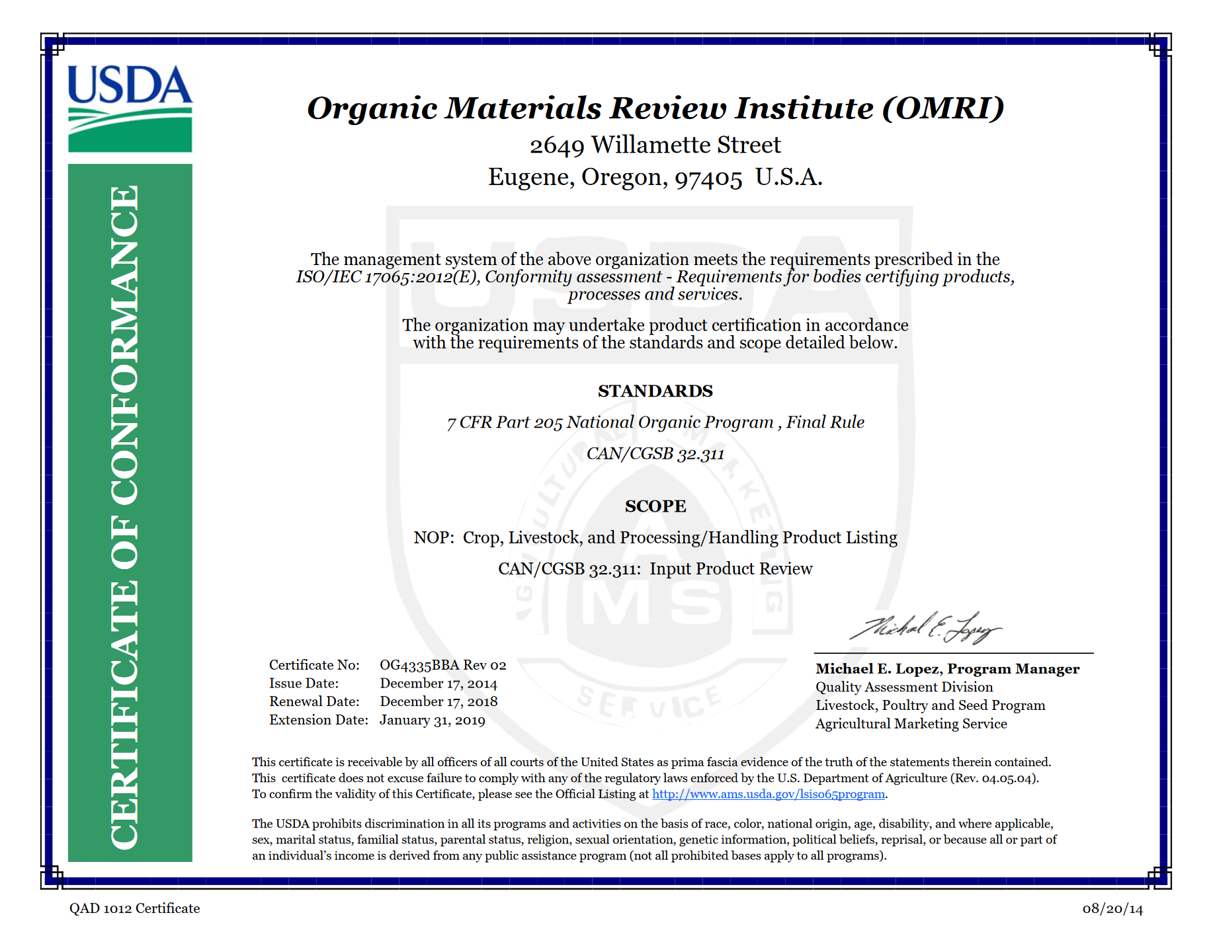
ISO 17065 Accreditation
Accredited by the USDA
for NOP and COR
input review
to ISO 17065 standard
Notes:
1. OMRI is accredited to ISO 17065 standards, which ensures the integrity of our review program
2. Accredited by USDA – routine audits to verify compliance
3. To ISO 17065 standard – specific to product certification
4. For NOP and COR review -- different standards; different scopes

Slide 7
OMRI Review Process
Application Received
Review by OMRI Staff
Decision by a Review Panel
Certificate / Listing
Ongoing Compliance/Product Changes/Limited Re-Reviews
Notes:
Review Process for product applications
1. Applications received: 65-120 applications received per month
Information requirements:
Formulation
Manufacturing Process
Product Label
2. Technical Review by OMRI Staff (qualifications – trained in Canadian regulations)
3. Review panel (all products)
Members:
Qualifications:
4. Certificate and Listing (if approved) – averaging around 2-month review time
Separate certificate and listing
5. Ongoing Compliance – annual update; 5-yr full review
Product Changes-Listed manufacturers required to report all changes to a product
Limited Re-reviews-Limited reviews stemming from a standards update

Slide 8
OMRI and Organic Standards
National Organic Standards
Foundation of OMRI Standards
TITLE 7 part 205 of the Federal Regulations
205.105 List of allowed and prohibited substances and methods
Subpart C- Organic methods, practice standards
All preventative management practices listed in 205.206 must be followed before using most pest control products, especially those formulated with an allowed synthetic.
Notes:
Published NOP and COR organic standards are the basis for OMRI’s policies and standards
205.105 is the list of allowed and prohibited substances and methods in organic production under NOP
Subpart C incudes practice standard which applies to the use of biological pesticides
Specifically 205.206 must be met before using most pest control products. Nonsynthetic biologicals may be used for disease control as a preventative management practice.
Products formulated with synthetic 2004 EPA List 4 inerts are subject to preventative practice restriction.

Slide 9
OMRI and Organic Standards
Canadian Organic Regime Standards
Foundation of OMRI Standards
CGSB 32.310 and 32.311
CGSB 32.310 1.4 List of allowed and prohibited substances and methods
CGSB 32.210 5.6 Organic methods, practice standards
All preventative management practices listed in 32.310 5.6.1 must be followed before using most pest control products
Notes:
COR standards are also the foundation of OMRI standards
CGSB=Canadian General Standards Board
32.210 1.4 is the list of allowed and prohibited substances and methods in organic production under COR
32.310 5.6 incudes practice standard which applies to the use of biological pesticides
Specifically 32.310 5.6.1 must be met before using a “biological or botanical substance, or other substances listed in Table 4.3 in the PSL (i.e. 32.311)

Slide 10
Relationship with USDA and CFIA
Changing the Organic Standards
Both USDA and CFIA use a petition process
Both USDA and CFIA are required to review standards every 5 years
-Scope of review differs
- USDA: Sunset review of allowed synthetic and prohibited nonsynthetic
- CFIA: Full review of organic standards and PSL
OMRI is a neutral 3rd party and does not submit petitions
Notes:
USDA and CFIA use a petition process to amend the organic standards
CFIA=Canadian Food Inspection Agency
Both USDA and CFIA are required to review standards every 5 years. The reviews however differ in scope.
OMRI is a neutral 3rd party and does not submit petitions

Slide 11
Public Comments
OMRI does review proposed revisions to the organic standards
Public comments are submitted when appropriate
OMRI’s public comments focus on:
-Precedent
-Standards interpretation
-Potential impacts of rulemaking
Notes:
OMRI follows proposed revisions to the organic standards and submits public comment when appropriate
OMRI’s public comment focuses on Precedent, Standards Interpretation, and Potential impacts of rulemaking

Slide 12
Questions? Comments?
Peggy Miars
Executive Director/CEO
peggy@omri.org
541-343-7600 ext. 102
Doug Currier
Technical Director
dougc@omri.org
541-343-7600 ext. 113

