Slide 1
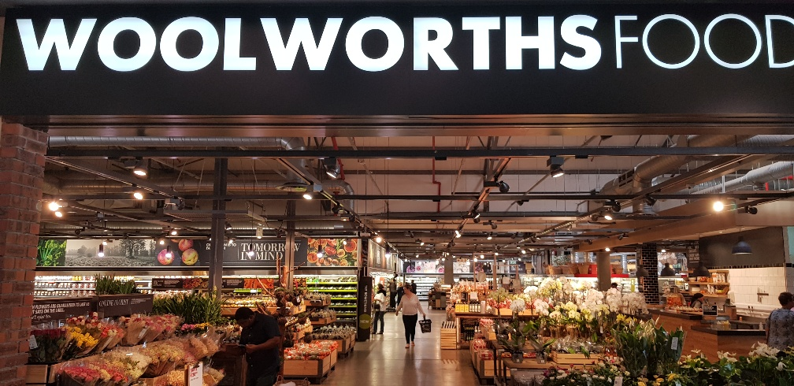






Notes:
K t

Slide 2
Notes:
K t

Slide 3
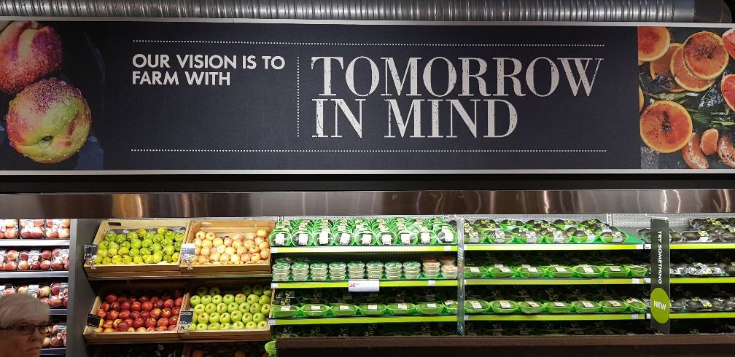
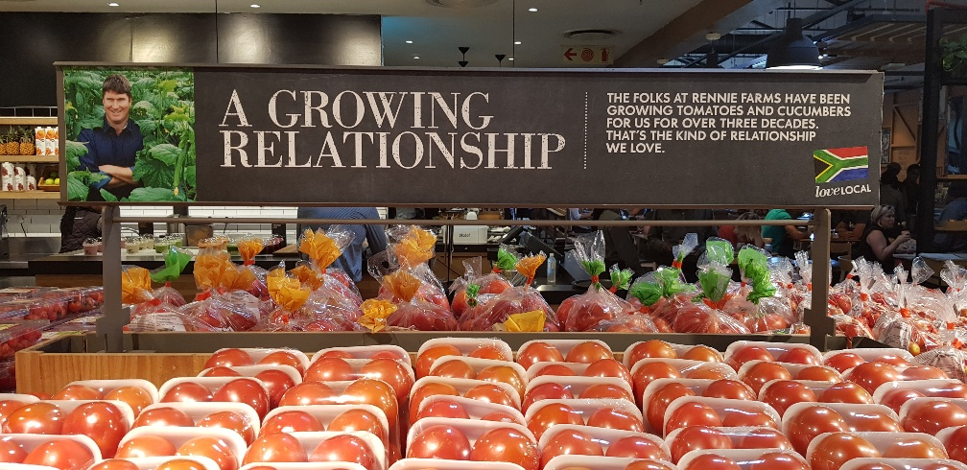
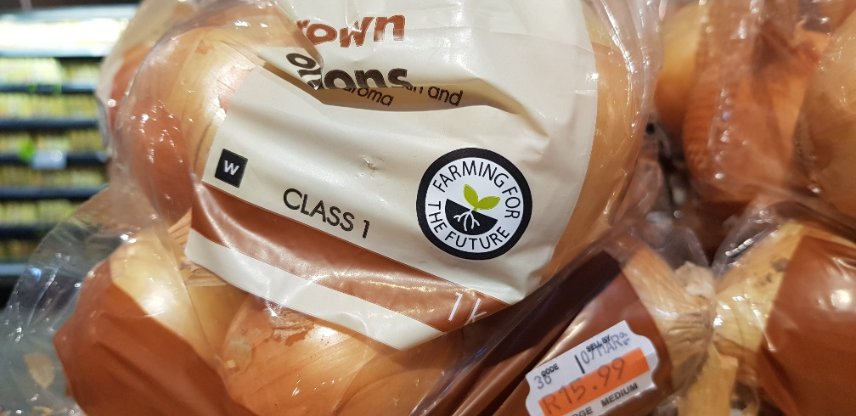
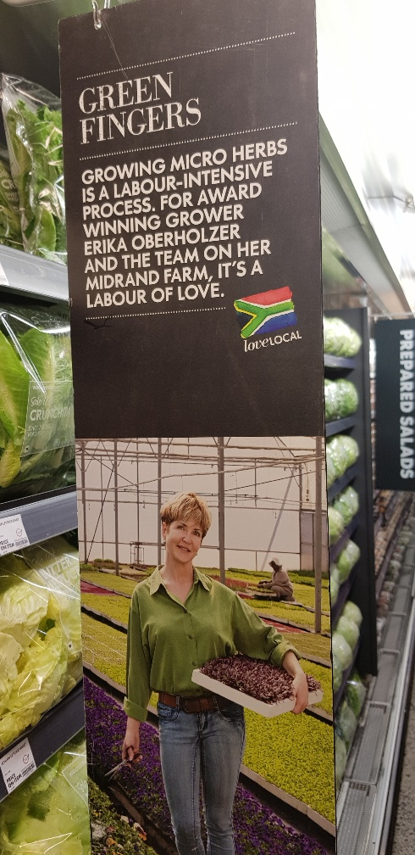
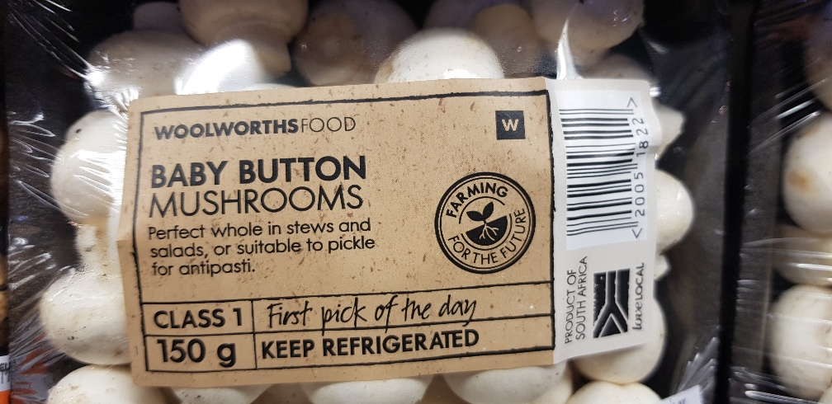

Slide 4
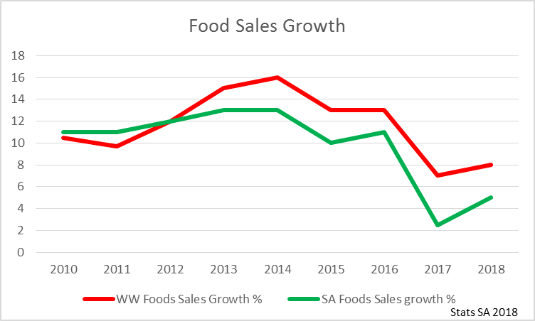

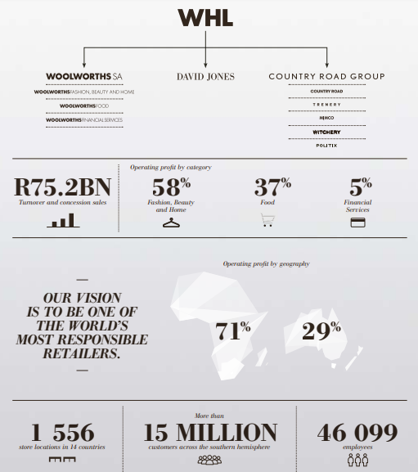
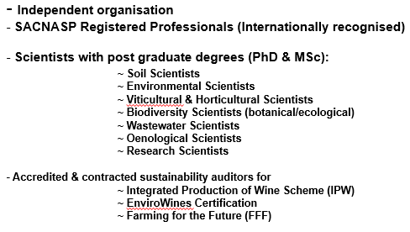
Partnership
Woolworths’ Suppliers
Notes:
Woolworths Food outperformed the market, with sales growth of 8.4% on price movement of 3.2%. Operating profit increased by 9.6% to R2 167 million

Slide 5


THE WOOLWORTHS CUSTOMER….
every purchase at Woolworths MUST make a difference
I WANT TO CHOOSE WISELY, CHOOSE ETHICAL, CHOOSE SUSTAINABILITY
“BUT WE’VE WANT CARING THAT IS CONVENIENT”
Tell me the story behind the product
FOOD THAT CARES
+
I trust you for doing the right thing
OUR GBJ LEGACY
+
“I am making a difference with every purchase”
BUY ONE, GIVE ONE, PRESERVE ONE
+
“Reward me for buying better”
MAKING A DIFFERENCE TIPPING POINTS

Slide 6

THE WOOLWORTHS CUSTOMER….
Large % of WW customers buy products based on its social and environmental credentials
Majority of WW customers buy products based on its health & safety credentials
1. Is it safe?
2. Is it healthy?
3. Fair price? (value for money)
4. What about the people?
5. What about the animals?
6. What about the environment?
Customers are not always right but they are king – listen to their voices

Slide 7
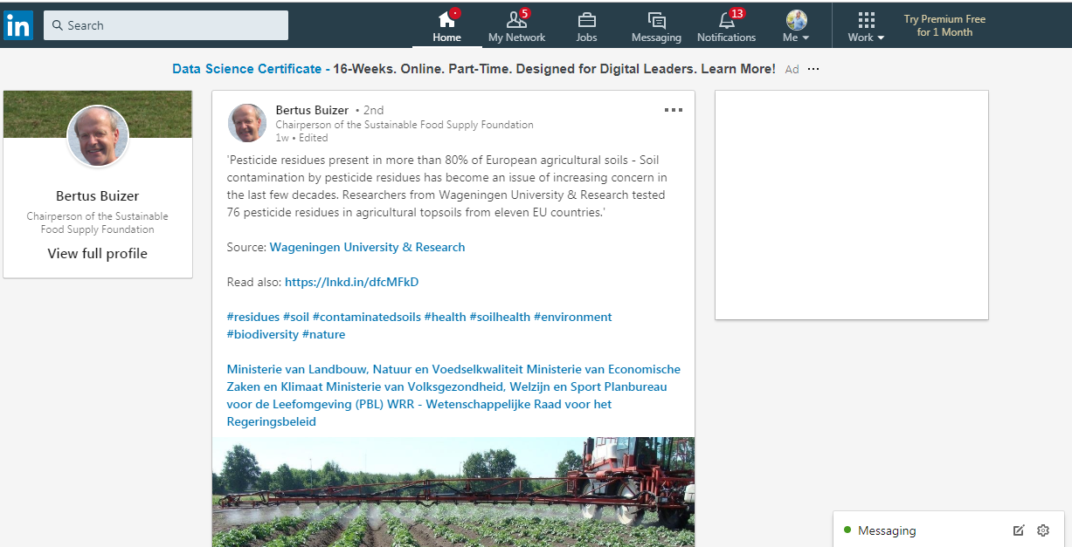

Slide 8
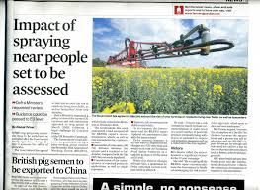
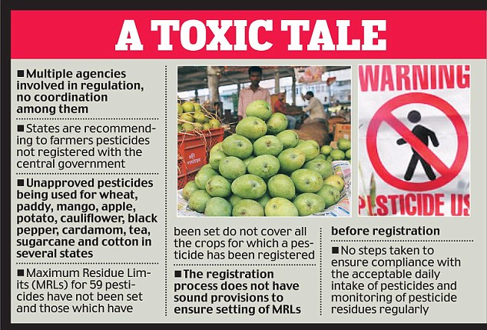
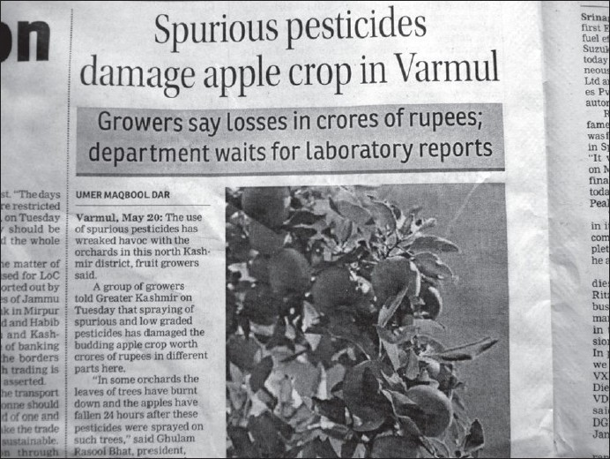
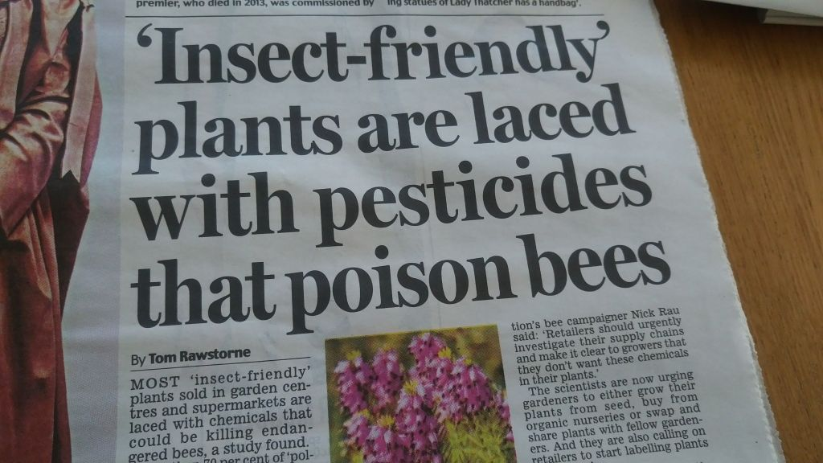
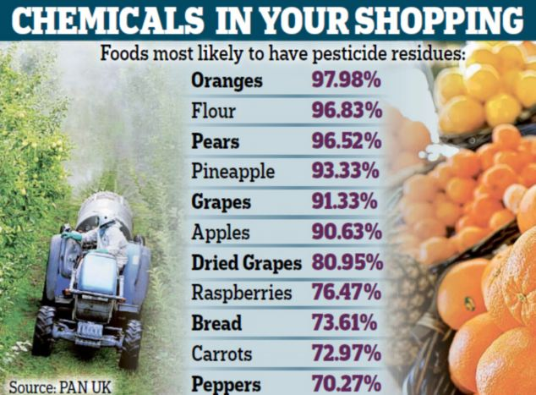
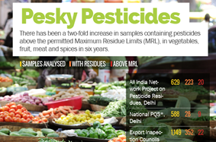

Slide 9
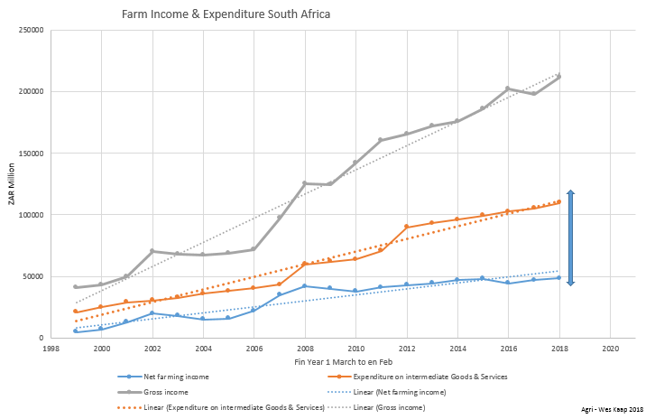
Securing long-term financial sustainability in food production a challenge

Slide 10
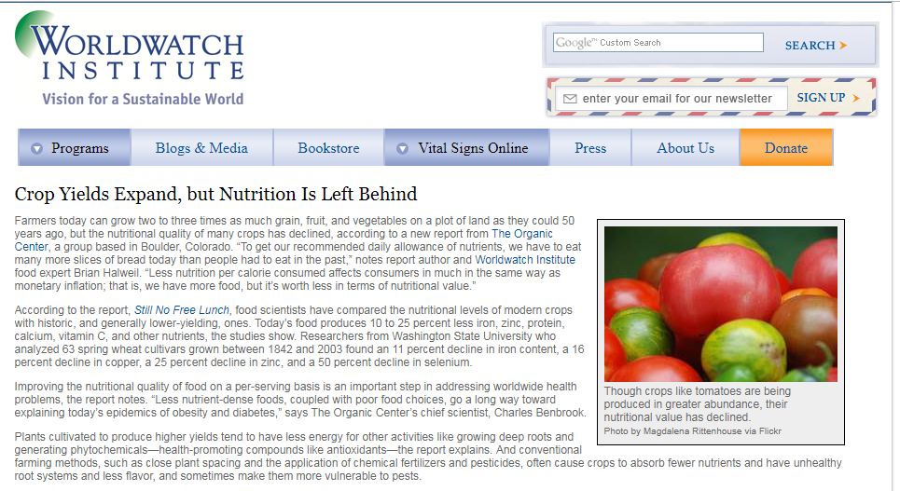
10 to 25 % less iron, zinc, protein, calcium, vitamin C, and other nutrients in fruit and vegetables
11% less iron, 25% less zinc & 50% decline in selenium in grains

Slide 11
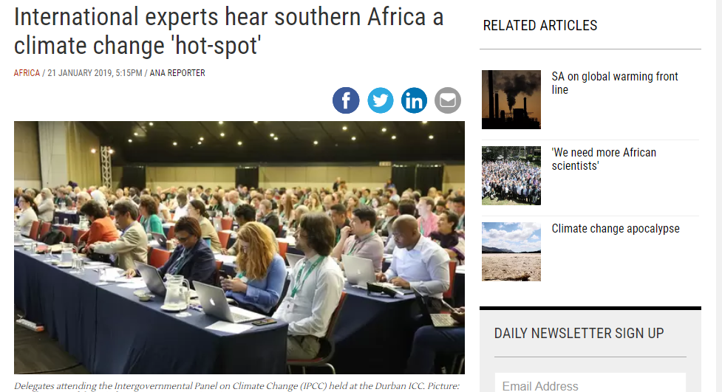
The South African interior temperatures are already about 2 °C higher than a century ago and is rising at a rate “twice the global rate of temperature increase! (Ngomane, 2019)

Slide 12
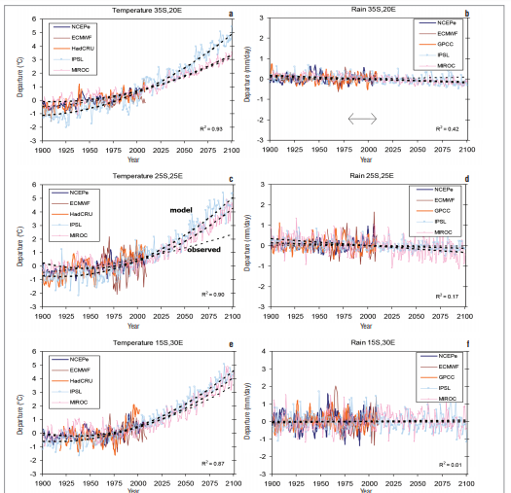
Changes in temperature and rainfall patterns in South Africa

Slide 13
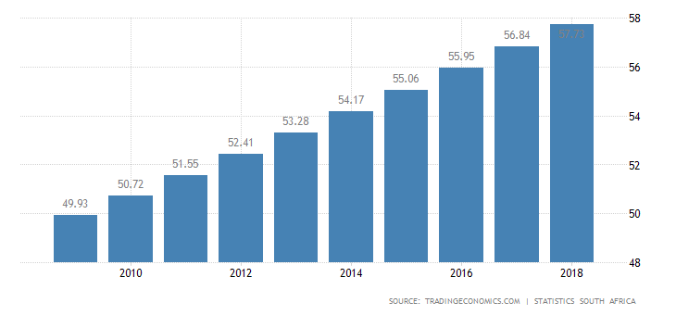
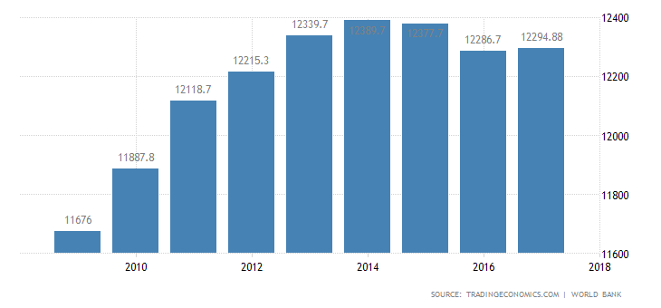
SA’s Population growth
SA’s GDP per capita

Slide 14
WHAT IS WOOLWORTHS’ RESPONSE?
Where in the value chain is the highest risk?
What did we do about it?
How do we evaluate/verify successes & failures?
How do we stay ahead of the pack?

Slide 15
Where in the value chain is the highest risk?
TOP 10 VOLUME LINES
Fruit & Veg Raw material | % of Total Volume Fresh | Est. area in Ha(based on yields 2014)
APPLES | 8.37 | 1381.58
BANANAS | 7.44 | 1228.72
POTATO GROUP | 7.17 | 1184.05
MANGOS | 6.70 | 1106.70
AVOCADOS | 6.69 | 1104.42
ONIONS | 5.99 | 988.72
WATERMELONS | 5.57 | 920.51
CARROTS | 4.60 | 760.21
SEEDLESS RED GRAPES | 3.84 | 633.63
SOFT CITRUS | 3.65 | 602.69
Total | 60.02 | 9911.21

Slide 16
Where in the value chain is the highest risk?
TOP 10 VOLUME LINES

Slide 17
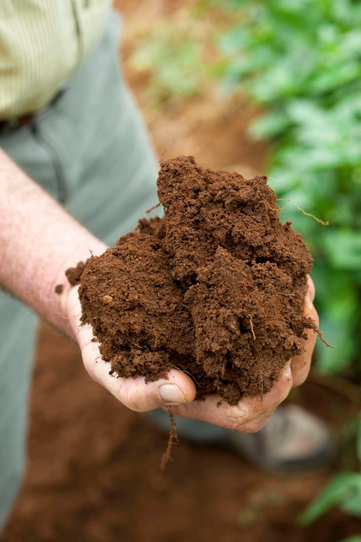

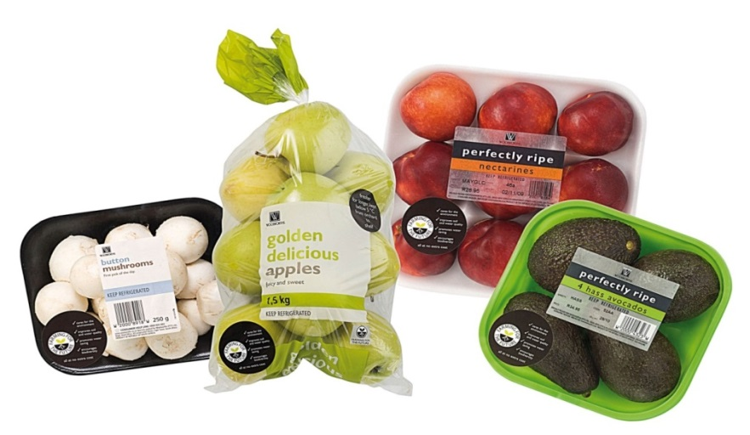

We concluded that:
Farmers are the most important custodians of the future of sustainability.
Notes:
In order to combat these key challenges we introduced a programme which we called farming for the Future in 2009. The programme is designed to help farmers which supply us to incrementally improve their environmental performance.
Farmers are independently audited against the programme which measures key aspects such a conservation status, suitability of the land for growing a specific crop type, legislatory requirements, water and irrigation efficiency, fertiliser and pesticide usage.
The focus is on achieving continuous improvement. The programme encourages farming in a sensitive and efficient manner and gives customers the peace of mind that their products are being grown in a sustainable manner.
To date, we have 98% of our tier 1 suppliers in produce, horticulture, dairy and beef working as part of this scheme, and are gradually extending this into our secondary suppliers too.

Slide 18



Slide 19
Highlights
FFF mentioned in the Forbes top 50 most sustainable companies in the world
Stanford lauds FFF
Large % of all site assessments paid by suppliers
> 200 farmers attended the FFF conference in the Western Cape
Well known UK retailer acknowledge FFF as a sustainability attribute
28 appearances on national TV
Yet to meet a farmer that rejects Farming for the Future
Endorsed by WWF
Customers demands a Farming for the Future Logo on each product
FFF is 10 years old
Competent auditors

Slide 20
Farming for the Future is subdivided into eight management categories
Aspect
Soil Health Management | Balancing chemistry, physical and biological properties of soil with crop and climate
 | Measuring: Soil chemical composition, Soil Nutrient status, fertilizer practices, organic carbon content, soil micro-biology and soil covering
Irrigation water management | Balancing water with crop, soil and climate
 | Measuring: Calculation of irrigation requirement, Plant available soil water content, water use efficiency, water chemical composition and water health
Environmental legal requirements | Ensure compliance to relevant regulations (incl. Agriculture)
 | Looking at compliance to: Environmental management, water management, agriculture management, heritage management and property zoning.
Hotspots

Slide 21
Farming for the Future is subdivided into eight management categories (cont.)
Aspect
Biodiversity management | Balancing the tightrope between profit and ecosystem health
 | Conservation of endangered ecosystems
 | Alien invasive management
 | Fire management
 | Game & problem animal management
 | Erosion management
Waste and waste water management | Looking at the level of pollution end to end
 | General waste
 | Factory/pack house waste
 | Hazourdas waste
 | Waste water from processing and cleaning
` | Sewage waste
Hotspots

Slide 22
Farming for the Future is subdivided into eight management categories (cont.)
Aspect
Cooling & Energy use | Measuring carbon footprint not included in other aspects
 | Measurement of energy use
 | Program for continual improvement
 | Refrigerant used
Pest & plant management | Encourages plant health
 | Legal agro chemical use
 | Agro chemical management
 | Integrated pest management
 | Integrated weed management
Water footprint index (WFI) | The WFI score has a total of 1, and an increased value indicates higher potential impact on the water resources. A value of 0.4 or lower can be regarded is a low Water Footprint.
 | Environmental aspects used in the WFI calculation on farms and packing/processing facilities include 116 individual parameters.
Hotspots

Slide 23
Farming for the Future is a paradigm-shift enabler
WW Suppliers before 2009 Suppliers implementing Farming for the Future
Energy intensive Information sensitive
Linear process Cyclical process
Farm factory culture Farm as ecosystem
Enterprise separation Enterprise integration
Single enterprise Many enterprises
Monoculture Diversity of plants and animals
Low-value products Higher-value products
Single use equipment Multiple use equipment
Passive marketing Active marketing
Limited environmental Holistic Environmental
management management
Assist farmers to think differently when making decisions
Everything is interrelated, and it is only through understanding these complex relationships that farmers can become ‘masters of their trade’ and maximize profit.

Slide 24
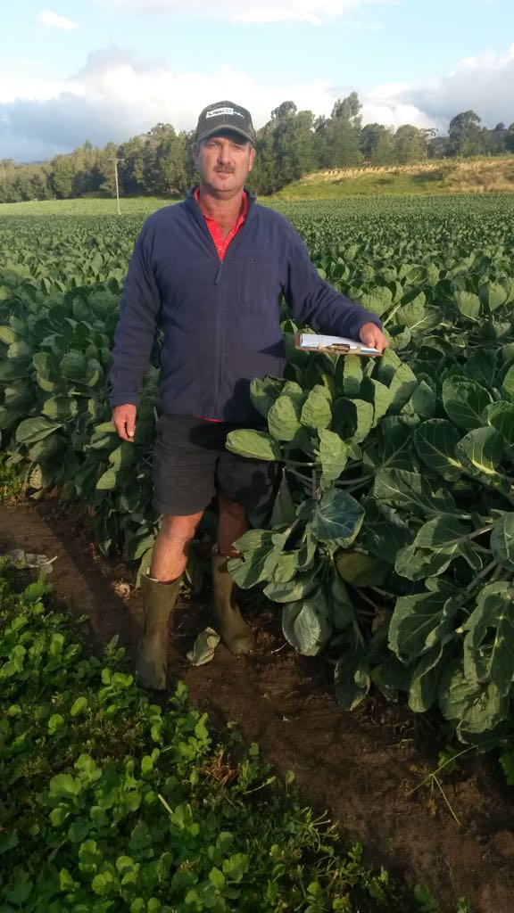
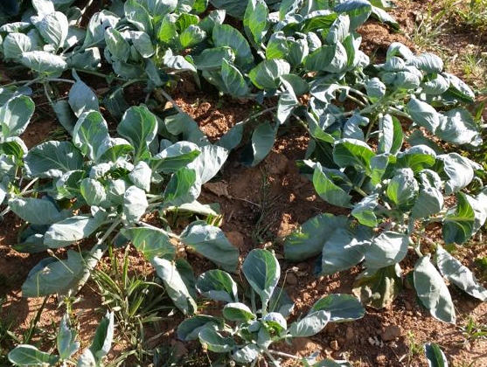
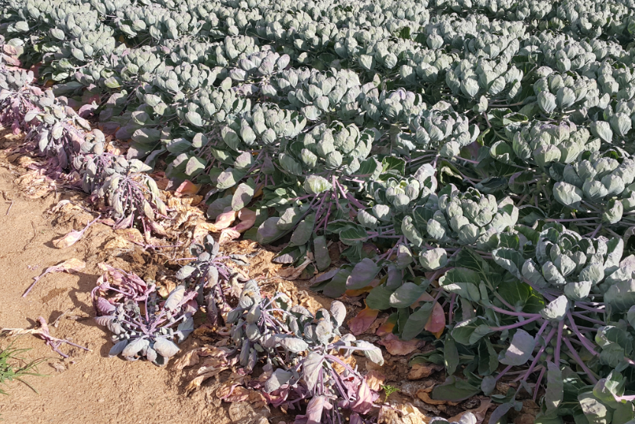
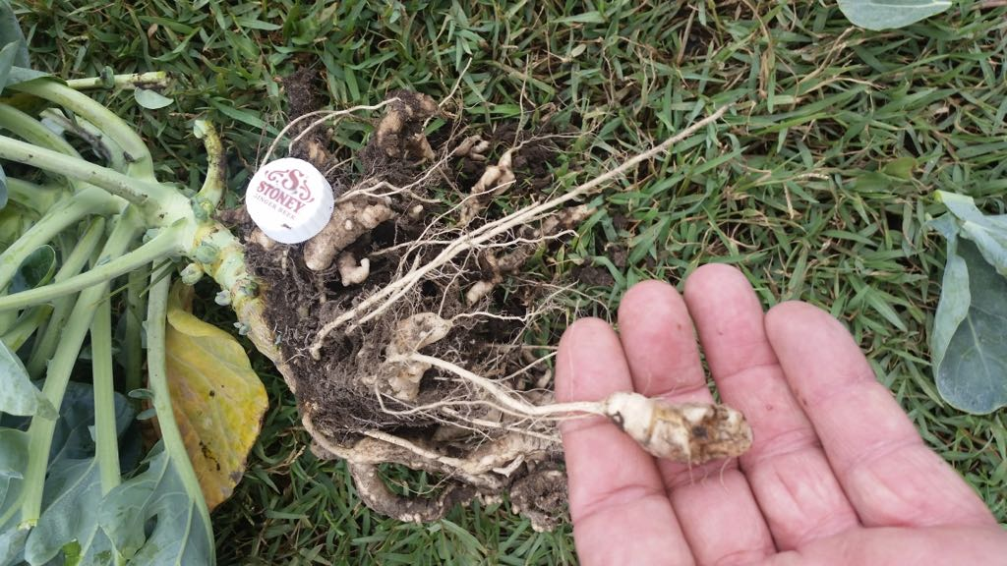
Club root (Plasmodiophora brassicae)
CLUB ROOT TREATMENT
Product |  | Week 1 | Week 2 | Week 3 | Week 4 | Total Quantity for first month/ha (ml)
Bacillus: Soil | Drench | 2000ml/ha | 1000ml/ha |  |  | 3000
Trichoderma: Soil | Drench | 200ml/ha | 200ml/ha | 200ml/ha | 200ml/ha | 800
Sea Brix | Drench | 1000 ml/ha |  |  |  | 1000
Humic acid | Drench | 500g/ha | 500g/ha | 500g/ha | 500g/ha | 2000
Met 69: Spray | Foliar spray
Trichoderma: | Foliar | 100ml/ha | 100ml/ha | 100ml/ha | 100ml/ha | 100
Bacillus: Spray | Foliar spray |  | 500ml/ha |  | 500ml/ha | 1000
Silwet | Foliar spray |  |  | 10-30ml/100lt |  | 80
Vegol | Foliar spray |  | 100ml/100lt |  | 100ml/100lt | 800
Sea Brix | Foliar spray | 500ml/ha |  |  |  | 500
Fulvic acid | Foliar spray |  | 100g/ha | 100g/ha | 100g/ha | 300
Product |  | Week 5 | Week 6 | Week 7 | Week 8 | Total Quantity for first month/ha (ml)
Bacillus: Soil | Drench
Trichoderma: Soil | Drench | 100ml/ha | 100ml/ha | 100ml/ha | 100ml/ha | 400
Met 69 | Drench | 100ml/ha |  |  |  | 100
Sea Brix | Drench | 1000 ml/ha |  |  |  | 1000
Humic acid | Drench | 500g/ha | 500g/ha | 500g/ha | 500g/ha | 2000
Met 69: Spray | Foliar spray | 100ml/ha | 100ml/ha | 100ml/ha | 100ml/ha | 400
Trichoderma: | Foliar | 100ml/ha |  | 100ml/ha |  | 100
Bacillus: Spray | Foliar spray |  | 500ml/ha |  | 500ml/ha | 1000
Silwet | Foliar spray |  |  | 10-30ml/100lt |  | 50
Vegol | Foliar spray |  | 100ml/100lt |  | 100ml/100lt | 800
Sea Brix | Foliar spray | 500ml/ha |  |  |  | 500
Fulvic acid | Foliar spray |  | 100g/ha | 100g/ha | 100g/ha | 300
Trichoderma asperellum
Bacillus subtilis

Slide 25
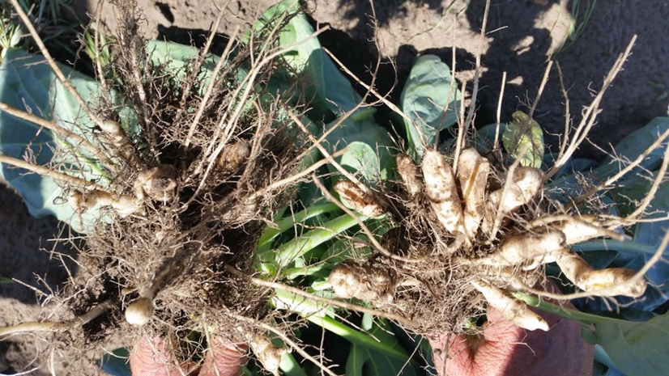
The club root
Club root?
Treated
Control

Slide 26
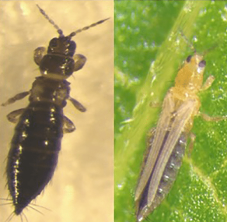
Thrips (Frankliniella occidentalis & Thrips tabaci)

Slide 27
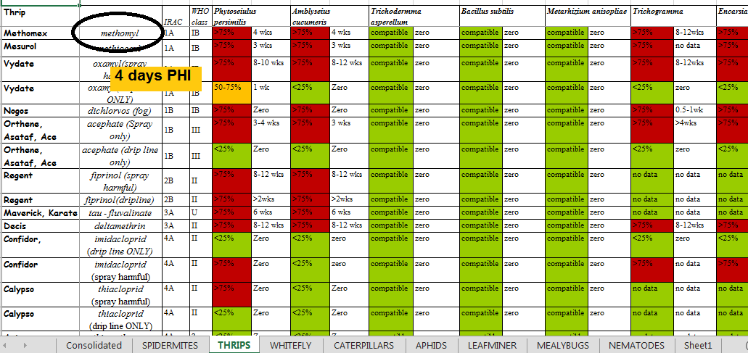
Caution: Food safety vs. environment!

Slide 28
Challenges
Chemical representative’s behaviour
SA registration process
Compatibility with chemicals and other bio-products
Lack of understanding of IPM
Logistical and admin support of bio – pesticide providers
Inadequate product range of bio – pesticide providers
“concentrations” or “counts”

Slide 29
Labelling sustainability on our shelves
Consumers demands that we undertake sustainability actions
They do not trust sustainability claims (suspicious of fronting)
People attach different meanings to it.
Language and ethic groups perceive the same terminology differently
Knowledge of different farming systems limited – emotional
The scientific world struggle to embrace systems thinking and complexity
Our fellow “green people” in constant conflict – no unity

Slide 30
How did FFF become a trusted sustainability label?
TOOK OUR CUSTOMERS ON A JOURNEY
NO HARM APPROACH, AVOID P.R.O. (FRONTING) AND DO LESS HARM APPROACH
DID NOT TRY TO DO IT ALONE - PARTNERSHIPS
KEPT THE PROCESS TRANSPARENT – INTEGRITY
PARTICIPATE IN OPEN FORUMS AND TARGET CONSUMER PLATFORMS
INVEST IN THE PROGRAM
EMBRASED COMPLEXITY AND SYSTEMS THINKING
INDEPENDENT 3RD PARTY VERIFICATION

Slide 31

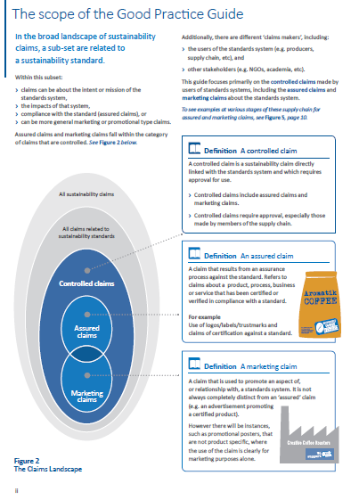

Study & understand the audience
Choose your partners
Values (integrity, transparency etc.)
Invest
Non-stop R&D
Prepare for war

Slide 32


