Slide 1
Biostimulants in the EU Fertilizing Products Regulation (FPR)
13 March 2019
BPIA
Massimo Toni (Agronutrition)
EBIC Board

Slide 2
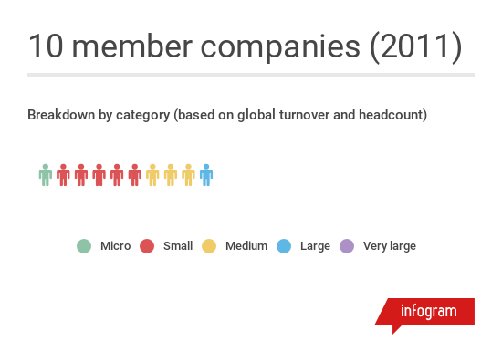
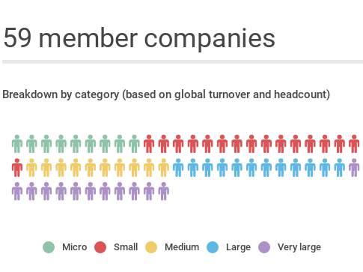
European Biostimulants Industry Council
Founded in 2011
…and still growing
Founded in June 2011
www.biostimulants.eu
@biostimulantsEU

Slide 3
What is EBIC’s mission?
To promote the contribution of plant biostimulants to make agriculture more sustainable and resilient
To foster the development of the European Biostimulant Industry
To secure a predictable and constructive operating environment for biostimulants, improving accessibility and transparency for the end-users: farmers

Slide 4
Today, there are 28 different sets of requirements for marketing biostimulants in the EU
→ This raises the cost of bringing products to market and discourages companies from serving farmers in smaller markets

Slide 5
→ Instead, producers can choose one single harmonized set of rules and requirements providing access to all EU countries

Slide 6
Pros and cons of the FPR for plant biostimulants
Access to the Single Market is now unlocked
EBIC can work to refine, improve and implement the framework
We‘ve managed to “bank“ this progress before European elections, which could have reset the process to zero
European Commission has significant delegated powers to improve text
Many of the small, but important technical details of biostimulants were eclipsed by the cadmium issue
Many of the CMCs still need significant work

Slide 7
…But under what conditions will plant biostimulants have access to the Single Market?

Slide 8
Securing proportionate regulation
1
Upstream legislation
4
Product quality
The focus of the legislation is safety, but some quality parameters are included. Biostimulant producers will have to demonstrate that claims are justified.
Components will only be eligible if they have met prerequisites like compliance with chemical legislation (REACH) or animal by-products regulation
2
Component material categories (CMCs)
5
CE-marking
Biostimulants will have to seek “type” certification from a Notified Body
Each CMC is subject to specific safety requirements (depending on nature of the component)
3
Product function categories (PFCs)
6
Market surveillance
Additional safety requirements are applied at the PFC level (depending on nature of product)
Member State surveillance officers can conduct controls and request full data from producers

Slide 9
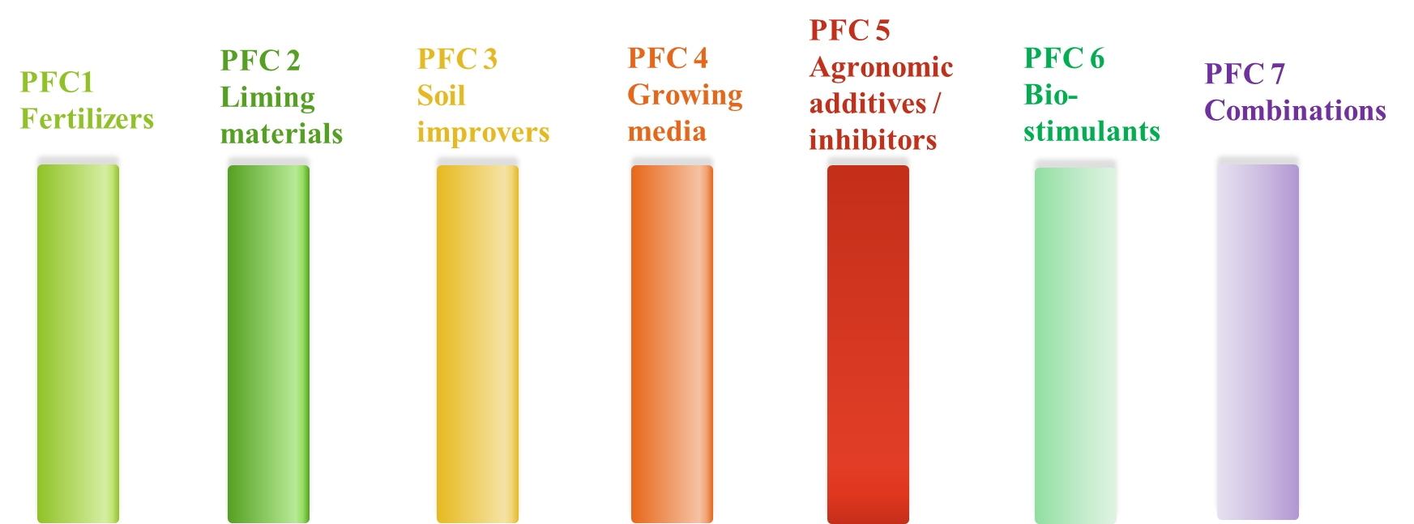
“Fertilising products” comprise 7 Product Function Categories (PFCs)
9

Slide 10
The component material categories (CMCs) (as listed in the November 2018 compromise text)
Virgin substances and materials (includes chelating & complexing agents and inhibitors)
Plants, plant parts or plant extracts (includes seaweeds)
Composts
Fresh crop digestate
Other digestate
Food industry by-products
Microorganisms
Agronomic additives
9. Nutrient polymers
10. Other polymers
11. Certain products derived from animal by-products
12. By-products within the meaning of Directive 2008/98/EC
Additional CMCs expected in future:
Struvite
Biochar
Ashes
= most relevant CMCs for biostimulants

Slide 11
CMC-specific requirements
CMC 1 (REACH requirements)
Minimum Annex VIII – data for tonnage of 10t-100t
CMC 2 (plant materials and extracts)
Positive list of defined treatment and extraction processes
CMC 6 (Food-industry by-products)
Positive list. Again, progress has been made in negotiations
CMC 7 (Microorganisms)
Positive list to be populated by delegated act following evaluation by an Expert Group
CMC 11 (Animal By-Products)
Materials having met endpoints for ABP Regulation obligations
(still to be defined)
CMC 12 (Industrial By-Products)
COM mandated in the regulation to define criteria during implementation period

Slide 12
Requirements for PFC 6 (Plant biostimulants)
Limits on heavy metal contaminants
– Cadmium, lead, hexavalent chromium, mercury, nickel, inorganic arsenic
Limits on pathogens
– List is modelled on OECD limits for microbial biocontrol agents and pathogens specified in the animal by-products regulation
Demonstrated effect
– The product shall have the effects claimed (and these must be within the effects specified in the definition)

Slide 13
Conformity assessment of biostimulants will be a two-step process
Type examination by Conformity Assessment Body CAB)*
Internal production control by producer
Description of the formulation of the product (i.e. list of ingredients)
Where appropriate information about raw materials
List of harmonized standards applied
Test reports
Product samples
Other supporting documentation
Monitoring and control to ensure that products are in conformity with the approved type
Self-certification of products by affixing the CE-mark and providing certificates of conformity
No national authorization is needed for a product that is CE-marked. Companies can submit their dossiers to any CAB, even if it is not in the main market they want to target.
*Also called a Notified Body

Slide 14
Relationship between EU legislation & EN standards
Directive/ Regulation
Conformity
assessment
Mandatory
EC Standardization request to CEN-CENELEC
For each relevant criterion, the Notified Body confirms that an acceptable value is reported and checks that the methodology is reliable
European Standard(s)
The use of a ‘Harmonised Standard’ referenced in OJEU
If all the criteria are satisfied, the Notified Body authorises the use of the CE-Mark
Voluntary
Creates a presumption of conformity for a given reported value (no documentation is required to justify methodology)

Slide 15
Standardisation is a critical aspect of the implementation of future regulation and its adaptation to technical progress
Analytical methods: to ensure comparability of results regarding contaminants, minimum content, etc.
Methodologies for making and justifying claims: to ensure verifiability of claims and to help users interpret claims.
Labelling requirements: to be complemented by guidelines from the European Commission and standards.
European standards can be elevated to the international level through a consultation process at the International Organization for Standardization (ISO) and thus promote global harmonization

Slide 16
Next steps

Slide 17
When does the EU regulation apply?
April/May 2022: the EU regulation on fertilizing products becomes fully operational and biostimulant products can be placed on the market through conformity assessment and CE-marking
Some key provisions will be applied earlier, for example: in May 2019, the EU definition of a plant protection product will change to explicitly exclude plant biostimulants. This may affect the implementation of some national rules.

Slide 18
What global cooperation can learn from the European experience
Agreeing basic definitions and terms is a key starting point for harmonization
We need to amplify our positive stories of more sustainable agriculture
The scientific case is critical for credibility and user empowerment
Standards support harmonization across different regulatory frameworks
Engagement with policy and value chain stakeholders is crucial

Slide 19
Any questions?

Slide 20
Biostimulants in the EU Fertilizing Products Regulation
7 March 2019
BPIA
Massimo Toni (Agronutrition)
EBIC Board
For more information:
www.biostimulants.eu
Can be circulated outside EBIC

