Slide 2
Biological Products:
Bridging the gap from research to uptake in greenhouse crops
Michael Brownbridge, Ph.D.
Notes:
I’m going to speak research that operates in the space between discovery and successful commercial uptake of biopesticides and biostimulants, and I’ll do that through the lens of the Canadian greenhouse sector.

Slide 3
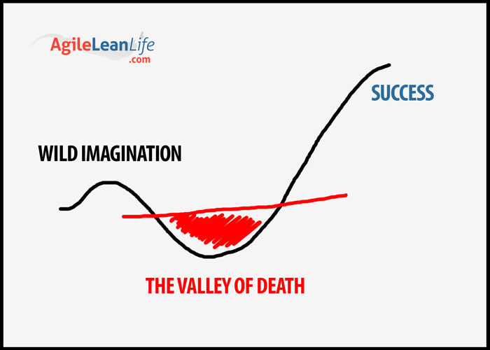
Notes:
I’m sure many of you are familiar with this sort of image being used to represent the gap between a wonderful idea and a viable commercial product; the so-called ‘Valley of Death’ where many great research outputs go to die.

Slide 4
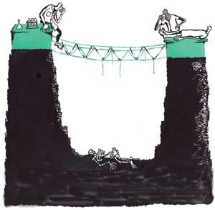
Research
Practice
The Gap
Notes:
Or the gap is portrayed as being littered with the skeletons of research products that ‘failed’ to make it to the other side. Research and development is clearly a continuum; fundamental studies only go so far, and a lot of work needs to be done to take what works in a controlled setting or on a small scale, and make it into a commercially viable product. This where we need the applied research to objectively select materials which have the right traits for commercialization, and to carry out the type of studies needed to bridge the chasm that exists between these two sides.

Slide 5
Types of research
Bridging the gap
Research-driven
  translation to pre-commercial prototype
Industry-driven
  product positioning, use practices
Types of research
Identify ‘flaws’
Product application/best practices
Product integration/compatibility
Strategic use and value
Notes:
The type of work needed can be driven by both sides. The push may come from the research side, to identify methods of scaling up production, stabilizing materials and developing prototype formulations; and to define how these can be effectively delivered to reach the desired target. The pull can also come from the commercial side, often when a product is further along the continuum where research may be needed to refine formulations, to understand what a product can do, its compatibility with other practices, the best place and time to use the product, and how to apply it; essentially to develop best practices. And this is the type of information needed to provide product support in commercial setting.

Slide 6



Integration of biologicals into the production system
Biopesticides
Biostimulants
Water
Biopesticide
Biostimulant
Light
Climate
Substrate
Biopesti
Biostimulant
Biocontrol
Fertilizer
Greenhouse structure
Crop
variety
Notes:
It is the type of information that end-users need, where they are likely to be faced with a wide range of product choices. They need to know which to chose and how to integrate the material into a production system to obtain consistent results in a cost effective and reliable manner. So understanding ‘fit’ is vital. And clearly, this is where research is still needed for many biological materials.

Slide 7
The Canadian landscape for biological products
Greenhouse floriculture (Vineland Survey 2018)
Notes:
The Canadian greenhouse sector is very well positioned to receive and integrate new biological products. Using results from a 2018 survey of the floriculture sector, you can see that there is a very high acceptance rate for these materials. Around 70% of growers already use biocontrol (principally microbial biofungicides) to manage diseases. And why do they do it? Really it revolves around the lack of chemical alternatives (resistance and limited efficacy); the ‘fit’ of the products into the production system as they have better safety profiles for workers and REIs that don’t interfere with other crop management needs; and (interestingly), because they see plants as being healthier when biologicals are used.

Slide 8
The Canadian landscape for biological products
Greenhouse floriculture (Vineland Survey 2018)
Notes:
And use of biocontrol is even higher for pests, with ca. 92% of growers using a suite of biocontrol agents, including biopesticides, in their IPM programs. The reasons why are similar to those given for diseases: more effective than available chemicals, pesticide resistance, their safety profile and fit within the system, and again ‘better plant health’.

Slide 9
Top research needs
Greenhouse floriculture (Vineland survey 2018)
PESTS | DISEASES
Compatible sprays | Reduce cost
Improve quality (consistency, better efficacy) | Improve product efficacy
BCA combinations to improve efficacy | Improved application methods/ease of use
Aphid control | More biocontrol products
Reduce cost
Must be able to demonstrate the value proposition
Notes:
Understanding the industry’s self-identified research needs helps understand the type of information that should accompany any biopesticides (or biostimulant), and may be used to shape research to improve these biological products. Clearly, there is a need for greater clarity around how to use these materials more efficiently, and how to integrate them into a production system to achieve greater efficacy and reduce cost. The bottom line for any new product, is to be able to articulate and demonstrate the value proposition associated with its use.

Slide 10
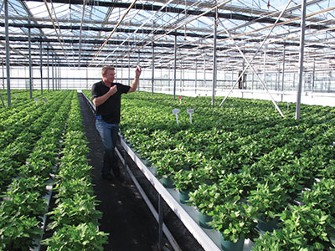
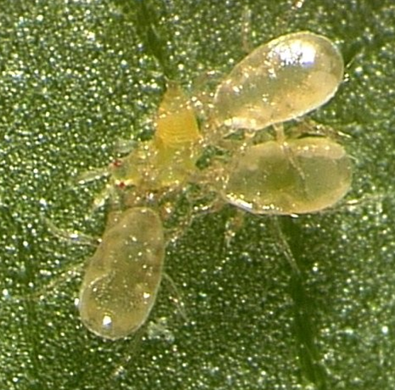
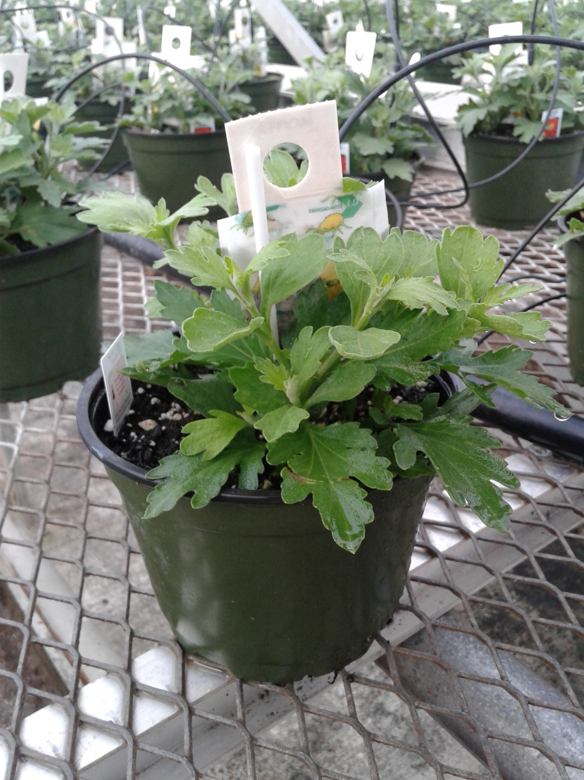
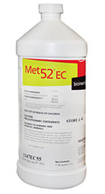


Biopesticides: IPM compatible
Notes:
Biopesticides are already widely used in production floriculture within integrated biocontrol strategies, where their action underpins that of other IPM components, and their compatibility with other biocontrol agents makes them an ideal fit into a production system. And we have done a lot of work over the years around the use and integration of biocontrols to manage thrips.

Slide 11
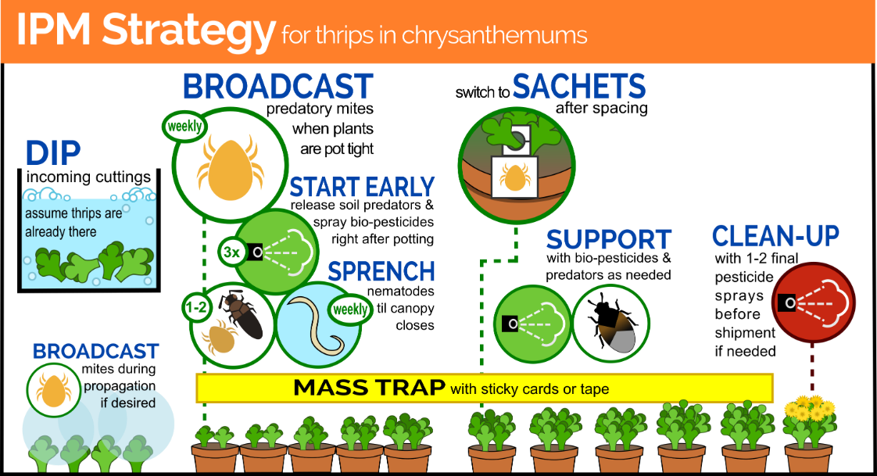
Biopesticides in integrated strategies
InfoGraphic by Ashley Summerfield, Vineland
Notes:
Biopesticides can really strengthen a biocontrol program when applied at strategic points in a production cycle. Using chrysanthemums as an example, biopesticides are used in cutting dips to clean up thrips on incoming cuttings; biofungicides are applied to the media right at the beginning of the crop cycle to protect against soil-borne pathogens; and bioinsecticide sprays often complement the bioprogram later in the growing cycle. And such systems allow crops to be managed biologically from start to finish. So I think we have a good handle on where and how to use biopesticides, but understand there is always room for improvement. What place biostimulants?

Slide 12
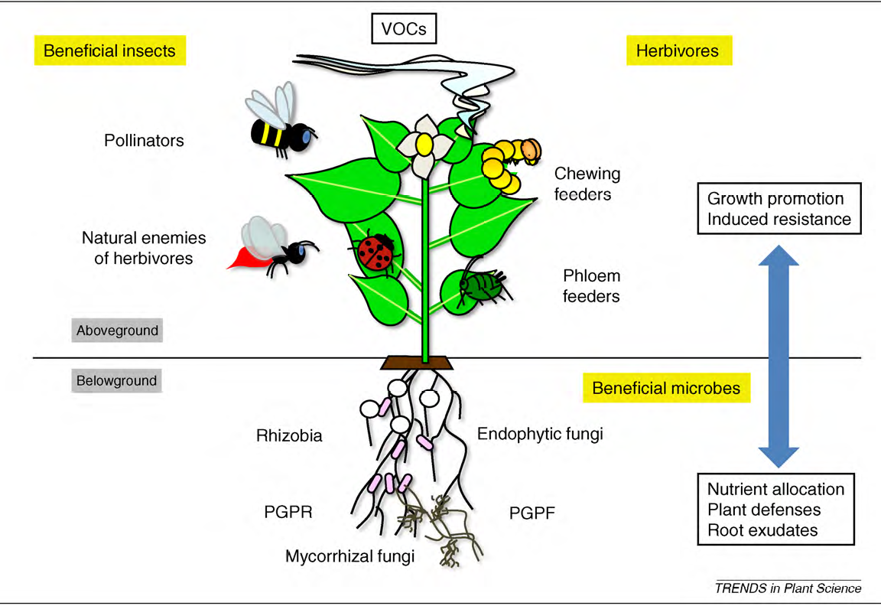
Biostimulants: So much promise…
But do we really know how (and when) to use them?
Responses vary by product, timing
Plant stress
Plant species, cultivar, growth stage
Soil, substrate, inputs, environment
Notes:
There is a tremendous interest in biostimulants, but there is not a lot of available and scientifically validated information around how and when to use these materials in greenhouse crops, and the benefits that they can provide. Most of the available data on biostimulant use has been generated in field crops, and we know that plant responses can vary widely depending on the product and when it is applied; plant species, cultivar and growth stage; and the fact that benefits may not be observed unless plants are under some form of stress; and responses will also be affected by the soil (type and condition) or substrate, inputs, and a slew of other environmental factors.

Slide 13
Biostimulant research: Gaps and challenges
Moving from the field to the greenhouse
Should we expect similar benefits when plants are grown in an environment where
  access to nutrients is not a limiting factor
  growing conditions are ‘optimized’ and (relatively) stable
Yet plants are constantly under stress
  crowded, ‘pushed’ to grow
  heat and humidity
  limited microbiota in the growing substrate
  pests and diseases
What is the value proposition?
  root stimulation in young plants
  improved fertilizer use efficiency
  improved uniformity in crop development
  promotion of yield, shelf life
Notes:
Of course, in the greenhouse, you could argue (and rightly so) that we don’t have to deal with so many variables as in field crops, but when applying biostimulants should we simply expect there to be similar benefits? In greenhouse crops, access to nutrients is not a limiting factor to crop development, and growing conditions are optimized to suit the crop. And yet, greenhouse crops – veg and ornamentals - are under stress. Plants are grown in crowded conditions, and are constantly being pushed to produce, even when light conditions and heat may be far from ideal. The microbiota in the growing substrate are limited, meaning that the chances for roots to form natural beneficial associations with microbes are limited (may affect nutrient uptake and root health), and the conditions that favour plants also favour pests and diseases. All of these aspects suggest that biostimulants could play a very important role and improve production efficiency…but how can they improve the life of a grower, what is their value proposition?

Slide 14
The biological future: Realizing the potential
Scientifically-validated performance data
How to integrate into a production system
Demonstrate effects on crop resilience
  less energy dealing with stress, more on production
Resource use efficiency, improved productivity
Consistency
  consistent quality
  reproducible benefits
Success requires
  understanding what growers want the biopesticide/biostimulant to do
  understanding what the biopesticide/biostimulant can do
  understanding when, where, and how to apply
Notes:
No question, for the greenhouse industry, the future lies in the use of biologicals. To fully realize the potential shown by these materials requires scientifically-validated data, so that we can convey information to the end user on how to integrate materials into a production system to obtain the desired benefits; to demonstrate how their use can improve crop resilience, production efficiency, and enhance productivity. And how this can be done in a consistent manner, so products must be of consistent quality and provide reproducible results. In the end, we need to understand what growers want the biological product to do, we need to be able to square that with what the product can do, and provide guidelines on when, where and how to apply to achieve the desired end-results in a cost-effective manner.

Slide 15
Thank you
Contact: Michael Brownbridge
Research Director, Horticultural Production Systems
michael.brownbridge@vinelandresearch.com

