Slide 1
WSDA Organic Registration
March 2019

Slide 2
Who we are
Certification Agency
USDA Organic Certification
WSDA Transitional Certification
Input Review Organization
Technical Assistance Provider
Over 1,200
certified businesses.
Over 1,000 approved inputs.
Notes:
Oldest and Largest State Program
1 of 4 with Official Recognition by USDA
Provide assistance with the requirements to market organic crops

Slide 3
Our Roots
Program established in response to farmer requests for organic standards and 3rd party inspections.
1985 - State Organic Law.
1987 - Depart of Agriculture Rules.
1988 - Inspections and Certifications.
1990 - Organic Food Production Act (OFPA) in US Farm Bill.
1999 – First Registered Materials List (175 approved products)
2002 – National Organic Standards in effect.
2018- 30+ Years Evaluating Organic Integrity.

Slide 4
Organic Input Material Registration

Slide 5
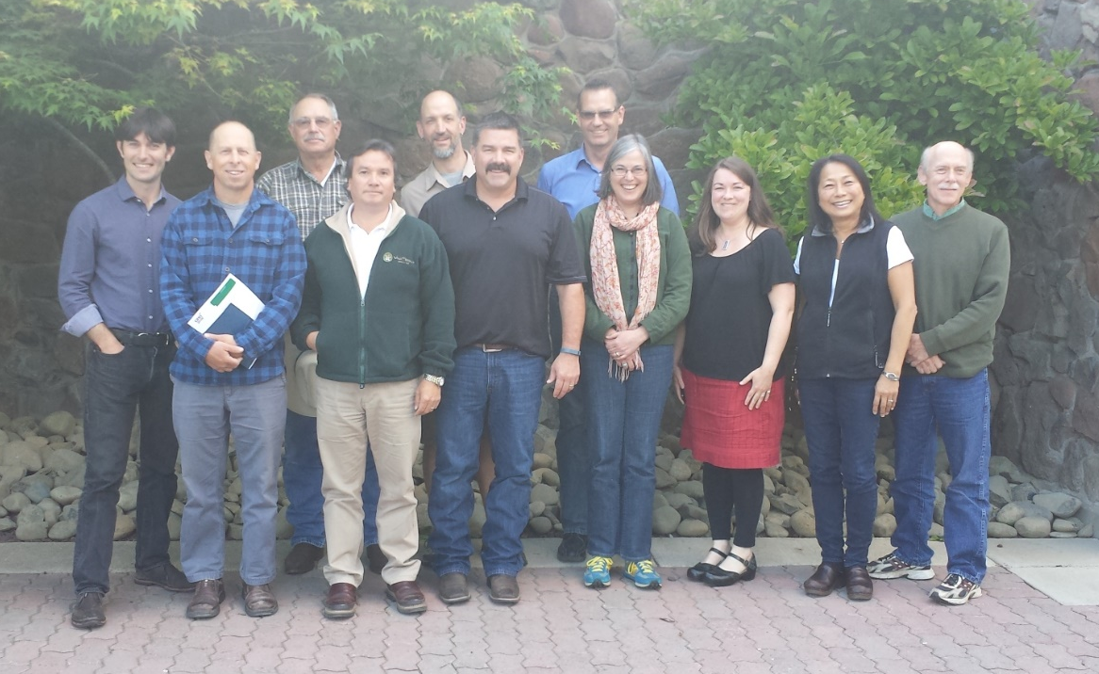
Who Oversees Us
USDA National Organic Program (NOP)
Regulatory program within the USDA Agricultural Marketing Service.
NOP authorizes certifiers to accept material review decisions made by:
Other organic certifiers (WSDA)
EPA
OMRI
CDFA
Washington State Organic Advisory Board

Slide 6
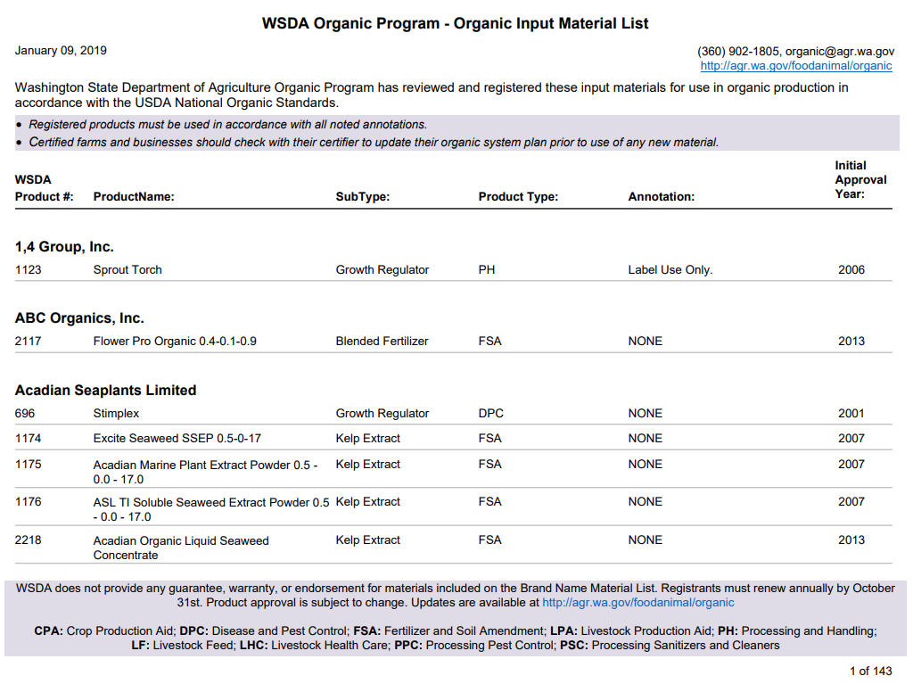
Approved Input List Online
Notes:
WSDA publishes a list (monthly) of inputs that have been pre-reviewed for compliance with organic standards.
Lists are only products that manufacturers voluntarily request to be evaluated.
Materials are currently provided in this list, but our agency is currently overhauling our website, which may allow us to present this information differently

Slide 7
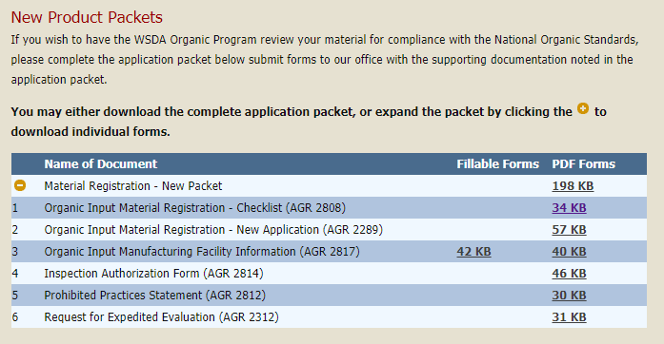
Application Process
Application materials available online & may be submitted electronically:
Application form
Full product formulation - EPA CSF form
Product manufacturing process
Manufacturing facility information
Product label
Ingredient information

Slide 8
Material Review & Registration
Application Review
Typically takes 1-3 months
Reviewed for completeness and compliance to USDA organic regulations
Expedite requests accepted based on capacity
WSDA Commercial Pesticide Registration required
Material Registration
Material registration certificate issued
Product appears on online list used by organic producers and certifiers
Use of registered logo granted (EPA currently prohibits use on Section 3 labels)

Slide 9
Allowed and Prohibited Inputs
Natural Substance
Allowed
Synthetic Substance
Prohibited
205.601 and 205.602
Exception to Basic Rule

Slide 10
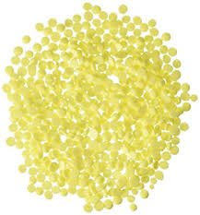
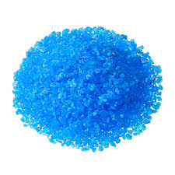
Review Criteria
Active Ingredient(s) must be nonsynthetic or one of the synthetic materials allowed at 7 CFR 205.601 of the USDA organic regulations
Soap, boric acid, copper sulfate, elemental sulfur, pheromones, potassium bicarbonate….
Inert Ingredients must be nonsynthetic or classified as List 4 inert ingredients (2004)

Slide 11
Nonsynthetic ≠ natural
Use National Organic Program’s Decision Tree
Starting material must be from a natural source
Any chemical changes must be biological/enzymatic

Slide 12
Material registration challenges
Ingredient Vendors unwilling to provide confidential information
A.I. manufacturing processes
Inert ingredient mixtures
All alternate formulations under EPA registration no. must be compliant
Nonylphenol ethoxylate CAS# mix-up

Slide 13
Resources
National Organic Program’s Synthetic/Nonsynthetic Decision Tree
https://www.ams.usda.gov/sites/default/files/media/NOP-Synthetic-NonSynthetic-DecisionTree.pdf
2004 EPA Inert List
https://www.epa.gov/sites/production/files/2015-10/documents/alphacomplete.pdf
USDA organic regulations – synthetic substances allowed in crop production
https://www.ecfr.gov/cgi-bin/text-idx?SID=8b41f3190cfac7ab2edbcb59ede5b822&mc=true&node=pt7.3.205&rgn=div5#se7.3.205_1601

Slide 14
NOSB Coming to Seattle
The National Organic Standards Board spring meeting will be held in Seattle.
April 24-26, 2019

Slide 15
Team of experts
Our team is available to assist you!
Contact us with questions, concerns, or referrals:
(360) 902-1805
organicmaterials@agr.wa.gov
http://agr.wa.gov/FoodAnimal/Organic/
Notes:
New! Calling our main line will bring you to a menu. Selecting crop (#5) will connect you directly with a trained specialist that can assist you with your questions.

