Slide 1
Specialty Horticulture
Industry Perspective -
Biological Products
Theresa Wildman
Regulatory and Technical Affairs Manager
Plant Products Inc
BPIA, March 13, 2019

Slide 2
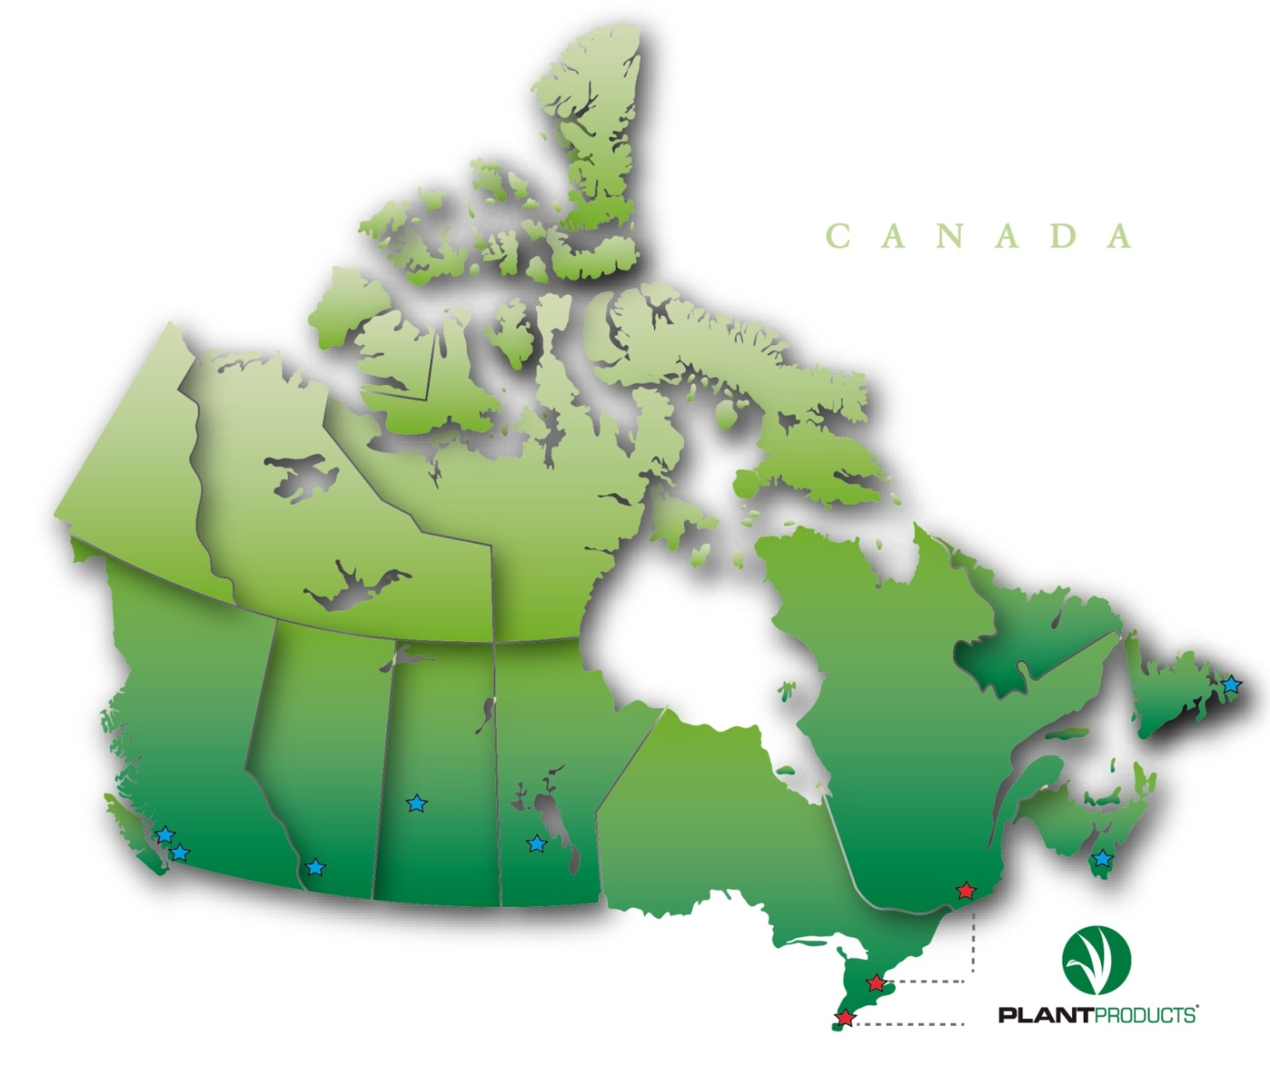
Canadian Coverage

Slide 3
Markets Served
Commercial
Turf
Greenhouse Ornamental
Greenhouse Vegetables
Nursery
Specialty Horticulture
Golf Courses
Athletic Fields
Municipalities
Lawn Care Operators
Landscapers
Sod Farms
Institutions

Slide 4
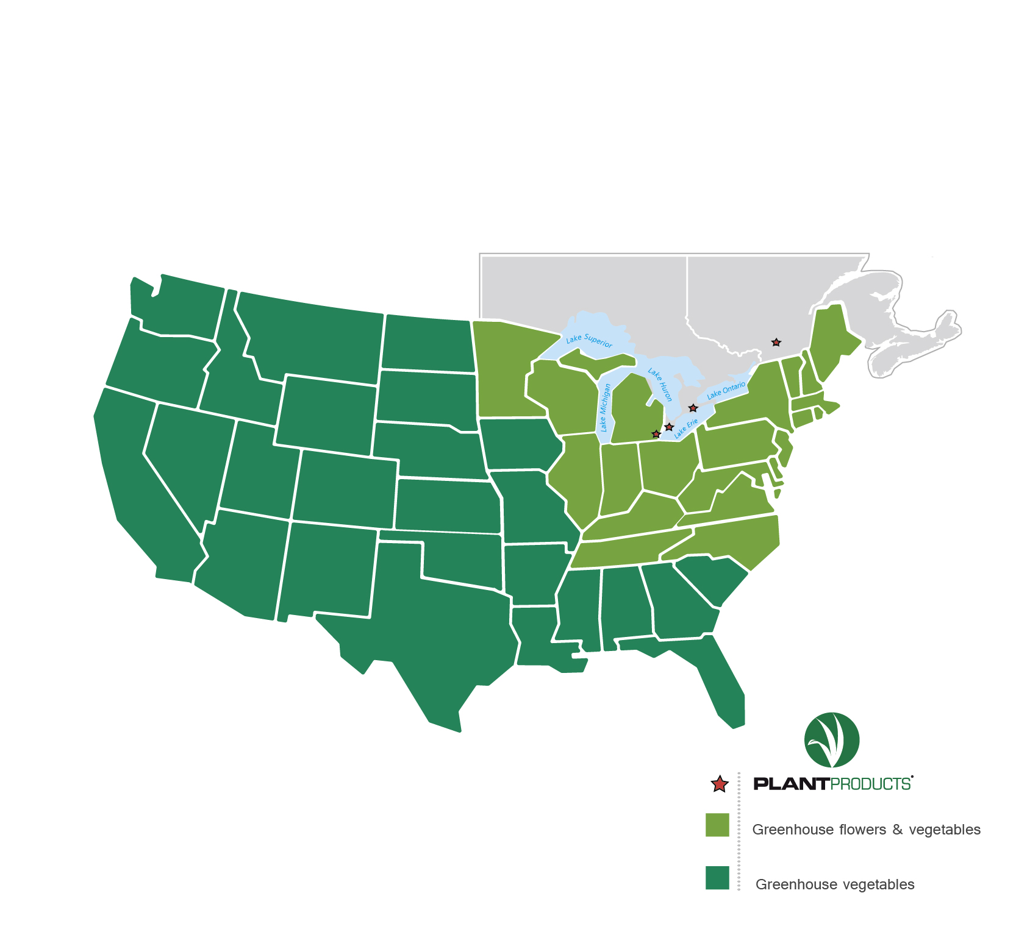
USA Coverage

Slide 5
Markets Served
Commercial
Greenhouse Ornamental
Greenhouse Vegetables

Slide 6
Commercial Biological products
Biopesticides (fungi, bacteria, viruses, extracts etc.)
registered via PMRA
Biostimulants (living, non-living)
registered via CFIA
Pheromones (disruption, monitoring)
some require registration

Slide 7
Biopesticides
Role
new active ingredients
new modes of action
broaden the tools available for crop protection
assurance of efficacy (suppression or control)
Part of commercial industry for decades

Slide 8
Biopesticides
Loss of broad spectrum ai’s
Cost of registration of new synthetic ai’s
Product Stewardship
Re-evaluations
Reduced applications per season
Maximum residue limits for export (MRL)

Slide 9
Biopesticides
Fill gaps for a more complete pest and disease management program:
Seed treatment
Very young plants
Close to harvest PHI - “extreme harvesting”
Re-entry Intervals REI - worker safety; flow of business; replant intervals

Slide 10
Biopesticides
Fill gaps:
certified organic production

Slide 11
Biopesticides - Bonuses
Compatibility with pre-existing biological control strategies

Slide 12
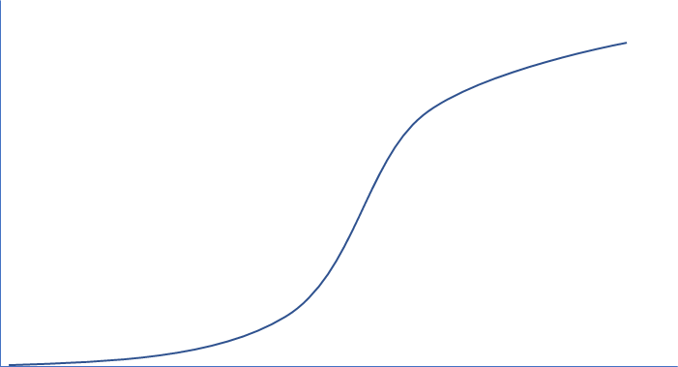
Pest and Disease management model
Pest
Population
Crop cycle
Economic threshold
Detection
Time
Notes:
V

Slide 13
Biopesticides - Challenges
Efficacy
Storage conditions
Use conditions – UV stable, surfactants, tank mixing
Application intervals - labour cost, ULV
Saturation of space
Problems that need solving
Compatibility with pre-existing biological control strategies

Slide 14
Non-pesticide - Biostimulants, Inoculants
Greenhouse, controlled environment (inert media):
genetic potential of plant
efficacy
cost vs benefit

Slide 15
Non-pesticide - Biostimulants, Microbial consortia
Soil or media use
inoculants
plant stress reduction
condition of soil
specific nutrient release
marginal land use

Slide 16
Commercial End use products
Quantifiable results
Science based standards
Technical specifications of products

Slide 17
Specialty Horticulture
Industry Perspective -
Biological Products
Thank you
www.plantproducts.com

