Slide 1

CEN/TC 455 « Plant biostimulants »
Definition of PFC 6 – Plant Biostimulant
A plant biostimulant shall be a EU fertilizing product the function of which is to stimulate plant nutrition processes independently of the product’s nutrient content with the sole aim of improving one or more of the following characteristics of the plant and the plant rhizosphere:
nutrient use efficiency,
tolerance to abiotic stress,
crop quality traits, or
availability of confined nutrients in the soil or rhizosphere

Slide 2
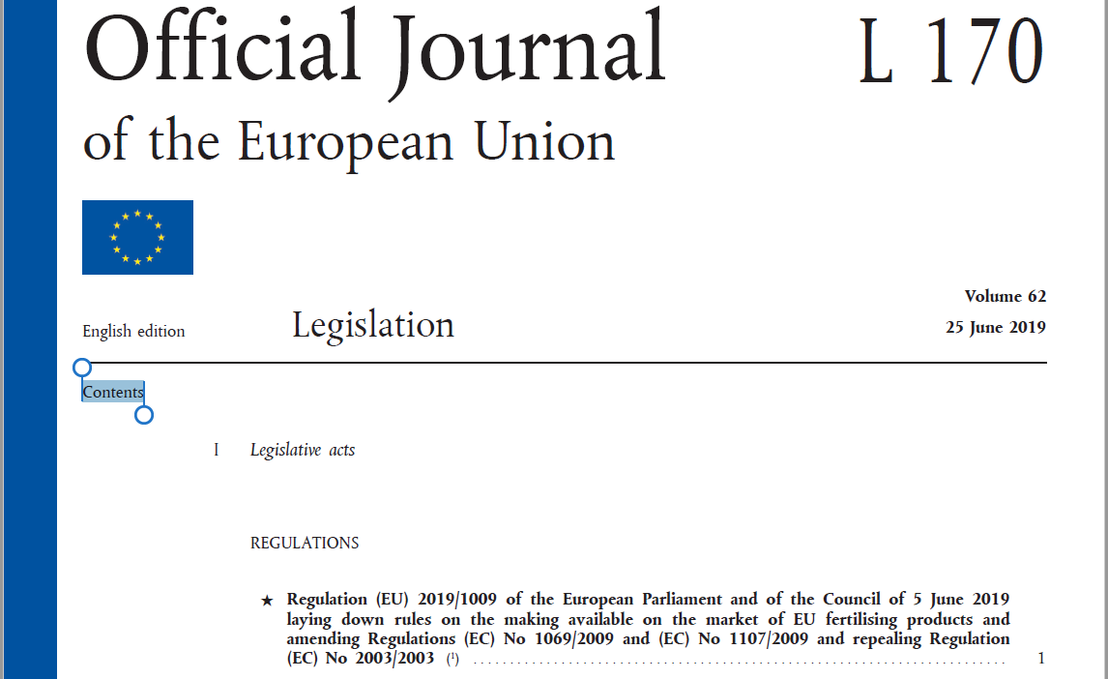
CEN/TC 455 « Plant biostimulants »
FPR - Fertilising Product Regulation
The European Parliament voted in 27 March 2019 to approve the compromise text of the EU Fertilising Products Regulation (FPR)
The Council will endorse the text on 22 May.
Publication in 25 June 2019
Entry into force 15 July 2019
Application 16 July 2022
https://eur-lex.europa.eu/legal-content/EN/TXT/PDF
/?uri=OJ:L:2019:170:FULL&from=EN

Slide 3
CEN/TC 455 « Plant biostimulants »
European Committee for Standardization (CEN) ?
The European Committee for Standardization (CEN) develops setting European standards (ENs) that are applied across the whole of the European single market.
CEN brings together the national standards agencies of 34 countries and a network of thousands of technical experts from business federations, commercial and consumer organizations, environmental groups and other societal stakeholders.
It will be mandated by the European Commission to develop standards supporting the implementation of the fertilising products regulation and in this context CEN has created a Technical Committee CEN/TC 455 on Plant Biostimulants.
AFNOR designs and deploys solutions based on voluntary standards in France and selected other countries. It serves the general interest in its standardization activities and provides services in such competitive sectors.
AFNOR Normalisation provides the secretariat of CEN/TC 455 Plant Biostimulants.

Slide 4
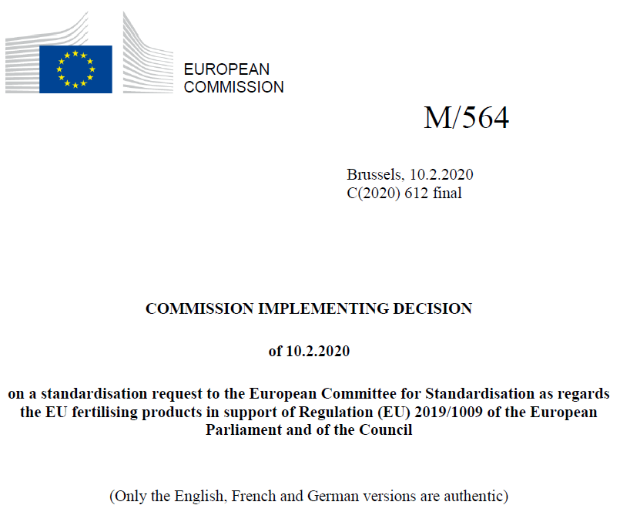
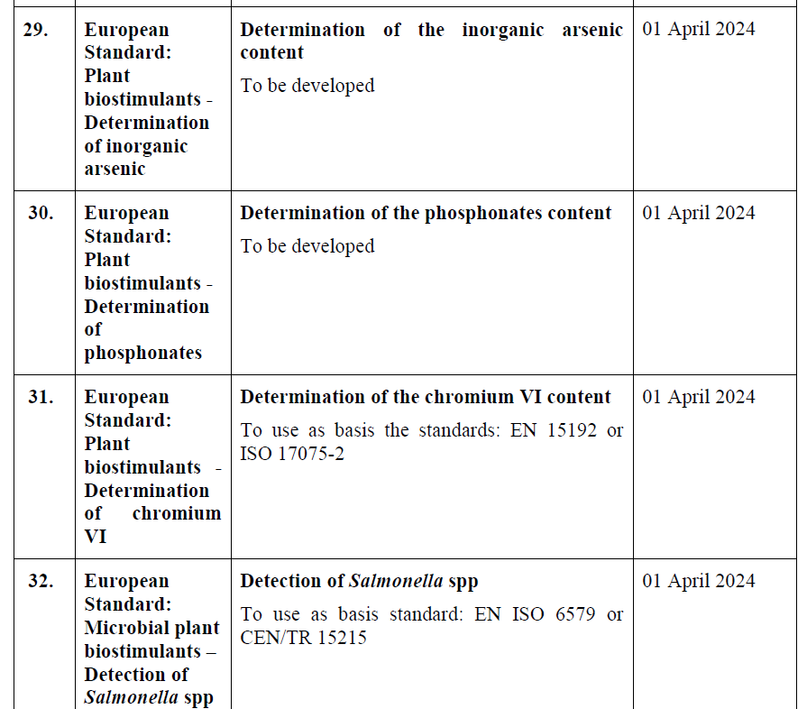
CEN/TC 455 « Plant biostimulants »
Relationship between EU legislation & EN standards
Validation by CEN of the Standardization Request from the Commission
https://ec.europa.eu/growth/tools-databases/mandates/index.cfm?fuseaction=search.detail&id=588
Development of standards in 2 steps :
TS: Technical Specification (EN without ring-test) before April 2022
hEN: Harmonized EN standard (EN with ring-test and citation into JOEU) before April 2024

Slide 5

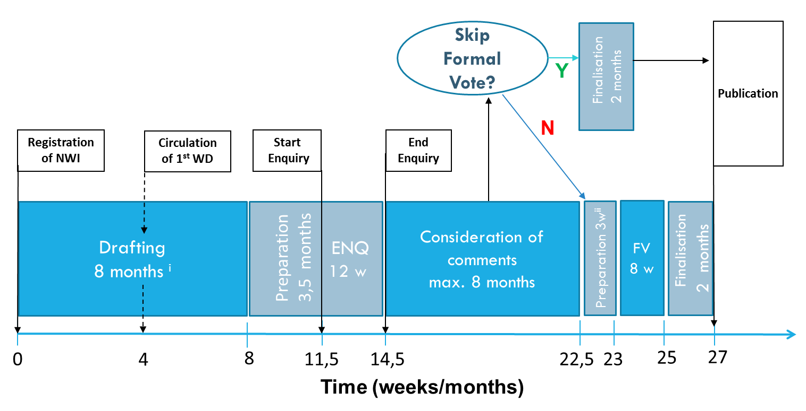
CEN/TC 455 « Plant biostimulants »
Standard development on CEN/TC 455
Available document
0: if possible (First draft proposal)
1: for TS vote
2: for publication
3: for CEN Enquiry
4: for Formal Vote
5: for publication
National Mirror Committees
For CEN/TC 455
Activation of PWI
Validation of PWI
+ JOUE
Work on PWIs
Appro-val
SR
Enquiry PWI to NWI
Work on Technical
Specification
Enquiry PWI to NWI
+ ring tests
First EC biostimulants (16th July 2022)
0
1
0
3
3
5
8,5
11,5
4
19,5
20
22
24
From
June
2018
March
2020
June 2020
2
5
April 2022
July
2022
Sept.
2022
Mi-Dec.
2022
Mi-March
2023
Mi-Nov.
2023
Dec.
2023
Feb.
2024
April
2024
TS
EN

